Slide 1
Parallel Platforms

Slide 2
Superscalar execution
Pipeline: fetch, schedule, decode, operand fetch, execute, store, among others
Multiple Pipeline = Multiple Cores

Slide 3
An Example...
Its more like you have two cooks in your kitchen.
If they do two different dishes independently, means no dependency in kitchenwares and food items, you get two dishes in time t1.
Just we imagine you being more stinge, and you have given only one stove/burner...
Now they are forced to wait for each other to complete their work before they could start the next, with time t2 < t1, obvious isn't?.
Same holds true for multiple core processors!
Lets see an superscalar execution of simple addition in two pipelines.
I leave the below assembly code for your rusted brain to process :)

Slide 4
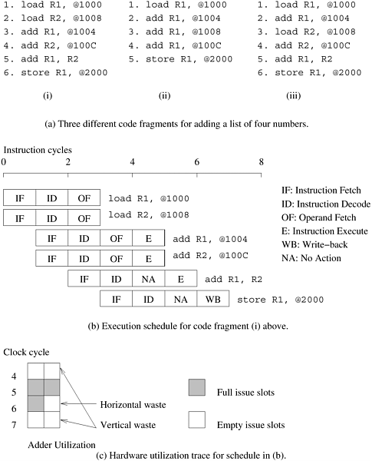

Slide 5
We imagine your kitchen with four cooks. (Too many cooks can/might spoil the dish!)
Any cooking starts with washing, cleaning, cutting, heating, adding taste stuff, furnishing and delivering to table.
So you being more strict BOSS, you have given them only two water pipelet, 2 cleaning area, 2 burners, 2 knife etc.., and finally only one table to serve.
When first two cooks are using the water pipelet, then other two has to wait for the later to finish and this hold true for all cases!

Slide 6
In assembly example,
  Add R1, R2
  Store R1, @2000
Could have issued simultaneously but not, the reason is more visible that the store depends on add command.
This is referred to as true data dependency.
Is like cook3 needs something from cook2.
Data dependencies should be done before the instructions are issued and to do this in hardware is costly one!
Its like having a manager for your cooks!
Second, the amount of instruction level parallelism in a program is often limited and is a function of coding technique.

Slide 7
The form of dependency in which two instructions compete for a single processor resource is referred to as resource dependency.
Like our water pipelet case.
Third form of dependency is branch dependencies or procedural dependencies
Cooks makes some decision while cooking to enhance the taste or do something shit from not getting fired, which is done only during the cooking.

Slide 9
In the third assembly code section, which is merely the re-ordering of section 1.
Now instructions can't be issued in parallel, however instruction 1 and instruction 3 can be issued simultaneously, by processor having a bit intelligent.
This is called as out-of-order execution, the later one is in-order execution.
This model, also referred to as dynamic instruction issue,exploits maximum instruction level parallelism.
The processor uses a window of instructions from which it selects instructions for simultaneous issue.
This window corresponds to the look-ahead of the scheduler.

Slide 10
Wastes
Horizontal
  only part of the execution units are used during a cycle, it is termed horizontal waste.
Vertical
  during a particular cycle, no instructions are issued on the execution units, it is referred to as vertical waste

Slide 11
Very Long Instruction Word Processors
The parallelism extracted by superscalar processors is often limited by the instruction look-ahead. The hardware logic for dynamic dependency analysis is typically in the range of 5-10%of the total logic on conventional microprocessors (about 5% on the four-way superscalar SunUltraSPARC).
This complexity grows roughly quadratically with the number of issues and canbecome a bottleneck.
Alternative is VLIW

Slide 12
Relies on compilers, which says it is a software instruction scheduler.
Compiler packs independent instruction, that can executed in all given set of processor as VLIW.
The VLIW concept, first used in Multiflow Trace (circa 1984) and subsequently as a variant in the Intel IA64 architecture, has both advantages and disadvantages compared to superscalar processors.
Compilers do not have the dynamic program state (e.g., the branch history buffer) available to make scheduling decisions.
Pros: Sophiscated static predictions
Other cons : the accuracy of branch, memory prediction & stalls on data fetch.

Slide 13
Finally, the performance of VLIW processors is very sensitive to the compilers' ability to detect data and resource dependencies and read and write hazards, and to schedule instructions for maximum parallelism. Loop unrolling, branch prediction and speculative execution all play important roles in the performance of VLIW processors.
Generally limited to smaller scales of implicit concurrency in the range of four- to eight-way parallelism.

