Slide 1
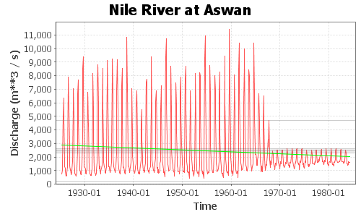
Hydrological Data Screening
Detecting inhomogeneity and trends in
hydrological time series due to climatic and environmental change
Raymond Venneker
UNESCO-IHE Institute for Water Education
Delft, the Netherlands

Slide 2
Hydrological Change
Alterations in the hydrological regime occur due to:
Influence from changing climatic conditions
GHG emissions, pollution, deforestation, …
Influence from physical changes at the land surface
Land use, infrastructure, water use, …
In order to determine the impacts on the hydrology we need data
Continuous
Good quality
Long records

Slide 3
Characteristics of water resources data
Lower bound of zero, negative values often not plausible
Presence of outliers, commonly in high values
Positive skewness, most values in the lower region
Therefore often non-normal distribution
Seasonal patterns are often present
Autocorrelation, mostly positive
Dependence on other variables, e.g. elevation, soils, land use
After: Helsel and Hirsch (2002)

Slide 4
Time series
A time series represents the values of a variable at successive points in time:
At point locations, from station observations
As area-averages, e.g. average rainfall in a river basin
In hydrology and hydrometeorology, time series are discrete, i.e. values at fixed calendar time intervals:
Fractions of a day, e.g. 30 minutes, 1 hour, 3 hours, …
Fractions of a year, e.g. 1 day, 1 month, 3 months, …
Annual series, usually mean value or sum for each year
5 year moving average/10-year average

Slide 5
Daily discharge at Lubok Paku, Malaysia, 2001-2006
STL decomposition (Cleveland et al., 1990)

Slide 6
Components of time series
Periodic variation:
daily cycles
Seasonal cycles
Trend:
Secular trend, systematic increase/decrease over long time periods
Cyclic trends, irregular variations, e.g. sequences of wet and dry years
Episodic variations due to extreme weather, usually small in number
Random fluctuations, often dominant source of variation in hydrology

Slide 7
Statistical description
Mean – measure of location
Standard deviation – measure of variation about the mean
Skewness – measure of symmetry about the mean
Standard error (i.e. the standard deviation of the mean):
Coefficient of variation:
See also: DID Manual Vol 4, Ch 5 (2009); Helsel and Hirsch (2002)

Slide 8
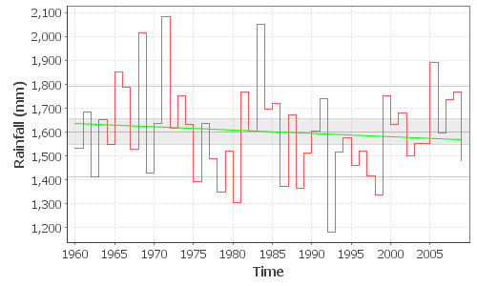
Example: 50 y annual rainfall, Lancang station, China
Mean SD Skew SE CV
1603 187.8 0.4344 26.56 0.1171
Mean + 1 SD
95% confidence interval of the mean,
Mean ± 1.96 SE
Mean − 1 SD
The green line is the apparent trend – needs to be tested if statistically significant

Slide 9
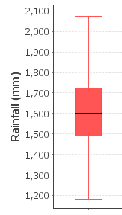
Tukey’s five-number summary and box plot (Lancang rainfall)
Min Q1 Median Q3 Max
1183 1490 1600 1723 2085
Q3 + 1.5 IQR, or maximum
Third quartile (Q3)
Inter quartile range:
IQR = Q3 − Q1
Contains 50% of the data
Median (Q2)
First quartile (Q1)
Q1 − 1.5 IQR, or minimum
Box plots are useful to visualize and compare distributions. See
Helsel and Hirsch (2002) for further details.

Slide 10
Autocorrelation
Autocorrelation function (ACF) is the Pearson R for each lag
The lag 1 R is a measure of persistence

Slide 11
Statistical testing
Statistical tests aim to accept or reject a null-hypothesis, with a specified level of significance, α
A null hypothesis for a specific test can be:
H₀ : There is no trend at significance level α
which leads to the alternative hypothesis:
H₁ : There is a trend at significance level α
A common value for α is 0.01, sometimes 0.1 or 0.05 is also used.
More specific, α is the probability of rejecting H₀ while it was actually true. This is called a Type 1 error.

Slide 12
Test computations (by software)
For a given test, we compute the test statistic from the data, say t_{s} , which follows a certain statistical distribution (e.g. Normal, Student-t)
Then we compute the p value from the probability density function (pdf) of the distribution for test statistic
The null hypothesis H₀ is rejected if p ≤ α
pdf
−z
0
t_{s}
+z

Slide 13
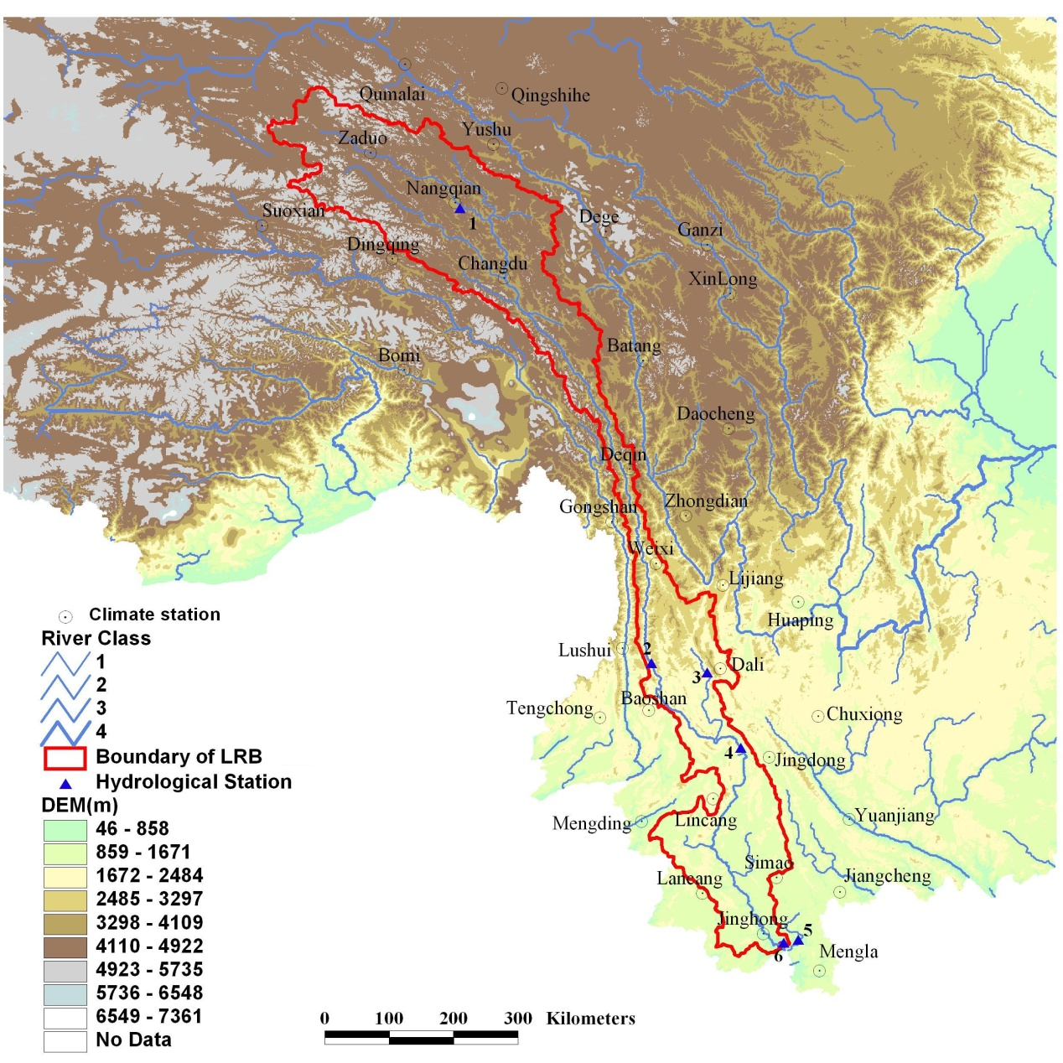
Example: temperature at Lancang station, China

Slide 14
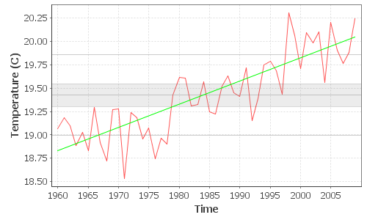
Step 1: Plot the data and obtain some statistics:
Mean SD Skew SE CV
19.42 0.4322 0.1724 0.06112 0.02225
Min Q1 Median Q3 Max
18.53 19.10 19.40 19.72 20.31

Slide 15
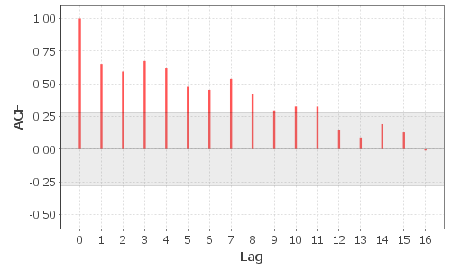
Step 2: test for absence of persistence (no significant lag 1 autocorrelation)
r(1)
UCL (α=0.05)
LCL (α=0.05)
r(1) = 0.652
Alpha 0.10 0.05 0.02 0.01
UCL 0.233 0.277 0.329 0.364
LCL -0.233 -0.277 -0.329 -0.364
Since r(1) is outside the range [LCL;UCL], we conclude that there is persistence

Slide 16
Intermezzo: Pre-whitening
If significant persistence is present, we have to pre-whiten the data when testing for trend
Pre-whitening removes lag 1 autocorrelation from the series by:
Then, testing persistence for the pre-whitened series:
r(1) = -0.153
Alpha 0.10 0.05 0.02 0.01
UCL 0.233 0.277 0.329 0.364
LCL -0.233 -0.277 -0.329 -0.364
The r(1) of the pre-whitened series is inside the range [LCL;UCL]

Slide 17
Step 3: tests for absence of trend should be non-parametric. That is, no underlying statistical distribution of the data is assumed. There are two tests:
Test based on Spearman’s rank-correlation coefficient, ρ (rho)
Test based on Kendall’s correlation coefficient, τ (tau)
The latter, the Mann-Kendall trend test is common in climatology
The test result for our (pre-whitened) temperature data is:
Mann-Kendall trend test (pre-white) :
Series Start = 1960 End = 2009 Length = 50
Null hypothesis: There is no trend in the series
S = 353
tau = 0.2882
p = 0.002875 ***
Since p < 0.05 (< 0.01), H₀ is rejected → Temperature increased significantly

Slide 18
Step 4: determine the warming rate
If a significant trend is present, the average rate of increase of decrease can be obtained from the slope of a simple linear regression:
Estimate SE t-stat Pr(>|t|)
Const 18.83 0.06900 272.9 <0.0001 ***
Slope 0.02442 0.002427 10.06 <0.0001 ***
Residual SE: 0.2476 Regression DF: 48
R-squared: 0.6784 Adj R-squared: 0.6717
Temperature rises on average with 0.24 °C in 10 years

Slide 19
Using DScreen software: Sungai Kerian, Malaysia
Data: annual rainfall (mm) in the Sg. Kerian catchment for 1947-2000
(DID Manual, Vol. 4, 2009)
In Windows explorer, go to the DIDWorkshop folder
Double click on the file DScreen.jar
Select File – Open from the menu bar
Choose the data file TS_Kerian_P_ann.txt

Slide 20
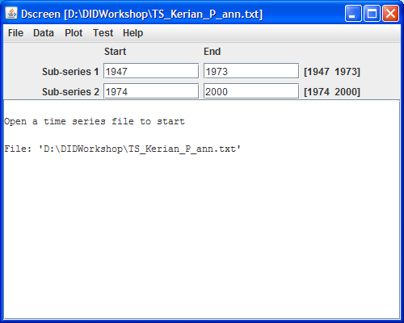
First year of data
Last year of data
Text output area

Slide 21
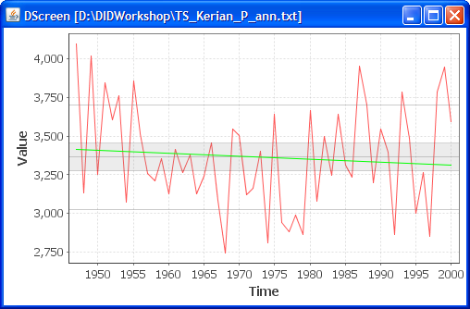
Step 1: plot the time series
Select Plot – Series – Continuous from the menu
(Plot windows stick on the screen until you close them
You can move them to a convenient place
Right-click in plot window opens a menu with options)

Slide 22
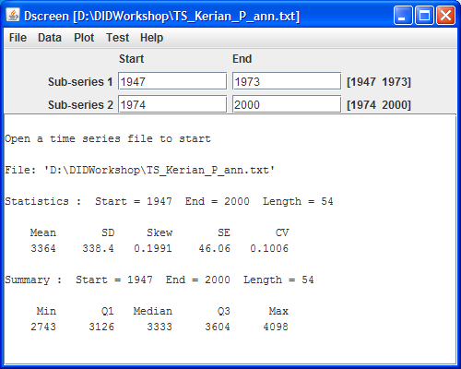
Step 1a: Describe the data
Select Data – Statistics
Select Data – Summary

Slide 23
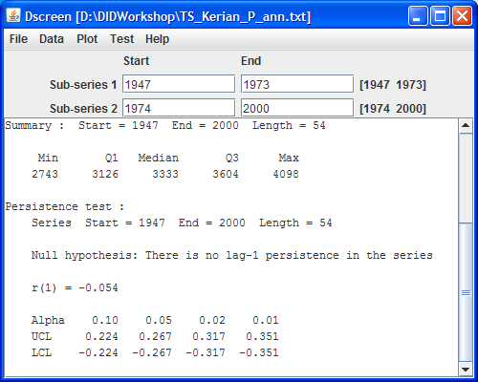
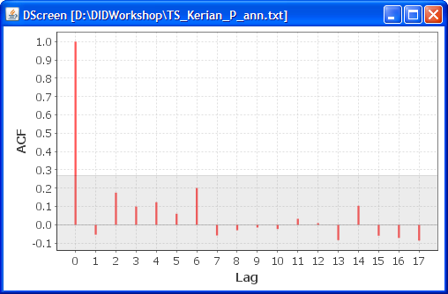
Step 2: Check autocorrelation / test persistence
Select Plot – Correlogram
Select Test – Autocorrelation – Persistence (no pre-white)
Verify absence of persistence

Slide 24
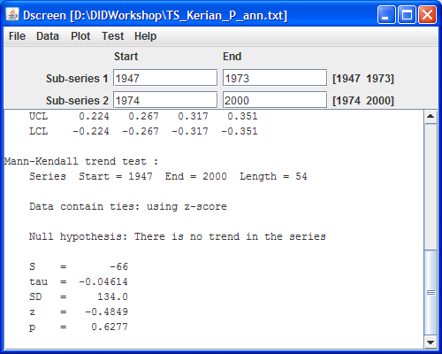
Step 3: Test for trend
Since there is no persistence, pre-whitening is not required
Select Test – Secular trend – Mann-Kendall
There is a
significant
trend if we
can reject the
null hypothesis
Can we?
Note: we can cross-verify using the Spearman test

Slide 25
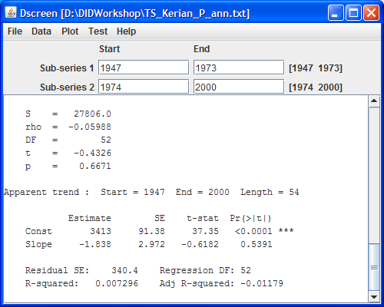
How much is the rainfall amount changing?
Select Data – Apparent trend
Decrease in rainfall of 18 mm per 10 years, too small to be significant

Slide 26
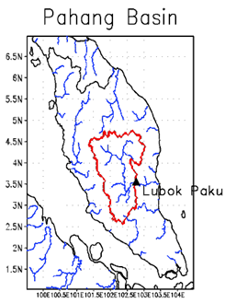
Application to Pahang, Malaysia
We carry out a trend analysis for each of the four data sets below
Summarize the outcome
Whole basin at Lubok Paku (25,600 km²):
TS_Pahang_T_ann.txt: annual temperature (°C, 31 y)
TS_Pahang_P_ann.txt: annual rainfall (mm, 31 y)
TS_Pahang_Q_ann.txt: annual discharge (m³/s, 23 y)
Pejabat JPS station (Sg. Kuantan):
TS_Pejabat_P_30mi-max.txt: annual maximum 30 min rainfall (mm, 39 y)
Source: DID data base; Wong et al., Hydrol. Proc. (2010); DID Manual Vol 4 (2009)

