Slide 1
Theory behind v.0
Qifan Wu
Derived from [1],[2],[3]&[4]
26.04.2026

Slide 2
Req. I/O according to assignment
Feature: a regression problem
-> Regression to be decided while implementing (not linear, gradient descend better)
Input:
features derived from the prefix of a case
activities done so far
Timestamps
Attributes
Output: a numeric value (i.e. remaining CT)

Slide 3
Key points:
Attribute to select
A uniform unit used to present / measure
Basic idea for prediction

Slide 4
Critical points in basic definition
Event logs only contain completed traces
Full trace
History
Prefix function:
Given a trace σ=⟨e1,...,en⟩ and a positive integer k≤n, hd^{k}(σ)=⟨e1,...,ek⟩.
Prefix log:
Given an event log L, its prefix logL∗ is the event log that contains all prefixes of L, i.e.,L∗={hd^{k}(σ) :σ∈L,1≤k≤|σ|}.

Slide 5
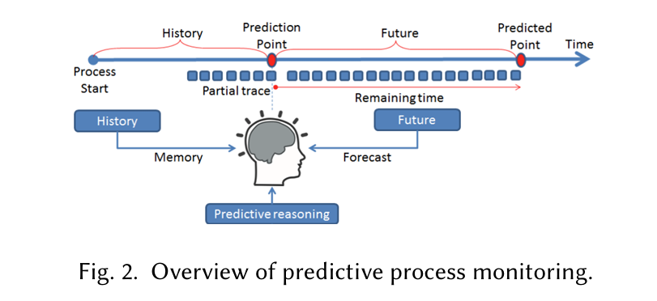
Critical points in basic definition (cont.)

Slide 6
Attribute to select (on event level)
Mandatory (PM standard)
Case identifier
Activity name
Timestamp
Two types: numeric & categorical
More contextual attributes:
Resource (who’s responsible, e.g. org:role, org:group, org:resource)
-> to detect inter-dependency & resource availability
lifecycle:transition (can be involved to imply queueing state)
Queues (e.g. how long is the queue now)

Slide 7
Attributes to be derived (on event level)
E := Event A := Activity
time:duration(Ex)
time:exiting_time(Ex) - time:entering_time(Ex)
time:waiting_time(Ex,Ex+1)
time:entering_time(Ex+1) - time:exiting_time(Ex)
int:queue_length(Ax,t)
|tokens with state waiting at activity Ax at time t|
etc.

Slide 8
Unit used
Hours/minutes
Reason
According to the timestamp in training set:
Accuracy to minute-level
Duration between activities can be days, also can be minutes
To avoid overfitting & underfitting -> choose hour, but minute can also be great, further discussion needed

Slide 9
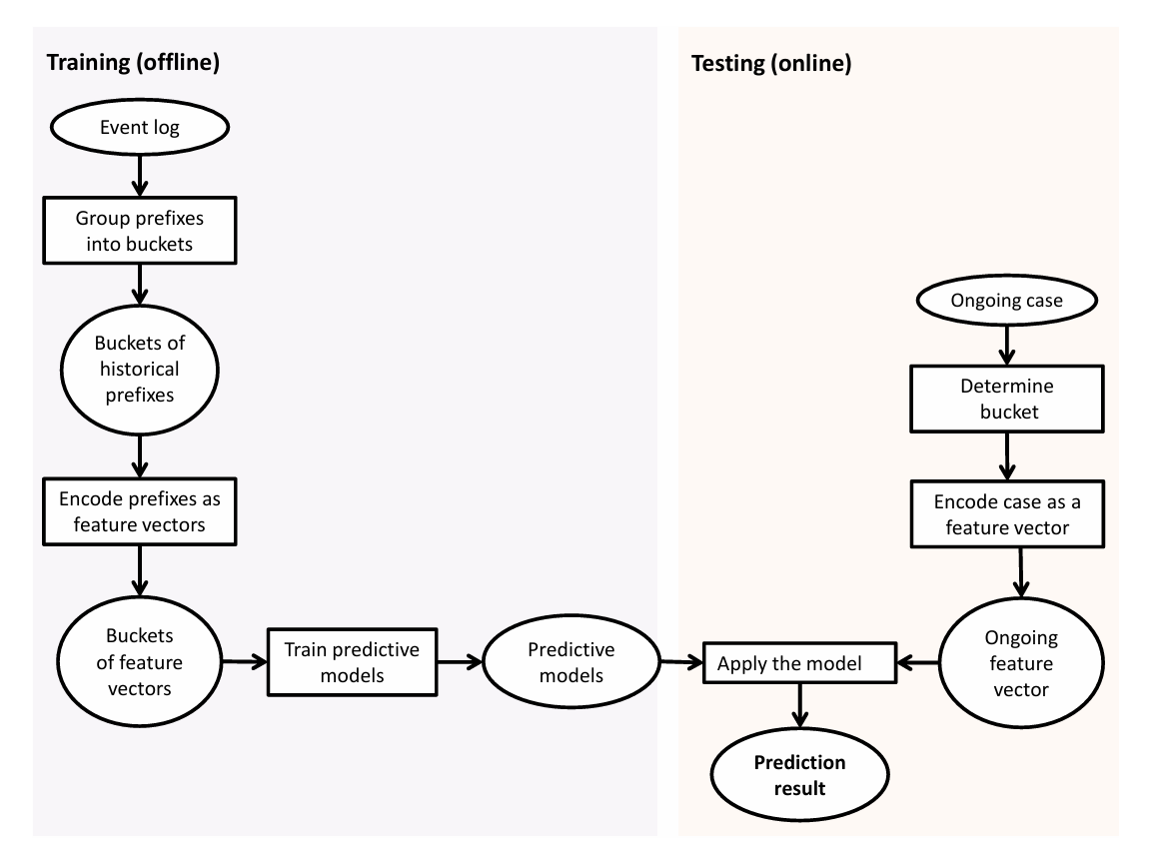
Basic idea for prediction

Slide 10
One option: XGBoost
Generally:
Weighed avg. derived from several ‘weak’ decision tree learners
Kinda ‘forest-like’
For more info, cf. [2]

Slide 11
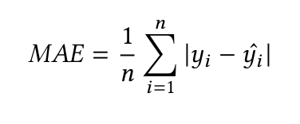
Options for evaluation metrics
Accuracy:
Cf. [2], Mean Avg. Error
Root Mean Square Error
Mean Percentage Error
[2]used the first one, however, the choice should be made depending on our target event logs and defined success metrics in milestone 1

Slide 12
Options for evaluation metrics (cont.)
Earliness (cf. [2])
What we may also consider [4]:
For classification:
Brier Score loss
Entropy/information gain (for single decision tree)
Confusion matrices

Slide 13
Typical data quality problems to confront
Missing data
Incorrect data
Imprecise data (Training data not met)
Irrelevant data -> filter data (mainly attributes)

Slide 14
Other Issues
Hard to predict rare cases
The prediction should be ‘real-time’, i.e. it should be updated periodically/according to request from user
Reason: The accuracy of prediction increases as the token approaches the sink of the process

Slide 15
References
[1] Wil M.P. van der Aalst. Process Mining: Data Science in Action. 2nd edition, Springer, 2016.
[2] Ilya Verenich, Marlon Dumas, Marcello La Rosa, Fabrizio Maria Maggi, and Irina Teinemaa. “Survey and cross-benchmark comparison of remaining time prediction methods in business process monitoring”. ACM Transactions on Intelligent Systems and Technology (TIST), 10(4), 2019.
[3]Assignment paper
[4] https://scikit-learn.org/stable/modules/model_evaluation.html#brier-score-loss

