Slide 1
AWS

Slide 2
Agenda
Cloud Computing
Cloud Models
What AWS is?
Services of AWS

Slide 3
What is Cloud Computing
Use of Remote Computer to do some task.
No need to buy any server, we can rent a Server. Need to pay as per the use
No Need to configure IP and Domain, Cloud provider will do it
No need to hire a Team, who will be looking after the servers, configuration and all
Hardware and Software up gradations will be managed by Cloud provider
Security will be provided by them
We can focus on App Development
Even if traffic increases or a Server is down, it will be managed by the cloud provider
Low investment

Slide 4
Cloud Products
NetFlix AWS
Amazon e-commerce site
Amazon prime AWS
Google drive GCP
Airbnb

Slide 5
Cloud Computing Model
Deployment Model
Service Model
Public Cloud- Servers offered by cloud provider over public internet. Servers will be shared by multiple Organization.
Private Cloud-Separate Servers for an organization. Or We can buy our own stack of Server and we are going to put our data on those Servers
Hybrid- Pubic+Private/ public cloud+OnPremise
ex: Marketing->public cloud
Login and Details-> Private cloud
Infrastructure as Service-provides complete access to the server.
ex: EC2
Platform as Service- No access to OS, we will get a Dashboard, I can upload some file/data, cloud provider will do rest of the process.
ex: Beanstalk
Software as Service- Entire software will be provided, which is already hosted on cloud.
ex: Google Docs

Slide 6
Cloud Providers
AWS (35)
Microsoft Azure(16)
Google Cloud(6.5)
Digital Ocean
IBM Cloud

Slide 7
Introduction to AWS
Global Infrastructure- Regions, AZ(Data Centers), Edge Locations
Compute- EC2, Elastic Beanstalk, Lambda, AutoScaling, LoadBalancers
Storage-S3, EFS, EBS, Glaciers
Database- RDBMS,
Security- Security groups, NACL
VPN- VPN, subnets, RouteTables, Natgateways and all.

Slide 8
AWS Account Creation
Aws.amazon.com
Create a new account

Slide 9
AWS Global Infrastructure
19 Regions 57 AZ(Availability Zone) →2018
5 more Regions in Regions and 19 more AZ
AZ is a Data Centre with switches, firewalls, load balancers, storage and all.
Region- A distinct geographical area. With 2 or more AZ. Like Tokiyo, N-Virginia, Singapore,Mumbai, N-America And so on.
Edge Locations are Endpoints for AWS which are used for caching content.
#EL>#AZ>#Regions
This consist of CloudFront which is Amazons content delivery network. There are more edge locations than regions. There are over 150 edge locations.
Edge locations are small data centers that hosts the web (static & dynamic) contents.

Slide 10
IAM(Identity Access Management)
Key terms for IAM
Users → End users such as people, employee of organization
Groups→ A collection of users, each user in the group will inherit the permission of the group
Policies→ made up of documents, called policy documents. They are in JSON Format. They give permission as to what a user/Group/Role is able to do.
Roles→ You create roles and then assign them to AWS Resources.

Slide 11
IAM(Identity Access Management)
LAB.

Slide 12
IAM(Identity Access Management) Summary
IAM is universal, it does not apply to any region
The root account is simply the account created when we first setup our AWS account. It has complete admin access
New users have no permissions when first created. Prog/ AWS console
New users are assigned AccessKeyId and Secret access Key when first created.
These are not same as passwords. You cannot use access key id and secret key id to login to the console. You can use this to access AWS via API’s and Command Line.
You get to view them only once, if you lose them you have to regenerate them, so save that CSV file safely
Always set MFA in your root account
You can create and customize your own password rotation policy.

Slide 13
IAM(Identity Access Management)
LAB.

Slide 14
EC2 (Elastic Compute Cloud)
Web service, which provides resizable compute capacity in the cloud.
EC2 reduces the time required to obtain and boot new server instances to minutes.
Allows you to quickly scale capacity, both up and down, as your computing requirement changes.
AMI>>instance type>>config>>storage(EBS)>>Security group(firewall)>>Key Value

Slide 15
EC2 (Pricing Models)
EC2 Pricing Models→
1. On Demand (allow you to pay a fixed rate by the hour) with no commitments. It is useful for
→ users that want the low cost and flexibility of Amazon EC2 without any up-front payment or long term commitment.
→Applications with short term, spiky or unpredictable workloads
→Applications being developed or tested on Amazon EC2 for the first time.
2. Reserved- provides you with a capacity reservation and offer a significant discount on the hourly charge for an instance. Contract term can be 1yr/ 3yr term
→Applications with steady state or predictable usage
→Applications that require reserved capacity
→users able to make upfront payment to reduce their total computing cost even further.

Slide 16
EC2 (Pricing Models)
EC2 Pricing Models→
3. Spot- Enables you to bid whatever price you want for the instance capacity, providing for even greater saving if your applications have flexible start and end times.
→applications that have flexible start and end times
→applications that are only feasible at very low compute prices
→users with urgent computing needs for large amounts of additional capacity.
4. Dedicated Hosts- physical EC2 server dedicated for your use. Dedicated hosts can help you reduce cost by allowing you to use your existing server-bound software license.
→Useful for regulatory requirement that may not support multi-tenant virtualization
→Great for licensing which does not support multi-tenant or cloud deployments
→Can be purchased On-Demand (hourly)
5. Reserved Scheduled Instances

Slide 17
EC-2
LAB.
Check description of instance
Then check status of instance

Slide 18
EC-2 Quiz
A provisioned EC2 resource is called an _____
You can create new instances based on ________
AMIs are preconfigured templates that include_______________
Combinations of CPU, memory, storage, and networking capacity for provisioning instances is called _____________
Data on an instance store vanishes when the instances are ______________
Amazon also provides persistent storage volumes on EC2, which is called ______ Volume
firewall to your instances is done through ________________

Slide 19
Security groups
LAB.
Change security rule and check its effect
Check one security group can be assigned to how many instances
Check outbound security rules

Slide 20
Security groups- Summary
All inbound traffic is blocked by default
All outbound traffic is allowed.
Changes to security group. Take effect immediately
You can have any number of EC2 instance within a security group
You can have multiple security groups attached to EC2 instances
Security groups are stateful (which means if you create an inbound rule allowing traffic in, that traffic is automatically allowed back again.)
You cannot block specific IP addresses using Security Groups, instead use Network Access Control Lists.
You can specify allow rules, but not deny rules

Slide 21
EC-2 MetaData
Go to ssh
Sudo su
Clear
curl http://169.254.169.254/latest/user-data
you will get full data you have fired previously
curl http://169.254.169.254/latest/user-data>bootstrap.txt
(to shift the data to bootstrap.txt)
Cat bootstrap.txt --→ to see the data in the txt file
For meta data
curl http://169.254.169.254/latest/meta-data/
to see data
curl http://169.254.169.254/latest/meta-data/local-ipv4
curl http://169.254.169.254/latest/meta-data/public-ipv4

Slide 22
Load balancer
Distributes traffics
Checks the health of instance
High availability of application
Fault tolerance
Elasticity
Security, robust networking
Enforces stickiness with cookies

Slide 23
Types : Load balancer
Classic- for highly available applications
Application-provides application level routing options, it routes the traffic based on application content, spread on multiple EC2 instances, services, micro services
Network-it handles TCP , have high capacity to handle millions of requests/second

Slide 24
Load balancer + AutoScaling groups
Lab.

Slide 25
VPC
Lab.
VPC
Subnets
RouteTable
Internet gateway
EC2 instances
NatGateway CIDR-classless inter domain routing
NACL

Slide 26
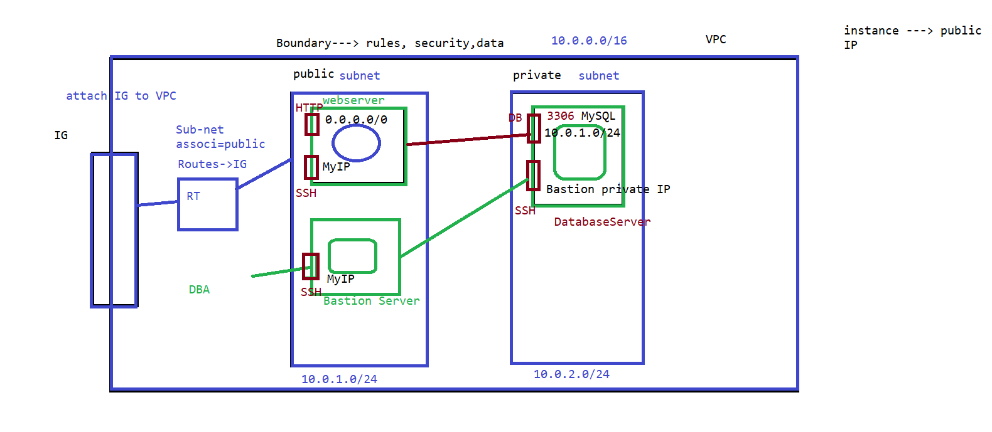
VPC
Lab.
VPC
Subnets
RouteTable
Internet gateway
EC2 instances
NatGateway CIDR-classless inter domain routing
NACL

Slide 27
NACL
Security group is the firewall of EC2 Instances whereas Network ACL is the firewall of the Subnet.
Any instance in the subnet with an associated NACL will follow rules of NACL
By default all traffic is denied, inbound as well as out bound
Network ACLs are stateless: This means any changes applied to an incoming rule will not be applied to the outgoing rule. e.g. If you allow an incoming port 80, you would also need to apply the rule for outgoing traffic seperately.
All rules in a security group are applied whereas rules are applied in their order (the rule with the lower number gets processed first) in Network ACL.
Subnet can have only one NACL, whereas Instance can have multiple Security groups.

Slide 28
AWS StorageService
Block Storage→(EBS) to install OS, DBS, platforms, runtime, hosting apps, web servers and so on
Object Storage→ static files, Objects, S3 , Glacier
File Storage→ (EFS)when we need a directory structure

Slide 29
EBS Volume type
General purpose SSD→ support 3000 iops, ideal for all workload types, specially for root Volume, used for development/ testing workloads
Provisioned IOPS Solid State Drive→ used for large DB workloads, SQL/Oracle critical ; used for IO intensive applications; which needs consistent throughput. Max 64000iops
Throughput optimized Hard Disk Drive→ data ware housing, for throughput optimize, 16tB
Cold HDD→ cost effective storage, when we need to access infrequently.
Magnetic→ low cost
SSD-backed volumes optimized for transactional workloads involving frequent read/write operations with small I/O size, where the dominant performance attribute is IOPS
HDD-backed volumes optimized for large streaming workloads where throughput (measured in MiB/s) is a better performance measure than IOPS

Slide 30
EBS Volume type
Lab(Create a windows instance)
Study features of different EBS Volumes
Create an EBS volume and attach it with your instance
Terminate instance observe the changes
Check if the same Volume could be attached with other instance or not

Slide 31
AWS EFS
Several EC2 instances can use single file system
Only used to store files and folders
provides a simple, scalable, fully managed elastic NFS file system for use with AWS Cloud services and on-premises resources
It’s a fully managed service
Different types are
Standard storage
Infrequent Access storage
Infrequent Access request
Provisioned Throughput

Slide 32
S3 (Simple Storage Service)
Contains buckets
Enable Versioning
Cross region replication can be done
Store and retrieve any amount of Data
Enables Life cycle Management
Enables static web Hosting
Encryption of file is allowed
Different types are
Standard , Intelligent tiering , standard IA , one zone IA , Glacier, Glacier Deep archive
Cost wise in descending Order
S3 standard>IA>Intelligent Tiering>one zone>Glacier>Glacier Deep archive

Slide 33
S3 (Simple Storage Service)
Lab
Create an S3 bucket, add files to it
Access the file
Add versioning
Static WebHosting

Slide 34
Acess S3 through CLI
Lab
Create an Ec2 instance
Attach security acess
List the bucket, create a new bucket, access objects of the bucket,remove all objects from the bucket
Create an IAM policy and attach it to EC2 instance and acess S3 buckets

Slide 35
Cloud Front
It’s a content delivery network
Content delivery networks provide a globally-distributed network of proxy servers which cache content, such as web videos or other bulky media, more locally to consumers, thus improving access speed for downloading the content.
Improves read performance, as content is cached at the edge.
There are total 216 edge locations
Origin Access Policy
Netflix
Amazon Prime

Slide 36
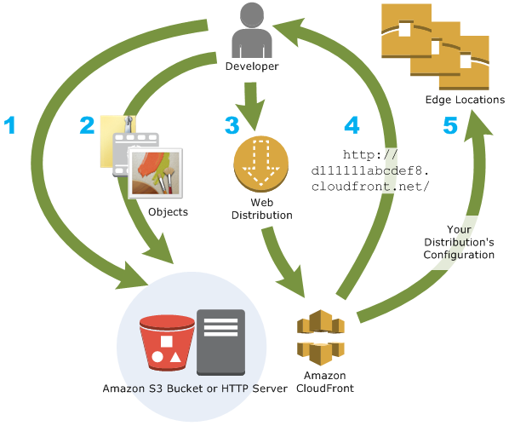
Cloud Front

Slide 37
Quiz
What is Amazon VPC
An AWS VPC is a component of which group of AWS services?
What does an AWS Region consist of?
What is Availability Zones?
Which of the following is correct?
#EL>#AZ>#Region
#AZ>#EL>#Region
#Region>#AZ>#EL
When creating a new security group, all inbound traffic is allowed by default. True or False?
Amazon's EBS volumes are ______ type of storage
If an Amazon EBS volume is an additional partition (not the root volume), can I detach it without stopping the instance?
EBS Snapshots are backed up to S3 in what manner?

Slide 38
Quiz
Types of LB
When we stop an EC2 instance its ____________ address changes (private/public)
You are running a website with a load balancer and 10 EC2 instances. Your users are complaining about the fact that your website always asks them to re-authenticate when they switch pages. You are puzzled, because it's working just fine on your machine and in the dev environment with 1 server. What could be the reason?
You quickly created an ELB and it turns out your users are complaining about the fact that sometimes, the servers just don't work. You realise that indeed, your servers do crash from time to time. How to protect your users from seeing these crashes?
You are designing a high performance application that will require millions of connections to be handled, as well as low latency. The best Load Balancer for this is ______________________

Slide 39
Quiz
You are running at desired capacity of 3 and the maximum capacity of 3. You have alarms set at 60% CPU to scale out your application. Your application is now running at 80% capacity. What will happen?
You're trying to upload a 25 GB file on S3 and it's not working, why and how can you achieve it?
I tried creating an S3 bucket named "dev" but it didn't work. This is a new AWS Account and I have no buckets at all. What is the cause?
You've added files in your bucket and then enabled versioning. The files you've already added will have which version?

Slide 40
Excercise
Create 4 EC2 instances with a LB, using auto scaling group and check if its working

