Slide 1
AWS-Session2

Slide 2
Agenda
Data Persistence
Computing
CloudFormation

Slide 3
Data Persistence (RDS)
AWS Relational Database Service (RDS) is a fully managed relational database
service from Amazon, backup, patching, failovers, recovery.
AWS RDS supports six database engines—Amazon
Aurora, PostgreSQL, MySQL, MariaDB, Oracle, and Microsoft SQL Server
It's a fully managed service that automatically manages backups, software
and OS patching, automatic failover, and recovery.
It also allows us to take a manual backup of the database as a snapshot.
Snapshots of a database can be used to restore a database as and when
required.

Slide 4
RDS Components
DB Instance→ Each Amazon RDS engine can create an instance with at least one database in it.
Each instance can have multiple user-created databases.
Database names must be unique to an AWS account and are called DB instance identifiers.
AWS RDS instances can also be accessed by the AWS Management Console, the API, and the CLI
The generalpurpose storage range for each DB engine can be categorized into two categories, as follows:
→One group of DB engines, such as MySQL, MariaDB, Oracle, and PostgreSQL, that support a minimum of 20 GB and a maximum of 32 TB.
→The second group of DB engines, such as MS SQL Server for Enterprise,
Standard, Web, and Express editions, that support 20 GB to 16 TB storage.

Slide 5
RDS Components
DB Instance→
Each Amazon RDS engine can create an instance with at least one database in it.
Each instance can have multiple user-created databases.
Database names must be unique to an AWS account and are called DB instance identifiers
AWS RDS instances can also be accessed by the AWS Management Console, the API, and the CLI
The general purpose storage range for each DB engine can be categorized into two categories, as follows:
→One group of DB engines, such as MySQL, MariaDB, Oracle, and PostgreSQL, that support a minimum of 20 GB and a maximum of 32 TB.
→The second group of DB engines, such as MS SQL Server for Enterprise,
Standard, Web, and Express editions, that support 20 GB to 16 TB storage.

Slide 6
RDS Components
Regions and AZ→
Each geographical location where the data centers are located is called a region
Each region comprises multiple distinct locations that are called AZs.
Amazon creates AZ’s in isolated locations so that a failure in one AZ does not impact other AZs in the region.
An RDS DB instance can be provisioned in several AZs by selecting the multi-AZ
deployment option
It is always recommended to create RDS in multiple AZ’s to avoid DataLoss due to any failures (disaster Recovery)

Slide 7
Read Replica’s
Main DB, will undergo multiple request/response for an application
We can create upto 5 read replca’s, which can be within AZ, cross AZ or cross Region
There will be Async replication between read replica’s
Application must update connection string to leverage read replica’s
Ex: Production DB running on normal load; we need to run some analytics. Create Read replica to run the new workload there.
Network Cost→ cost for transferring data from one AZ to other

Slide 8
RDS Components
Security Groups→
It acts like a firewall
They control access to RDS Instance, by specifying the allowed source ports, Protocols and IP’s
Three types of Security groups can be attached with RDS RDS Security group, VPC Security group and EC2 security group
RDS security group is used when the RDS instance is not within any VPC
VPZ security group is used when RDS instance is a part of any VPC
EC2 SG can be used with EC2 instance and RDS instance.

Slide 9
RDS Components
RDS DB Engine→
Amazon RDS engine types Default port Protocol
1521
DB Engine | PORT
Aurora DB | 3306
MariaDB | 3307
Microsoft SQL | 1433
MySQL | 3306
Oracle | 1521
PostgreSQL | 5432

Slide 10
RDS Encryption + Security
At Rest encryption, we can encrypt master & read replica’s
If master is not encrypted, read replica’s cannot be encrypted
In flight encryption-SSL certificate to encrypt the data in flight
Snapshot of unencrypted DB are unencrypted
Copy a snapshot into an encrypted one
Network security→ RDS Db is deployed on private subnet

Slide 11
RDS Amazon Aurora
Amazon Aurora is a MySQL and PostgreSQL-compatible
Your existing Amazon RDS for MySQL applications is converted to Amazon Aurora by providing push-button migration tools
Creating an Amazon Aurora DB instance will create a DB cluster.
These clusters consist of two types of instance—primary instance and Aurora Replica.
Primary instance: Performs read, writes, and modifies data to the cluster
volume. Each Aurora DB cluster has one primary instance.
Aurora Replica: Performs only read operations. Each Aurora DB cluster
supports up to 15 Aurora Replicas plus one primary instance. Amazon RDS
Aurora instance availability can be increased by spreading Aurora Replicas
across multi-AZs.

Slide 12
RDS LAB
Connect it with SQL WorkBench
Connect it with Java Application to fetch data from DB
Self Task→ Find more about Amazon Aurora DB engine and its Features

Slide 13
RDS Summary
An RDS is a fully managed relational database service.
An RDS provides fine-grained access control with the help of AWS IAM.
An RDS does not allow the user to access the underlined host operating
system.
You can stop and start any RDS database engine.
You can stop and start an RDS instance irrespective of whether it is in
single-AZ or multi-AZ, except for SQL Server. SQL Server RDS in multi-AZ
cannot be stopped.
An RDS instance can be stopped for a maximum of seven consecutive days.
After seven days, the instance is automatically restarted.

Slide 14
RDS Summary
Amazon Aurora is a MySQL-and PostgreSQL-compatible, fully managed
RDBMS.
MariaDB is a community version of MySQL RDBMS

Slide 15
DynamoDB (NoSQL DB)
DynamoDB is an easy-to-use and fully managed NoSQL database service provided
by Amazon
It provides fast and consistent performance, highly scalable architecture,
flexible data structure, event-driven programmability, and fine-grained access
control.
A relational database stores data in one or more related tables. The relational model
and tabular format minimizes data duplication.
NoSQL databases store related data in a single document, which can improve accessibility and scalability
Key-value pair, Document(xml,json,yaml) ,Graph, wide column stores

Slide 16
DynamoDB Components(KV+D)
Tables→ DynamoDB stores data in an entity called a table. A table consists
of a set of data(items)
Item→ A table consists of multiple items. An item consists of a group of
attributes. An item is like a record or row in an RDBMS table
Attribute→ An item in a table consists of multiple attributes. An attribute is
the basic data element of an item. It is similar to a field or a column in an
RDBMS. However, unlike the case in an RDBMS, attributes in a table item
can have sub-attributes

Slide 17
DynamoDB Components

Slide 18
DynamoDB Primary Key
Primary Key→ While creating a DynamoDB table, you need to specify the table name and the primary key of the table. It is mandatory to define a primary key in the DynamoDB table
There are two types of Primary Key
1. Partition Key→This is a simple primary key that is composed of a single
attribute named a partition key. It is also called Hash Key
2. Partition Key and Sort Key→The partition key and sort key are composed of
two attributes and that's why they are also called a composite primary key.

Slide 19
DynamoDB Secondary indexes
DynamoDB allows you to create secondary indexes on a table. This is an alternate way to query table data in addition to querying it using the primary key
There are two types of Secondary Indexes
1. Global Secondary Index- p+s different than the primary key def for table
2. Local Secondary Index-
DynamoDB allows you to create 20 GSIs and 5 LSIs on a table

Slide 20
Read Consistency Model
Amazon provides DynamoDB in multiple AWS regions across the globe.
All of these regions are independent and physically isolated from one another.
If you create a DynamoDB employee table in the us-east-1 region and similarly create another employee table in the us-west-2 region, these tables are two separate and isolated tables.
An AWS region consists of multiple AZs.
Each of the AZs are isolated from failures in any of the AZs in a region. Amazon provides an economical and low latency network connection between all the AZs in a region.

Slide 21
Read Consistency Model
There are 2 types of Consistency Model
1. Eventually Consistent Reads- Data will be synced eventually.
2. Strongly Consistent Reads- it provides the response with the most up-to-date data
By default, DynamoDB uses eventually consistent reads.
If you need to use strongly consistent reads, you need to specify this while creating the
table

Slide 22
Supported Data Types In AWS
1. Scalar Type-each primary key, must be defined as one of the following scalar data
types—string, number, or binary.
2. Document Type-A document data type contains a complex structure with nested attributes. XML/JSON Data. List/Map
3. Set Type-A set data type contains a group of scalar values. The set types supported by
DynamoDB are string set, number set, and binary set. In Set type, Data must be of Same type always.

Slide 23
ThroughPut Calculation
1 read capacity=1 SCR
1 read capacity=2 ECR
1 read operation→process 4Kb in size
item>4 need additional read operation

Slide 24
DynamoDB Lab
Create a DynamoDB
Choose a Primary Key
TTL Property
https://docs.aws.amazon.com/amazondynamodb/latest/developerguide/WorkingWithTables.html

Slide 25
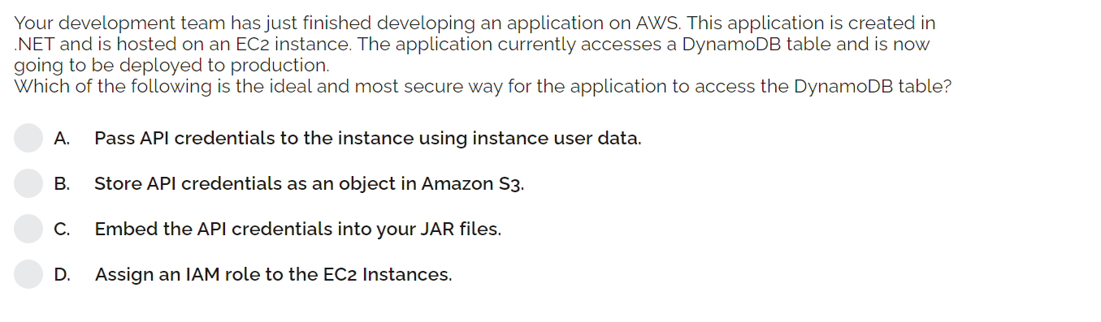
DynamoDB sample Questions
Amazon Aurora is a MySQL and PostgreSQL-compatible
Your existing Amazon RDS for MySQL applications is converted to Amazon Aurora by providing push-button migration tools
Creating an Amazon Aurora DB instance will create a DB cluster.
These clusters consist of two types of instance—primary instance and Aurora Replica.
Primary instance: Performs read, writes, and modifies data to the cluster
volume. Each Aurora DB cluster has one primary instance.
Aurora Replica: Performs only read operations. Each Aurora DB cluster
supports up to 15 Aurora Replicas plus one primary instance. Amazon RDS

Slide 26
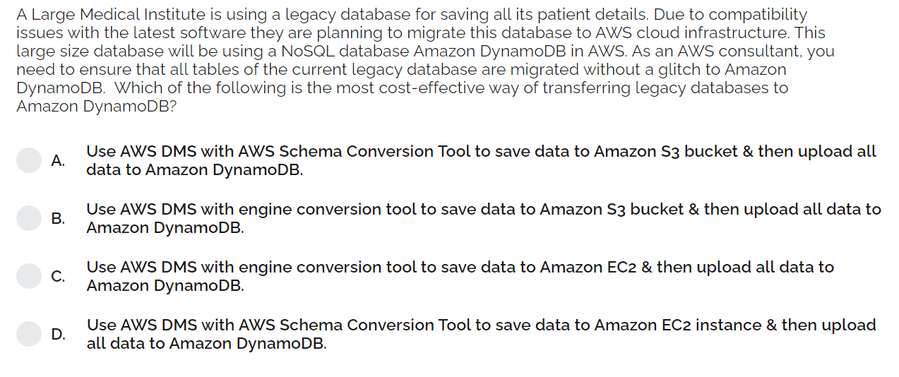
DynamoDB sample Questions
Amazon Aurora is a MySQL and PostgreSQL-compatible
Your existing Amazon RDS for MySQL applications is converted to Amazon Aurora by providing push-button migration tools
Creating an Amazon Aurora DB instance will create a DB cluster.
These clusters consist of two types of instance—primary instance and Aurora Replica.
Primary instance: Performs read, writes, and modifies data to the cluster
volume. Each Aurora DB cluster has one primary instance.
Aurora Replica: Performs only read operations. Each Aurora DB cluster
supports up to 15 Aurora Replicas plus one primary instance. Amazon RDS

Slide 27
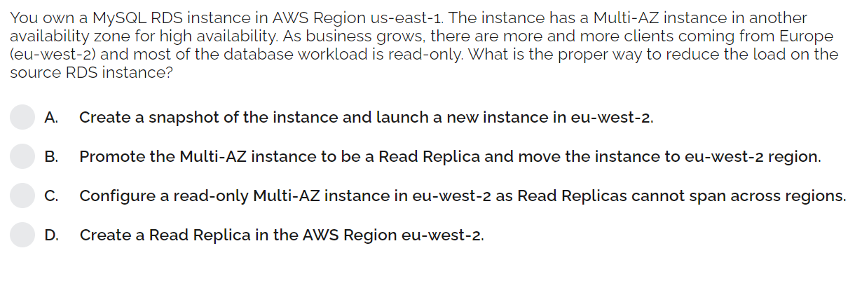
DynamoDB sample Questions
Amazon Aurora is a MySQL and PostgreSQL-compatible
Your existing Amazon RDS for MySQL applications is converted to Amazon Aurora by providing push-button migration tools
Creating an Amazon Aurora DB instance will create a DB cluster.
These clusters consist of two types of instance—primary instance and Aurora Replica.
Primary instance: Performs read, writes, and modifies data to the cluster
volume. Each Aurora DB cluster has one primary instance.
Aurora Replica: Performs only read operations. Each Aurora DB cluster
supports up to 15 Aurora Replicas plus one primary instance. Amazon RDS

Slide 28
QUIZ
We have setup read replicas on our RDS database, but our users are complaining that upon updating their social media posts, they do not see the update right away. Reason?
Which RDS Classic (not Aurora) feature does not require us to change our SQL connection string? l
Your application functions on an ASG behind an ALB. Users have to constantly log back in and you'd rather not enable stickiness on your ALB as you fear it will overload some servers. What should you do?
Which RDS database technology does NOT support IAM authentication?
Your company has a production Node.js application that is using RDS MySQL 5.6 as its data backend. A new application programmed in Java will perform some heavy analytics workload to create a dashboard, on a regular hourly basis. You want to the final solution to minimize costs and have minimal disruption on the production application, what should you do?

Slide 29
ElasticBeanStalk (PaaS)
AWS Elastic Beanstalk wipes out the need to physically build a
framework for the designer and makes it accessible for them to rapidly send and deal
with a web application on AWS of any scale
Developers only need to upload the code. All other aspects, such as capacity
provisioning, building, and configuring AWS resources, such as EC2 instances, ELB,
auto scaling, and application health monitoring, will be handled by Elastic Beanstalk.
Its an orchestration service, which orchestrates number of services like EC2, Autoscaling, LB, Security, CloudWatch, SNS, S3 bucket.
There are no additional charges for using AWS Elastic Beanstalk; charges only apply for using the underlying resources, such as EC2, ELB,and autoscaling

Slide 30
ElasticBeanStalk

Slide 31
ElasticBeanStalk Components
Application-version of application, environment, configuration
Application Version-It points to an Amazon S3 object containing deployment code,
such as a Java .war file
Environment- webserver envt(process http) & Worker envt(e-mail)
Environment Configuration
It has 3 architecture model-single instance deployment, LB+ASG, only ASG(for non-web app in production)

Slide 32
WebServer Environment Tier

Slide 33
Beanstalk Deployment Models
All At Once
Rolling
Rolling with additional batches
Immutable- Temporary ASG is launched

Slide 34
ElasticBeanStalk LAB
Launch a BeanStalk Application
Create multiple Environments for the Same application
Explore Deployment Policies of EBS
https://docs.aws.amazon.com/elasticbeanstalk/latest/dg/tutorials.html

Slide 35
CloudFormation
AWS CloudFormation allows you to create and customize the AWS infrastructure
using code
It also enables you to create your infrastructure as code.
This program or code is known as a template in AWS CloudFormation
Each CFT can be written in one of the supported scripting languages (such as JSON or YAML).
You can use these CFTs to recreate the same infrastructure in a different region or in a different AWS account
With little or no changes in the template using runtime parameters, the infrastructure gets ready in different regions or in different AWS accounts.

Slide 36
CloudFormation Templates
Template extensions can be .json, .yaml, or .txt/.template
When these templates are executed, the defined AWS resources are created in the respective AWS account
You can either upload the template to an S3 bucket.
While creating a stack, if the template path is pointing to the local machine, then it will automatically upload the CloudFormation template to the AWS S3 bucket in the relevant region.
In each region, AWS CloudFormation will create its own bucket.
We can also design the template using Designer (provided by AWS)

Slide 37
CloudFormation Templates

Slide 38
CloudFormation Stack
A stack is created upon the successful execution of a template.
When a CloudFormation execution fails, it rolls back all of the execution steps and deletes any resources created during the process.
At the time of creation of Template, CloudFormation, only checks for the syntactical errors.
When the stack is deleted, all of the AWS resources created during stack creation are also deleted
Template will be retained in the S3 Bucket.

Slide 39
Template Sections
AWSTemplateFormatVersion: “2010-09-09”
Description:”VPC, us-east-1, ”
MetaData: “AWS::CloudFormation::EC2”
Parameters:
AWS Specific Parameters
Mapping
Conditions
Resources

Slide 40
CloudFormation Lab
Template to create an EC2 instance
Create an EC2 instance with a Security group

