Slide 1
AWS-Session4

Slide 2
Agenda
Quiz

Slide 3
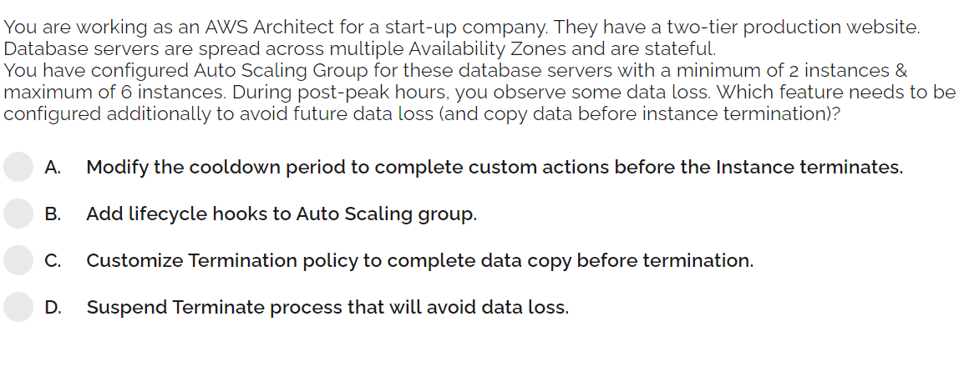
Notes:
b

Slide 4
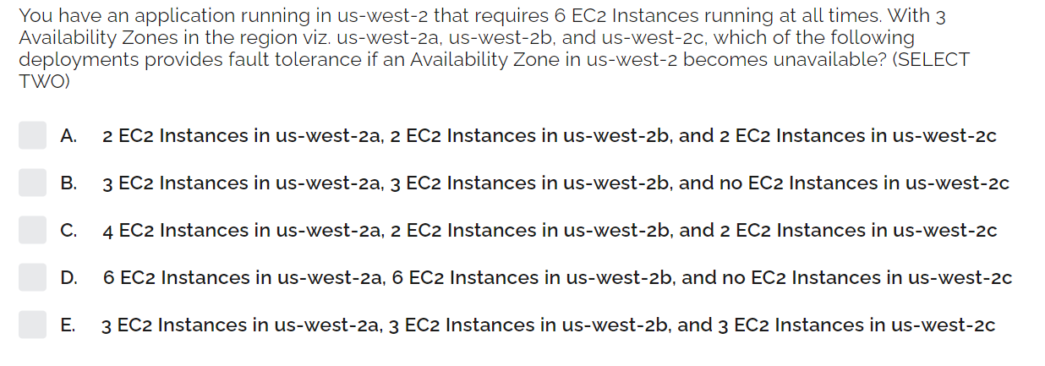
Notes:
D,e

Slide 5
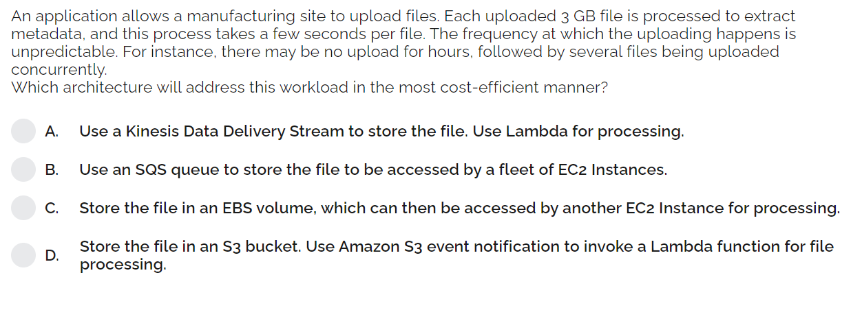
Notes:
D

Slide 6
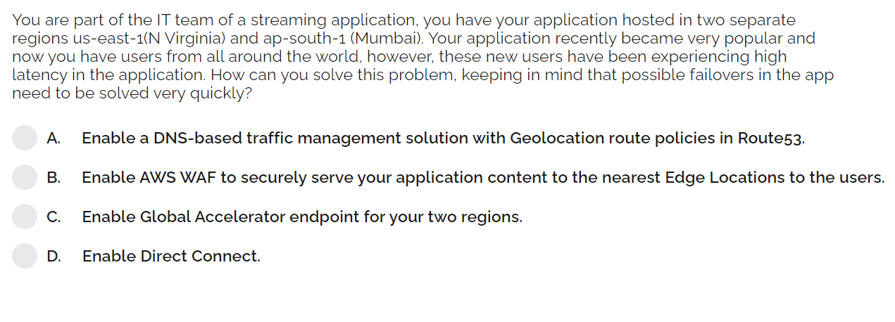
Notes:
c

Slide 7
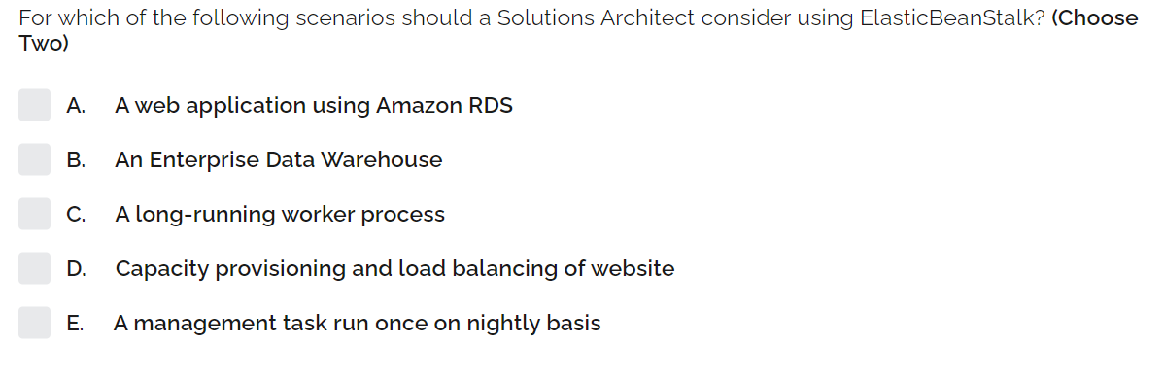
Notes:
A,d

Slide 8
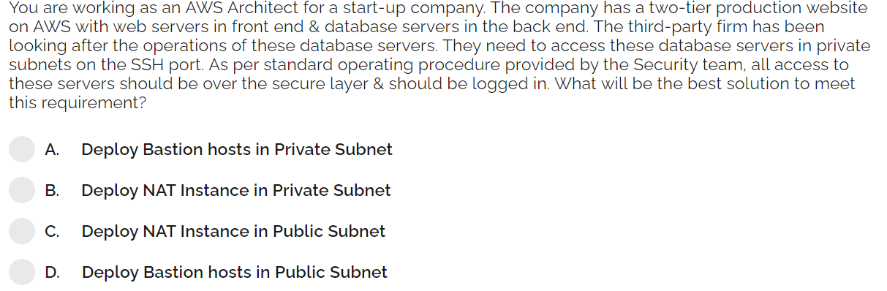
Notes:
d

Slide 9
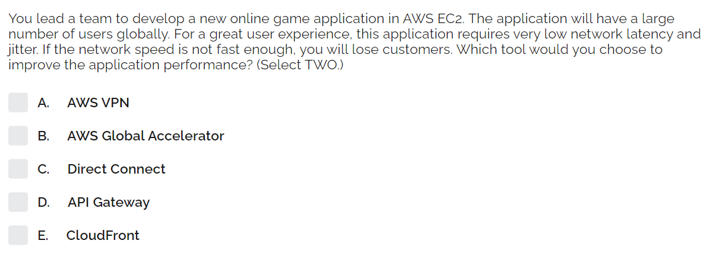
Notes:
B,E

Slide 10
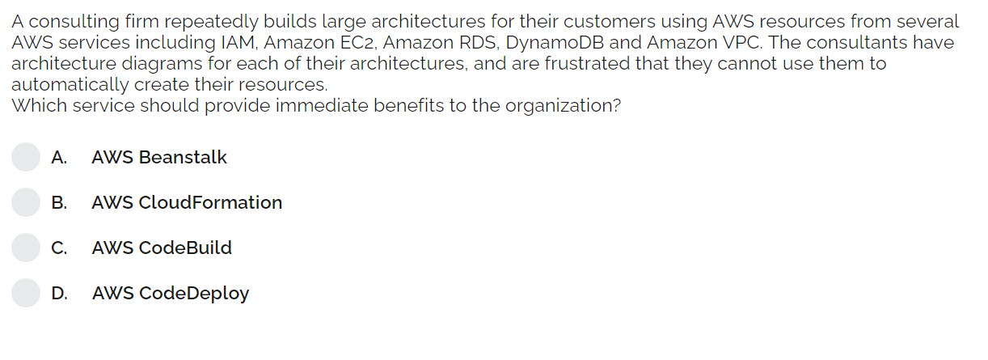
Notes:
B

Slide 11
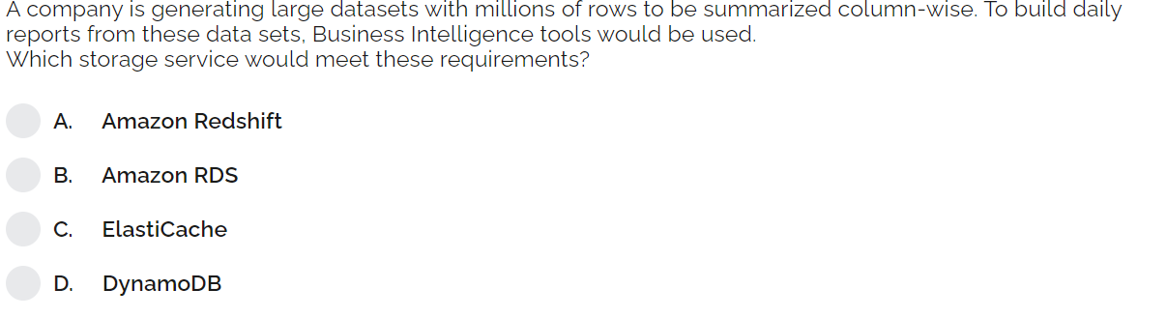
Notes:
A

