Slide 1

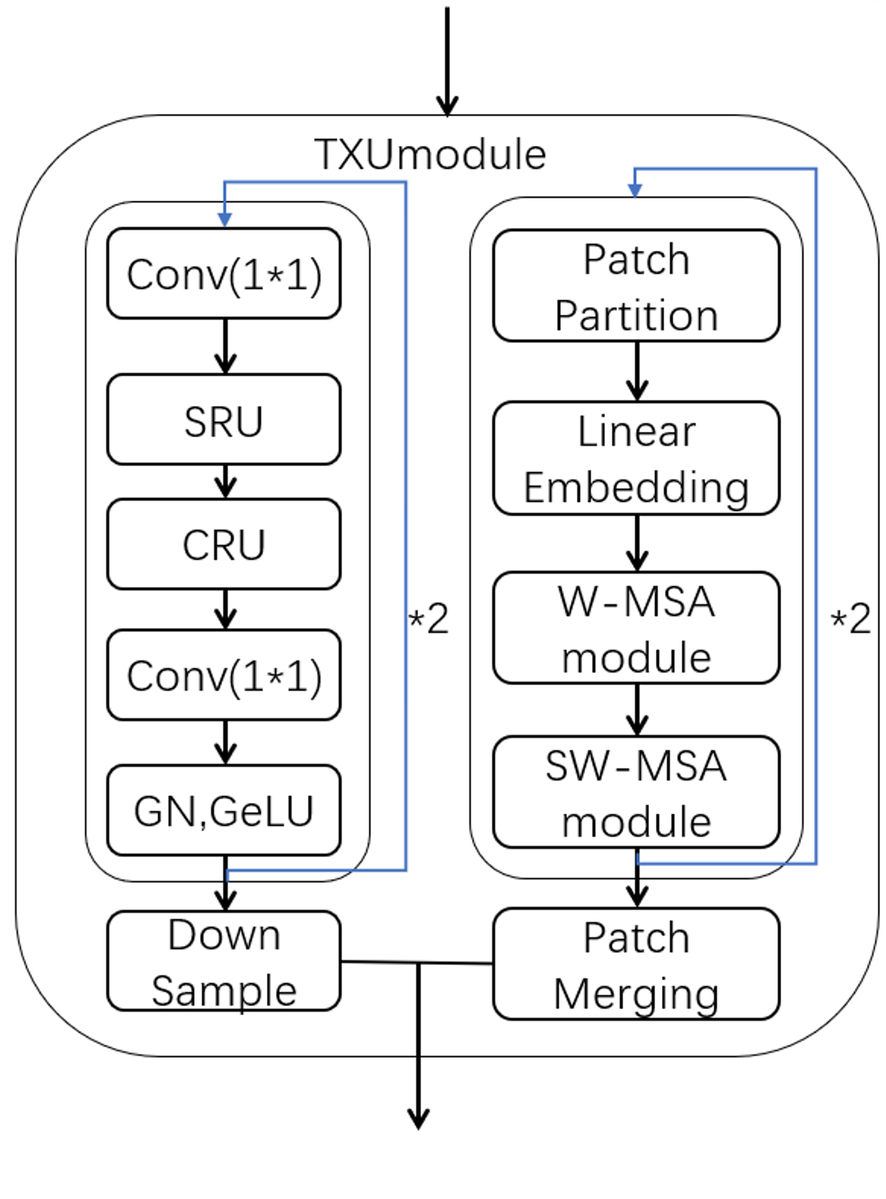
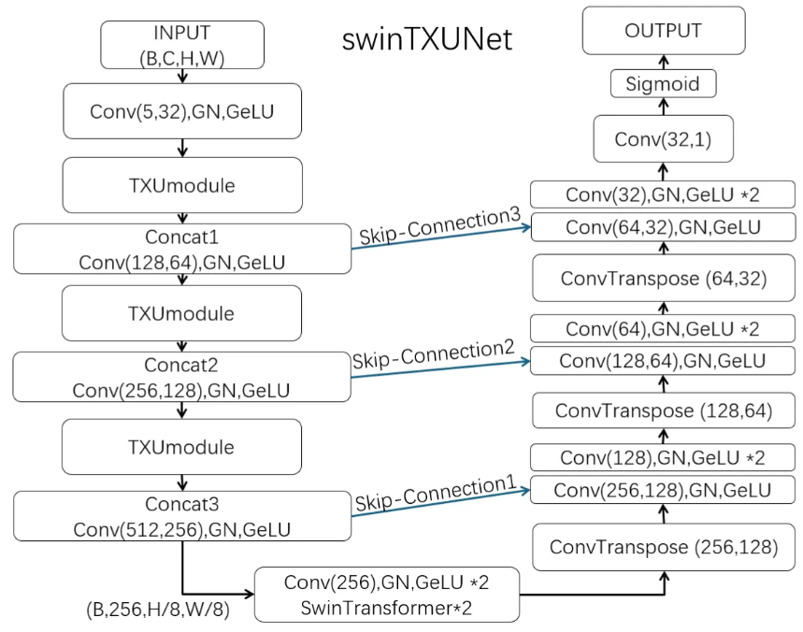
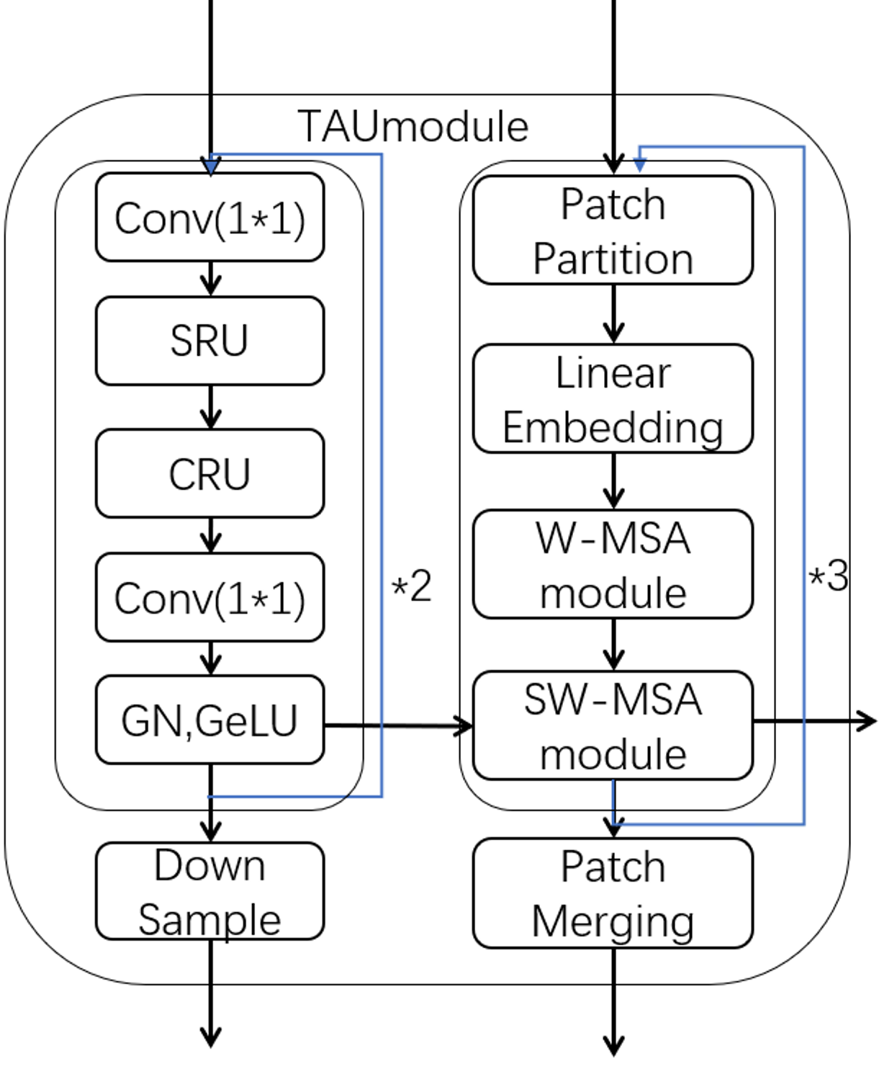
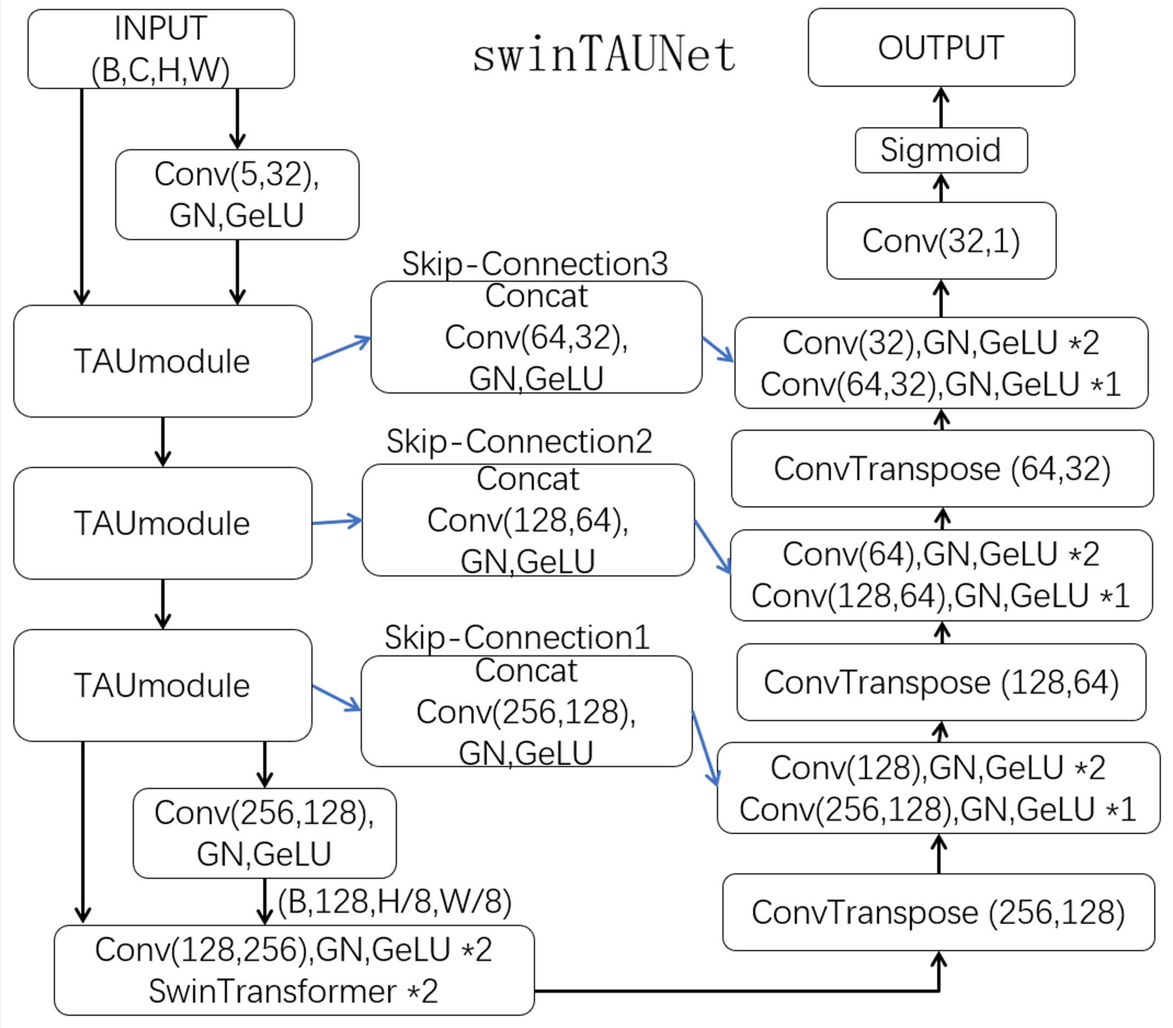
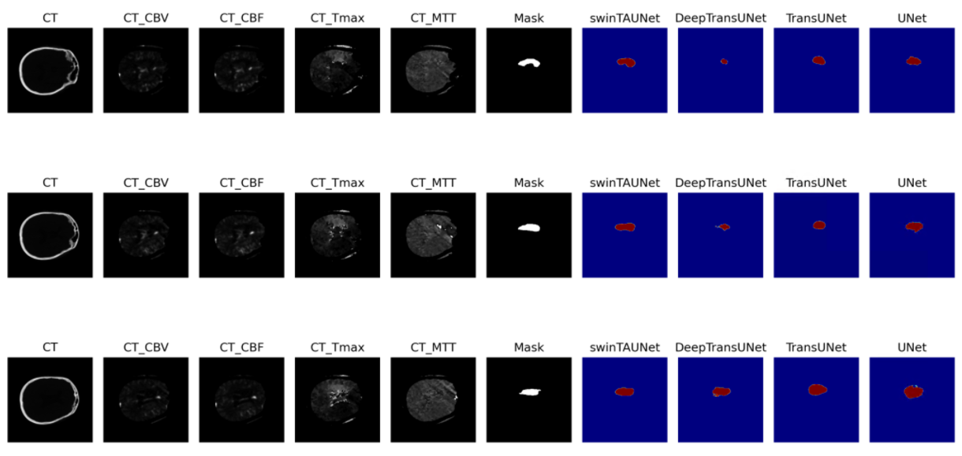
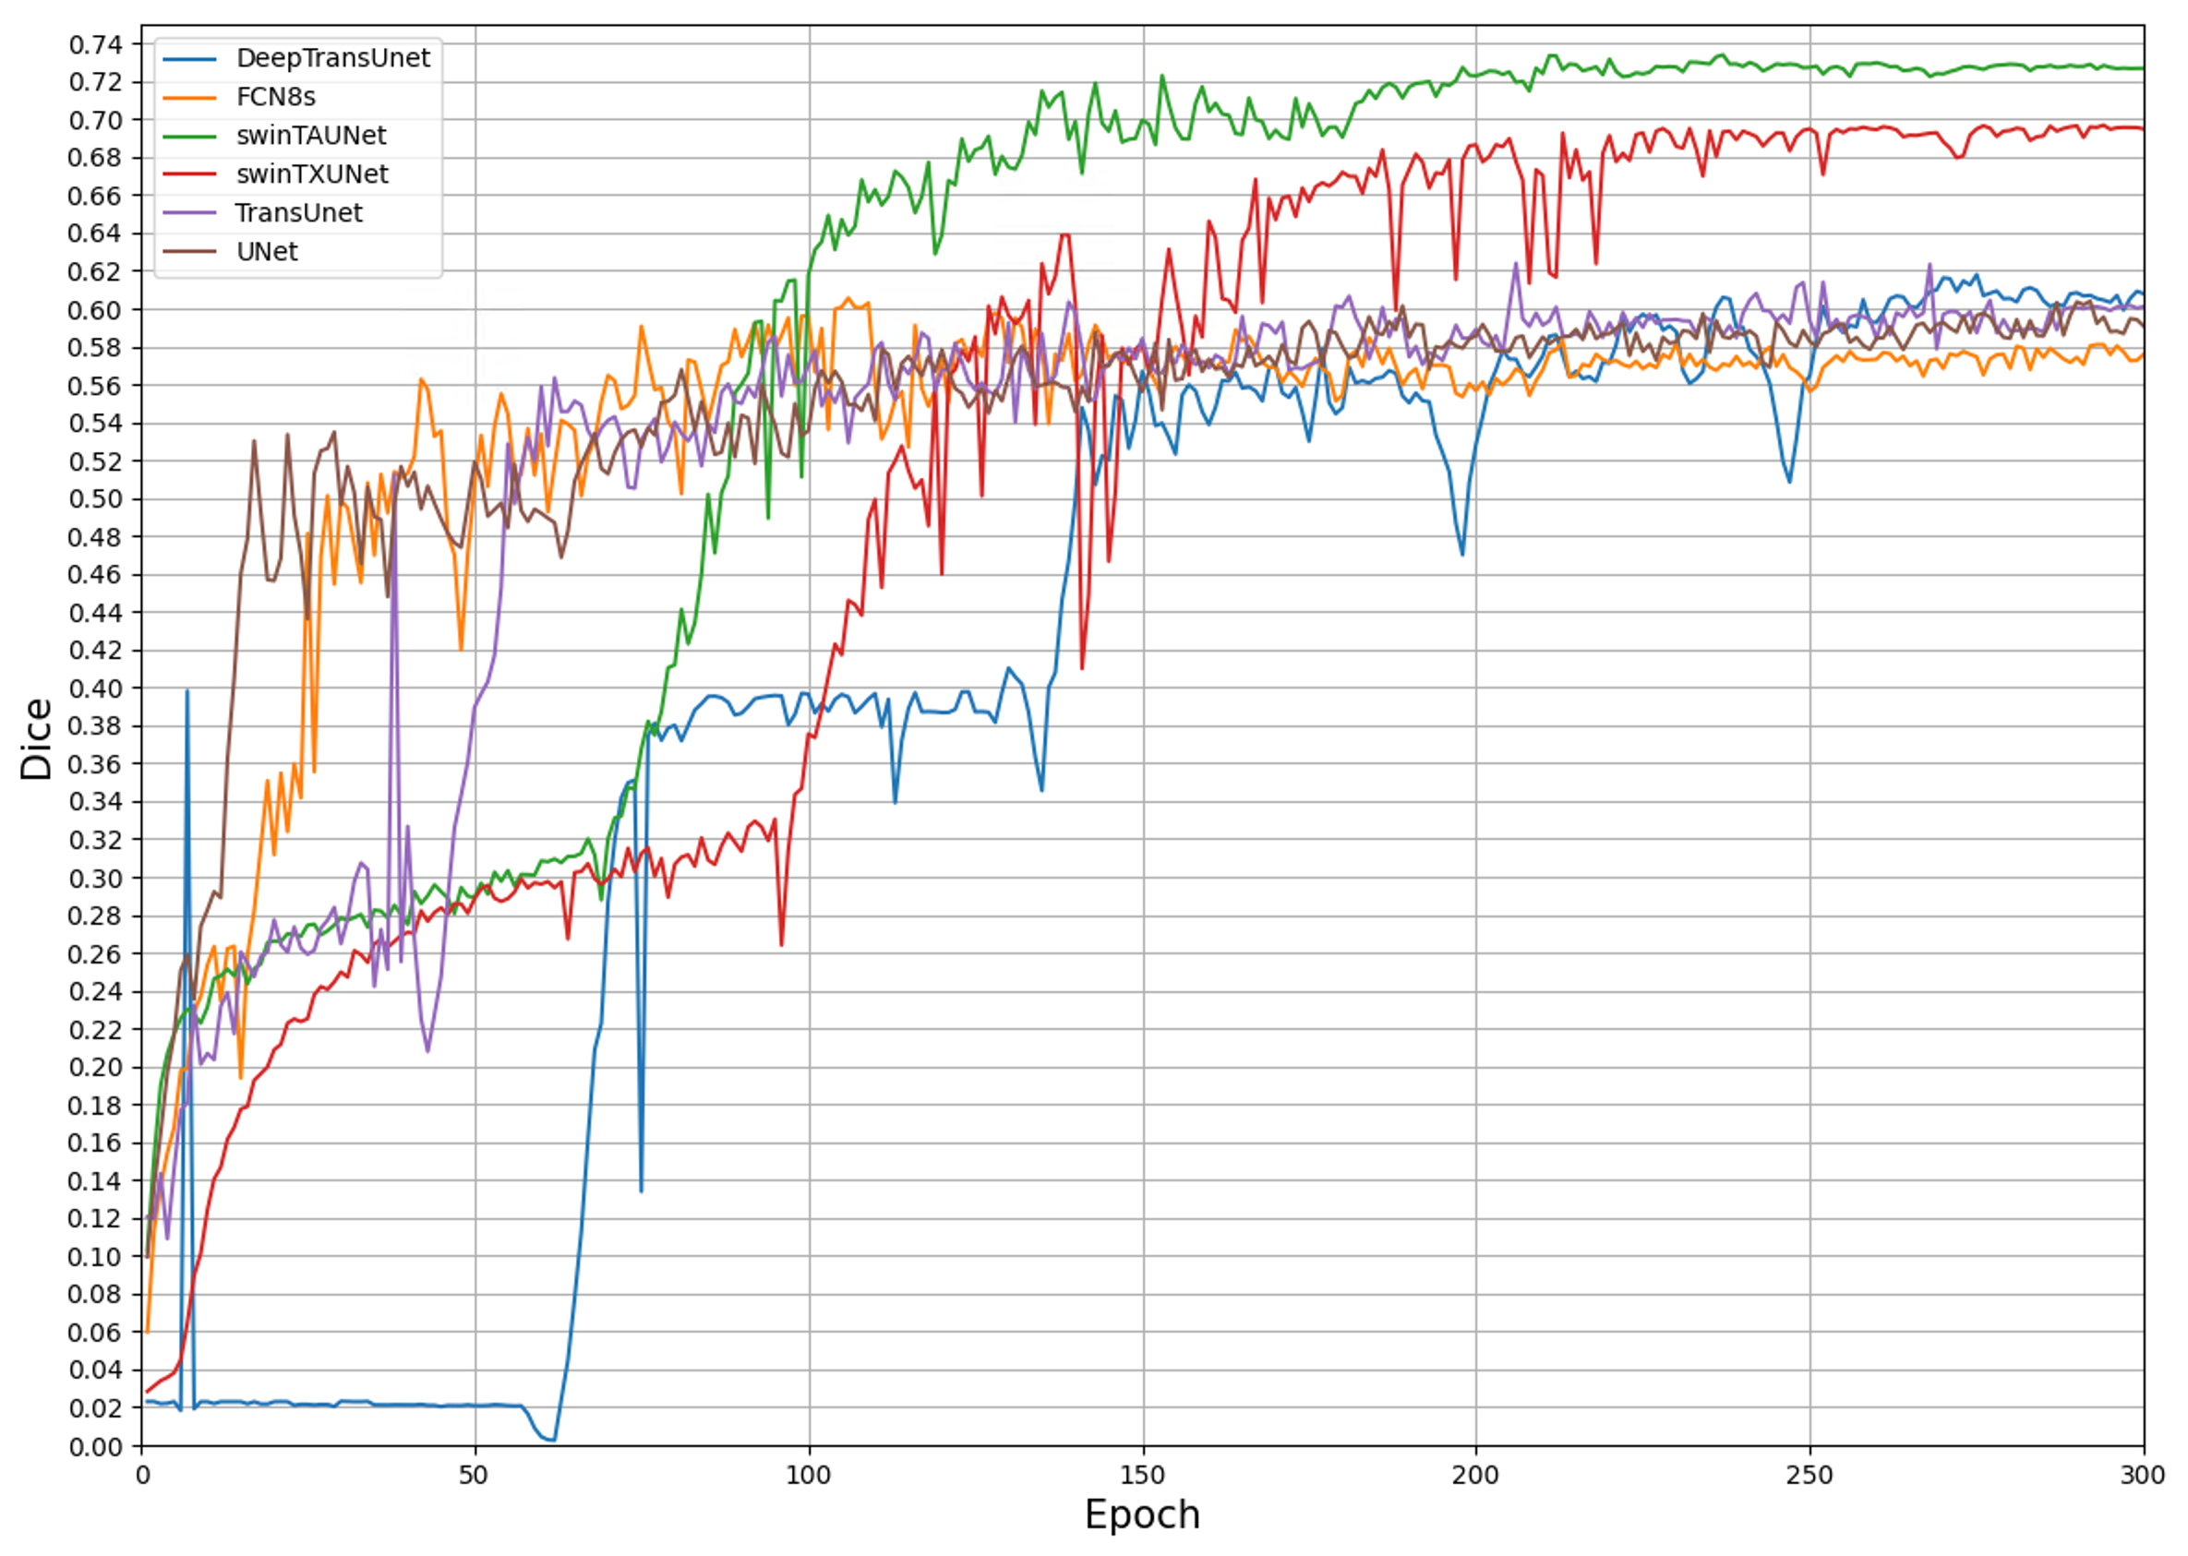
2024 IEEE 13th Global Conference on Consumer Electronics (GCCE 2024)
Proposed Models for Improving Lesion Segmentation in Ischemic Stroke CT Images Based on Hybrid CNN-Transformer Architectures
Yonghao BA and Yuji Watanabe (Graduate School of Science, Nagoya City University)
Semantic segmentation is crucial for many applications, but achieving high performance in complex real-world scenarios remains challenging. In this study, we explore combining CNNs and Transformers for feature extraction and propose two new models: swinTXUNet and swinTAUNet for the publicly available ischemic stroke CT dataset ISLES2018.
We base our models on the traditional U-Net and significantly enhance its encoder. We adopt the branching structure that combines CNN and Transformer, resulting in two new models differentiated by data flow methods.
Experiments show that our proposed methods achieve the validation accuracy of 73%, about 12% higher than the previous models, without relying on pre-training. Test results confirm the effectiveness of our methods and demonstrate the potential of hybrid CNN-Transformer models for feature extraction.
Abstract
Proposed Methods
Method
swinTXUNet
Result
About 9% improvement over the previous methods.
Problem
The computational complexity of the model increase, and the computation time become longer.
Structure
We proposed the swinTXUNet network as figure.
The encoder of network is designed based on the TXUmodule.
Inputs are sent to the CNN and Transformer branches for processing after receiving inputs respectively and are spliced after obtaining the results to be used as inputs for the next stage.
Method
swinTAUNet
Improve
We improved the feature extraction method of Encoder and proposed the swinTAUNet.
Result
About 3% over the swinTXUNet, 12% improvement over the previous methods and reducing training time by 58%.
Structure
The Encoder of swinTAUNet is designed based on the TAUmodule.
Unlike the TXUmodule, the TAUmodule only performs feature fusion at the time of skip-connection, and the feature extraction part is performed using two independent branches of CNN and Transformer.
Dataset: ISLES2018
Loss function: Soft dice loss
Optimizer: AdamW
Scheduler: ReduceLROnPlateau(min)
Software: Pytorch 2.2.5
Learning rate: 5.23e-05
Hardware: RTX3090(24GB)
Experimentations
Models | swinTAUNet | swinTXUNet | DeepTransUNet | TransUNet | UNet | FCN8s
Test Dice | 0.733083 | 0.683273 | 0.635591 | 0.587543 | 0.622802 | 0.621229
From the training result, both of our proposed models show a large improvement over the previous models, with the accuracy of swinTXUNet is improved by about 9% , swinTAUNet is improved by almost 12%.
However, due to without relying on pre-training, our proposal maneuver converges slower than the previous models.
From the results of the final 100 epochs of training, the model converges smoothly with small fluctuations, no obvious decrease in the model accuracy in the late stage of training, which shows that no obvious sign of overfitting, and proving the potential of the hybrid structure of the CNN and the Transformer.

