Slide 1
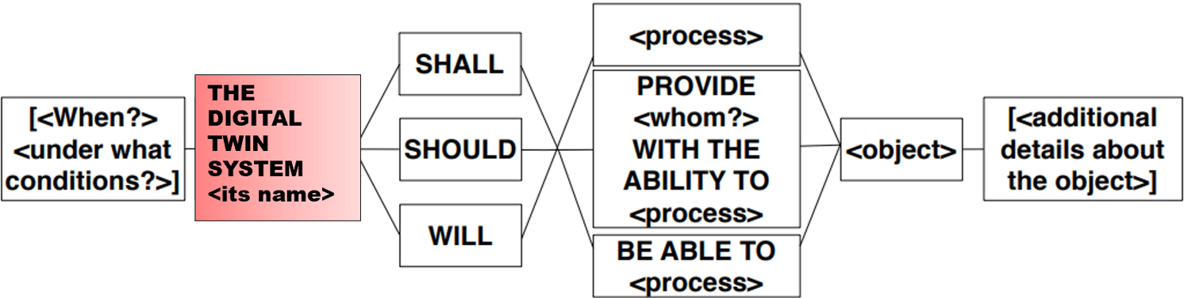
Functional Stakeholder’s requirement (need):
« BF001- The user wants the Workshop A’s DTS to simulate a scenario of machines allocation which he/she provides »
After applying RUPP’s boilerplate
Functional DTS requirement :
« EF001 – When a user provides a scenario of machines allocations, the Workshop A’s DTS shall be able to simulate it»

Slide 2
Stakeholder’s requirement (need) in terms of ergonomics and human factors :
« BT001- The user wants all Human-Machine Interfaces (HMIs) of the Workshop A’s DTS to be highly intuitive»
After applying RUPP’s boilerplate
DTS requirements in terms of Interface (HMIs):
“ET001 – The Workshop A’s DTS should provide the user with the ability to use in a highly intuitive way the HMI dedicated to the simulation.”
“ET002 – The Workshop A’s DTS shall provide the user with the ability to use in a very simple and intuitive way the HMI dedicated to the visualization of the data contained in the database of products orders.”
“ET003 - The Workshop A’s DTS shall provide the user with the ability to use in a very simple and intuitive way the HMI dedicated to the visualization of the data contained in the database of energy loading.”

Slide 3
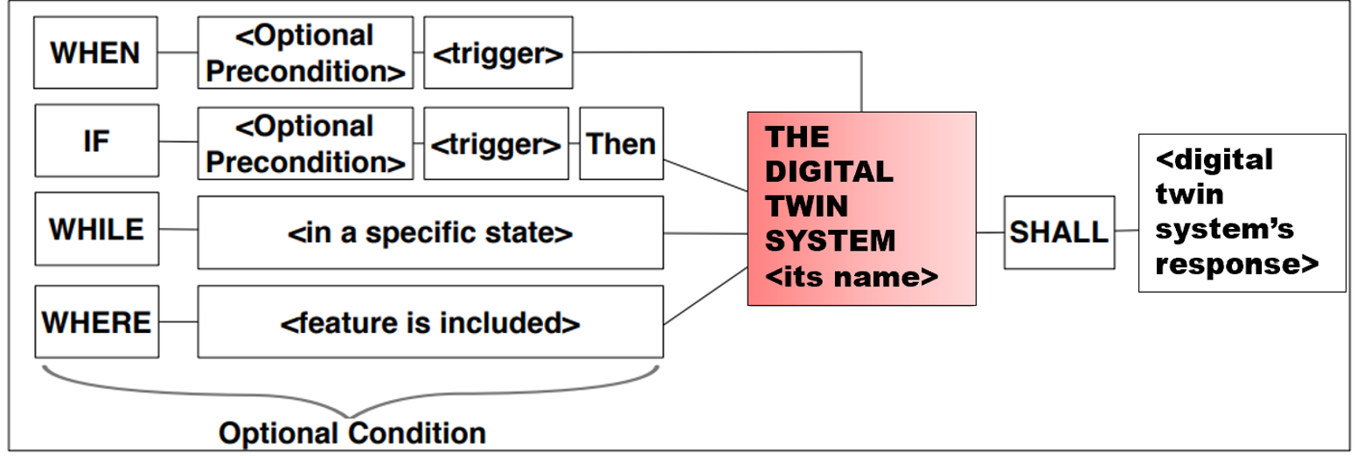
Non-functional stakeholder’s requirement (need) in terms of Evolutivity :
« NNF004- All the stakeholders want the Workshop A’s DTS to be easy to evolve. »
After applying EARS’ boilerplate
Non-functional DTS requirement :
« RNF004 –The Workshop A’s DTS shall be easy to evolve»

Slide 4
Operational stakeholder’s requirement (need) in terms of Installation/Deployment/Delivery /Configuration:
« NO001- The Company wants any version of any Modeling & Simulation’s sub-project composing the Workshop A’s DTS to be stored and accessible for any update-related modifications within a repository»
After applying EARS’ boilerplate
Operational DTS requirement in terms of Installation/Deployment/Delivery/Configuration:
« RO001 –While the Workshop A’s DTS is deployed, delivered and configured, any Workshop A’s DTS’ version of any Modeling & Simulation’s sub-project composing it shall be stored and accessible for any update-related modifications within a central repository »

Slide 5
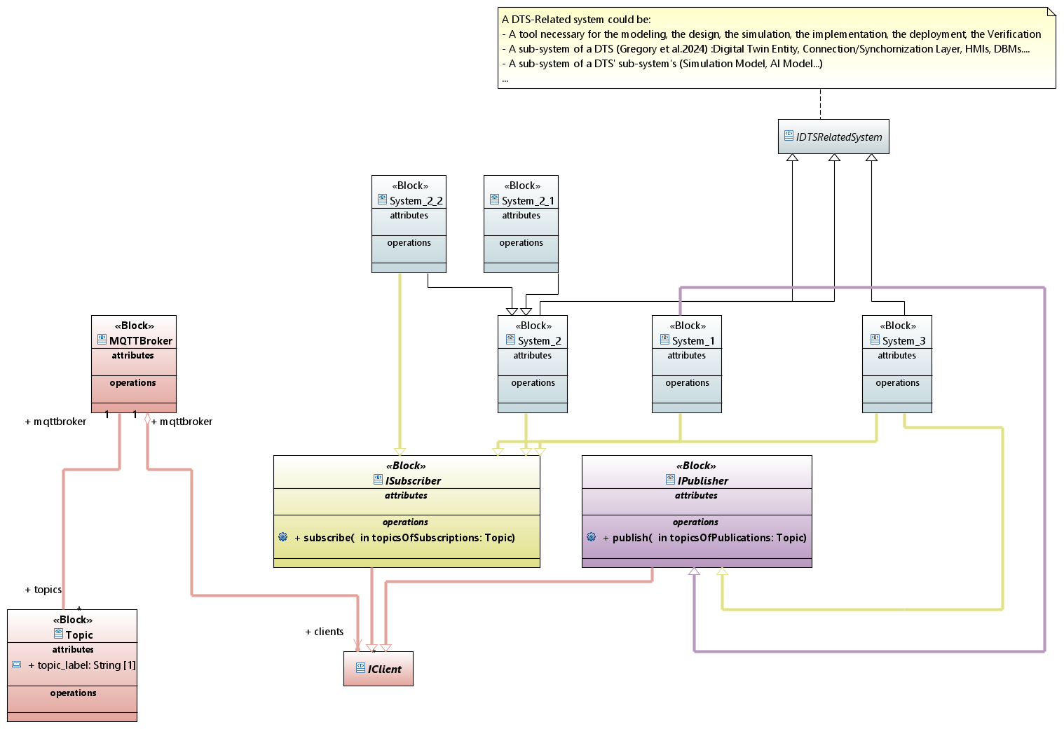

Slide 6
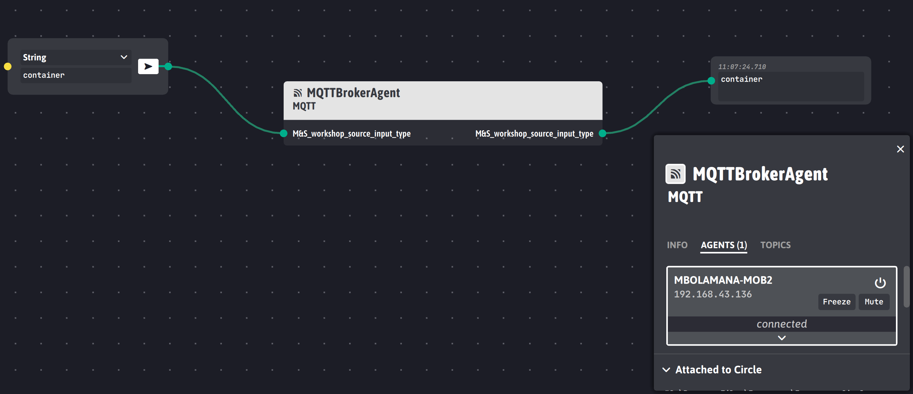
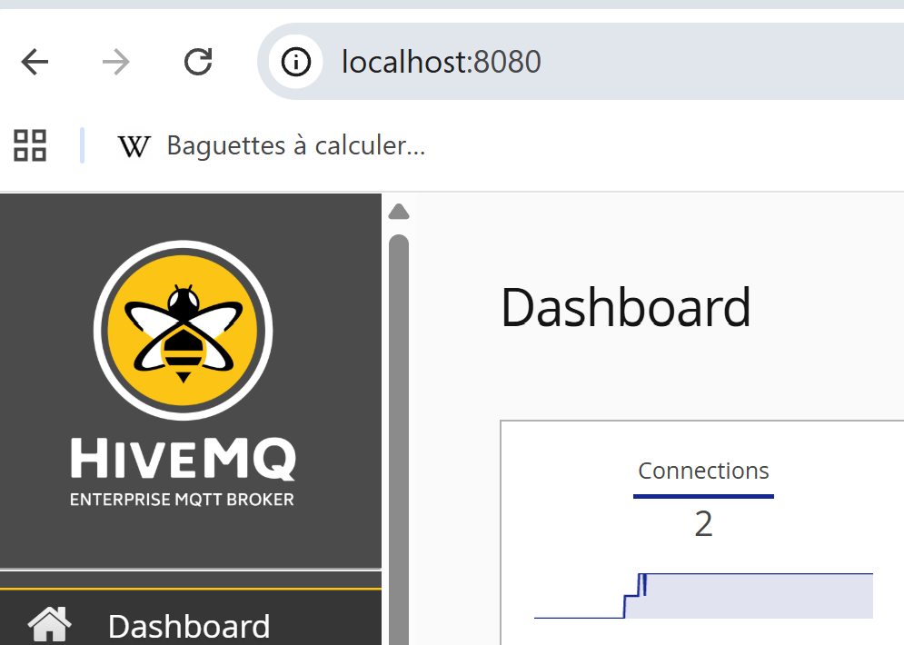
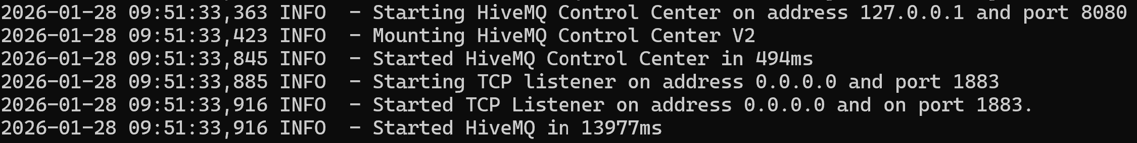
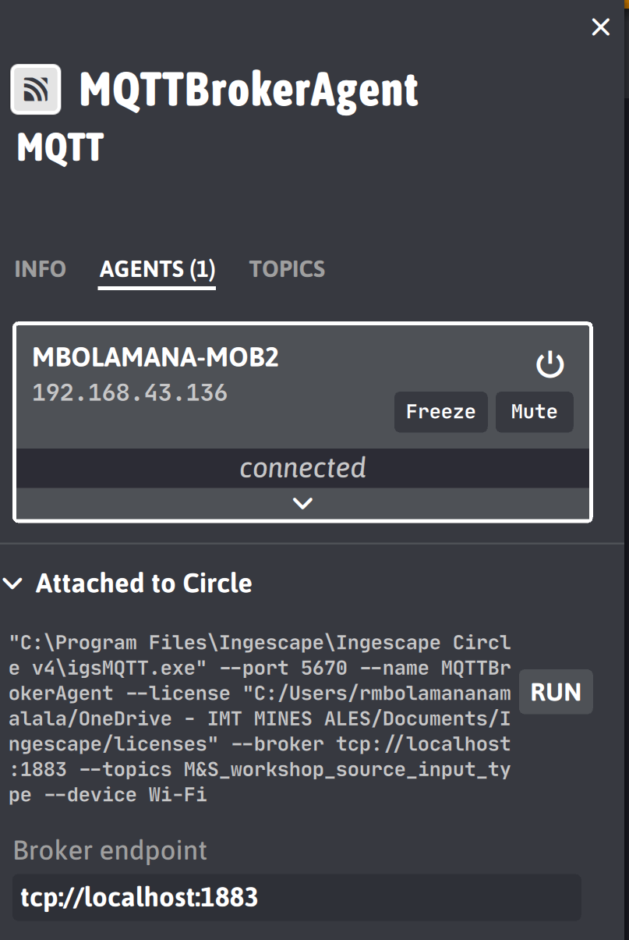
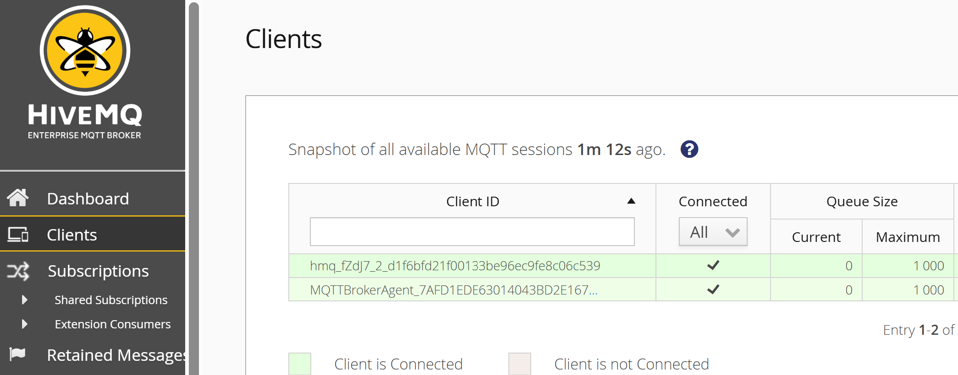
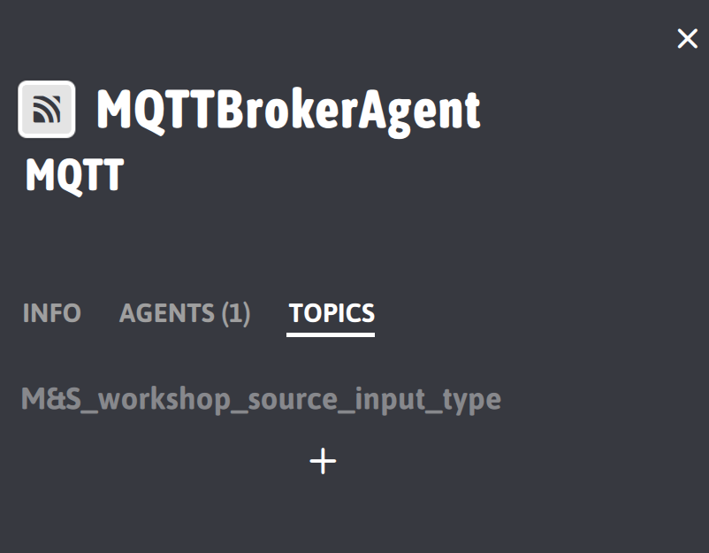

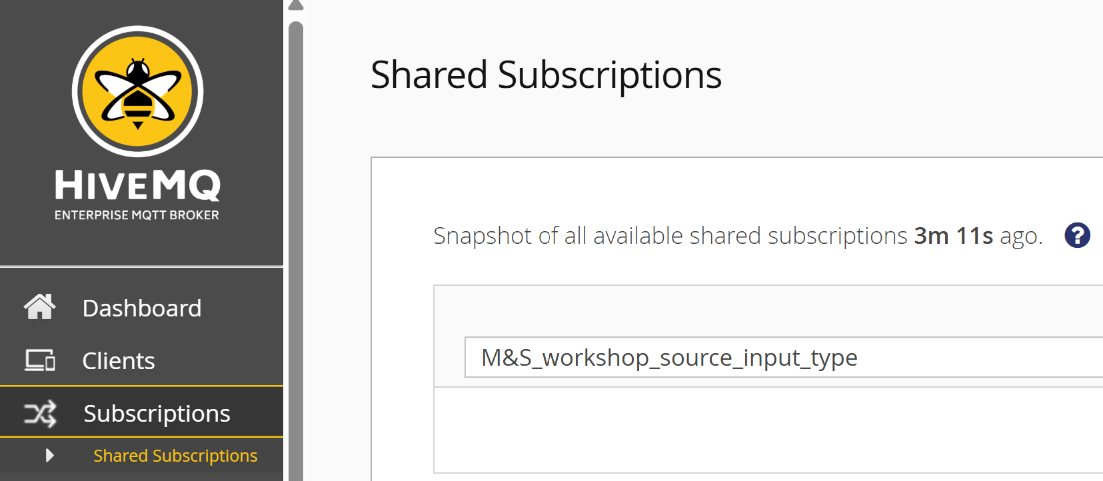
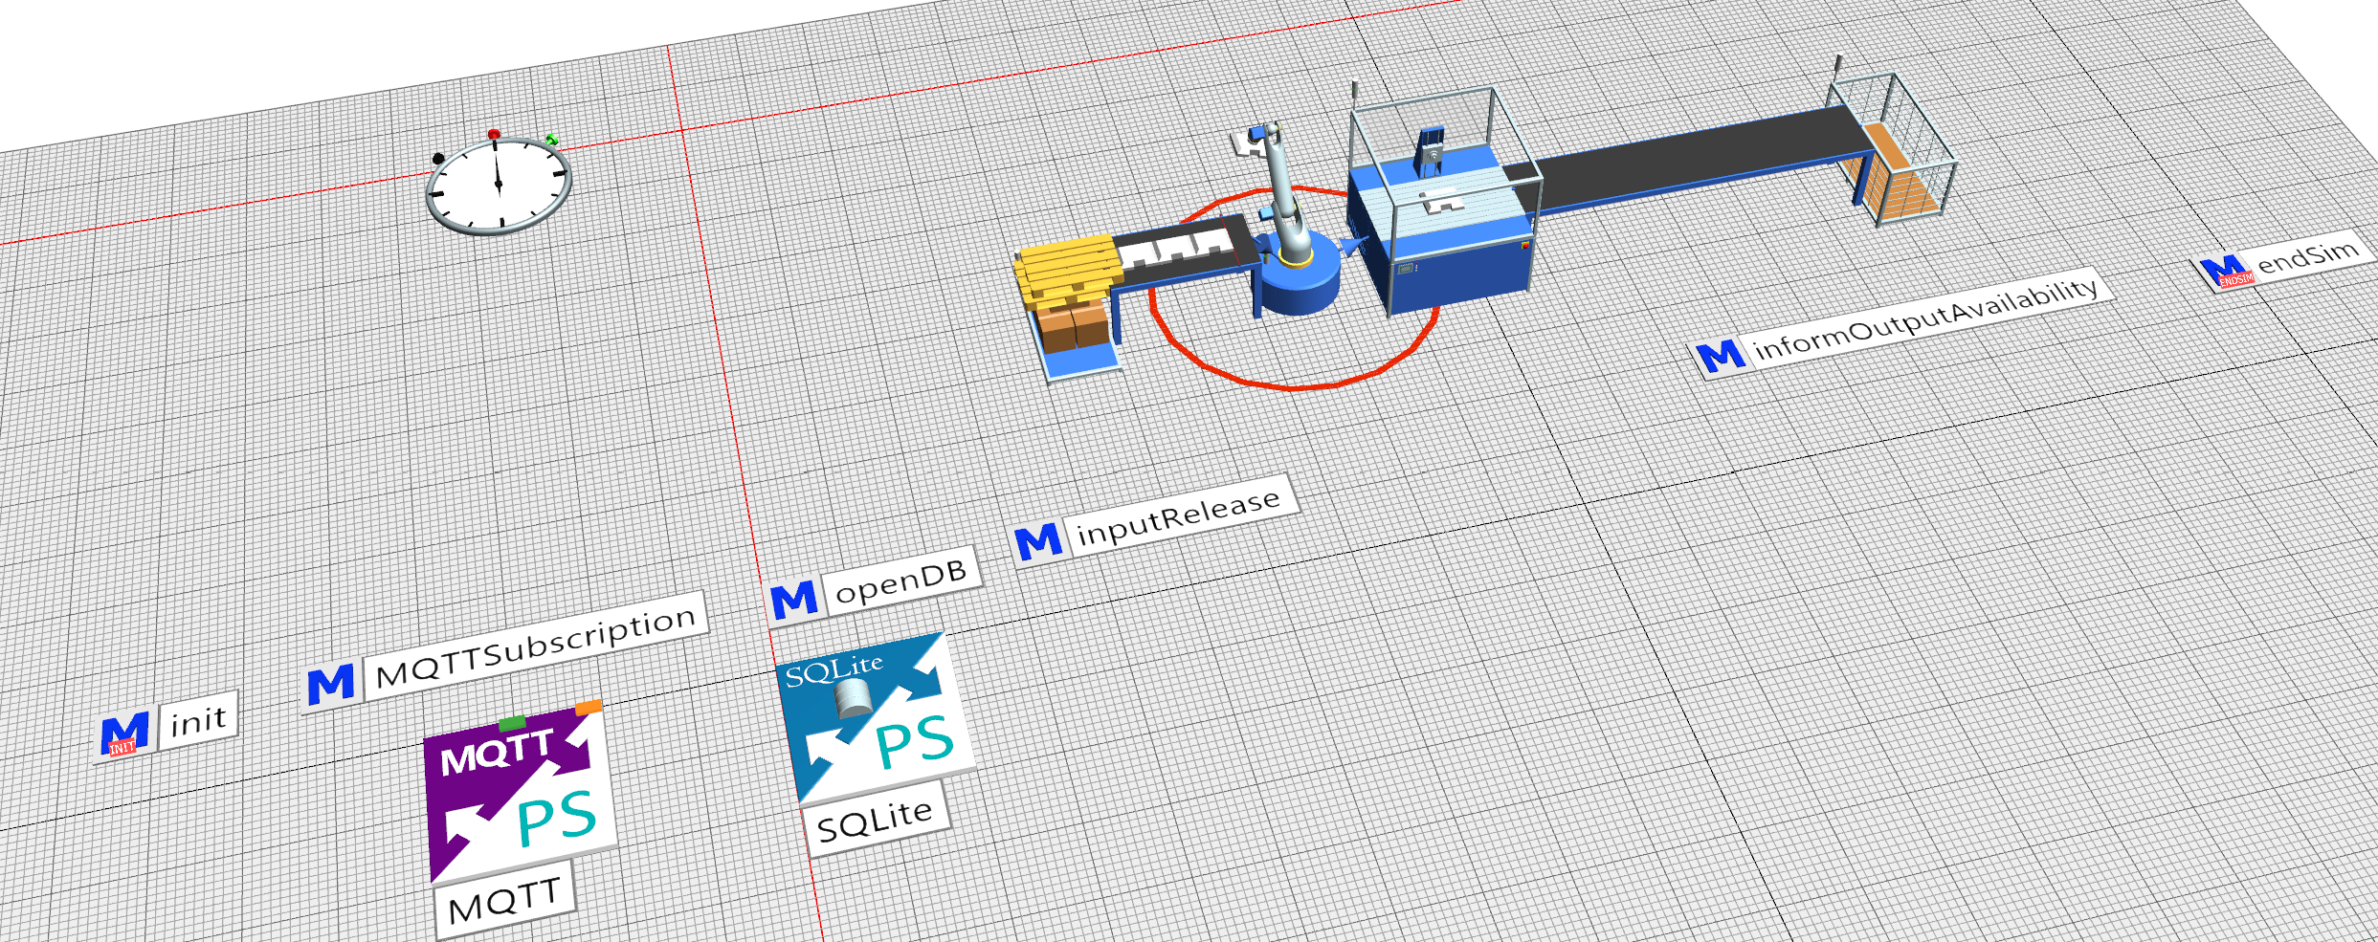
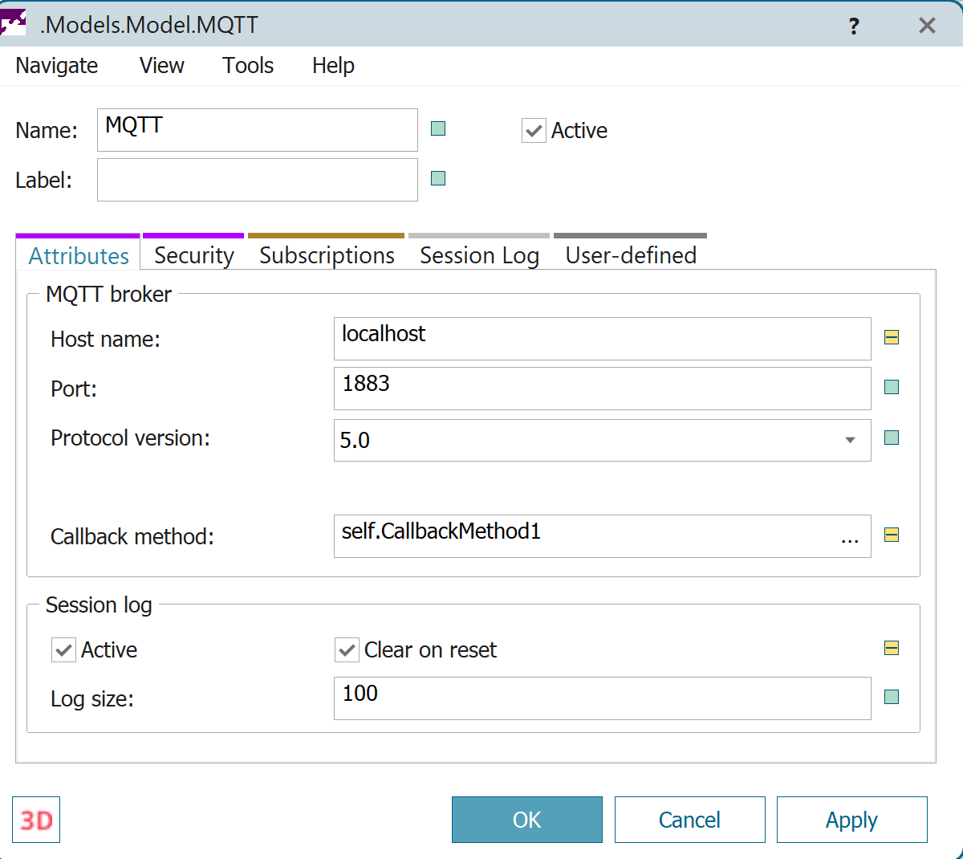

Encapsulates
Agent commanding the type of input
PlantSimulation M&S Client (SUBSCRIBER)
Ingescape Agent Client (SUBSCRIBER & PUBLISHER)
Topic of subscription of all the agents

