Slide 1
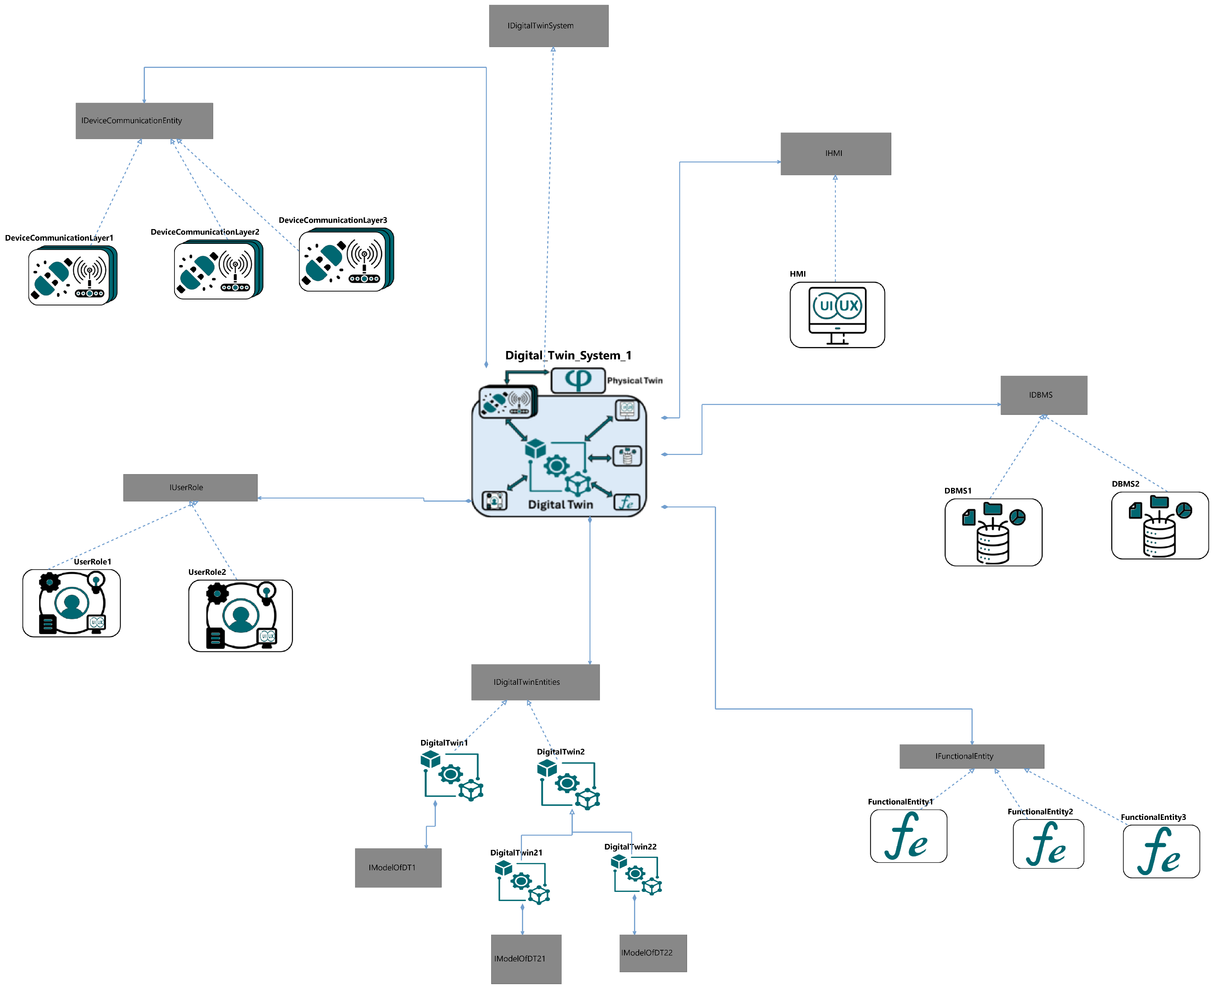
/currentHMI
/currentDeviceCommunicationLayer
/currentDBMS
X
/currentUserRole
X
X
/currentFE1
X
/currentFE2
/currentDTEntityOLD
X
/currentDTEntity
/currentDTEntityNEW

Slide 2
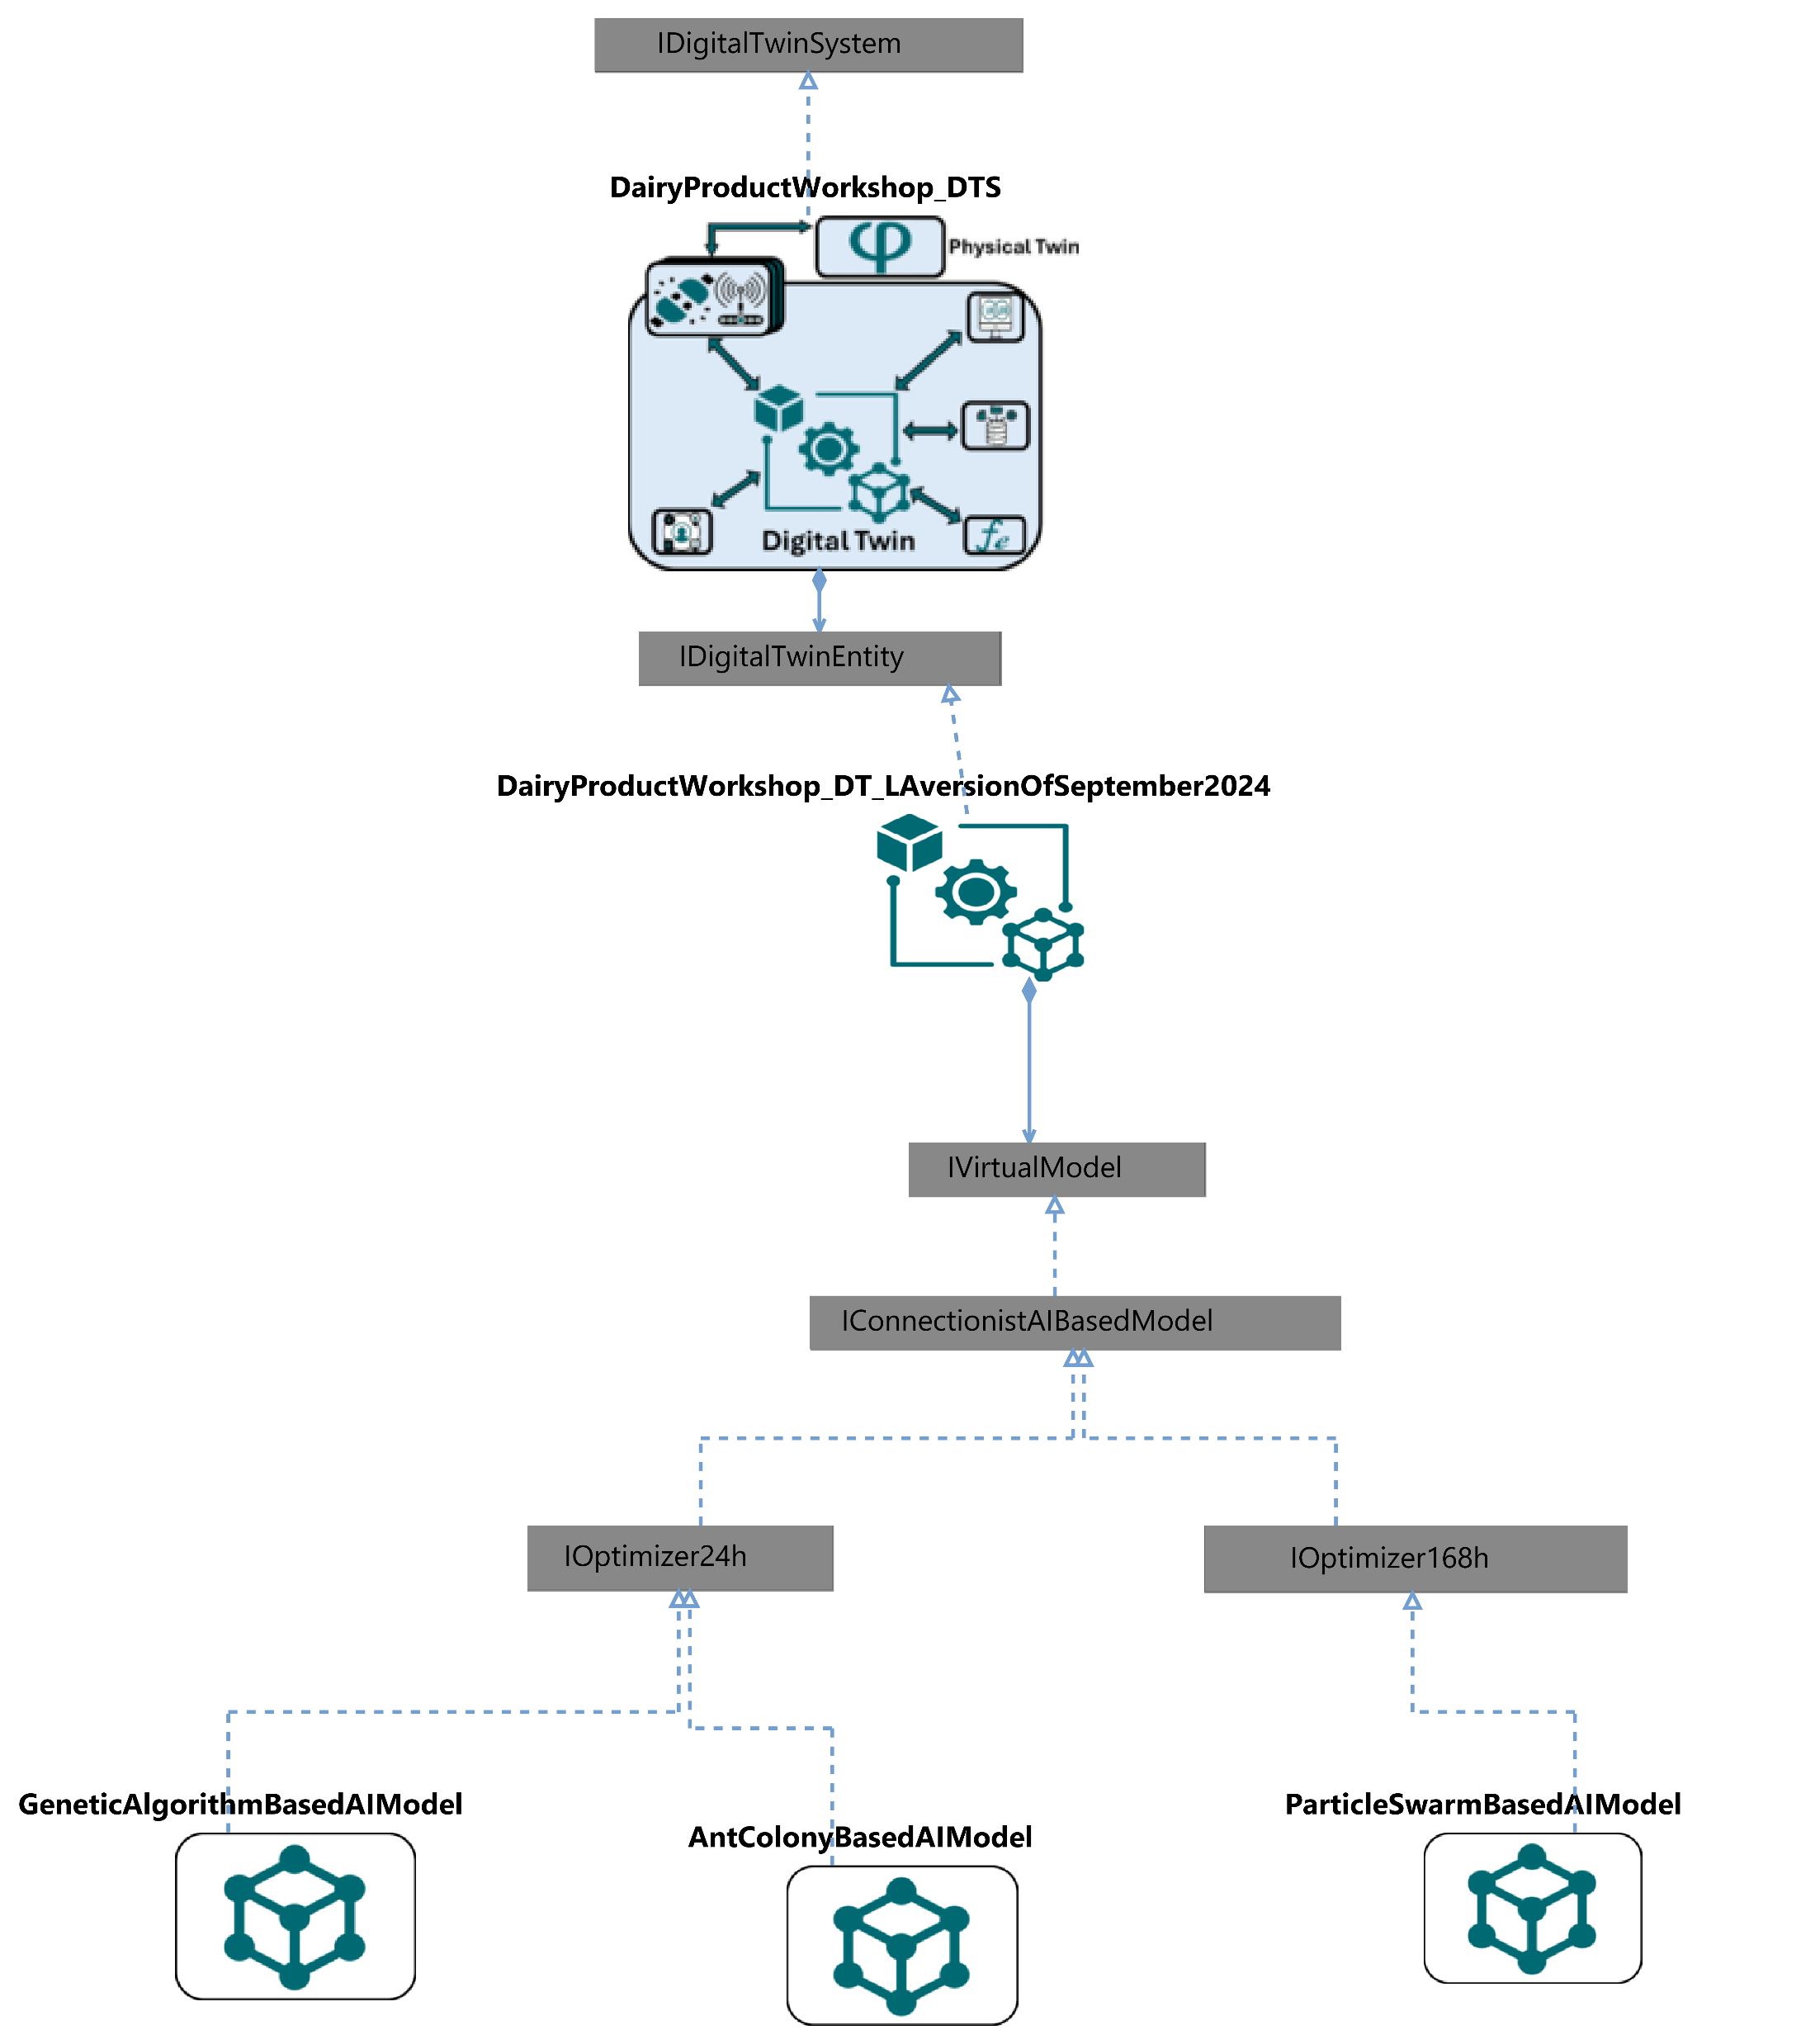
X
X
X
X
X
/currentPDPOptimizer (OLD)
X
X
/currentPDPOptimizer (NEW)
X
X

Slide 3
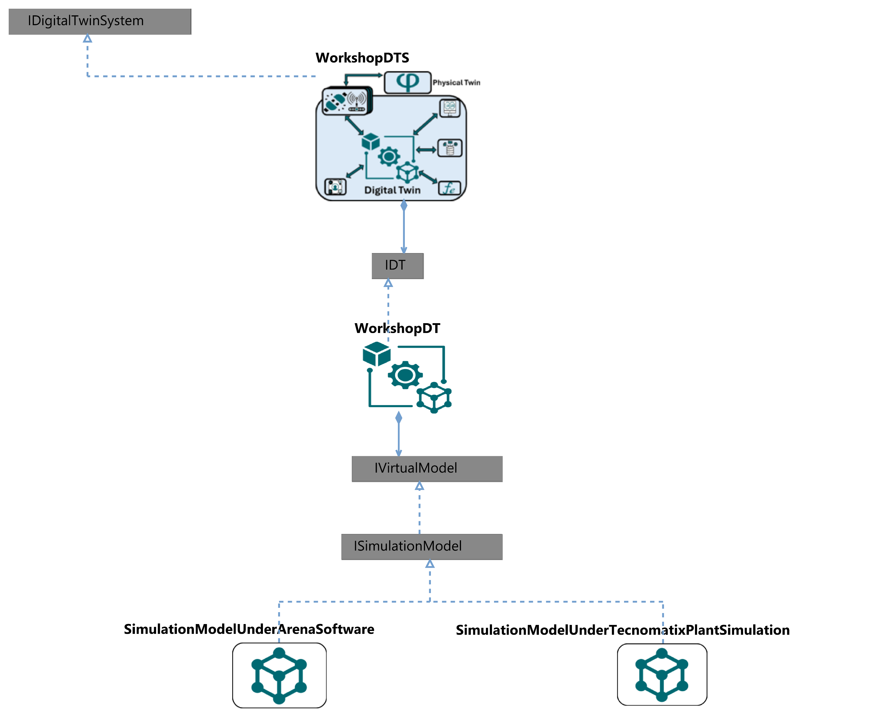
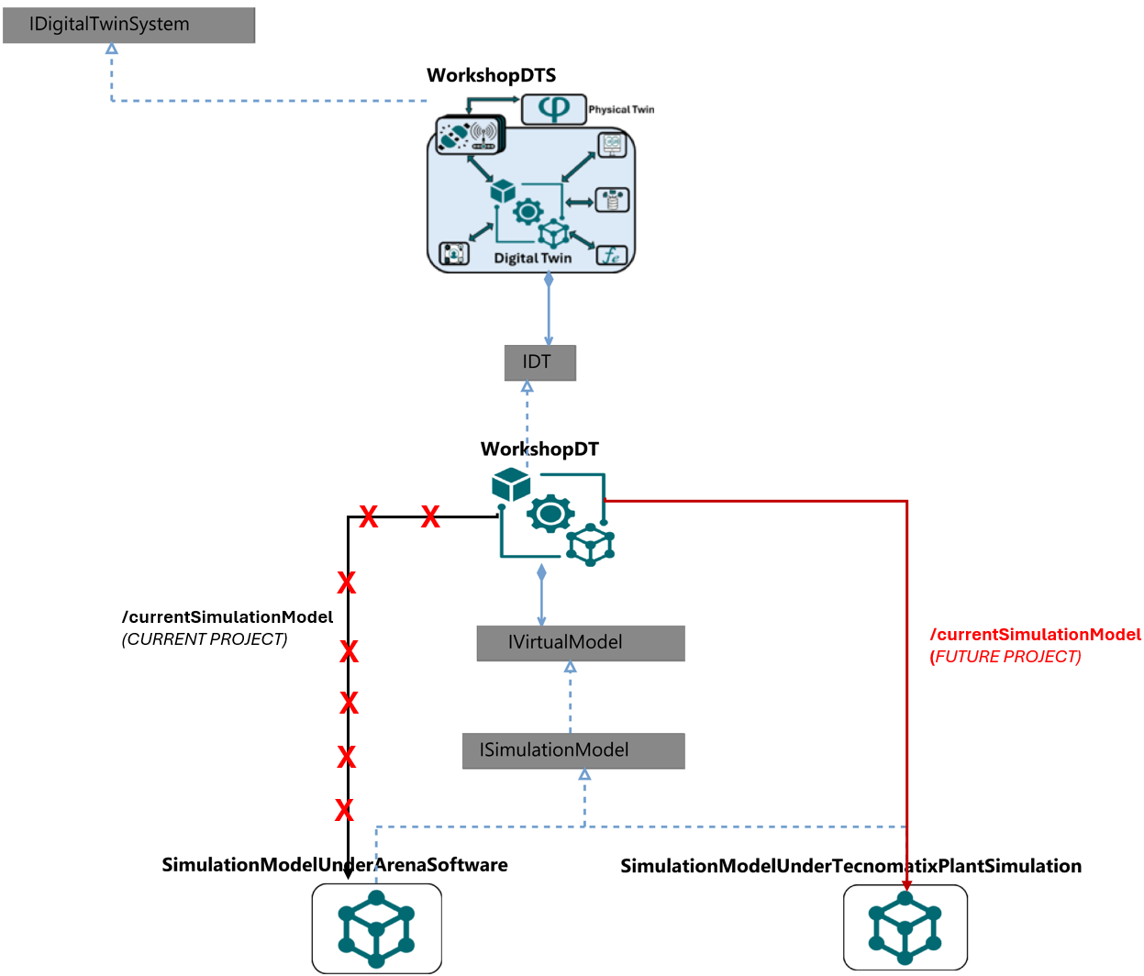
X
X
X
/currentSimulationModel (CURRENT PROJECT)
/currentSimulationModel (FUTURE PROJECT)
X
X
X
X

