Slide 1
Tribhuvan university institute of engineering
Lalitpur engineering college
PROJECT DEFENSE ON
“Network Intrusion detection System using ML”
Presenters :
Aastha Bhatt[LEC080BCT002]
Dharmendra Mandal[LEC080BCT012]
Kiran Thapa Magar[LEC080BCT017]
Rinesh Shakya[LEC080BCT026]

Slide 2
outlines
Introduction
Background
Problem Statement
Objectives
Significance
Literature Review
Requirement Analysis
System block diagram
Methodology
Result and Discussion
Limitation
Future Enhancement
References

Slide 3
introduction
NIDS are security solutions that, like antivirus software, firewalls, and access control schemes, are designed to make information and communication systems more secure.[1]
This proposed NIDS is used to detect anomaly in network such as cyberattack.

Slide 4
background
This project is motivated by a personal experience of a cyberattack in which sensitive personal information was compromised and multiple online accounts were affected.
This incident highlighted the increasing risks and real-world impact of cyber threats in today’s digital environment.
As a result, it inspired the selection of this project topic with the aim of understanding cyberattack mechanisms and developing effective machine learning-based tools for detecting and preventing such attacks in the future.

Slide 5
Problem statement
Traditional intrusion detection systems (IDS) use signature-based and anomaly-based detection methods to identify and alert on malicious network traffic. It struggles to effectively identify and classify diverse and evolving cyberattacks, especially when data is imbalanced with some attack types being significantly uncommon.
Methods of machine learning are utilised to find a solution to the problem of recognising new attacks or (zero-day attacks), which is a challenge that is confronted by technologically advanced businesses in today's world.

Slide 6
objectives
To design and develop a Machine Learning-based Network Intrusion Detection System capable of effectively identifying and classifying malicious network activities.
To classify different types of network attacks present in the CICIDS2017 dataset,including DoS, DDoS, PortScan, Brute Force, Web Attacks, Botnet, Infiltration,and Heartbleed attacks, and provide appropriate mitigation measures for the detected attacks

Slide 7
Significance
The scope of this project is to design and implement a Machine Learning-based Net-work Intrusion Detection System (NIDS) capable of analyzing network traffic data and identifying malicious activities using the CICIDS2017 dataset.
The system focuses on detecting and classifying various attacks, including DoS, DDoS, PortScan, BruteForce, Web Attacks, Botnet, Infiltration, and Heartbleed, using supervised machine learning algorithms.
It aims to improve intrusion detection performance and reduce false alarms through data preprocessing, class balancing, feature scaling, model training, and evaluation techniques.

Slide 8
Literature review
Summary of review in Tabular form
ref | Method used | Dataset | contribution | limitation
[2] | RandomForest+ ApacheSpark | NSL-KDD | Distributed ML based intrusion detection | Limited attack classification, high FN rate
[3] | Text-CNN+Random Forest | NSL-KDD | Hybrid deep learning + ML model | High computational complexity
[4] | Random Forest, Naive Bayes, SGD | NSL-KDD | Comparative ML performance analysis | Limited multi-class analysis
[5] | RF, NB, MLP, Bayes Network | KDD Cup99 | Impact of preprocessing techniques | Uses outdated dataset
[6] | RF, SVM, NB,LR | CICIDS2017 | Compared ML models with SMOTE | Limited model and dataset scope

Slide 9
Literature review
Ref | Method used | dataset | contribution | limitation
[7] | Multiple ML Algorithms | KDDCup99, NSL-KDD | Dataset comparison study | Focus only on datasets, not optimization
[8] | RNN | KDD-99,NSL-KDD | Applied deep learning to IDS | High computational cost
[9] | RF, XGBoost, KNN,SVM,NB | KDDCup99 | Evaluation of modern ML algorithms | Uses traditional datasets only
[10] | Deep Auto en-coder + Random Forest | NSL-KDD | Combined deep feature extraction with Random Forest for NIDS | increased model complexity and computational cost
[11] | Hybrid Machine Learning Methods | NSL-KDD | improved intrusion detection through a hybrid ML approach | Requires careful model configuration and additional computational resources

Slide 10
Requirement Analysis
Hardware Requirement:
  Laptop or desktop computer
  Intel Core i3 processor or equivalent
  4GBRAM(minimum)
  5GBfree storage space
  Network adapter (Wi-Fi or Ethernet)
  Keyboard and mouse/touchpad
  Internet connection
Software Requirement:
  Windows 10/11 or Linux operating system
  Python 3.x
  Jupyter Notebook or Visual Studio Code (VS Code)
  Pandas library for data preprocessing and analysis NumPylibrary for numerical computations
  Scikit-learn library for machine learning model development
  Matplotlib library for data visualization
  Seaborn library for statistical data visualization
  CIC-CIDS2017 for training and testing the intrusion detection model
  Git (optional) for version control and project management

Slide 11
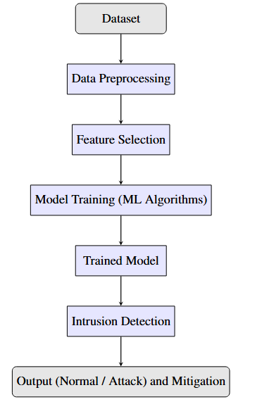
system block diagram
System architecture:

Slide 12
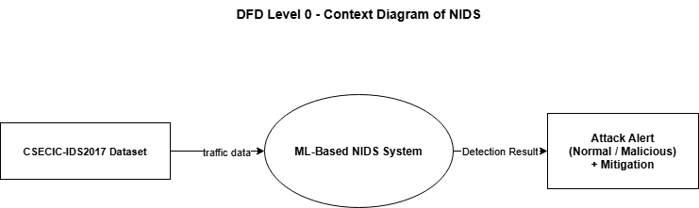
Dataflow diagram
Fig: DFD level 0

Slide 13
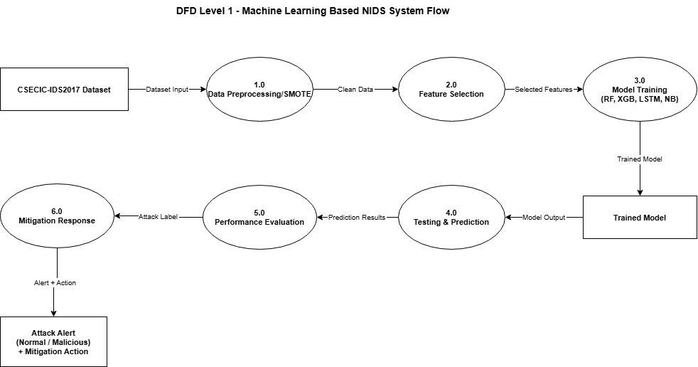
Data flow diagram
Fig : DFD level-1

Slide 14
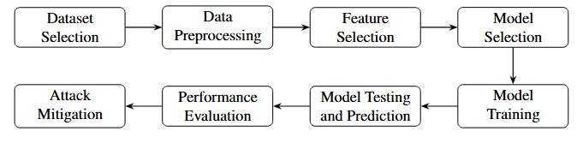
Methodology
Fig : overview of methodology

Slide 15


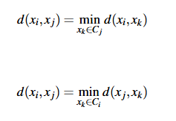
SMOTE
The CICIDS2017 dataset contains significant class imbalance, where some attack categories contain substantially fewer samples than the majority classes. This imbalance can cause machine learning models to favor the majority class and perform poorly on minority attacks.
SMOTETomek was applied to the training data. The SMOTE-Tomek technique consists of two main steps: SMOTE for generating synthetic minority-class samples and Tomek Links for removing overlapping samples
Generation equation:
Euclidean distance:
Tomek Links condition:

Slide 16
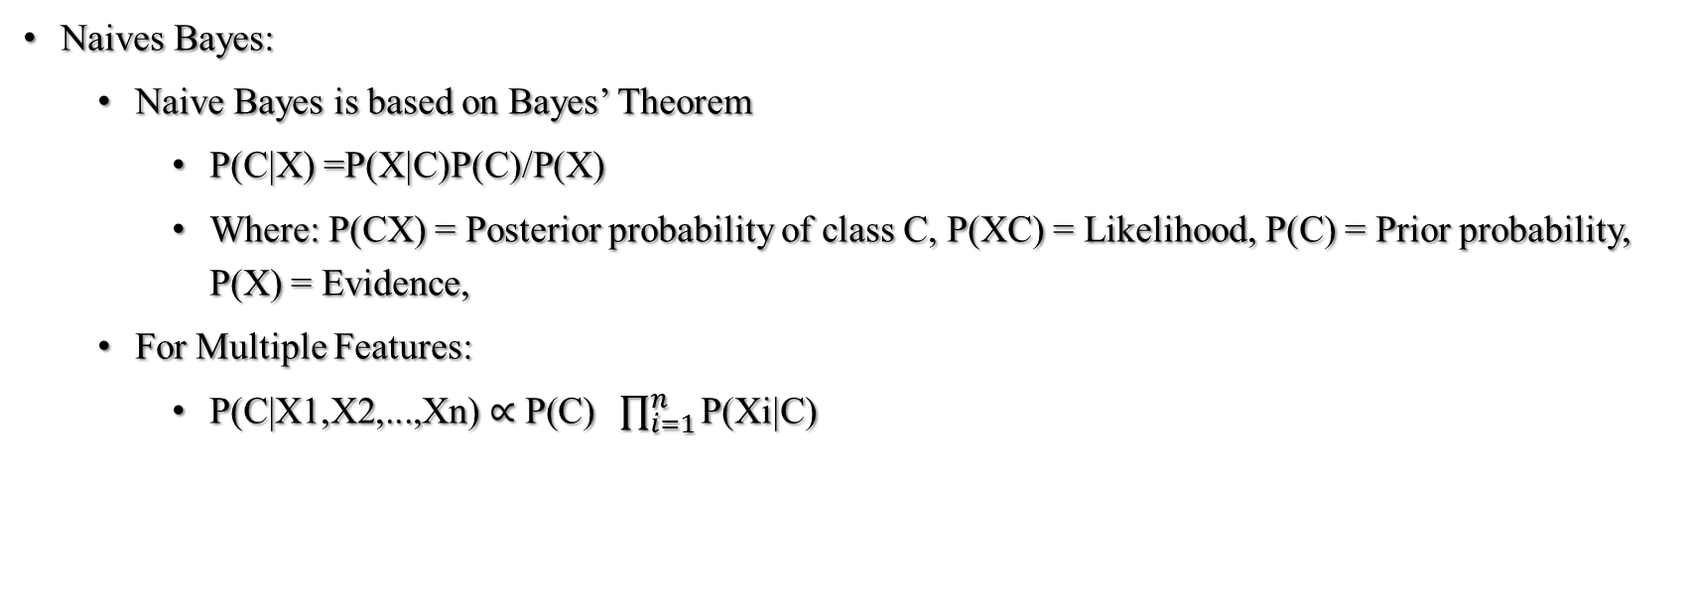
MODELs SELECTED
Naives Bayes:
  Naive Bayes is based on Bayes’ Theorem
    P(C|X) =P(X|C)P(C)/P(X)
    Where: P(CX) = Posterior probability of class C, P(XC) = Likelihood, P(C) = Prior probability, P(X) = Evidence,
  For Multiple Features:
    $\text{P}\text{(}\text{C}\text{|}\text{X}\text{1,}\text{X}\text{2,...,}\text{Xn}\text{) ∝ }\text{P}\text{(}\text{C}\text{) }\prod_{i=1}^{n}{\text{P}\text{(}\text{Xi}\text{|}\text{C}\text{)}}$

Slide 17
Random Forest
Random Forest is an ensemble learning method that constructs multiple decision trees during training.
Each tree independently predicts the class of a network traffic instance, and the final prediction is made using majority voting.
Random Forest combines predictions from multiple decision trees.
Prediction:
  Y′ =majorityvote(T1(X),T2(X),...,Tn(X))
  Where: Ti(X)=prediction from the i-th decision tree, n=number of trees

Slide 18

Random forest
Classification:
  $\hat{y}=argmax \sum_{i=1}^{n}{ I\left(Ti\left(x\right)=c\right)}$
Entropy:
  $Entropy\left(S\right)=− \sum_{i=1}^{c}{p_{i} \log_{2}\left(p_{i}\right)}$
Information Gain:
  $IG\left(S,A\right)=Entropy\left(S\right)− \sum_{v∈Values(A)}{\frac{\left|Sv\right|}{\left|S\right|}}Entropy\left(Sv\right)$

Slide 19
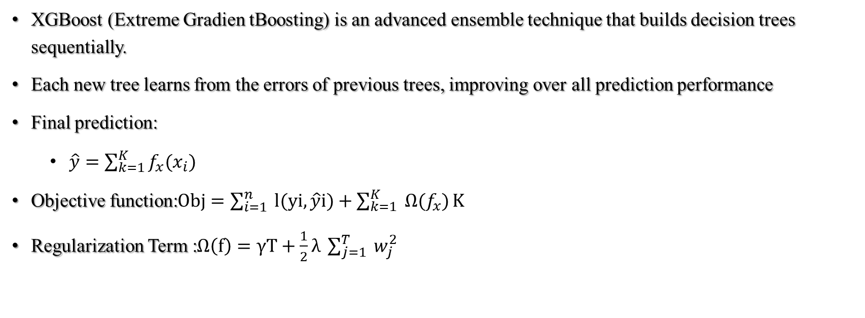
XGBoost
XGBoost (Extreme Gradien tBoosting) is an advanced ensemble technique that builds decision trees sequentially.
Each new tree learns from the errors of previous trees, improving over all prediction performance
  Final prediction:
    $\hat{y}=\sum_{k=1}^{K}{f_{x}(x_{i})}$
  Objective function:$Obj=\sum_{i=1}^{n}{ l(yi,\hat{y}i)}+\sum_{k=1}^{K}{ Ω(f_{x})}K$
  Regularization Term :$Ω\left(f\right)=γT+\frac{1}{2}λ \sum_{j=1}^{T}{ w_{j}^{2}}$

Slide 20
LSTM
LSTM (Long Short-Term Memory) is a type of Recurrent Neural Network (RNN)specifically designed to learn long-term temporal dependencies in sequential data. In the context of Network Intrusion Detection Systems (NIDS), network traffic flows exhibit temporal patterns that LSTM can effectively learn and classify. LSTM addresses the vanishing gradient problem in standard RNNs by introducing a cell state and three gating mechanisms: the forget gate, input gate, and output gate.
Forget Gate : ft = σ(Wf · [ht−1, xt ] + b f)
Input Gate: it = σ (Wi · [ht−1, xt ] + bi)
Candidate Cell :˜Ct = tanh (WC · [ht−1, xt ] + bC)
Cell State Update: Ct = ft ⊙Ct−1 + it ⊙ ˜Ct
Output Gate: ot = σ (Wo · [ht−1, xt ] + bo)
Hidden State Output: ht = ot ⊙ tanh(Ct )
Final Classification (Softmax):

Slide 21
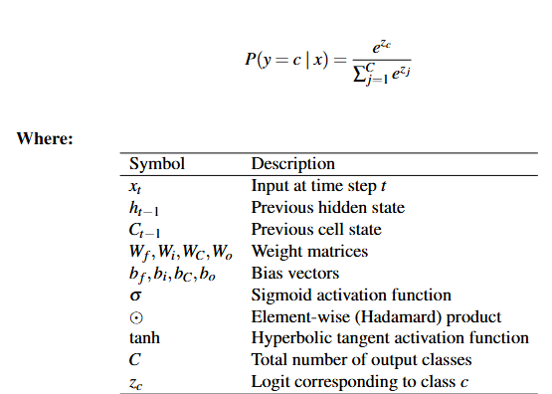
LSTM

Slide 22
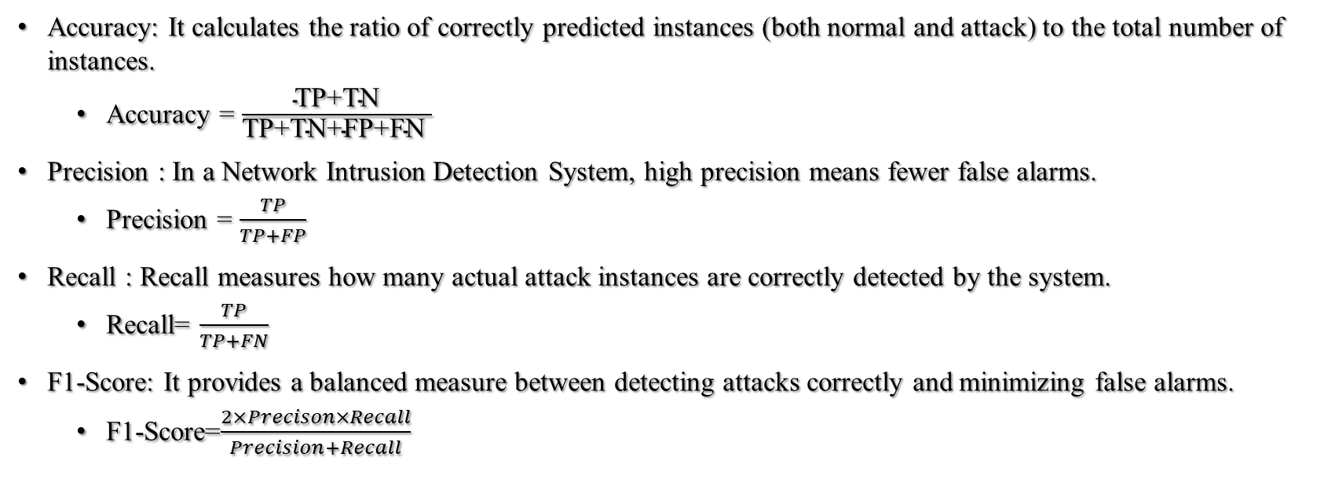
Performance parameter
Accuracy: It calculates the ratio of correctly predicted instances (both normal and attack) to the total number of instances.
  Accuracy = $\frac{\text{TP}\text{+}\text{TN}}{\text{TP}\text{+}\text{TN}\text{+}\text{FP}\text{+}\text{FN} }$
Precision : In a Network Intrusion Detection System, high precision means fewer false alarms.
  Precision = $\frac{TP}{TP+FP}$
Recall : Recall measures how many actual attack instances are correctly detected by the system.
  Recall= $\frac{TP}{TP+FN}$
F1-Score: It provides a balanced measure between detecting attacks correctly and minimizing false alarms.
  F1-Score=$\frac{2×Precison×Recall}{Precision+Recall}$

Slide 23
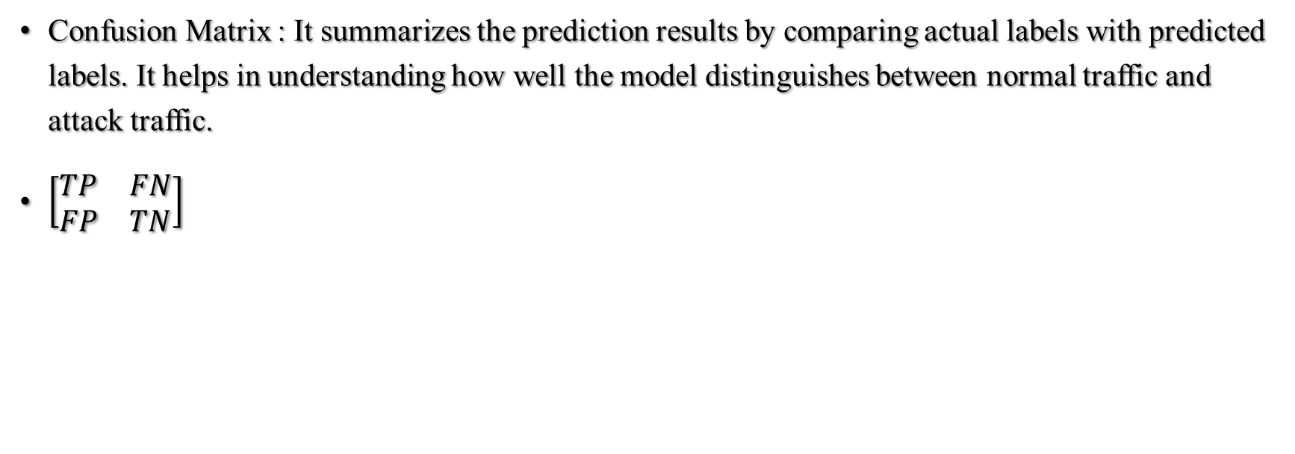
Performance parameter
Confusion Matrix : It summarizes the prediction results by comparing actual labels with predicted labels. It helps in understanding how well the model distinguishes between normal traffic and attack traffic.
$\left[\begin{matrix}TP & FN \\ FP & TN\end{matrix}\right]$

Slide 24
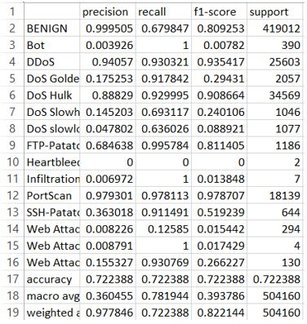
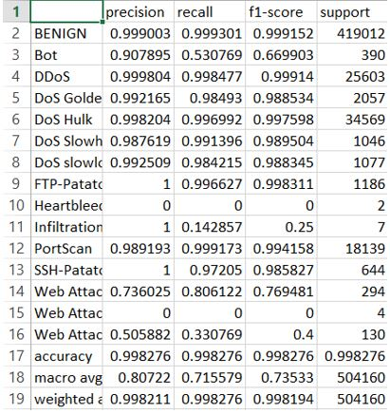
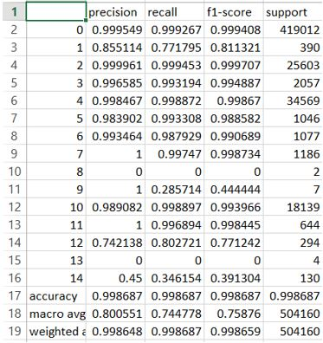
RESULT AND DISCUSSION
The proposed Machine Learning-based Network Intrusion Detection System effectively detected and classified network intrusions using the CIC-CIDS2017 dataset.
Naives Bayes
Random Forest
XGBoost
Model Classification Report before SmoteTomek

Slide 25
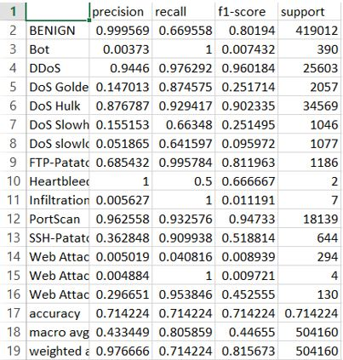
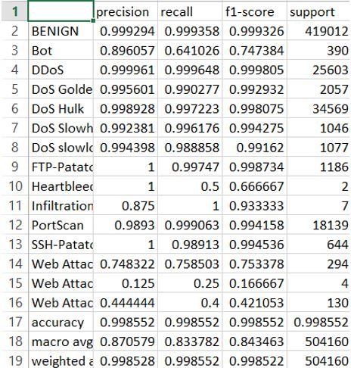
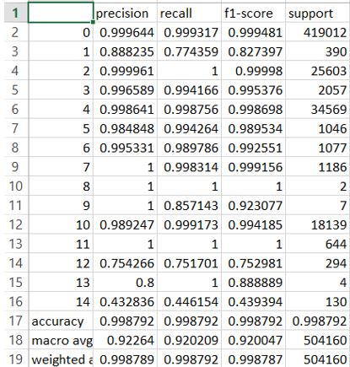
RESULT AND DISCUSSION
Naives Bayes
Random Forest
XGBoost
Model Classification after SMOTETOMEK

Slide 26
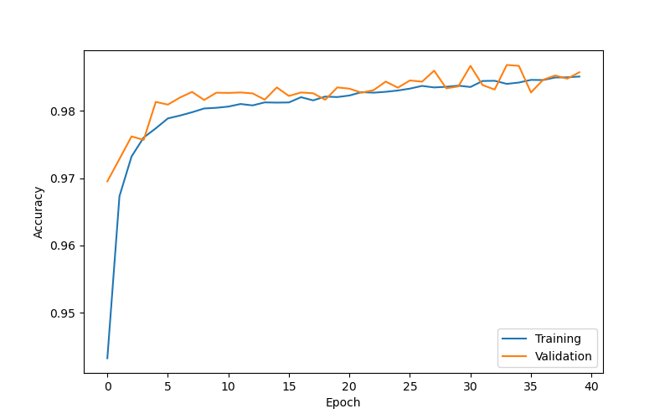
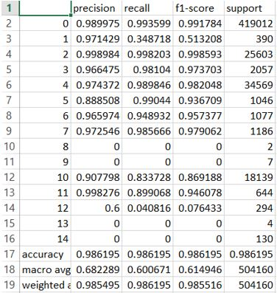
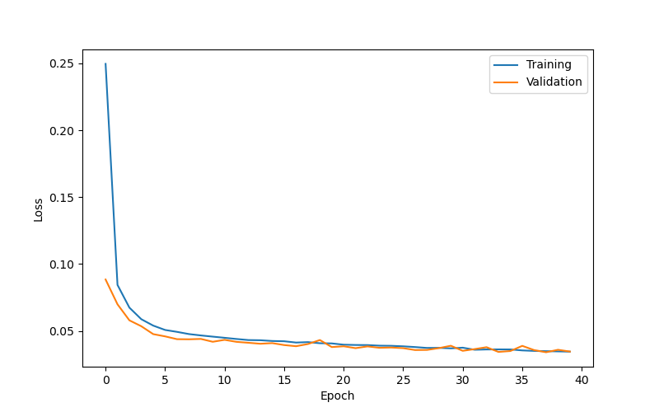
RESULT AND DISCUSSION
LSTM Classification Report

Slide 27
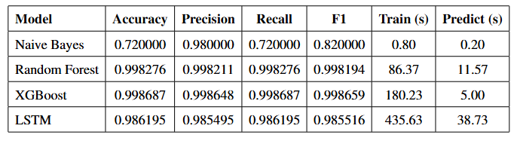
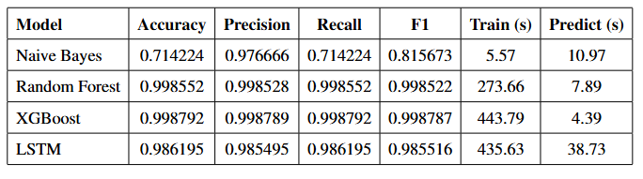
MODEL COMPARISION
Before Smote
After Smote

Slide 28
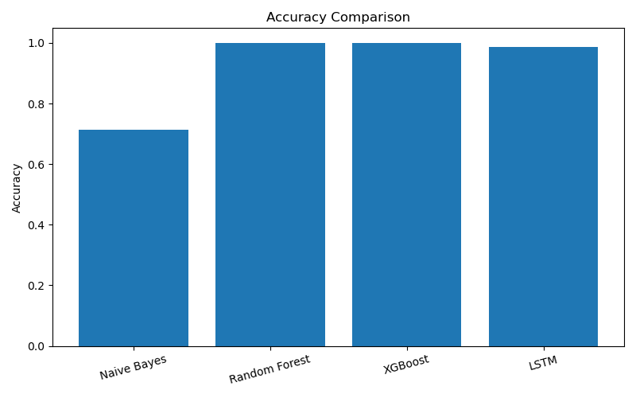
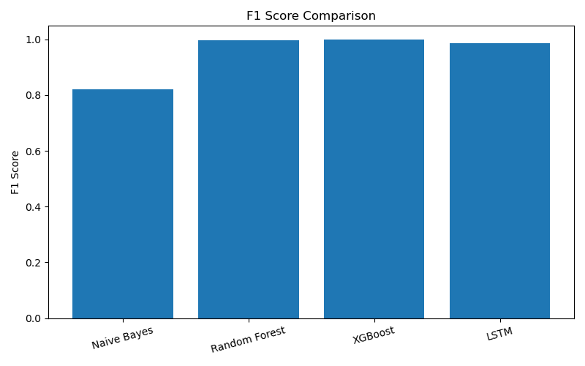
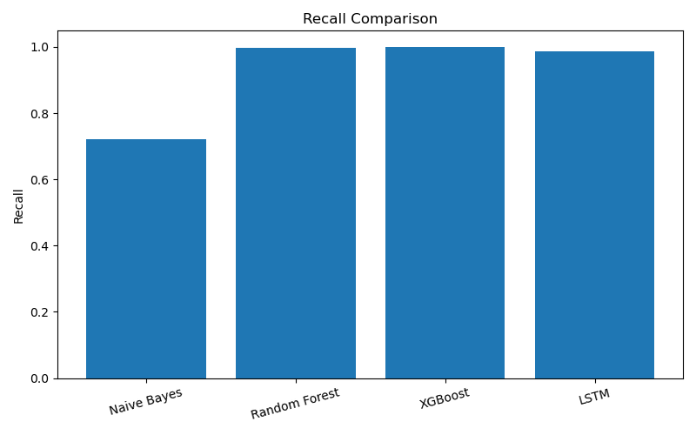
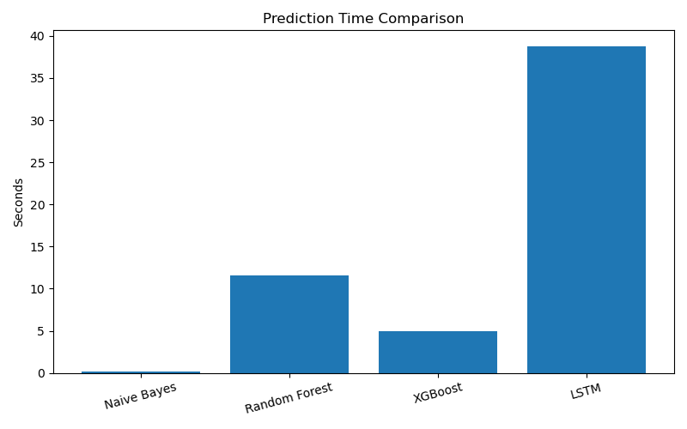
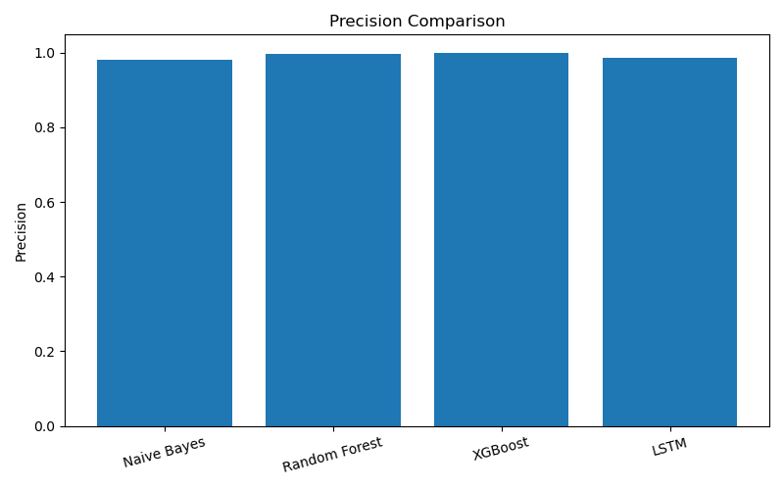
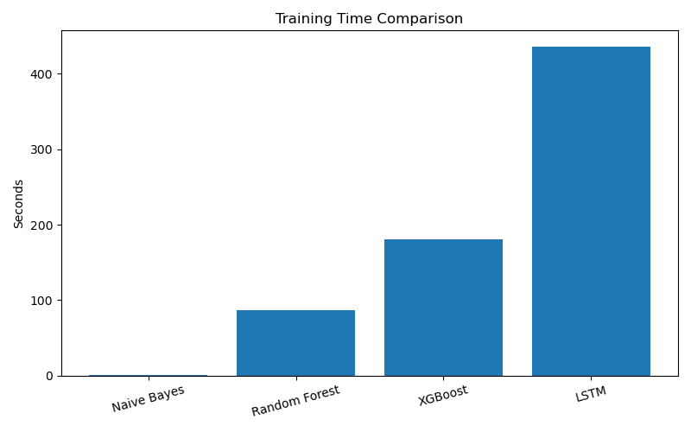
BAR GRAPHS before smote

Slide 29


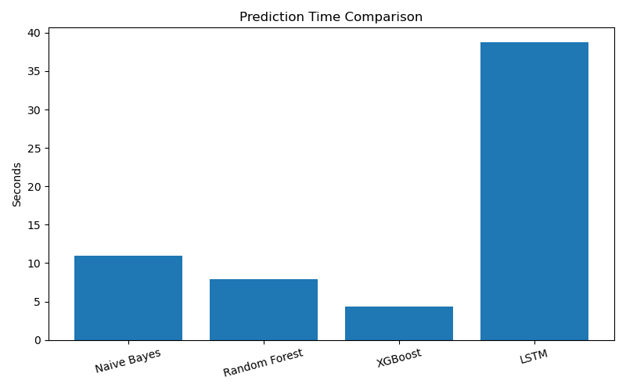
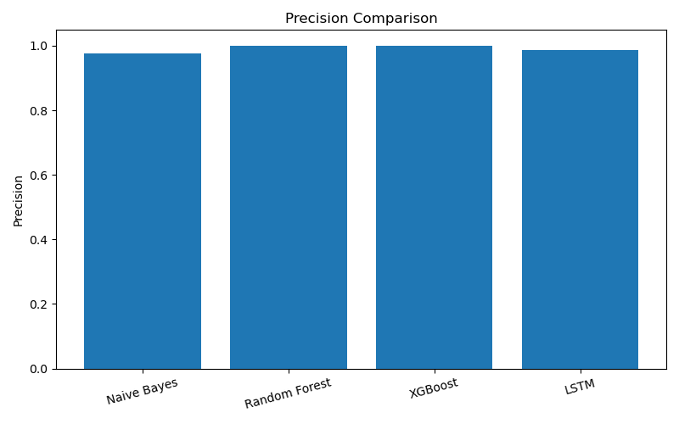
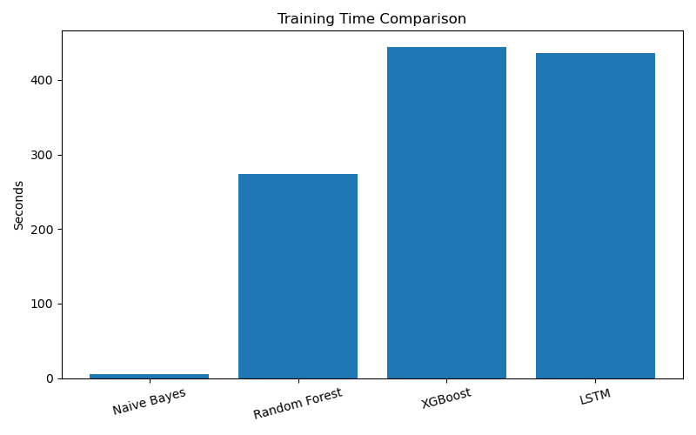
Bar graphs after smote

Slide 30
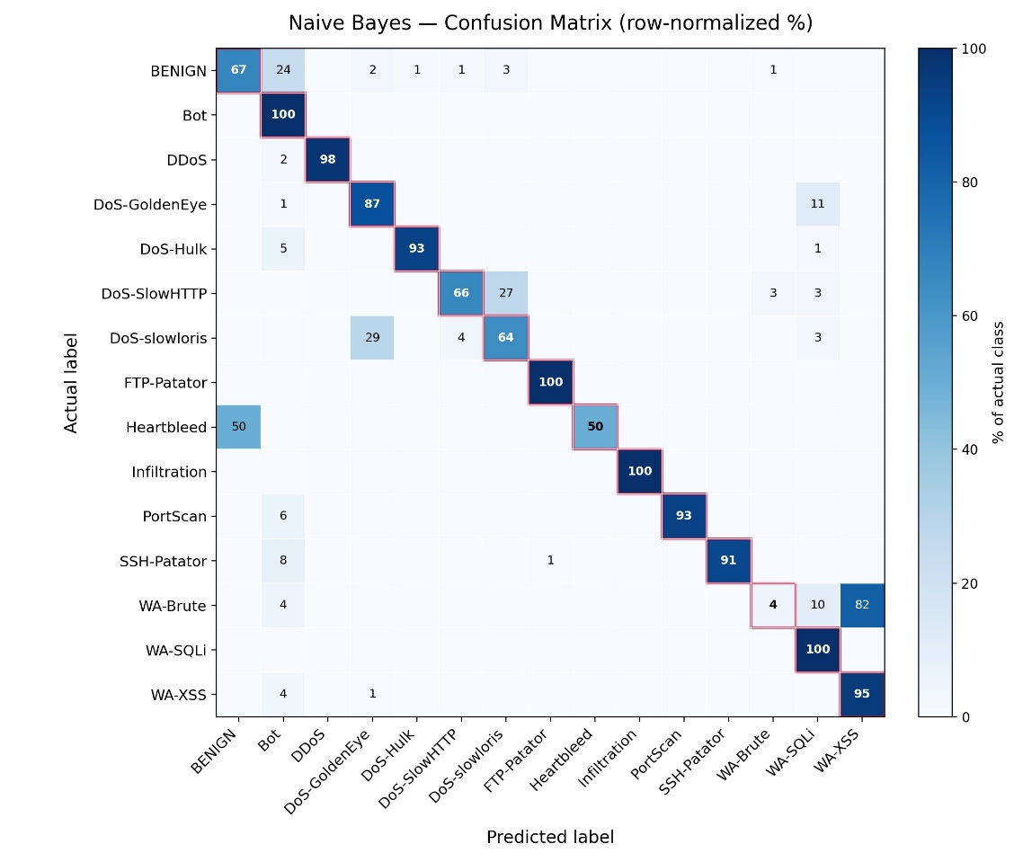
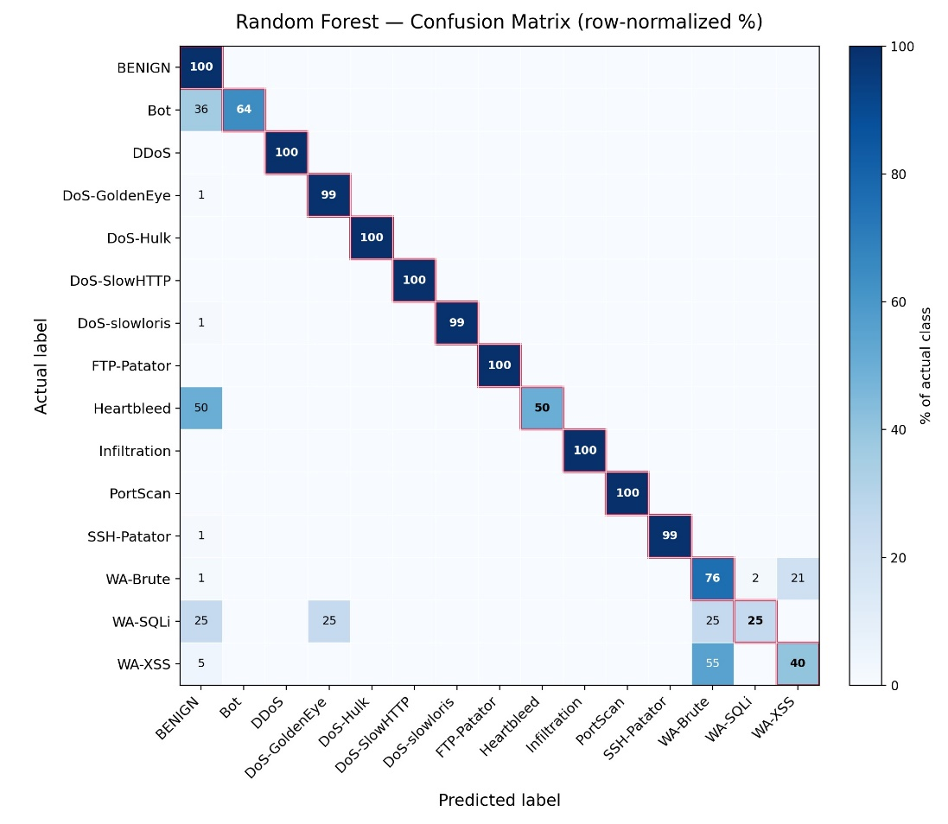
CONFUSION MATRIX
Naives Bayes
Random Forest

Slide 31
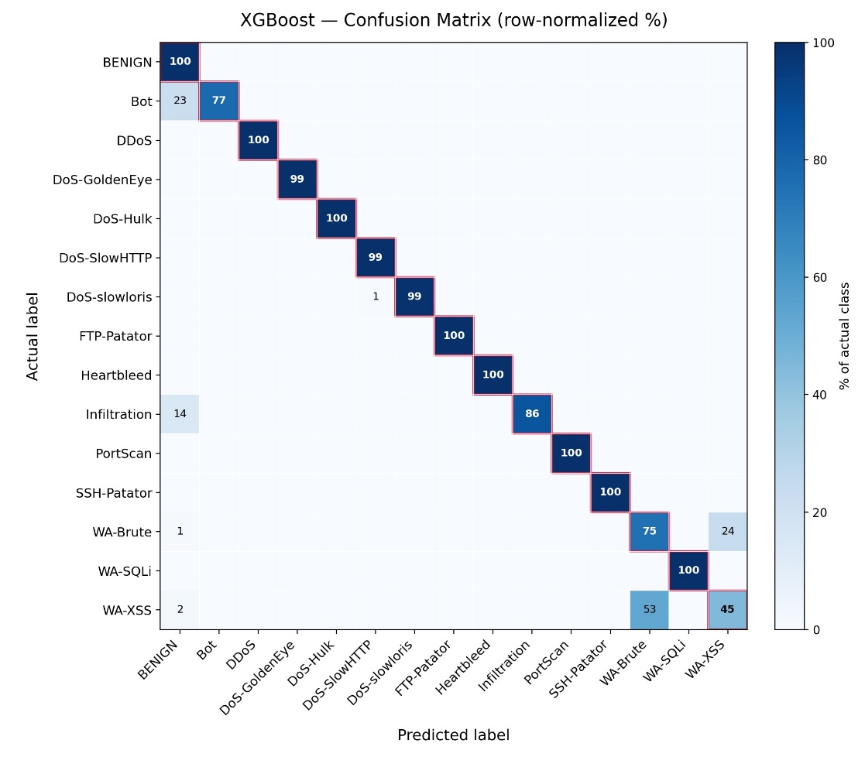
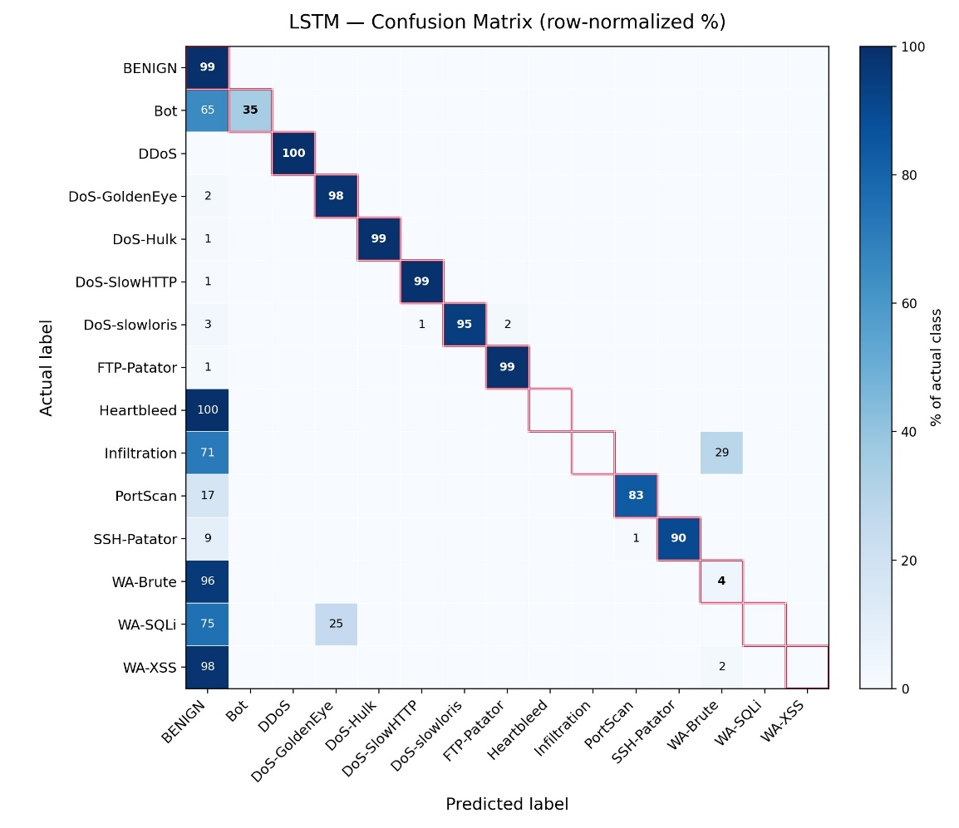
CONFUSION MATRIX
XGBoost
LSTM

Slide 32
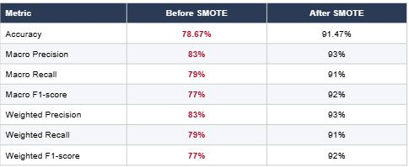
Minority attack DETECTION

Slide 33
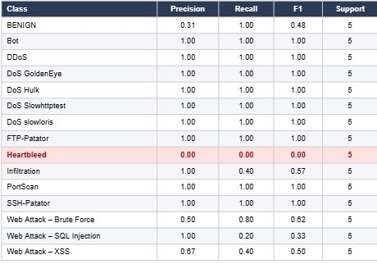
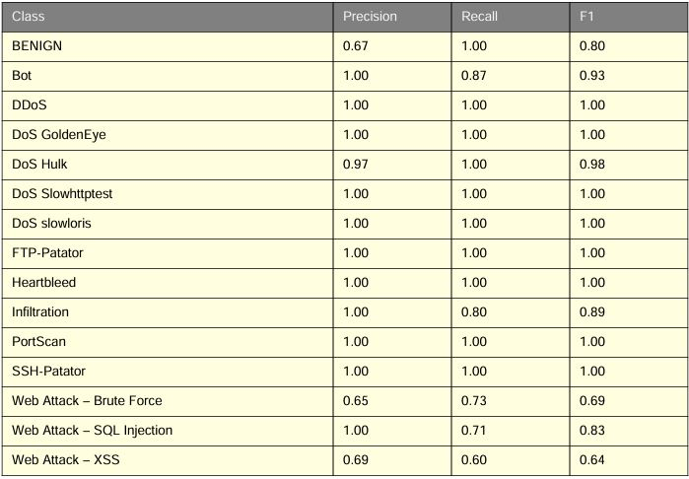
Minority attack detection

Slide 34
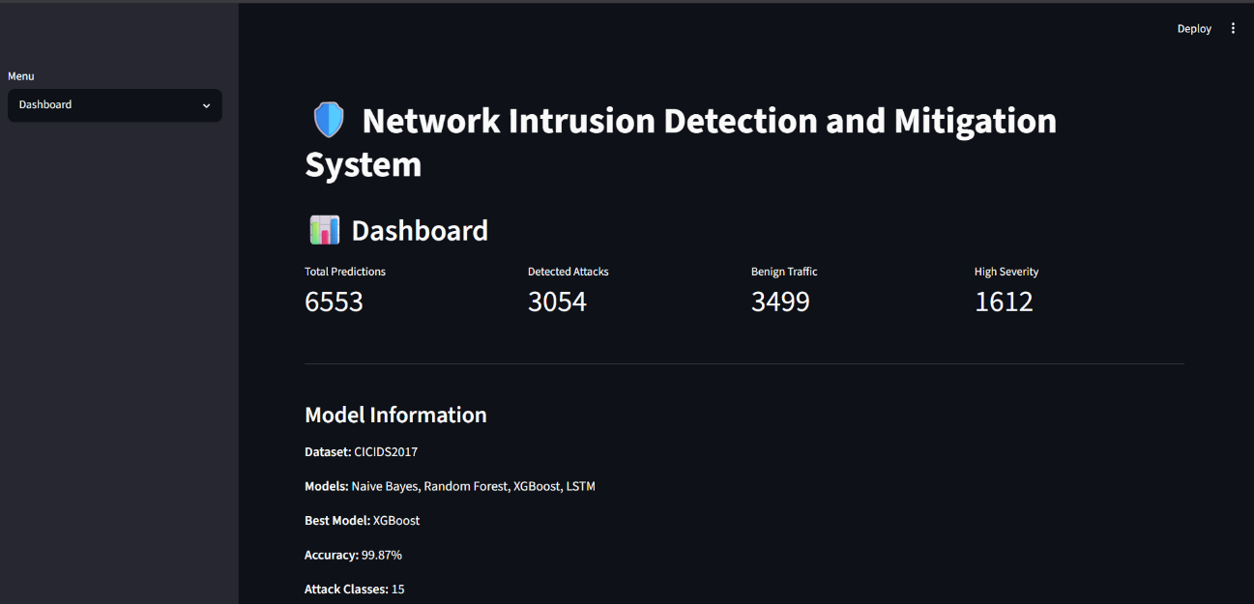
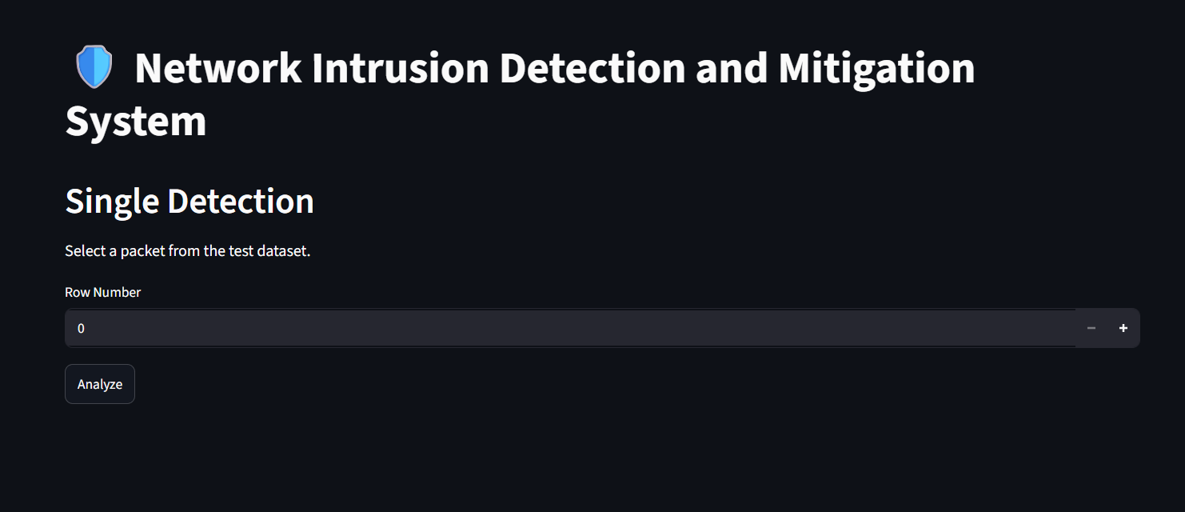
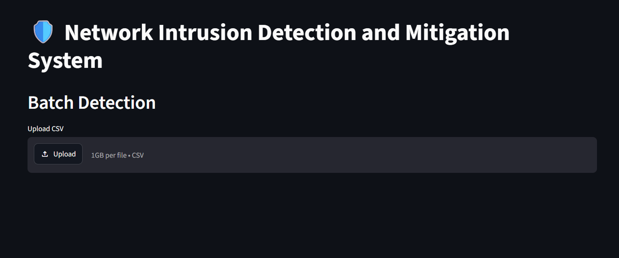
SYSTEM UI

Slide 35
limitation
Dataset Dependency
Limited Real-Time Testing
Detection of Unknown Attacks
Class Imbalance
Mitigation Limitation
Computational Requirements

Slide 36
FUTURE ENHANCEMENT
Independent Dataset Evaluation
Improved Minority Attack Detection
Real-Time Deployment
Online Learning
Advanced Deep Learning Models
Enhanced Attack Mitigation
Explainable AI
Continuous Performance Monitoring

Slide 37
References
[1] Almutairi,Y. S, Bader A., Amr, A. M.(2022). Network Intrusion Detection Using Machine Learning Techniques. Advances in Science and Technology Research Journal 2022 , 16(3), 193–206.
[2] Ravipati and Abualkibash (2019) evaluated several ML algorithms on KDD- 99 and NSL-KDD datasets. Random Forest achieved better accuracy, but the study lackedreal-time implementation considerations.
[3] Min et al. (2018) developed a hybrid IDS using Text-CNN for feature extraction and Random Forest for classification. The model improved detection performance but re-quired high computational resources, making it less suitable for lightweight systems.
[4] Maniriho and Ahmad (2018) compared multiple machine learning models including Random Forest and Naive Bayes for intrusion detection. Results showed that ensemblemethods generally perform better, but attack-type classification was limited.

Slide 38
References
[5] Obeidat et al. (2018) emphasized data preprocessing techniques such as normalization and feature selection to improve IDS performance. However, the study used the older KDD Cup 99 dataset, which reduces real-world applicability.
[6] Al-Yaseen et al. (2023) compared several machine learning algorithms for network in-trusion detection using the CICIDS2017 dataset. The study evaluated models including Random Forest, Support Vector Machine, Naive Bayes, and Logistic Regression, andapplied SMOTE to address class imbalance. The results showed that ensemble-based methods achieved strong detection performance, demonstrating the importance of data balancing and model selection in intrusion detection.
[7] Sapre et al. (2019) compared KDDCup99 and NSL-KDD datasets for IDS evaluation. They concluded that NSL-KDD is more balanced and suitable for machine learning-based intrusion detection.
[8] Yin et al. (2017) proposed a deep learning approach for intrusion detection using Recur-rent Neural Networks (RNN). The model was evaluated on network intrusion datasets5and demonstrated that deep learning could effectively learn patterns from network traf-fic for attack classification. However, the computational requirements of deep learning models can make them less suitable for resource-constrained environments.

Slide 39
REFERENCEs
[9] Tripathy and Behera (2023) evaluated multiple ML models including Random Forest, XGBoost, and Naive Bayes. Ensemble methods showed superior performance, but thestudy used traditional datasets
[10] Shone et al. (2018) proposed a deep learning-based network intrusion detection system that combined non-symmetric deep auto encoders with a Random Forest classifier. The approach achieved improved detection performance compared with several traditional machine learning methods. However, the additional complexity of deep learning-based feature extraction can increase computational requirements .
[11] C¸ avus¸o˘glu (2019) developed a hybrid intrusion detection approach using multiple ma-chine learning methods and evaluated its performance for detecting network attacks. The study demonstrated that combining different learning techniques can improve intrusion detection performance. However, hybrid approaches may require additional computational resources and careful model configuration .

Slide 40
Thank you

Slide 41
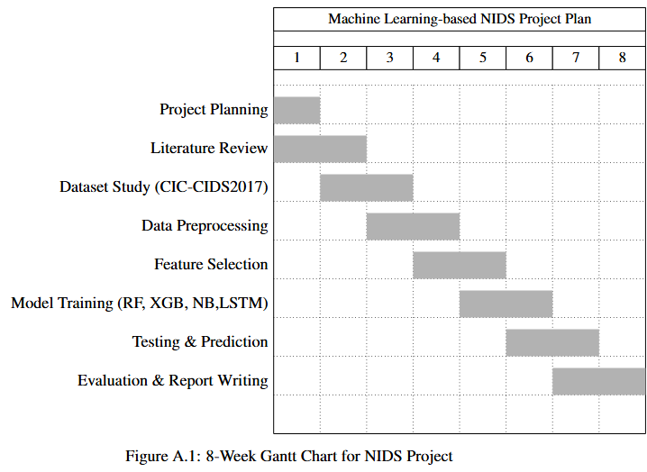
APPENDIX

