Slide 1

INTRODUCTION TO PYTHON
SUMMER 2022

Slide 2
What is Computer Science?
Science of problem solving
Discipline that spans theory and practice
Requires abstract and concrete thinking
A computer scientist…
Must be able to model and analyze problems
Designs solutions
Verifies that solutions are correct

Slide 3
What is programming?
Three-step process:
1) Think of a solution
2) Translate it into a sequence of instructions (coding)
3) Check that the solution is correct (testing) and fix any problems (debugging)
Challenge: breaking down large problems into smaller and simpler tasks

Slide 4
What are algorithms?
Sequence of logical steps that specify how to solve a problem
Computer science is the science of algorithms!
Examples:
Cooking recipes
Moves to solve a Rubik’s cube
List of instructions to install your favourite video game

Slide 5
What is Python?
Python is a popular programming language
Allows you to “speak” to the computer
The logical sequence is:
English → Python → Machine language
Middle-man between us and the computer’s internal language
There exist many different programming languages, each with their own set of strengths and weaknesses (e.g. Java, JavaScript, C++, C#, …)
Python is popular in the scientific community for being beginner-friendy and providing visual tools for creating diagrams and graphs

Slide 6
Let’s install Python!
Click on the following link to download Python to your computer:
https://www.python.org/downloads/
You should see a big box that says “Download the latest version for Windows”
Click on Download Python 3.10.5

Slide 7
Integrated Development Environment (IDE)
Now that Python is installed, we need an environment to write and execute Python code in → IDE
An IDE is just an application (like Word, PowerPoint, etc)
Allows you to write, test, debug, and run your Python code

Slide 8
Jupyter Notebook
We will install a popular IDE called Jupyter Notebook with the following steps:
1) Open the Windows Command Promp
a) Click on the Windows Start menu
b) Type in “command prompt”
c) Click on the first option
2) Copy-and-paste the following command to install:
pip install notebook
3) Launch Jupyter Notebook by copy-and-pasting the following command:
jupyter notebook

Slide 9
Git
Git is a popular tool that allows easy and organized version control
Allows you to keep track of changes made to your code and collaborate with other programmers
Allows you to easily revert changes and avoid costly mistakes
Overall an absolutely indispensable programming tool

Slide 10
Installing Git
We will install git to our computers using the following steps:
1) Click on the following link:
https://git-scm.com/download/win
2) Download the latest version of git
You should see a link that says “Click here to download the latest 64-bit version of Git for Windows
Click to start download
3) Once download is finished, click on the .exe file to begin installation

Slide 11
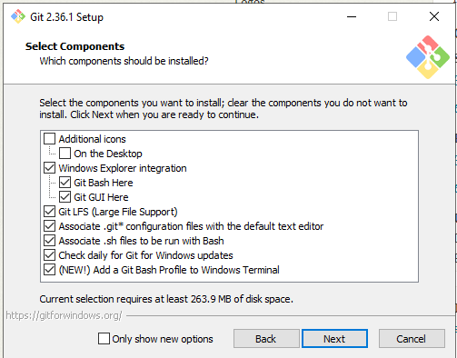
Installing Git (cont.)
Make sure the following options are enabled:
Otherwise, just keep clicking on “next”
When you reach the end, click on “install”
This will install with the default configuration

Slide 12
Let’s write our first program!
Click on the following link to access the Banque d’exercices:

