Slide 1

INTRODUCTION TO PYTHON
SUMMER 2022

Slide 2
What is Computer Science?
Science of problem solving
Discipline that spans theory and practice
Requires abstract and concrete thinking
A computer scientist…
Must be able to model and analyze problems
Designs solutions
Verifies that solutions are correct

Slide 3
What is programming?
Three-step process:
1) Think of a solution
2) Translate it into a sequence of instructions (coding)
3) Check that the solution is correct (testing) and fix any problems (debugging)
Challenge: breaking down large problems into smaller and simpler tasks

Slide 4
What are algorithms?
Sequence of logical steps that specify how to solve a problem
Computer science is the science of algorithms!
Examples:
Cooking recipes
Moves to solve a Rubik’s cube
List of instructions to install your favourite video game

Slide 5
What is Python?
Python is a popular programming language
Allows you to “speak” to the computer
The logical sequence is:
English → Python → Machine language
Middle-man between us and the computer’s internal language
There exist many different programming languages, each with their own set of strengths and weaknesses (e.g. Java, JavaScript, C++, C#, …)
Python is popular in the scientific community for being beginner-friendy and providing visual tools for creating diagrams and graphs

Slide 6
Let’s install Python!
Click on the following link to download Python to your computer:
https://www.python.org/downloads/
You should see a big box that says “Download the latest version for Windows”
Click on Download Python 3.10.5
Open the .exe file that appears in your Downloads

Slide 7
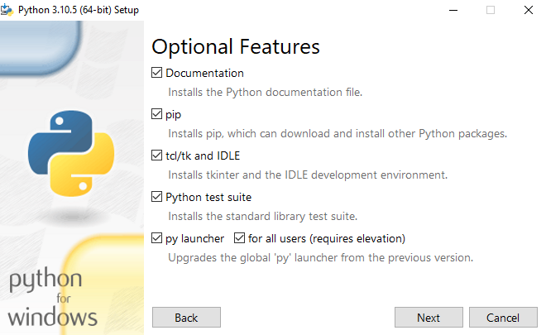
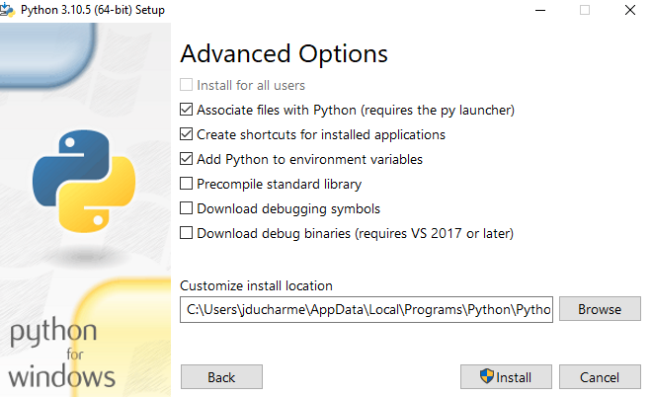
Python add-ons
Make sure all these features are selected before clicking next
Make sure all these features are selected before clicking install

Slide 8
Integrated Development Environment (IDE)
Now that Python is installed, we need an environment to write and execute Python code in → IDE
An IDE is just an application (like Word, PowerPoint, etc)
Allows you to write, test, debug, and run your Python code

Slide 9
Jupyter Notebook
We will install a popular IDE called Jupyter Notebook with the following steps:
1) Open the Windows Command Promp
a) Click on the Windows Start menu
b) Type in “command prompt”
c) Click on the first option
2) Copy-and-paste the following command to install:
pip install notebook
Jupyter Notebook is now installed and ready to use!

Slide 10
Git
Git is a popular tool that allows easy and organized version control
Allows you to keep track of changes made to your code and collaborate with other programmers
Allows you to easily revert changes and avoid costly mistakes
Overall an absolutely indispensable programming tool

Slide 11
Installing Git
We will install git to our computers using the following steps:
1) Click on the following link:
https://git-scm.com/download/win
2) Download the latest version of git
You should see a link that says “Click here to download the latest 64-bit version of Git for Windows”
Click to start download
3) Once download is finished, click on the .exe file to begin installation

Slide 12
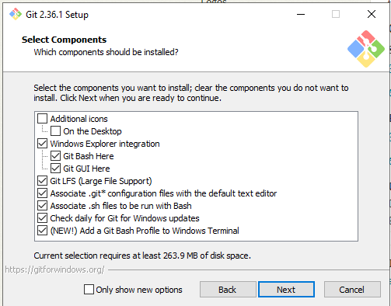
Installing Git (cont.)
Make sure the following options are enabled:
Otherwise, just keep clicking on “next”
When you reach the end, click on “install”
This will install with the default configuration

Slide 13
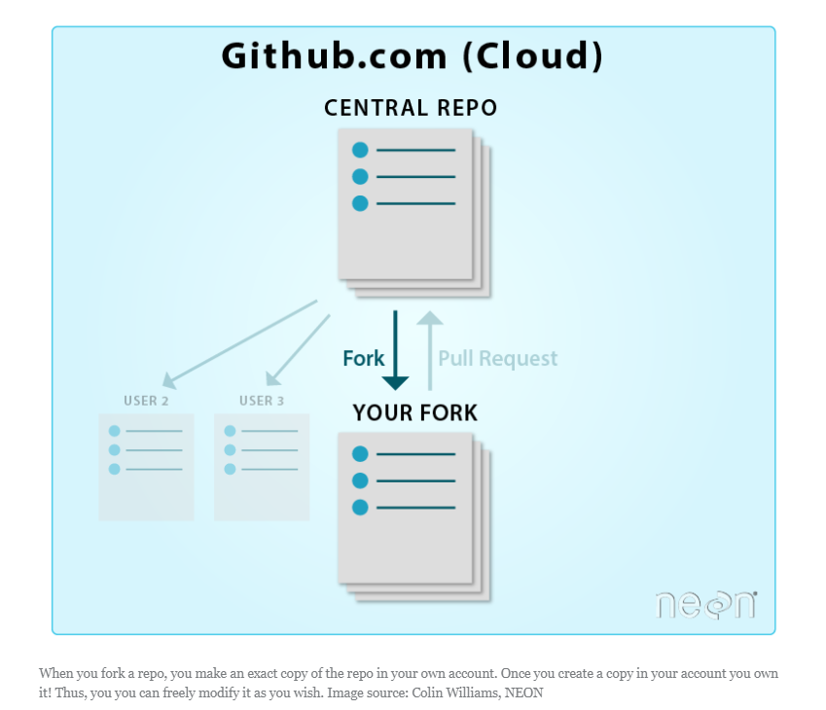
Access the Exercises
Click on the following link to access the Banque d’exercices:
https://github.com/baron-de-montrouge/Intro-to-Python
We will want to “fork” this repository onto our own computer
This will allow you to “own” the repo and modify it freely!

Slide 14
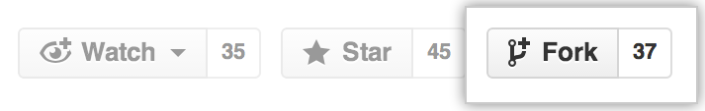
Fork a GitHub repository
You will need a (free!) GitHub account to fork the repo
You can create one easily with an email and a password
Once that is done, follow these steps to fork the repo:
1) Click on the “Fork” icon on the top-right corner
2) Navigate to your copy of the repo in GitHub
It should be named YOUR-USER-NAME/Intro-to-Python

Slide 15

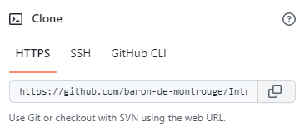
Fork a GitHub repository (cont)
3) In your forked copy of the repo, click on the green “Code” icon
4) Click on this icon to “clone” the repo

Slide 16
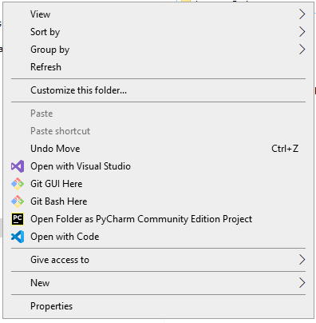

Clone a GitHub Repository
5) Open up the File Explorer and navigate to where you would like the files to be
For example:
6) Right click and select “Git bash here”

Slide 17
Clone a GitHub Repository (cont)
7) Type in the following
git clone link-to-repo
Replace the “link-to-repo” with the link you copied in Step 4
8) Finally, you can open your cloned repo directly in the file explorer and access all the exercises!

Slide 18
Okay, but why not use the F drive?
It’s true, I could’ve simply put all these exercises in the F drive and you could’ve easily accessed them this way
The advantage with GitHub is that you can freely modify the code you forked, and I (or anyone else!) can access your version of the code and help with writing, testing, debugging, etc. without affecting the “main” code

Slide 19
Finally, let’s write our first program!
Open up the Windows Command Prompt
Type in the following
jupyter notebook
If this command raises an error, type this in instead:
python –m notebook
This should open up Jupyter Notebook in your web browser!
Navigate to your cloned Intro-to-Python repo
Open up the Exercises folder and click on Week1.ipynb

Slide 20
Hello World
The first Python functionality we will learn is the “print” statement
As the name suggests, it allows the user to “print” a piece of information on the screen
Exercise 1: print out Hello World using the following syntax:
print(“Hello World”)
Quotes are important!

Slide 21
Math functionalities
The second Python functionality we will learn relates to mathematical operations
Math is super easy in Python!
Add numbers using +, subtract using -, multiply using *, and divide using /
Let’s write a code that adds two numbers, a and b, using the following syntax
a = 1
b = 2
print(a+b)
Notice the lack of quotation marks this time

Slide 22
Python Objects
Python classifies different bits of text into different objects
These include…
Strings
These are any pieces of text enclosed in quotations marks
E.g. “Hello World” is a string object
Used to represent exactly what is enclosed in the quotation marks
Integers
Round numbers with no decimals
E.g. 1, 2, 3, …
Floats
Floating point numbers are numbers with decimal places
E.g. 3.1415, etc

Slide 23
Combining Objects
Exercise 3: Let’s write a code that outputs our name and age using the following syntax
name = “Jade”
age = 21
print(“My name is”, name, “and I am”, age, “years old.”)
Notice the quotations around “Jade” (string object), and the lack of quotations around 21 (int object)
To combine different objects in a print statement, use a comma!

