Slide 1
Business Intelligence
Sales Volume & Stability Analysis
Beyond forecasting, we analyze which product categories drive the most revenue and which exhibit volatile, unpredictable demand patterns.
Volume Analysis
Stability Analysis
Question: Which categories sell the most units?
Question: Which categories have unpredictable demand?
Metric: Total quantity sold across all time periods
Metric: Coefficient of Variation (CV = SD / Mean)
Business value: Identifies core revenue drivers deserving supply chain priority
Business value: High CV signals need for flexible inventory and contingency planning

Slide 2
Calculating Volume & Stability Metrics
monthly_stats <- df_final %>%
mutate(Month = floor_date(orderdate, "month")) %>%
group_by(productcategory, Month) %>%
summarise(MonthlyUnits = sum(quantitysold, na.rm = TRUE)) %>%
group_by(productcategory) %>%
summarise(
Total_Sold = sum(MonthlyUnits),
Avg_Monthly_Sold = mean(MonthlyUnits),
SD_Monthly_Sold = sd(MonthlyUnits)
) %>%
mutate(Stability_CV = SD_Monthly_Sold / Avg_Monthly_Sold)
We calculate monthly sales per category, then aggregate to get total volume, average monthly sales, and standard deviation. The Coefficient of Variation normalizes volatility, making it comparable across categories with different sales volumes.

Slide 3
Visualizing Total Sales Ranking
p1 <- ggplot(monthly_stats,
aes(x = reorder(productcategory, -Total_Sold),
y = Total_Sold,
fill = productcategory)) +
geom_col(show.legend = FALSE) +
geom_text(aes(label = Total_Sold), vjust = -0.5, size = 3) +
labs(
title = "Total Sales Ranking by Product Category",
subtitle = "Which category sells the most?",
x = "Product Category",
y = "Total Units Sold"
) +
theme_minimal() +
theme(axis.text.x = element_text(angle = 45, hjust = 1))
The bar chart ranks categories from highest to lowest total sales. The reorder() function sorts categories by descending sales, and geom_text() adds exact values on top of each bar for precise comparison.

Slide 4
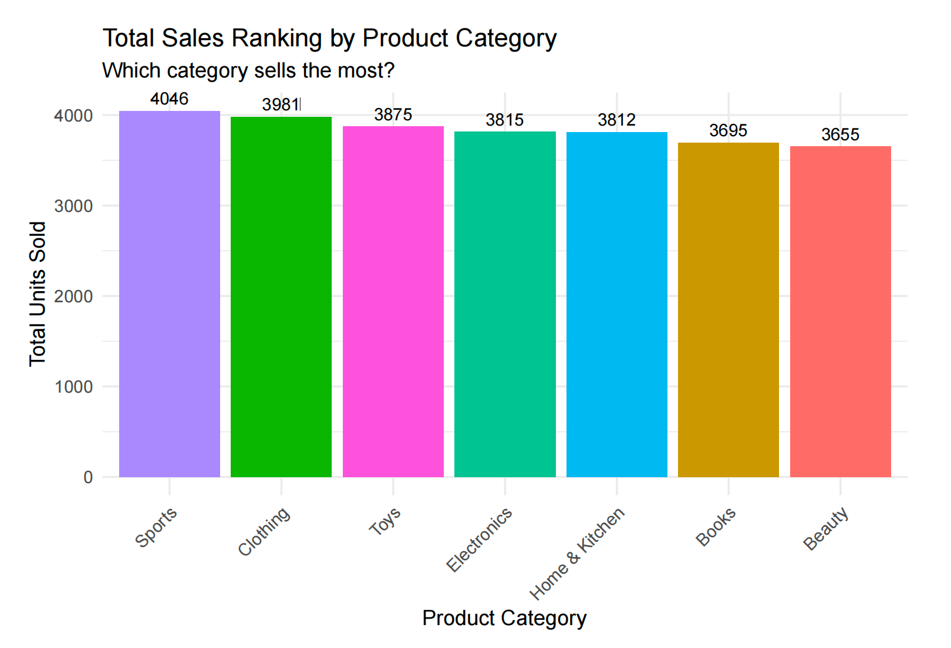

Slide 5
Stability Visualization: The Lollipop Chart
p2 <- ggplot(monthly_stats,
aes(x = reorder(productcategory, Stability_CV),
y = Stability_CV)) +
geom_segment(aes(xend = productcategory, y = 0, yend = Stability_CV),
color = "gray") +
geom_point(aes(color = Stability_CV), size = 4) +
scale_color_gradient(low = "green", high = "red") +
labs(
title = "Sales Stability Analysis by Category",
subtitle = "Higher CV indicates larger monthly fluctuations",
x = "Product Category",
y = "Instability (CV Value)"
) +
theme_minimal()
Higher dots indicate more volatile categories. The red-to-green gradient provides instant visual feedback on risk level.

Slide 6
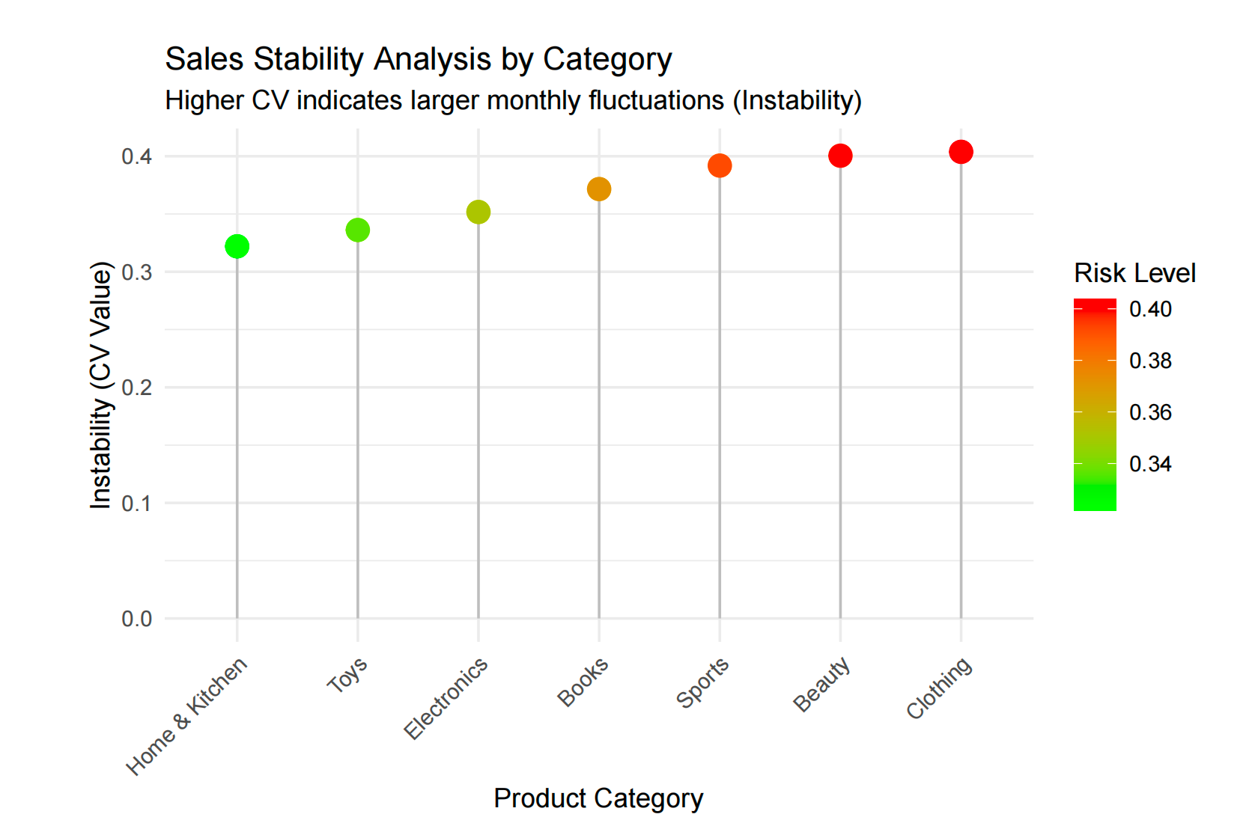

Slide 7
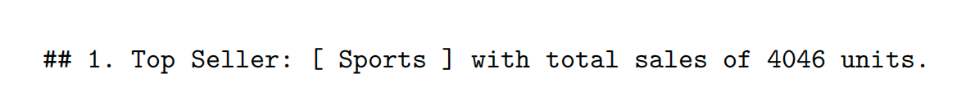
Automated Business Insights
top_seller <- monthly_stats %>%
arrange(desc(Total_Sold)) %>% slice(1)
most_unstable <- monthly_stats %>%
arrange(desc(Stability_CV)) %>% slice(1)
cat(paste("1. Top Seller: [", top_seller$productcategory, "] with total sales of", top_seller$Total_Sold, "units.\n"))
cat(" -> Recommendation: This is a core revenue source. Prioritize supply chain to prevent stockouts.\n")
cat(paste("2. Most Unstable: [", most_unstable$productcategory, "] has the highest volatility (Highest CV).\n"))
cat(" -> Recommendation: This category may be highly seasonal or promotion-driven. Flexible inventory management is advised.\n")
Code can generate narrative insights automatically, highlighting the categories requiring strategic attention.

Slide 8

Correlation Analysis
Understanding Price, Rating & Sales Relationships
Does higher pricing suppress sales volume? Do better customer ratings drive more purchases? Correlation analysis reveals these relationships.
Price Sensitivity
Rating Impact
Correlation Matrix
Negative correlation between unit price and quantity sold indicates elastic demand—customers buy less when prices rise.
Positive correlation between ratings and sales demonstrates the power of social proof and word-of-mouth marketing.
The cor() function computes Pearson correlation coefficients between all numeric variables simultaneously.

Slide 9
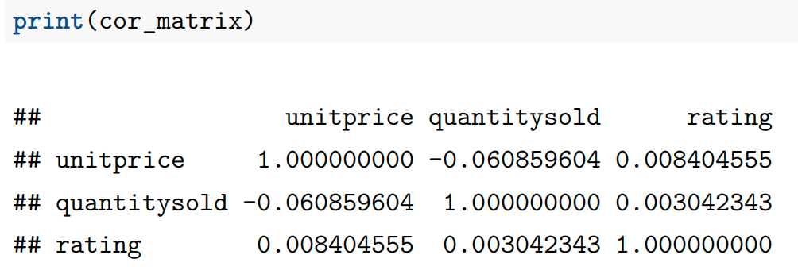
Simulating Rating Data
# Original dataset lacks rating column
set.seed(999)
df_analysis <- df_final
df_analysis$rating <- round(runif(nrow(df_analysis),
min = 3.0, max = 5.0), 1)
# Calculate correlation matrix
cor_matrix <- cor(df_analysis[, c("unitprice",
"quantitysold",
"rating")])
print(cor_matrix)
Since the original Amazon sales dataset doesn't include customer ratings, we simulate them using runif() to generate random values between 3.0 and 5.0. This demonstrates the analytical technique—in production, you would use actual rating data.

Slide 10
Price vs. Sales: The Demand Curve
Economic Theory
p3 <- ggplot(df_analysis,
aes(x = unitprice, y = quantitysold)) +
geom_point(alpha = 0.3, color = "blue") +
geom_smooth(method = "lm", color = "red", se = TRUE) +
labs(
title = "Correlation: Unit Price vs Quantity Sold",
subtitle = "Downward trend indicates negative correlation",
x = "Unit Price",
y = "Quantity Sold per Order"
) +
theme_minimal()
Basic economics predicts an inverse relationship: as price increases, quantity demanded decreases.
A negative correlation confirms this pattern in our data.
Interpretation:
Strong negative (-0.5 to -1.0): Price very sensitive
Weak negative (-0.3 to 0): Luxury/inelastic goods
The scatter plot reveals the underlying relationship, while the red regression line quantifies the trend direction and strength.

Slide 11
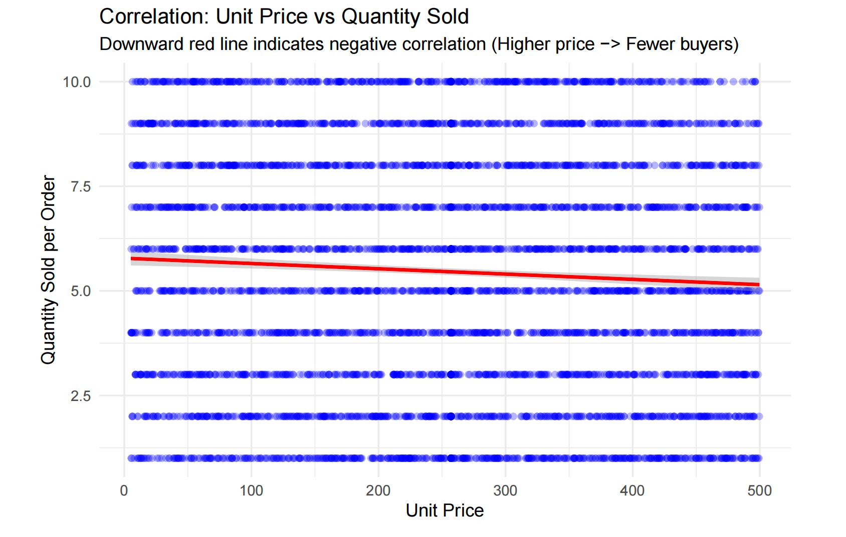

Slide 12
Rating vs. Sales Distribution
p4 <- ggplot(df_analysis,
aes(x = factor(rating), y = quantitysold)) +
geom_boxplot(fill = "orange", alpha = 0.6) +
labs(
title = "Product Rating vs Sales Distribution",
subtitle = "Do higher ratings lead to higher sales per order?",
x = "User Rating",
y = "Sales Distribution"
) +
theme_minimal()
Boxplots show the distribution of sales quantities for each rating level. If higher-rated products consistently show higher median sales (middle line of box), it confirms that positive reviews drive purchasing behavior.

Slide 13
