Slide 1

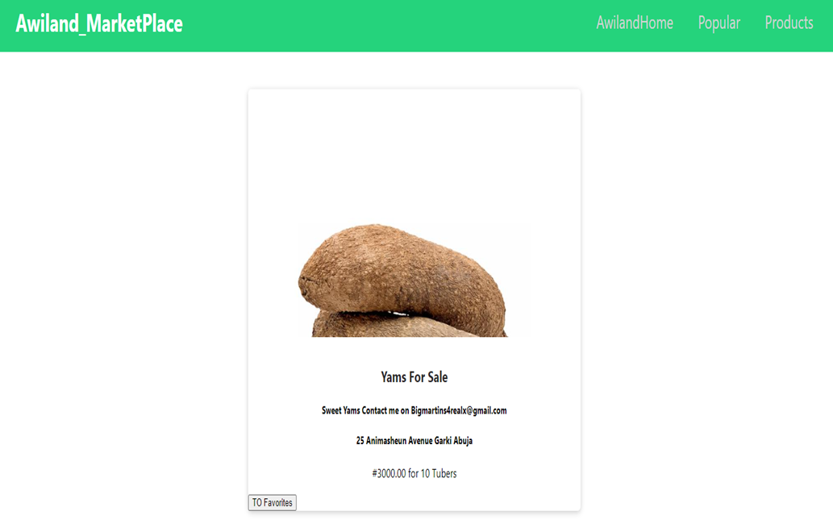
Online MarketPlace Using MERN Stack
Ibrahim Lawal

Slide 2
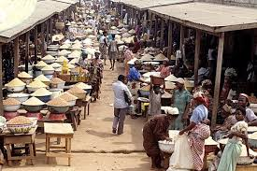


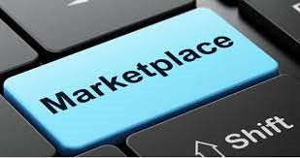

Agenda
Introduction
Background
Technology Description
Descriptive Diagrams
Conclusion

Slide 3
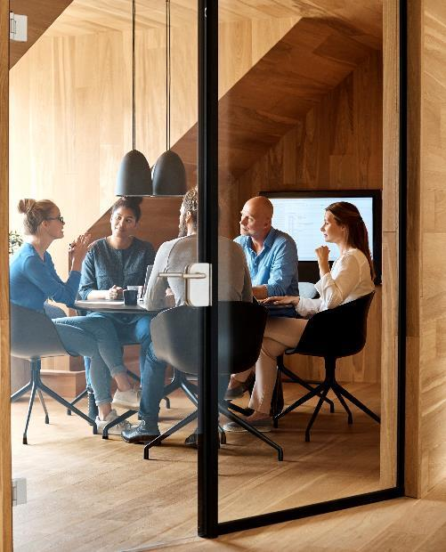



Introduction
Awiland Marketplace is an Online Store, I developed because of the inspiration I got from the Nigerian online community during the ban on twitter by the Federal Government of Nigeria, due to the #ENDSARS protests and riots in parts of Nigeria 2020.

Slide 4
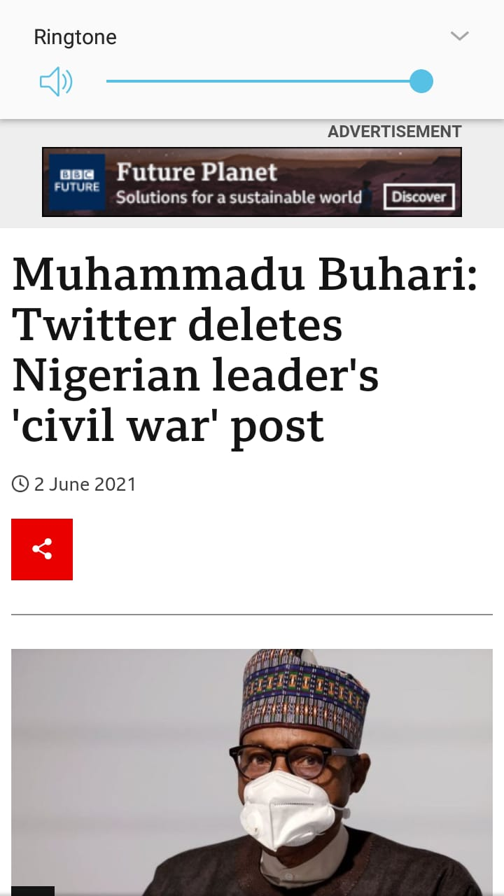


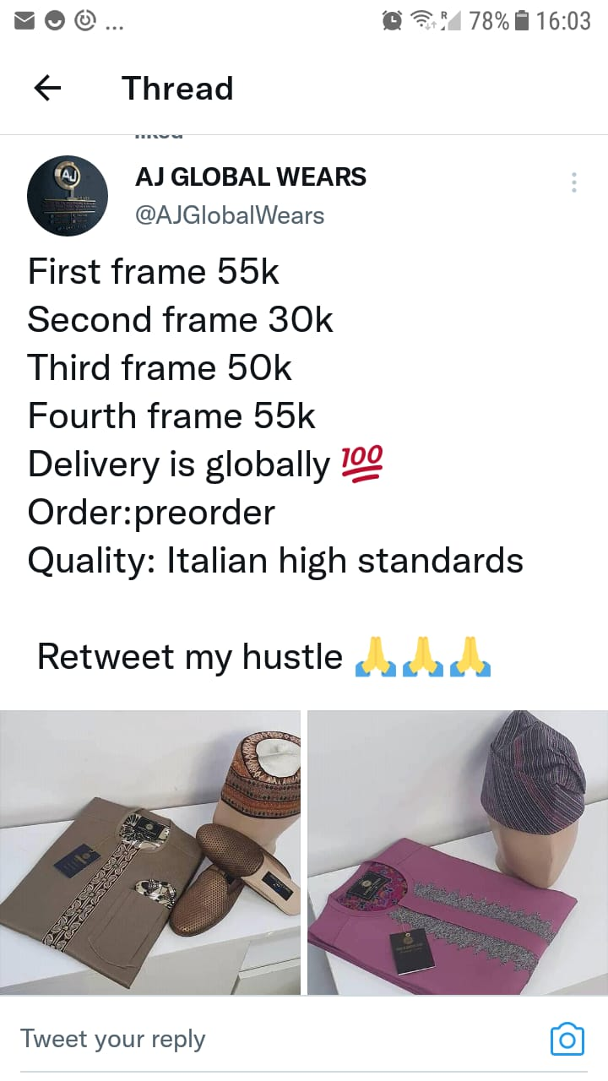
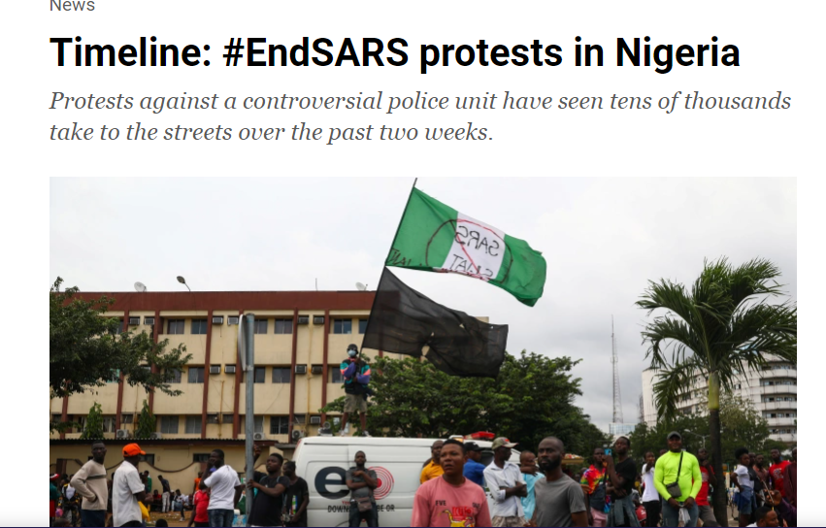

Slide 5
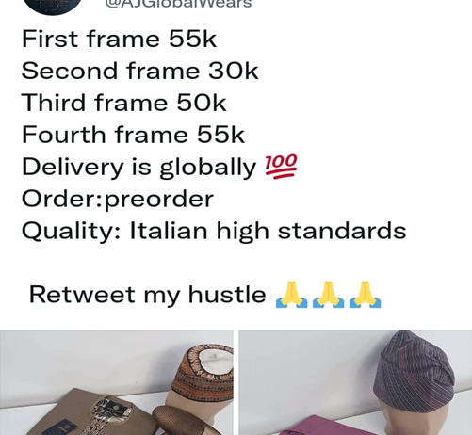
The ban meant that small entrepreneurs who mostly use twitter to advertise goods and services couldn’t anymore, and therefore were forced to look for VPN or lose business. This was my motivation and inspiration to create an online store where users can post goods and services to gain a prospective customer.

Slide 6

Background
Method

Slide 7

Frontend — In the frontend side, I am using React as the frontend library, Redux for state management, and React Bootstrap library for basic designing of the interface.

Slide 8
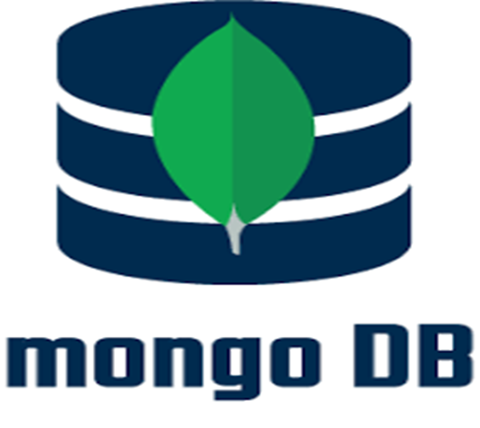

Backend — For the backend side, I have used the Express library on top of Nodejs. MongoDB as the NoSQL database to store data as documents in JSON format, mongoose to connect to my MongoDB database. I have also created REST APIs with Express and use these endpoints in the React frontend to interact with the backend.

Slide 9
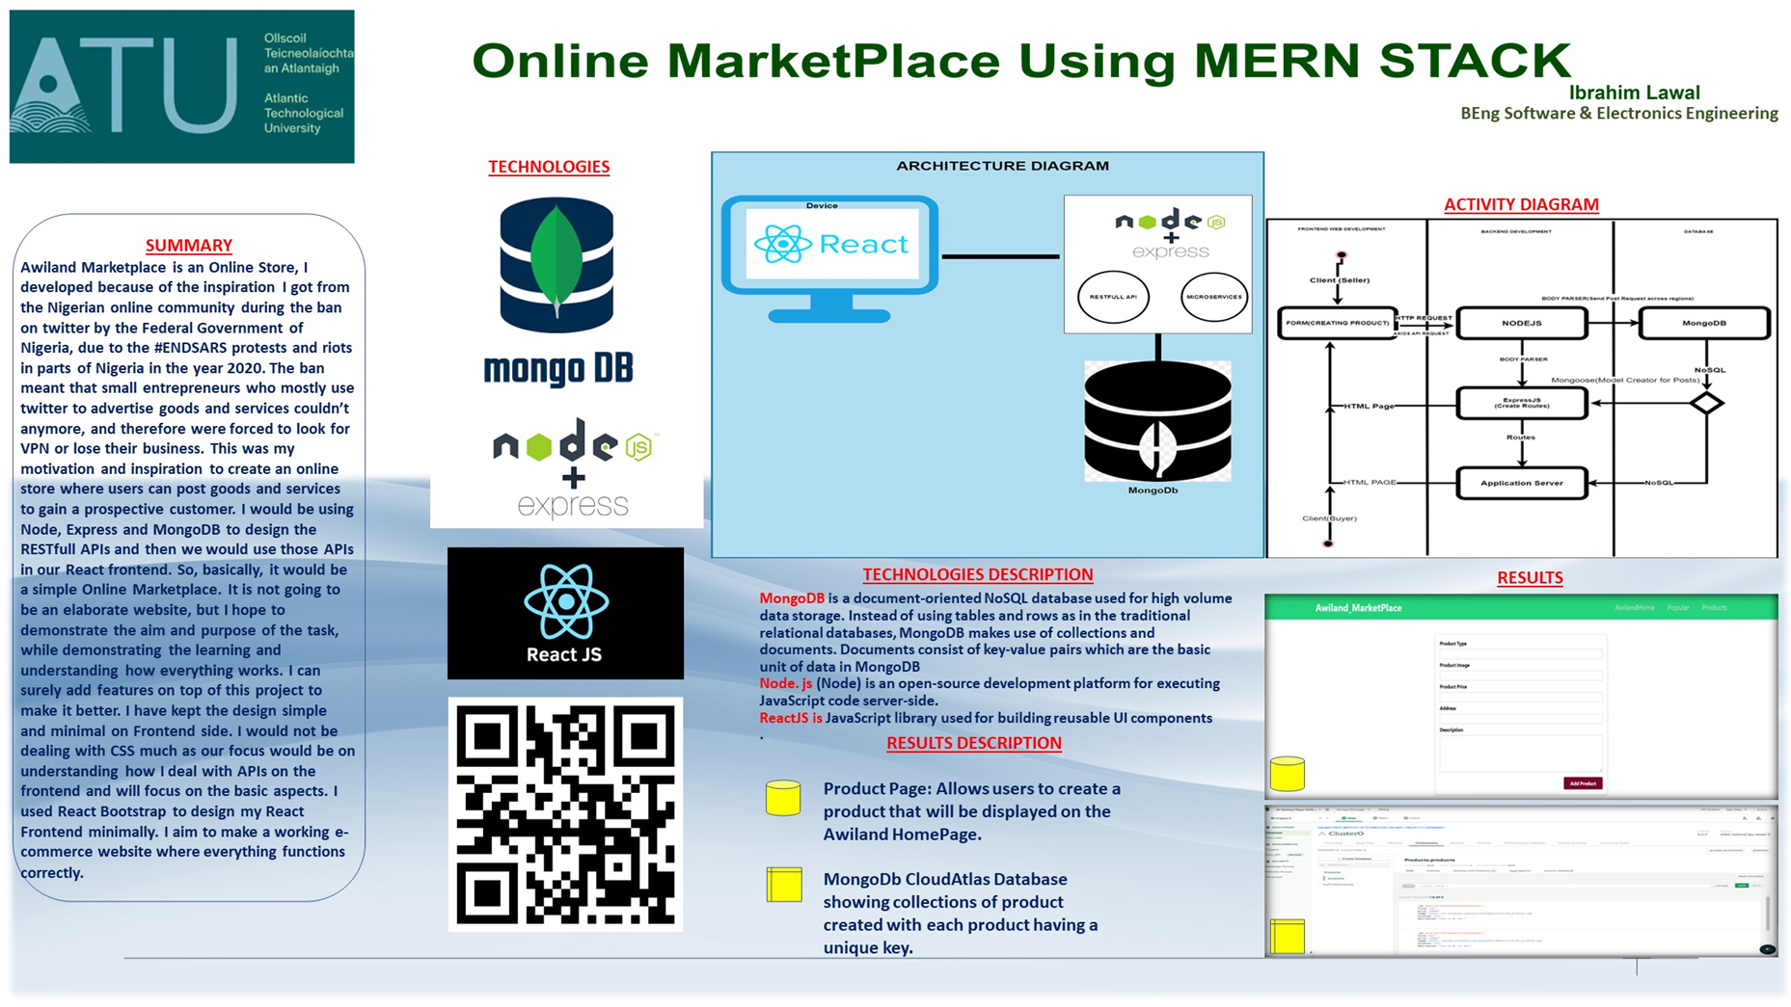
POSTER

Slide 10
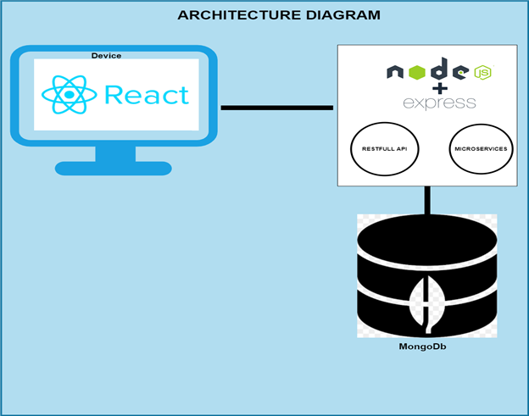
Architecture Diagram
Technologies Description
MongoDB is a document-oriented NoSQL database used for high volume data storage. Instead of using tables and rows as in the traditional relational databases, MongoDB makes use of collections and documents. Documents consist of key-value pairs which are the basic unit of data in MongoDB​
Nodejs (Node) is an open-source development platform for executing JavaScript code server-side. ​
ReactJS is JavaScript library used for building reusable UI components​
RestFul API is an application programming interface (API or web API) that conforms to the constraints of REST architectural style and allows for interaction with RESTful web services
Microservices are an architectural and organizational approach to software development where software is composed of small independent services that communicate over well-defined APIs

Slide 11
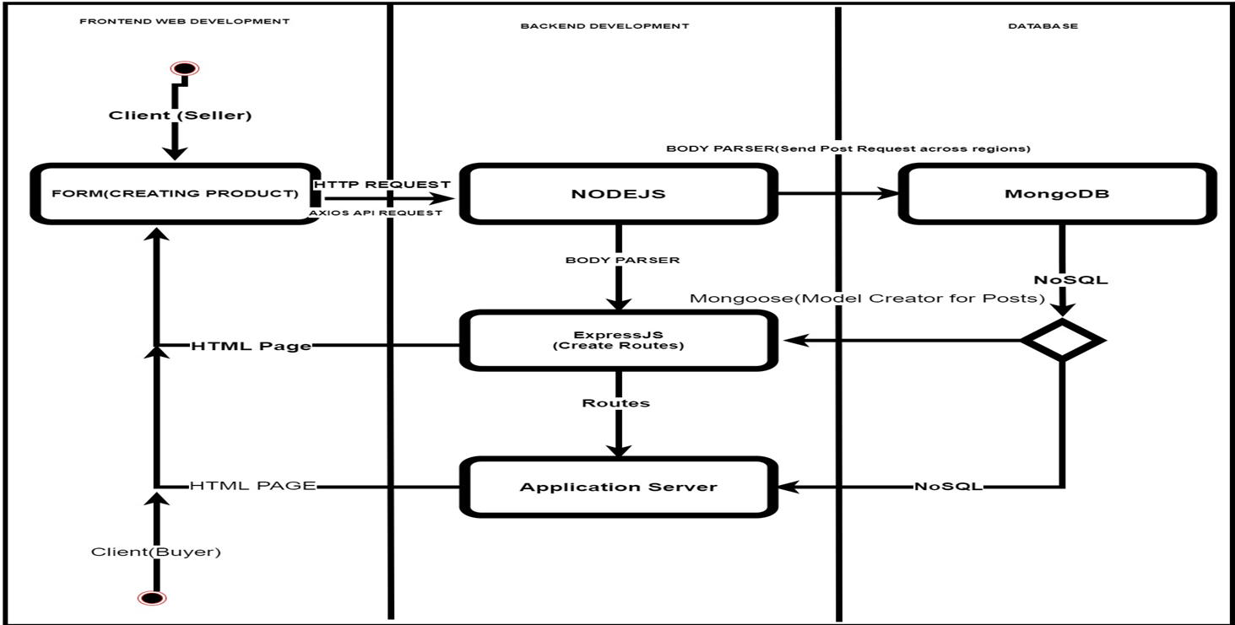
Activity Diagram
This diagram visually presents a series of actions or flow of control in a system like to a flowchart or a data flow diagram, it describes the steps in the use case diagram

Slide 12
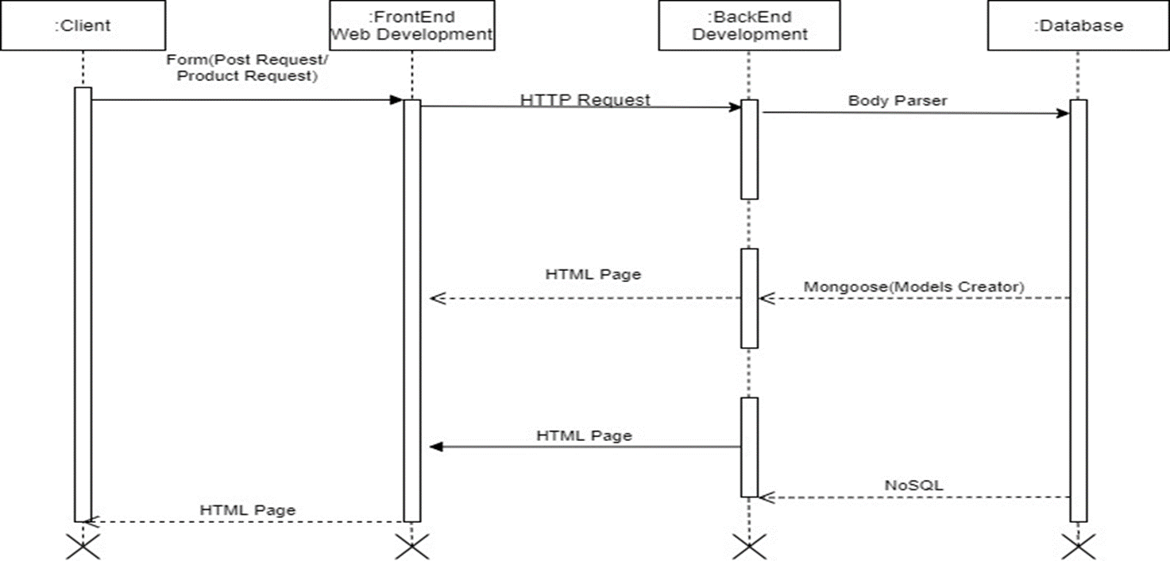
Sequence Diagram
This sequence diagram is a type of interaction diagram because it describes how and in what order these group of objects work together

Slide 13

Conclusion
In this presentation, I have presented a detailed explanation of my motivation and inspirations in developing AwilandMarketPlace.com. The goal was for users to be able to create a product in the app and post it, so that their customers can view and get product detail through the online store. The dream is to use the understanding and knowledge I have developed during this project to fully develop this app for the purpose it was inspired. To improve the app, a user profile page could be added, so each product is linked to the product creator’s page.
And the database could be done properly like creating a page that sorts product according to its category, type and date created.

Slide 14


Thank You
Ibrahim Lawal
G00375512@gmit.com

