Slide 1
Introduction:
My name is Ibrahim Lawal, I am currently a 4th year student at GMIT. I am studying Software and Electronics Engineering Level 8 BEng (Hons). I am here today to Demonstrate my final year project work completed for this semester.
The title for my project is “Online Marketplace Using MERN Stack”.
Awiland Marketplace is an Online Store, I developed because of the inspiration I got from the Nigerian online community during the ban on twitter by the Federal Government of Nigeria, due to the #ENDSARS protests and riots in parts of Nigeria 2020.
The ban meant that small entrepreneurs who mostly use twitter to advertise goods and services couldn’t anymore, and therefore were forced to look for VPN or lose business. This was my motivation and inspiration to create an online store where users can post goods and services to gain a prospective customer.

Slide 2
Method
I would be using Node, Express and MongoDB to design the RESTfull APIs and then we would use those APIs in our React frontend. So, basically, it would be a simple Online Marketplace. It is not going to be an elaborate website, but I hope to demonstrate the aim and purpose of the task, while demonstrating the learning and understanding how everything works. I can surely add features on top of this project to make it better. I have kept the design simple and minimal on Frontend side. I would not be dealing with CSS much as our focus would be on understanding how I deal with APIs on the frontend and will focus on the basic aspects.
I used React Bootstrap to design my React Frontend in a small scale. I aim to be able to connect frontend and backend together for the purpose of sending data and fetching data. So, the features I have in the application that I am building are:
Authentication using JSON Web Tokens (JWT).
Option to add, edit, view, and delete all the items in the store.
So, these are the basic features we would be having in our application. Now, let’s get familiar with the tech stack we are going to use for building this application.
Frontend — In the frontend side, I am using React as the frontend library, Redux for state management, and React Bootstrap library for basic designing of the interface.
Backend — For the backend side, I have used the Express library on top of Nodejs. MongoDB as the NoSQL database to store data as documents in JSON format, mongoose to connect to my MongoDB database.
I have also created REST APIs with Express and use these endpoints in the React frontend to interact with the backend.

Slide 3
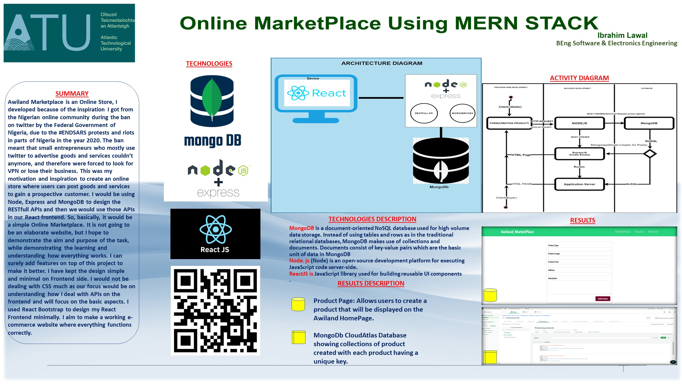
Poster

Slide 4
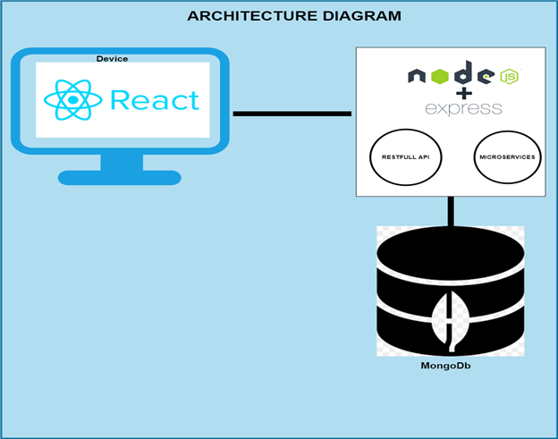
Architectural Diagram

Slide 5
Technologies Description
MongoDB is a document-oriented NoSQL database used for high volume data storage. Instead of using tables and rows as in the traditional relational databases, MongoDB makes use of collections and documents. Documents consist of key-value pairs which are the basic unit of data in MongoDB​
Nodejs (Node) is an open-source development platform for executing JavaScript code server-side. ​
ReactJS is JavaScript library used for building reusable UI components​
RestFul API is an application programming interface (API or web API) that conforms to the constraints of REST architectural style and allows for interaction with RESTful web services
Microservices are an architectural and organizational approach to software development where software is composed of small independent services that communicate over well-defined APIs

Slide 6
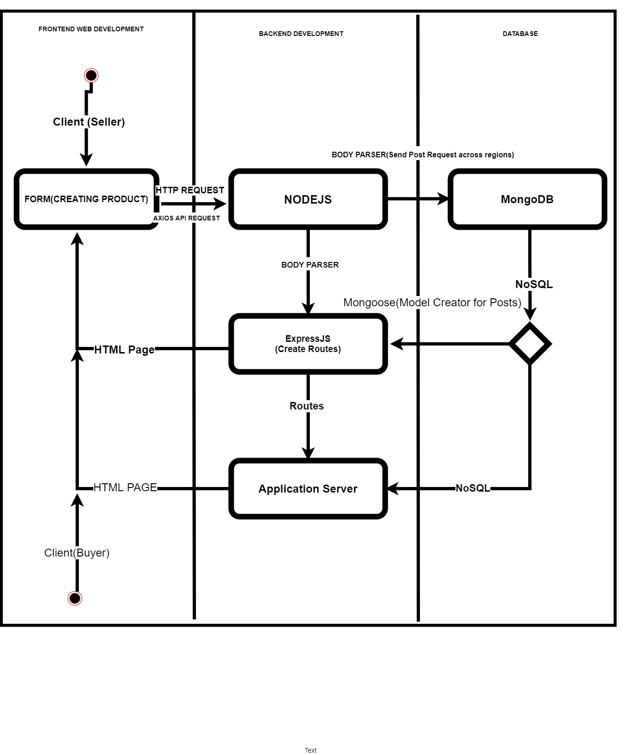
Activity Diagram
This diagram visually presents a series of actions or flow of control in a system like to a flowchart or a data flow diagram, it describes the steps in the use case diagram

Slide 7
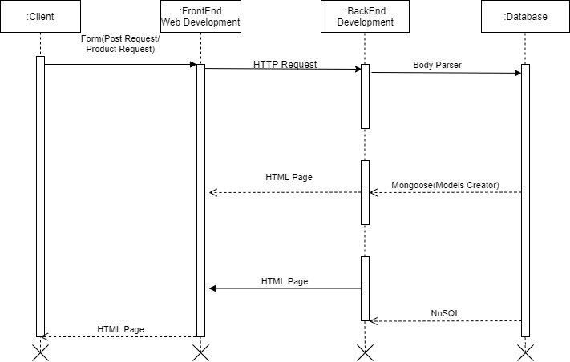
Sequence Diagram
This sequence diagram is a type of interaction diagram because it describes how and in what order these group of objects work together

Slide 8
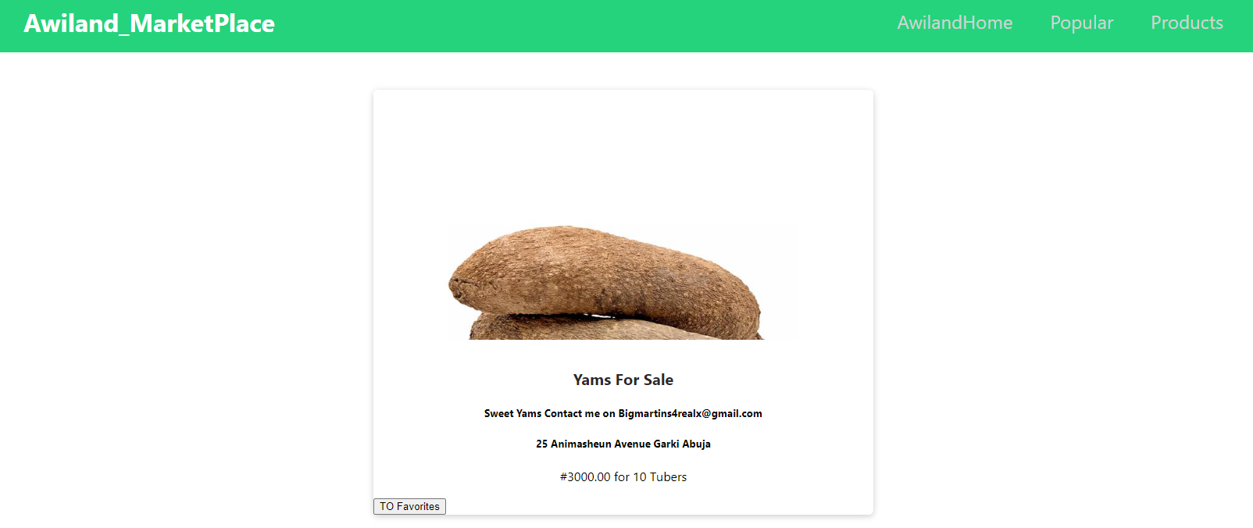
Results
Showing result of a product posted on the Awiland Marketplace.

Slide 9
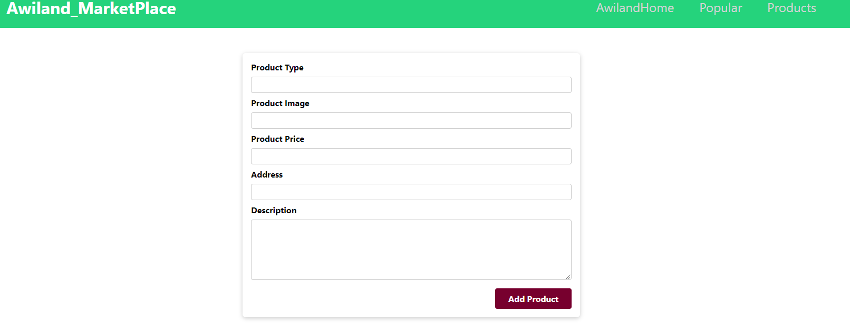
Showing result of the form used in creating a post.

Slide 10

Conclusion
In this presentation, I have presented a detailed explanation of my motivation and inspirations in developing AwilandMarketPlace.com. The goal was for users to be able to create a product in the app and post it, so that their customers can view and get product detail through the online store.
The dream is to use the understanding and knowledge I have developed during this project to fully develop this app for the purpose it was inspired. To improve the app, a user profile page could be added, so each product is linked to the product creator’s page.
And the database could be done properly like creating a page that sorts product according to its category, type and date created.

