Slide 1



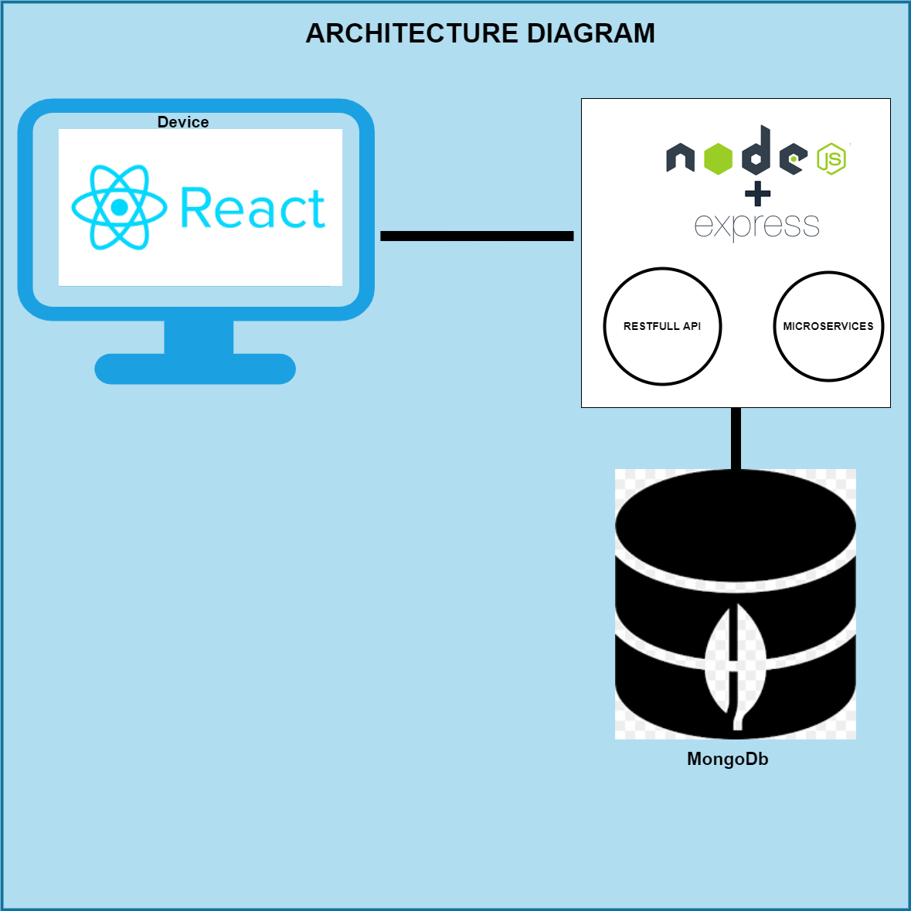

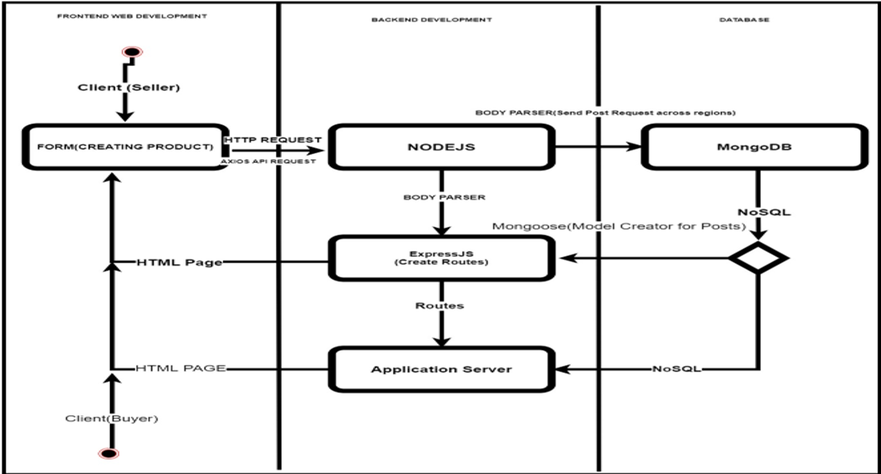



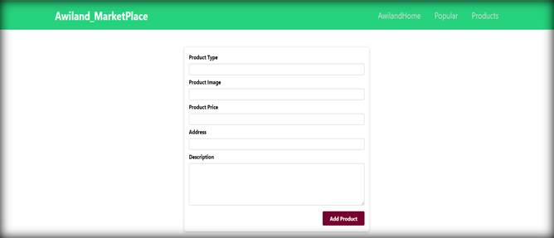
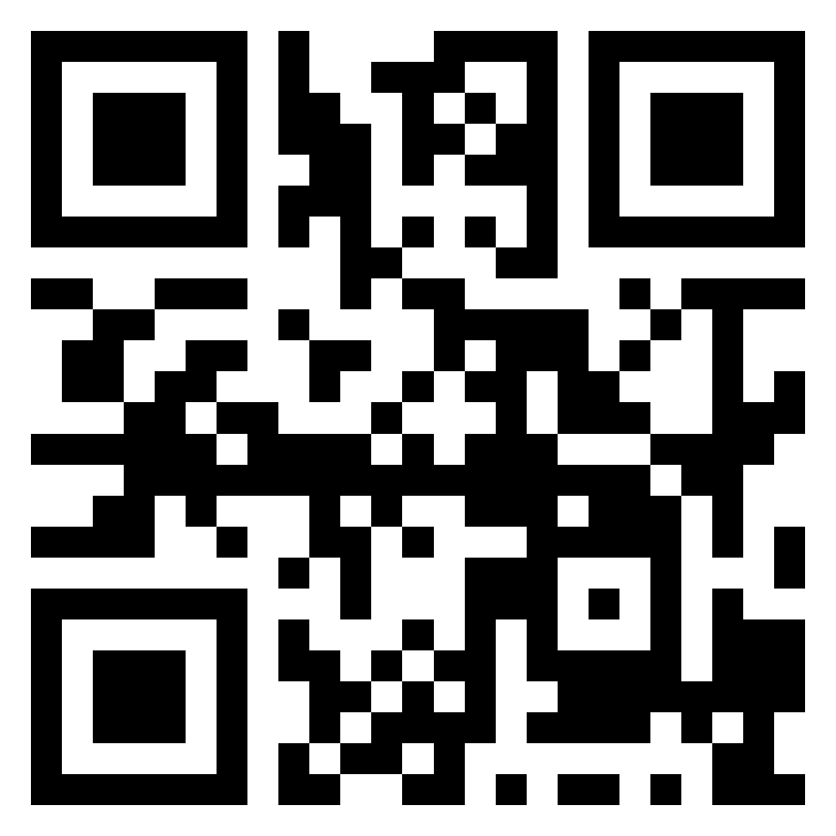
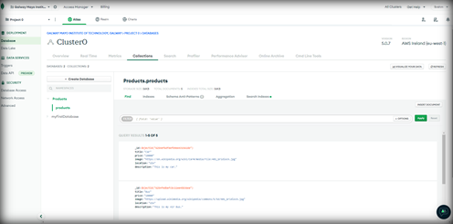
BEng Software & Electronics Engineering
TECHNOLOGIES
ACTIVITY DIAGRAM
SUMMARY
Awiland Marketplace is an Online Store, I developed because of the inspiration I got from the Nigerian online community during the ban on twitter by the Federal Government of Nigeria, due to the #ENDSARS protests and riots in parts of Nigeria in the year 2020. The ban meant that small entrepreneurs who mostly use twitter to advertise goods and services couldn’t anymore, and therefore were forced to look for VPN or lose their business. This was my motivation and inspiration to create an online store where users can post goods and services to gain a prospective customer. I would be using Node, Express and MongoDB to design the RESTfull APIs and then we would use those APIs in our React frontend. So, basically, it would be a simple Online Marketplace. It is not going to be an elaborate website, but I hope to demonstrate the aim and purpose of the task, while demonstrating the learning and understanding how everything works. I can surely add features on top of this project to make it better. I have kept the design simple and minimal on Frontend side. I would not be dealing with CSS much as our focus would be on understanding how I deal with APIs on the frontend and will focus on the basic aspects. I used React Bootstrap to design my React Frontend minimally. I aim to make a working e-commerce website where everything functions correctly.
TECHNOLOGIES DESCRIPTION
RESULTS
MongoDB is a document-oriented NoSQL database used for high volume data storage. Instead of using tables and rows as in the traditional relational databases, MongoDB makes use of collections and documents. Documents consist of key-value pairs which are the basic unit of data in MongoDB
Node. js (Node) is an open-source development platform for executing JavaScript code server-side.
ReactJS is JavaScript library used for building reusable UI components
.
RESULTS DESCRIPTION
Product Page: Allows users to create a product that will be displayed on the Awiland HomePage.
MongoDb CloudAtlas Database showing collections of product created with each product having a unique key.

