Slide 1
Mushroom Classification using CNN(Custom)
Group members:
Ringkang Basumatary(202002021010) (CSE)
Arup Sarkar (202002021033) (CSE)
Maophung Lu Lahary(202002021044) (CSE)
Jimmy Brahma(202002021050) (CSE)

Slide 2
Contents
Introduction
Problem Statement
Literature Survey
Objectives
Methodology
Dataset
Analysis
Comparison
Result
Conclusion
References

Slide 3

Introduction
Mushrooms are a type of fungus that can be found all over the world. There are over 45000+ species of mushrooms and only a small fraction of them are edible.
•Mushroom classification is the process of identifying the mushrooms and classifying them into different categories based on their edibility.
CNN (Convolutional Neural Network) is a deep learning neural network specialized for image and video analysis.

Slide 4
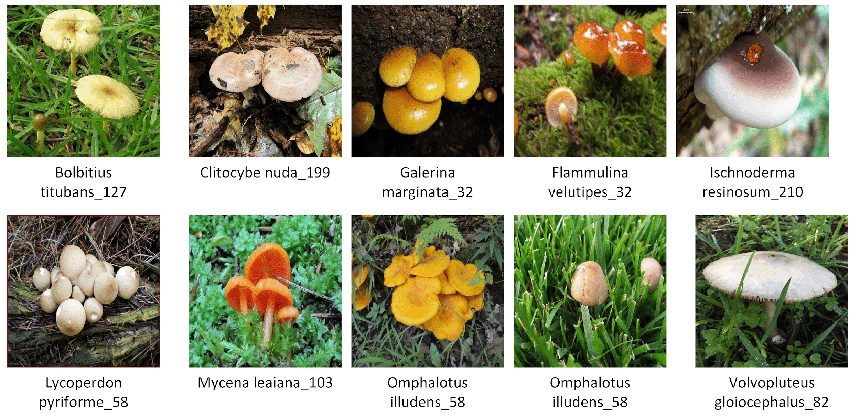
Problem Statement
Some mushrooms are poisonous and can cause serious illness or even death if eaten.
To tackle this problem we create a machine learning model that can predict edibility of a mushroom.

Slide 5
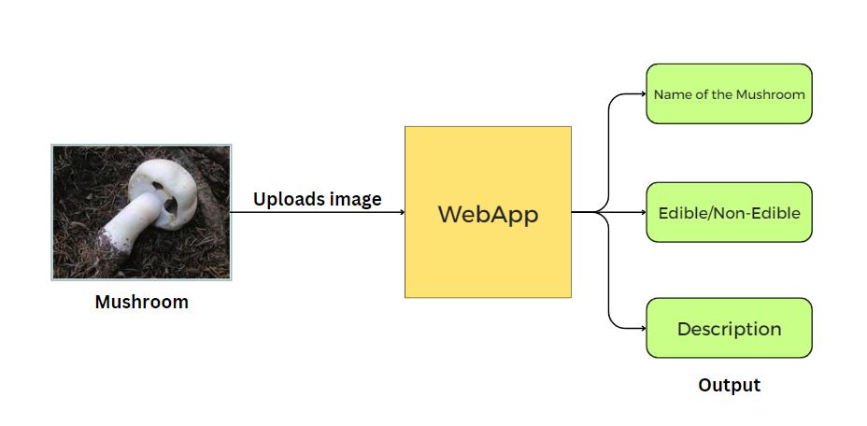
Problem Statement
Fig - Problem Statement Diagram

Slide 6
Literature Survey
“Classification of Mushroom Fungi Using Machine Learning Techniques” utilized data mining and four machine learning algorithms (neural network, SVM, decision tree, KNN) to predict mushroom toxicity. The neural network achieved the highest accuracy at 99.3% with an 8,124 mushroom dataset.
“Identification of Edible and Non-Edible Mushroom Through Convolution Neural Network” there they used Image dataset of mushrooms are classified as edible or non-edible applying machine learning algorithms such as sNet, LeNet, AlexNet, cNet and DCNN. Classification is performed using different CNN network architectures and evaluated for performance accuracy.

Slide 7
Objectives
Identify the mushrooms with their images.
Classify the mushrooms into Edible and Non-Edible categories with their image.
Will Give brief descriptions about that mushroom.
Deploy the machine learning model in a way that is accessible to people.

Slide 8
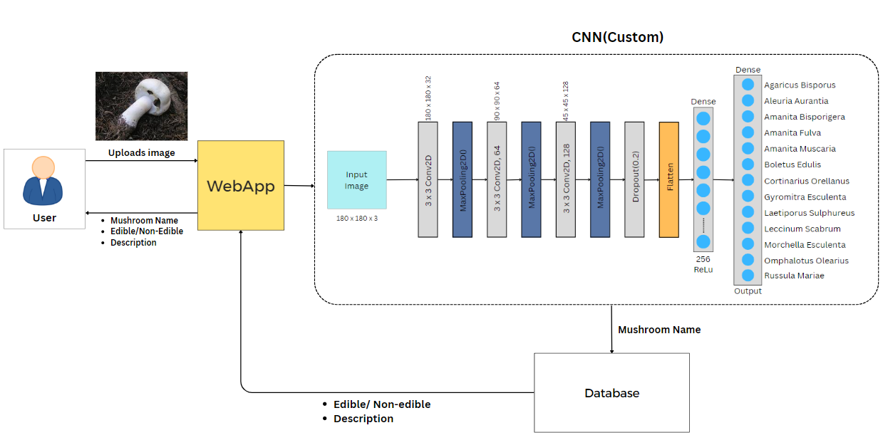
Methodology

Slide 9
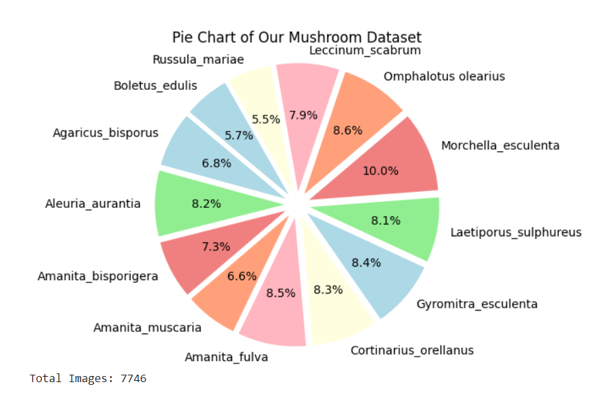
Dataset
Fig : Pie Chart of Our Mushroom Dataset

Slide 10
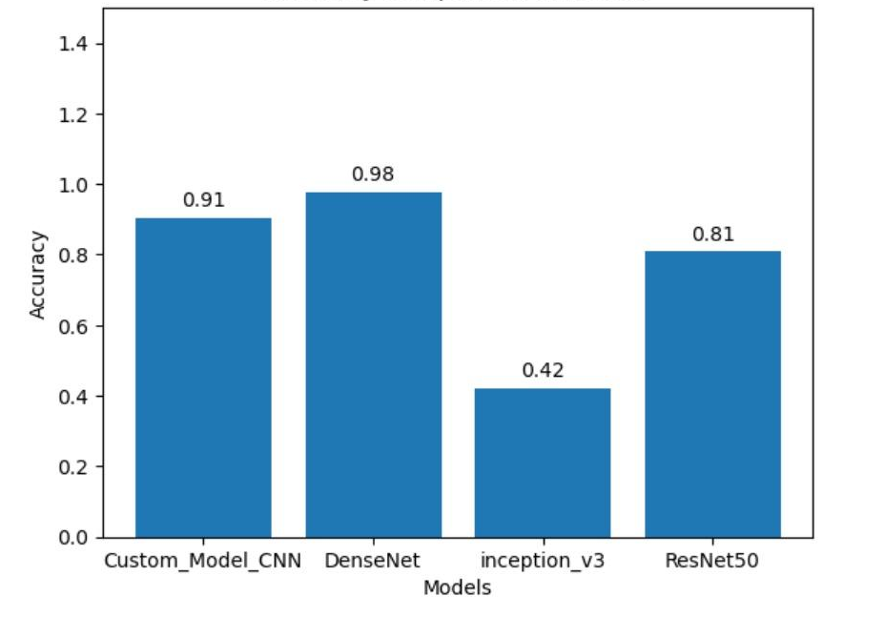
Analysis
Fig : Accuracy comparison between Custom CNN and other Pre-Trained Models

Slide 11
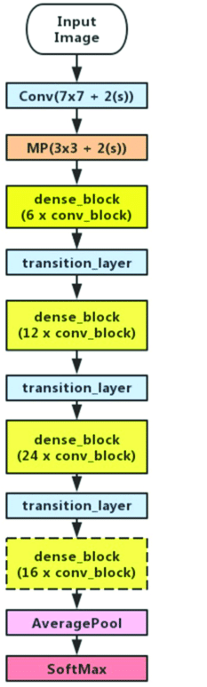
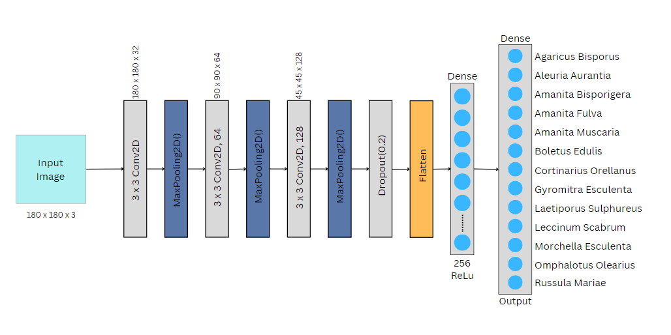
Comparison
DenseNet-121: 121-layer CNN with dense connections between blocks, sharing features, reducing parameters, and gradient issues. Efficient and effective for image classification.
In Our Custom model there are 9 layers in the model, which includes 3 convolutional layers, 3 max-pooling layers, 1 dropout layer, and 2 fully connected layers
Fig : DenseNet vs Custom Architecture

Slide 12
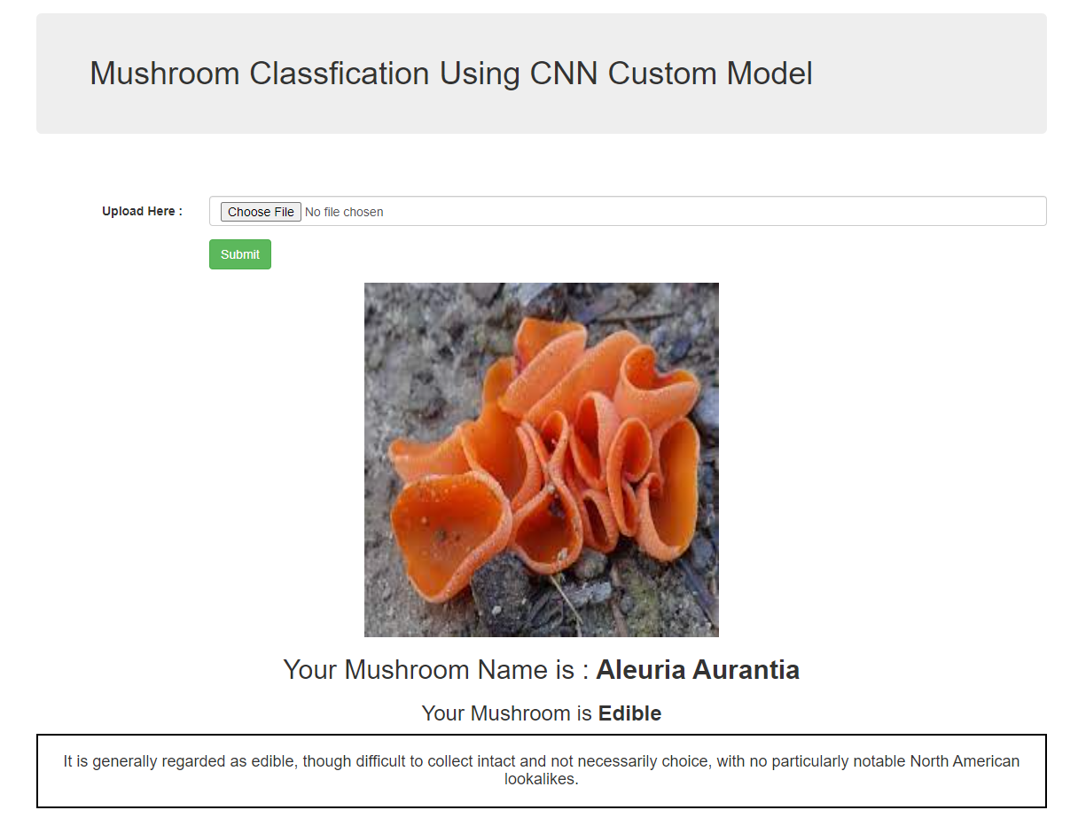
Result

Slide 13
Conclusion
After experimenting with different pre-trained models such as ResNet-50, Inception V3, and DenseNet-121, it was observed that the accuracy of these models varied.
Unfortunately, ResNet-50 and Inception V3 did not yield satisfactory results in terms of accuracy. However, DenseNet-121 showed better accuracy compared to the custom CNN model.
The custom CNN model has a total of 15,956,557 trainable parameters, while DenseNet-121 has 7,219,597 trainable parameters.

Slide 14
References
[1]https://www.researchgate.net/publication/362374571_Mushroom_classification_using_machine-learning_techniques
[2] Identification of Edible and Non-Edible Mushroom Through Convolution Neural Network Devika G1,* Asha Gowda Karegowda2
[3] https://www.kaggle.com/datasets/derekkunowilliams/mushrooms
[4]Derek Kuno-Williams. (2022). <i>Mushrooms</i> [Data set]. Kaggle. https://doi.org/10.34740/KAGGLE/DSV/3690937
[5]https://www.kaggle.com/datasets/harperd17/mushroom-pictures
[6]https://www.kaggle.com/datasets/maysee/mushrooms-classification-common-genuss-images

Slide 15
Thank You

