Slide 1

Data Engineering Test Case
Designing a Data Model & Architecture for Marketing Campaign Performance Analysis
Presented by: Rini Laha Date: 24-03-2025
Notes:
Hi, I’m Rini Laha, and this is a data engineering case study I worked on. The goal was to design and implement a data model and pipeline to track the performance of marketing campaigns from different sources.

Slide 2
Introduction
This test case requires designing a data model to analyze marketing campaign performance.
Data sources: HubSpot (Marketing) & Salesforce (Sales).
Objective: Enable reporting on campaign revenue, conversion rates, and yearly comparisons.
Tools: Airbyte, Redshift, DBT, Airflow, SNS, SlACK, great expectations.
Notes:
We needed to bring data from Salesforce and HubSpot together, calculate key metrics like revenue and conversion rate, and make sure the pipeline was stable, accurate, and easy to extend in the future.

Slide 3
Assumptions
Currency rates are relatively stable and updated daily (not real-time Batch load).
opportunities and prospects are streamed via Airbyte with CDC.
Campaign data includes both successful and unsuccessful responses
No significant data growth expected for at least 3 years.
Logical data models is built on top of the gold layer; separate BI-layer datamart creation is optional.
Notes:
I have assumed currency rates would vary over time, so we used historical exchange rates. I also assumed data would be loaded weekly, and there wouldn’t be any major growth or more data sources right away.

Slide 4
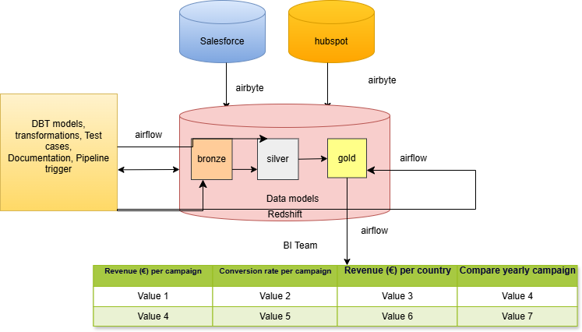
High level diagram
Notes:
This is a simplified view of the system. We pull raw data using Airbyte and land it in Databricks. From there, dbt handles the transformation from bronze to silver to gold models, and final KPIs are available for analysis. The architecture is modular, so it’s easy to debug or scale later.

Slide 5
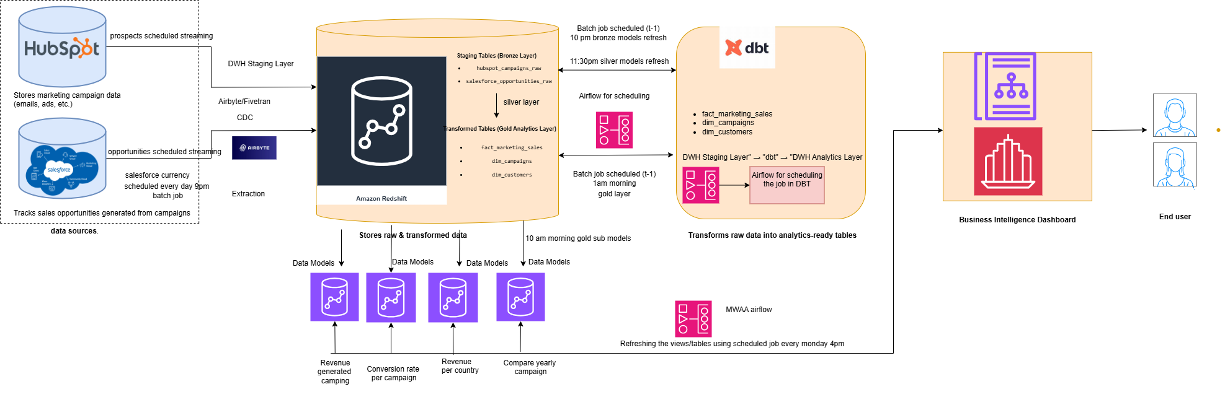
Architecture Diagram
Link
Notes:
Please use the draw.io for better visibility, or you could also enlarge the image.
The flow shows how data from different sources comes together and how it’s transformed at each layer before being exposed to the business users.

Slide 6
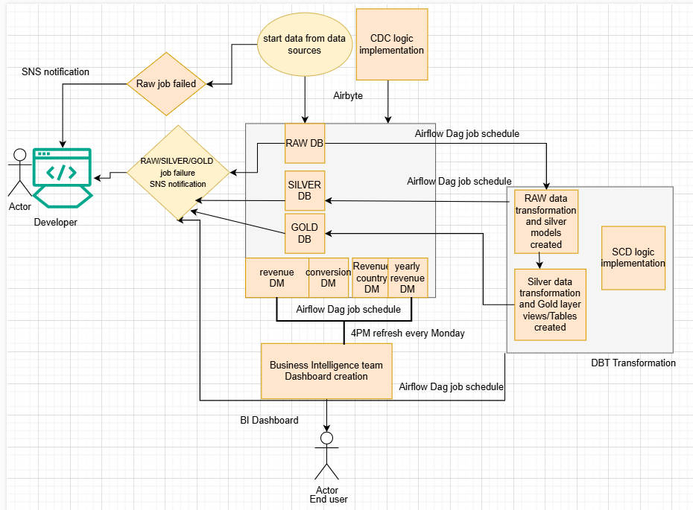
Use-case diagram
Notes:
I used a star schema where the central fact table captures sales and campaign metrics. Dimensions like campaign, country, and date are connected to this fact for easy slicing in BI tools.

Slide 7
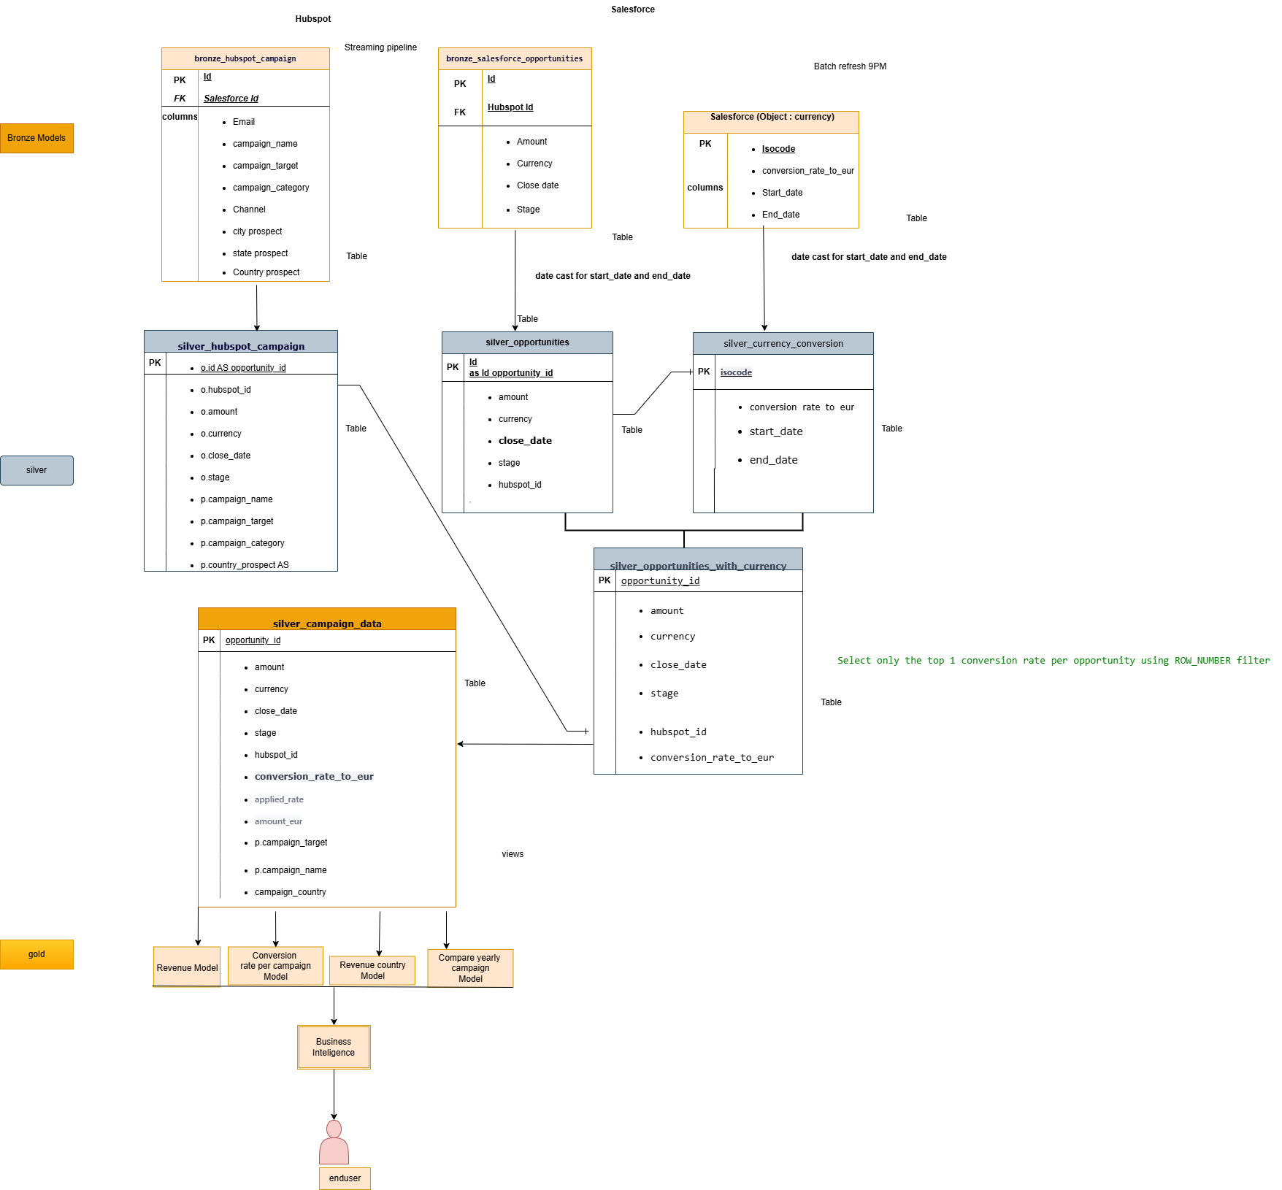
Data Modelling
Link
Notes:
Please use draw.io for better visibility, or else you could also enlarge the image. Currency conversion uses the rate valid on or before the opportunity’s close date. We run weekly batches, keep data for at least 3 years, and used CDC logic for updates. HubSpot and Salesforce data are matched using foreign keys and carefully joined to avoid duplicates or mismatches.

Slide 8
Star Schema
Ingestion | Airbyte streams opportunities, prospects; batch for currency
Storage | DWH (Databricks, Redshift, etc.) with bronze → silver → gold layers
Transformation | dbt models (T-1 logic for silver & gold layers)
Orchestration | Airflow schedules daily + Monday 4PM refresh
Logical Data Models | Gold layer = logical datamodels were build.
BI Dashboards | Refreshed weekly on Monday at 4 PM
Fact Table:
fact_marketing_sales
Dimensions:
Campaign
Country
Date
Metrics:
Revenue (EUR)
Conversion status
Notes:
I use Airflow to schedule the pipeline every Monday at 2 PM. The DAG includes Airbyte sync, dbt transformations, and tests. Email or SNS alerts are sent if anything fails.

Slide 9
Data Processing & Transformation Scalability & Future Considerations
• Historical currency conversion rates are applied per transaction date.
• Change Data Capture (CDC) strategy: Near real-time updates but weekly aggregation for analysis.
• Data reconciliation between HubSpot and Salesforce.
• Weekly orchestration schedule for BI Dashboard (Monday 4 PM).
• Data retention strategy: At least 3 years.
• No expected significant data growth.
• No immediate plans for additional data sources or geographic expansion.
Notes:
I applied multiple dbt tests — like not_null, uniqueness, and relationships — to ensure data is clean and joins are valid. We also added row count comparisons between raw and processed tables to catch missing data early.

Slide 10
⏱️ Orchestration & Scheduling Overview
🔄 Airbyte syncs opportunities and prospects continuously throughout the day.
🕗 The currency table is loaded in daily batches at 9:00 PM.🧪 Silver layer transformations run on a T-1 schedule, processing data from the previous day.
🥇 Gold layer models also refresh daily on a T-1 basis, preparing metrics for reporting.
📊 BI dashboard is refreshed every Monday at 4:00 PM to support weekly reporting.
🛠️ All Airbyte syncs and dbt model runs are orchestrated via Airflow, with the full pipeline scheduled for a weekly refresh on Mondays at 2:00 PM.
Notes:
I used Git for version control. Airbyte, dbt, and Redshift changes are deployed via scripts and monitored with logs and alerts. This helped automate the pipeline and made it easier to manage small changes safely.

Slide 11
Data Quality Strategy and Data Governance
✅ Schema and null checks using dbt tests
✅ Deduplication of records in silver layer
✅ Referential integrity enforced between models
✅ Monitoring with test coverage reports in dbt Cloud
Role-based access at schema/model level
📜 dbt documentation for model transparency
🧾 Version control of all transformations via Git
⏳ Data retention managed through table partitioning
Notes:
This project helped me build a full pipeline from raw data to business-ready insights, using tools I use every day like Airbyte, dbt, Redshift and Airflow. Happy to walk you through any piece in more detail.

Slide 12

Test Cases
✅ dbt Schema Tests: Check for presence of required fields
✅ Null Value Tests: Validate key fields like IDs, currency, stage
✅ Relationship Tests: Ensure referential integrity across joins
✅ Currency Join Accuracy: Ensure correct mapping based on date ranges
✅ Row Count Checks: Validate consistency across raw to silver transitions
✅ KPI Verification: Compare expected vs actual values for revenue/conversion
Notes:
I applied multiple dbt tests — like not_null, uniqueness, and relationships — to ensure data is clean and joins are valid. I also added row count comparisons between raw and processed tables to catch missing data early.

Slide 13
CI/CD Integration for Data Engineering Pipeline
(Airbyte, Redshift, dbt, BI Tool)
🔹 Goal: Automate deployment, version control, and monitoring for data ingestion, transformation, and analytics
CI/CD Workflow Steps
🔹 Step 1: Version Control (Git)
main (production), develop (testing), feature branches
Stores: airbyte-config.yaml, dbt_project.yml, migrations/
🔹 Step 2: Continuous Integration (CI) – Automated Testing
✅ Airbyte Tests: Validate syncs & connections
airbyte check-connection --source salesforce --destination redshift
✅ dbt Tests: Schema integrity, data quality
dbt test
✅ Redshift Schema Tests: Validate SQL migrations
psql -h redshift_host -U user -d database -f migrations/test_schema.sql
🔹 Step 3: Continuous Deployment (CD) – Automated Deployments
🚀 Deploy Airbyte → airbyte apply --config airbyte-config.yaml
🚀 Deploy dbt → dbt run + dbt docs generate
🚀 Deploy Redshift Schema → psql -h redshift_host -U user -d database -f migrations/apply_schema.sql
🚀 Deploy BI Dashboards (if applicable)
🔹 Step 4: Monitoring & Alerts
✅ Airbyte Logs (sync failures → Slack, Email)
✅ dbt Monitoring (dbt debug, Cloud alerts)
✅ Redshift Monitoring (AWS CloudWatch, SNS alerts)
✅ BI Alerts (Tableau/Power BI stale data warnings)
Notes:
I used Git for version control. Airbyte, dbt, and Redshift changes are deployed via scripts and monitored with logs and alerts. This helped automate the pipeline and made it easier to manage small changes safely.

Slide 14
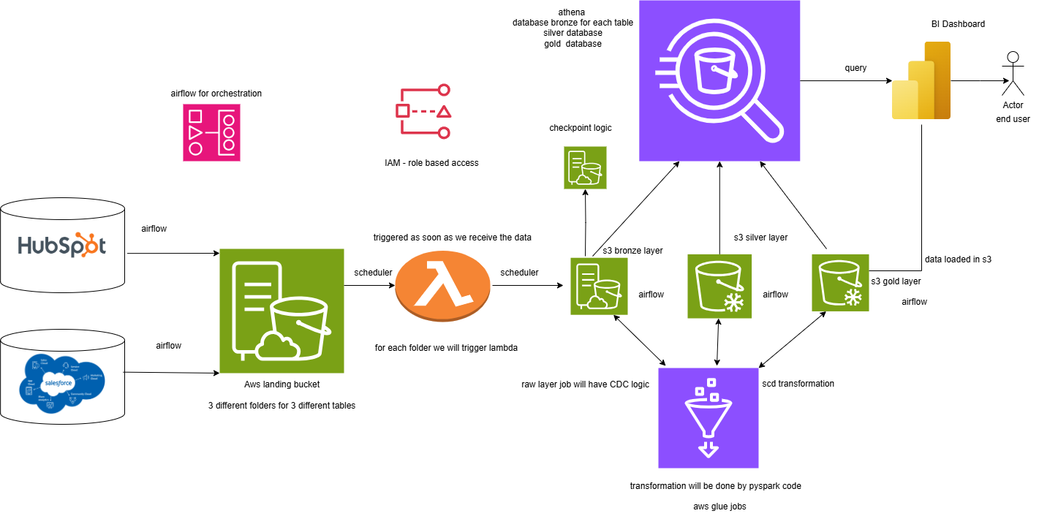
Alternative Architecture
Notes:
Alternative architecture

Slide 15

Thank You !!!
Notes:
This project helped me build a full pipeline from raw data to business-ready insights, using tools I use every day like Airbyte, dbt, Databricks, and Airflow. Happy to walk you through any piece in more detail.

