Slide 1

Visitor-Exhibitor Matching & Insights
ITE Group
Presenters: Rinisha Mohammed

Slide 2


Agenda
Problem Statement
Dataset Analysis
Data Processing and Cleaning
Data Visualization for Visitors and Exhibitors
Cluster Analysis
Cluster Theme Detection using LLM
Visitor-Exhibitor Matching Model
Future Scope

Slide 3

Problem Statement & Business Challenge
Corporate events connect visitors (seeking opportunities) with exhibitors (offering products/services), but inefficient matchmaking leads to missed connections.
Key Challenges:
🔹 Manual matchmaking fails at scale due to thousands of participants. 🔹 Visitors’ interests are expressed in free text, requiring NLP for understanding. 🔹 Exhibitors overgeneralize, selecting all categories, reducing recommendation quality. 🔹 Traditional keyword-based matching lacks personalization and accuracy.
Solution Approach:
✔ Data-driven matchmaking model using Traditional NLP, Generative AI & Clustering. ✔ Scoring system based on semantic similarity & category overlap. ✔ LLM based Penalization logic for overgeneralizing exhibitors. ✔ Optimized networking through insights & recommendations.

Slide 4

Dataset Analysis
Dataset | Key Columns | Description | Relationships
visitors_df | email, gender, id, data | Stores visitor details & their responses (JSON). | data → answers_df (for responses)
answers_df | id, answer, questionId | Stores visitor-selected answers. | questionId → questions_df (for questions)
questions_df | questionId, questionTypeId, stepId, question | Stores visitor registration questions. | Used for visitor preference analysis
exhibitors_df | exhibitorID, Name, MainCategories | Stores exhibitor details & selected categories. | MainCategories → categories_df (for category descriptions)
categories_df | categoryId, categoryName | Defines available exhibitor categories. | Used for exhibitor categorization

Slide 5
Data Processing and Cleaning
Unstructured category names required extensive cleaning for accurate similarity calculations.
Breaking down JSON-based visitor responses helped refine matchmaking accuracy.
Merging exhibitor and category datasets enabled more effective insights into shared interests.
Merging visitors and answers datasets enabled comprehensiveness of visitor profiles
Basic Pre-processing and feature engineering significantly improved the efficiency of recommendations.
Traditional penalization logic for overgeneralizing exhibitors often apply blanket penalties struggled with arbitrary thresholds, potentially misclassifying relevant exhibitors.
The LLM-driven penalization logic ensures context-aware selection, preventing exhibitors from unfairly dominating recommendations while maintaining fairness in rankings.

Slide 6
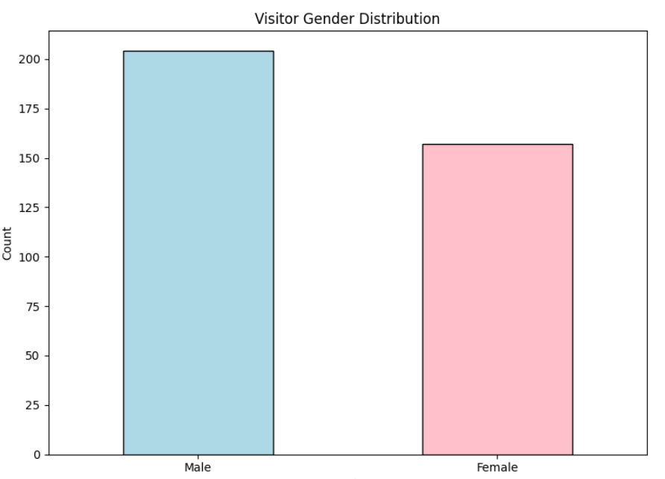
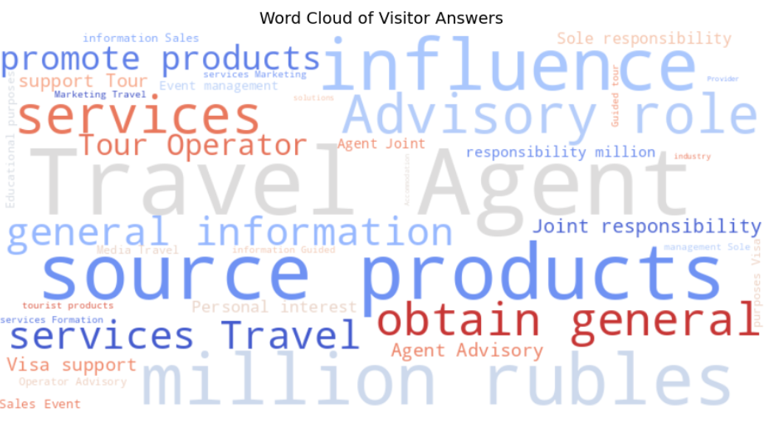
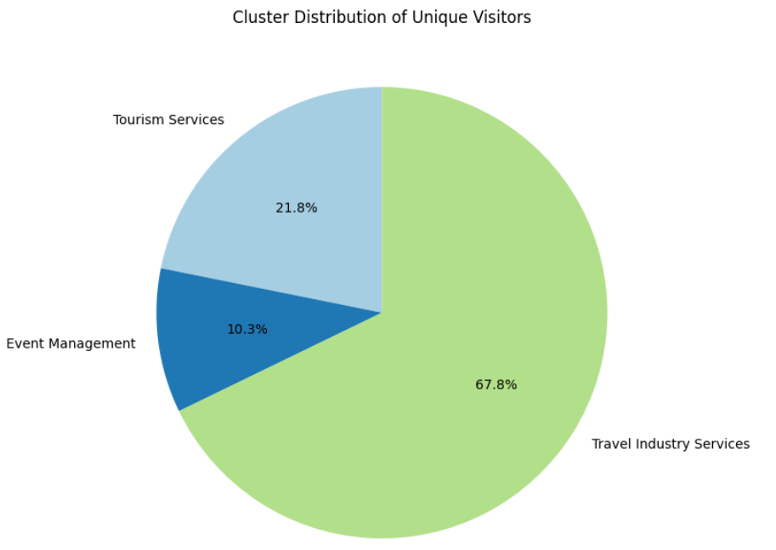
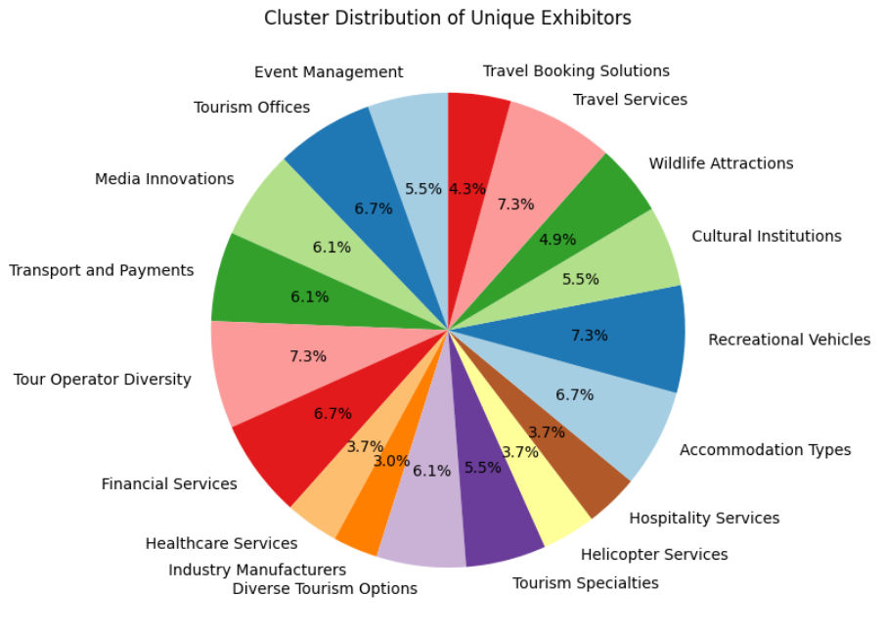
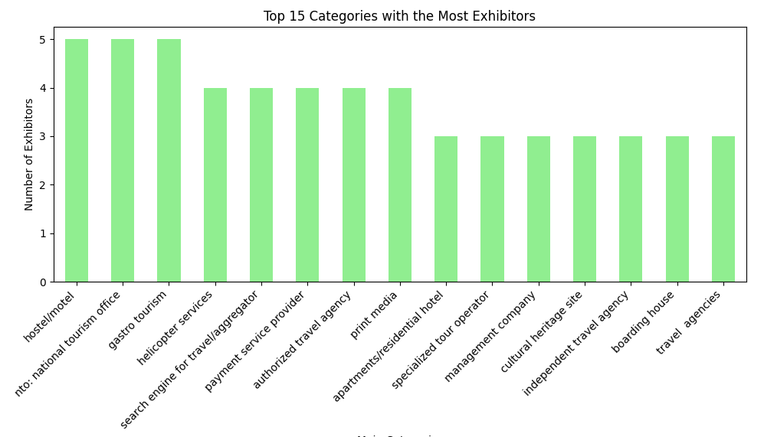
Data Visualization for Visitors and Exhibitors

Slide 7

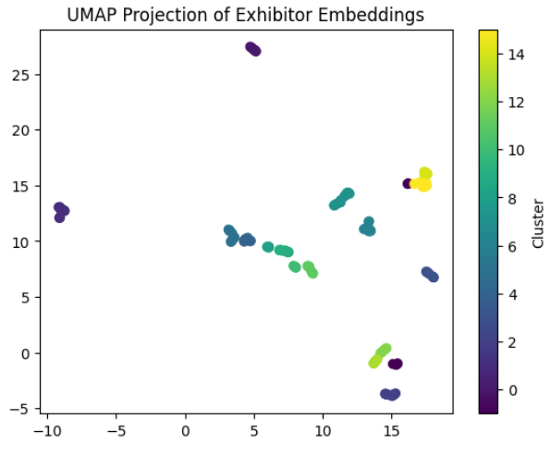
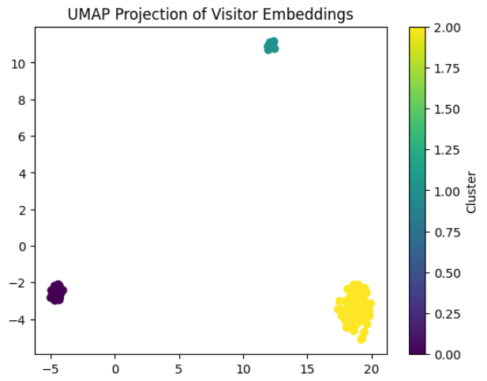
Cluster Analysis
HDBSCAN is used for cluster analysis because it handles clusters of varying shapes and densities, unlike KMeans which assumes spherical clusters.
Additionally, HDBSCAN automatically detects and handles noise and outliers, providing more flexibility without needing a predefined number of clusters.
Exhibitor clusters based on categories
(13 clusters identified)
Visitors clusters based on answers
(3 clusters identified)

Slide 8
Cluster Theme Detection using LLM
LLM (GPT 4o mini) is used to generate themes for clusters, offering a deeper, context-aware analysis.
This approach overcomes the limitations of keyword extraction for topic clustering, which often misses nuanced relationships and context.
Exhibitor clusters based on categories
(13 clusters identified)
Visitors clusters based on answers
(3 clusters identified)
Event Management
Tourism Offices
Media Innovations
Transport and Payments
Tour Operator Diversity
Financial Services
Healthcare Services
Industry Manufacturers
Diverse Tourism Options
Tourism Specialties
Helicopter Services
Hospitality Services
Accommodation Types
Recreational Vehicles
Cultural Institutions
Wildlife Attractions
Travel Services
Travel Booking Solutions
Tourism Services
Event Management
Travel Industry Services

Slide 9
Visitor-Exhibitor Matching Model Semantic Cluster-Based Hybrid Recommendation System
Recommendation Approach
Retrieve Visitor Data – Extracts visitor preferences and themes from stored records.
Extract Visitor Categories – Identifies key topics in visitor responses using NLP.
Compute Semantic Similarity for Clusters – Measures how closely the visitor’s theme matches exhibitor clusters.
Select Top Clusters – Picks the most relevant clusters based on similarity scores.
Filter Exhibitors – Narrows exhibitors to those within the top clusters.
Calculate Category Overlap Score – Assesses how much the visitor’s interests align with exhibitor categories.
Aggregate Scores – Averages similarity and category overlap scores for each exhibitor.
Compute Weighted Scores – Assigns different weights to semantic and category overlap scores.
Select and Return Top Exhibitors – Ranks exhibitors based on the final score and provides recommendations.

Slide 10
Visitor-Exhibitor Matching Model Semantic Cluster-Based Hybrid Recommendation System
Personalized Recommendations – Matches visitors with the most relevant exhibitors.
Context-Aware Matching – Uses themes and category overlap instead of simple keyword matching.
Improved Accuracy – Semantic similarity ensures deeper understanding of visitor interests.
Scalability – Can handle large datasets with multiple exhibitors and visitors efficiently.
Dynamic Adaptability – Can refine recommendations based on visitor feedback and interactions.
Key Advantages of Semantic Cluster-Based Approach

Slide 11

Future Scope
Data Quality Improvement: Collect more data cleaning and validation pipelines to ensure accurate, consistent data for better matching.
Enhanced Data Enrichment: Augment visitor profiles with external data (e.g., social media, event history) for deeper insights.
Advanced NLP Techniques: Employ advanced NLP models (e.g., BERT, GPT) for better understanding of visitor responses and theme extraction.
Predictive Visitor Intent: Use ML models to predict visitor interests and proactively suggest relevant exhibitors.
Collaborative Filtering: Integrate collaborative filtering for recommendations based on similar visitors’ behaviors.
Real-Time Feedback Loop: Collect visitor feedback during the event to adjust recommendations in real-time.
Include historic data: Incorporating historic data allows to track visitors' past preferences. This enables to provide more personalized recommendations based on their previous choices.
Context-Aware Recommendations: Consider event context (e.g., time, visitor goals) to make more relevant suggestions.

Slide 12




THANK YOU!
Rinisha Mohammed
rinishaniyamol@gmail.com
+971553440294

