Slide 1
UNIONS

Slide 2
Session Objectives
Discuss Unions
Create Union variable
Access Union member using . operator
Discuss Unions of Structures
Compare Structure and Array
Difference between structure & union

Slide 3
Unions are collection of different datatype grouped together under a single variable name for convienient handling.
syntax : union <union name >
{
datatype member1;
datatype member2;
};
union book
{
int pages;
char bookname[10];
char author[20];
float price;
};

Slide 4
For Example :
#include<stdio.h>
union amount
{
int ac_no;
char name[10];
char city [20];
int bal;
}a;
void main()
{
printf("Enter the account Details:\n");
scanf("%d%s%d",&a.ac_no, &a.name, &a.state, &a.bal);
printf(“%d\n%s\n%d\n", a.ac_no, a.name, a.city, a.bal);
printf("%d\n",sizeof(union amount));
getch();
}

Slide 5
/* For Example 2 */
#include<stdio.h>
#include<conio.h>
void main()
{
union a
{
int i;
char ch[2];
}a1;
a1.i=150;
clrscr();
printf("%d %c %c",a1.i,a1.ch[0],a1.ch[1]);
getch();
}
OUTPUT :
150 ã

Slide 6
Example 3 :
#include<stdio.h>
union amount
{
int acct_no;
int acct_type;
char name[10];
char street[50];
char city_state[20];
int balance;
}a;
void main()
{
printf("Enter the account Details:\n");
scanf("%d%d%s%s%d" ,&a.acct_no,&a.acct_type,&a.name,&a.city_state,&a.balance);
printf("The values are %d\n%d\n%s\n%s\n%d\n", a.acct_no, a.acct_type, a.name, a.city_state, a.balance);
printf("%d\n",sizeof(union amount));
}

Slide 7
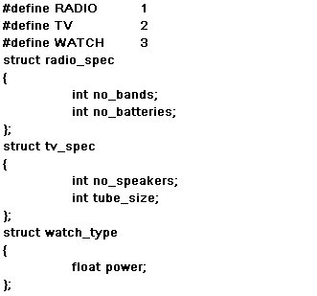
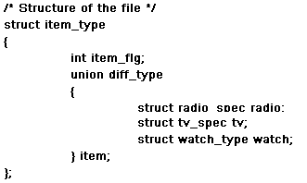
Unions of Structures
It is possible to nest unions within unions, unions in structures,
and structures in unions.

Slide 8

Difference -
Structure & Arrays

Slide 9
Structure | Arrays
It is an single entity representing a Collection of data types of different data types | It is an single entity representing a Collection of data types of same data types
Individual entries in a structure are called Members | Individual entries in a array are called array elements
The members of a structure are not stored in sequence of memory locations | The members of a array are stored in sequence of memory locations
All the members of a structure can be initialized | Only the first member of an union can be initialized
Individual structure elements are referred through the use of .(dot or membership) operator | Individual array elements are accessed by its name followed by the square braces[] within which the index is placed
Initialization of elements can be done only during structure definition | Initialization of elements can be done during array declaration
Structure definition reserve enough memory space for its members | Array declaration reserve enough memory space for its elements
The keyword ‘struct’ tells us what we are dealing with structure | The is no keyword to represent arrays

Slide 10
Difference -
Structure & Union

Slide 11
Structure | Union
Keyword : struct | Keyword : union
Each member in a structure occupies and uses its own memory space | All the members of a union use the same memory space
More memory space is required since each member is stored in a separate memory locations | Less memory space is required since all member is stored in the same memory locations
All the members of a structure can be initialized | Only the first member of an union can be initialized
The variables that make up the structure are called Structure variable | The variables that make up the union are called union variable
Individual structure elements are referred through the use of .(dot or membership) operator | Individual union elements are referred through the use of .(dot or membership ) operator
Structure is a user-defined data type. | Union is a user-defined data type.
Possible to have one structure within another structure | Unions within union is possible

Slide 12
Session Summary
The union is another compound data type may hold the variables of different types and sizes with the compiler keeping track of the size.
The memory space reserved for a union members is large enough to store its largest member
The keyword “union” begins the union declaration followed by the tag (i.e., union name)
Within the braces union members are declared

Slide 13
EXERCISES
Define a union called student that will describe the following information student name,class,rollno, subject marks & total. Using student declare an array stu_list with 30 elements. Write program in C to read the information about all the 30 students and to display the information?

