Slide 1
Powered to Live Better
LIFE POWERED BY TECH · HACKATHON PITCH
Know what your CEB bill really costs, and how much solar could save your family.
Team The Revengers
Ryan Boodhoo · Rohini Beegoo · Laura Isabelle · Lohit Durbarry · Vihaan Seetohul
Notes:
OPEN (10 sec). Keep this up while judges settle in.
Team: Ryan Boodhoo, Rohini Beegoo, Laura Isabelle (Design / QA / Pitch), Lohit Durbarry, Vihaan Seetohul. Other roles to assign: Backend Lead, Data Lead, Frontend Lead, Integrator.
Time budget: Problem 30s, Solution 30s, Before/After 20s, Live demo 60s, How it works and our edge 40s, Impact 20s, then the Questions slide.

Slide 2


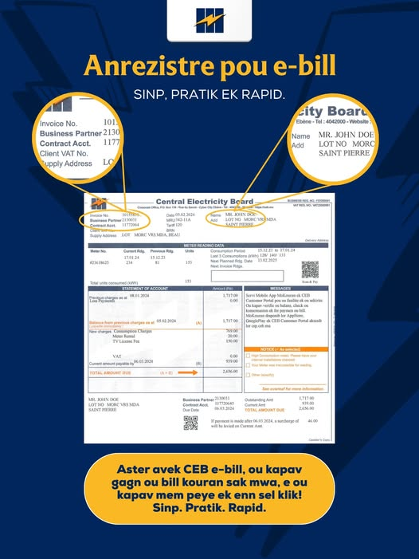
The problem
+15%
WHO STRUGGLES, AND WHY
Most Mauritian households
Since 1 May 2026, a typical 200 kWh bill went from Rs 1,058.25 to Rs 1,216.75. Families can't see how their bill is worked out, or whether solar would pay off for them.
rise in CEB household rates, 1 May 2026
Rs 60 to Rs 450 more every month since 1 May 2026
Source: CEB tariffs 2026 (ceb.mu/tariffs)
Source: L'Express, 1 May 2026
CEB'S OWN SAMPLE BILL
153 kWh = Rs 769 in Feb 2024. The same usage today: Rs 884 (+15%).
Source: CEB Facebook, e-billing post (sample bill). 2026 figure calculated from CEB tariffs 2026.
«Cette dépendance au fioul lourd nous expose directement aux fluctuations du marché international.»
This dependence on heavy fuel oil exposes us directly to international market swings.
Shamshir Mukoon, Director General, CEB. Défi Media, 11 Apr 2026
Notes:
PROBLEM (30 sec). One real number, one real person, real proof. Replace [X] with your strongest statistic and say where it comes from. Paste 2–3 real screenshots, clippings or photos into the dashed boxes (delete any box you don't use). Even 5 quick answers from classmates or family count as a survey.
SOURCES: +15% and Rs 1,058.25 to Rs 1,216.75: CEB tariffs 2026 (ceb.mu/tariffs). Rs 60 to Rs 450 a month: L'Express, 1 May 2026, Mahen Chitamun. Power cuts: Défi Media infographic, CEB communiqué of 12 Nov 2026. Sample bill: CEB official Facebook page, e-billing launch post (https://www.facebook.com/ceb.intnet.mu/posts/-new-e-service-launch-ceb-e-billing-now-availabledear-valued-customerswe-are-ple/1421842509744653/); Rs 884 is our calculation with CEB 2026 tariffs. Quote: Défi Media, 11 Apr 2026, Sharone Samy, https://defimedia.info/securite-energetique-hausse-de-15-du-tarif-le-1er-mai

Slide 3



Our solution
ReVolt shows Mauritian families what their electricity costs today, and how much they'd save with solar, using official CEB data.
Bill calculator
MAIN FEATURE · THE ONE WE LEAD WITH
Your bill split by official CEB tariff band
Solar check
Puts your bill without solar next to your bill with solar: how much you save each month, and how many years until the panels pay for themselves under the 2026 scheme (25% grant, up to Rs 75,000).
My readings
Save each month's usage and see the trend
Cyclone mode
Hours your battery keeps fridge, lights, Wi-Fi on
Notes:
SOLUTION (30 sec). A non-technical judge should get it instantly. Lead with the single feature that matters most, then mention the others in one breath. Be honest about what is a future idea.
SURPRISE CARD (Made for Mauritius): Cyclone mode. In a cyclone the CEB grid goes down, and ordinary rooftop solar switches off with it; only a battery keeps the power on. Cyclone mode tells families, before the storm, how long their battery keeps the fridge, lights and Wi-Fi running (up to about 4 days on a standard 5 kWh battery, assuming a new, fully charged battery). For official cyclone warnings, the screen points families to the MMS. (Only if the OpenWeather wind outlook ships before the freeze: add that it also says when to charge the battery.)
Pitch line: Every cyclone season the grid goes down, and normal solar goes down with it. ReVolt tells you, before the storm, how long your battery keeps your fridge cold.
Future idea if asked: Scan your bill (photo of the CEB bill reads the kWh). Not built yet.

Slide 4


Before vs. after
Before
After
Bill up 15%, no idea why
Bill split by official CEB bands
Can't tell if solar would pay off
Monthly savings and payback years
No easy way to track usage
Usage trend, month by month
From guessing to knowing
One number from the CEB bill gives a family a clear answer on solar.
Notes:
BEFORE / AFTER (20 sec). This is the pivot: the non-technical story has landed, now go straight into the demo. Keep each point to a few words. Fill the bottom strip with the single most memorable improvement.

Slide 5
Live demo
[Backup: paste a screenshot or a 30-second screen recording of the app here, in case the live demo fails]
1
A family opens ReVolt
with 200 kWh from their CEB bill
2
Bill by band, then Solar check
monthly savings and payback years
3
Cyclone mode
how long the battery keeps the fridge on
DEMO SAFETY NET
Demo data seeded in advance
Runs locally, no Wi-Fi needed
One person drives, one narrates
Notes:
LIVE DEMO (60 sec). Tell it as the persona's story in three clicks, not a feature tour. Rehearse the exact path at least 3 times. Put a screenshot or recording in the dashed box so that if anything breaks you say "here is what you would see" and keep going. Never debug on stage.
DEMO ORDER: 1) enter 200 kWh. 2) bill by band (Rs 1,216.75), then Solar check. Leave the panel size on "Recommended for my usage": the app picks 2 kWp for 200 kWh. Read: with solar Rs 211.60 (CEB minimum, tariff 150A), save Rs 1,005.15 a month, money back in 13 years. 3) Cyclone mode: tick fridge, Wi-Fi and LED light (6 hours a day) and read the result exactly as the screen shows it: "up to about 4.1 days" (98.3 hours) on a 5 kWh battery. Always say "up to", and add that it assumes a new, fully charged battery. Say it's our answer to the Made for Mauritius card. 4) My readings: Aug 2026 = 190 kWh and Sep 2026 = 201 kWh are already entered (reset the database and enter them just before going on stage). Say "we've entered two example months already", then type Oct 2026 = 230 kWh live: bill Rs 1,458.85 and the trend goes up. 5) Close: back to the slides for Impact.
BEFORE GOING ON STAGE: reset the database, enter Aug 190 and Sep 201, check the bill page shows Rs 1,216.75 for 200 kWh, and have the backup screenshot ready.

Slide 6





How it works, and our edge
Frontend
API
Database
Blazor
ASP.NET Core
SQLite
Enter kWh, see the bill, solar savings and battery hours
Bill by CEB band, solar savings, payback and battery hours
CEB tariffs, 2026 solar scheme, monthly readings
Our edge in one line: Unlike CEB's calculator, ReVolt explains your bill band by band, works out solar savings without needing a quote first, and tracks your usage month after month.
Official data
CEB tariffs and solar scheme, Statistics Mauritius, PVGIS (EU JRC)
Notes:
HOW IT WORKS (30 sec). Keep it to screen > logic > storage. Saying clearly what is mocked builds trust; judges usually ask anyway. Save deeper technical detail for Q&A (see the backup slide at the end).
OUR EDGE: say the one-line edge out loud. Judges always wonder whether this already exists. The closest existing tool is CEB's online solar calculator; be fair to it, then say what only ReVolt does.
IF ASKED ABOUT ACCURACY: a solar home moves to CEB tariff 150A, which has a minimum charge (Rs 211.60 for 76 to 300 kWh). ReVolt follows it, so it never promises a bill below what CEB will charge. CEB's own calculator showed a negative bill (Rs -388.40) for the same household. Source: GN 473/2026, Appendix VIII.

Slide 7
Impact
484,680
201.5
Rs 1,902
domestic CEB customers
kWh a month, average home
more per year on a 200 kWh bill
Statistics Mauritius, 2025
Statistics Mauritius, 2025 (derived)
Rs 158.50 a month, CEB tariffs 2026
Less imported fuel for Mauritius
Every home that switches to solar cuts what CEB has to burn. CEB spent about Rs 6.87 billion on heavy fuel oil from January to September 2026, up about 17% on the same months of 2025.
Source: L'Express, 1 Oct 2026 (CEB figures)
Notes:
IMPACT (20 sec). Say how each number was found: 484,680 domestic customers and 201.5 kWh per home come from Statistics Mauritius 2025; Rs 1,902 is Rs 158.50 a month x 12 from the CEB 2026 tariffs.
FUEL: CEB spent about Rs 6.87 billion on heavy fuel oil in January to September 2026, against Rs 5.88 billion in the same months of 2025 (about +17%). Source: L'Express, 1 Oct 2026, Mahen Chitamun. CEB's director: dependence on heavy fuel oil exposes Mauritius directly to international market swings (Defi Media, 11 Apr 2026).
Then move to the Questions slide.

Slide 8
Questions?
THANK YOU
ReVolt: see what your electricity costs today, and what solar could save you.
Team The Revengers
Ryan Boodhoo · Rohini Beegoo · Laura Isabelle · Lohit Durbarry · Vihaan Seetohul
Notes:
QUESTIONS. Keep this up while judges ask questions. Decide now who answers each topic (full list in docs/demo/qa-prep.md).
- Real vs mocked: everything runs on real data. Bill: CEB tariffs 2026 (and 2023 rates for older readings). Solar: CEB 2026 scheme, 25% grant, Rs 2,000 fee, PVGIS, tariff 150A. Cyclone: sourced appliance watts and battery figures.
- Can solar make my bill zero? No: tariff 150A keeps a minimum (Rs 211.60 for 76 to 300 kWh).
- Privacy: no login and no personal details; we store only the month and kWh of each reading.
- Cyclones: solar keeps the lights on only with a battery (CEB SSDG Grid Code, April 2026, s. 2.5). Up to about 4 days for fridge, Wi-Fi and LED light on a 5 kWh battery.
- Built in 24 hours: [who did what]
If you can't answer: Good question, we haven't solved that yet, here is how we'd approach it.

