Slide 1



SOCIAL MEDIA SENTIMENT ANALYSIS REPORT: LAWRENCE TECHNOLOGICAL UNIVERSITY
Course: INT6303 – Social Media Data Analytics
Mentor: Prof. Mazin Al Hamando
Team: Rinkuben Dhavalkumar Patel, Swathi Kannapiran
Date: 8th May 2025

Slide 2

INTRODUCTION
Definition: Sentiment analysis as a subset of Natural Language Processing (NLP).
Context: Analyzes user-generated content from students, faculty, alumni on Twitter, Reddit, and Glassdoor.
Importance: Helps universities monitor feedback, mitigate risks, and enhance strategy (e.g., marketing, admissions).
01

Slide 3
PROBLEM STATEMENT
Issue: Lack of automated tools to interpret large volumes of unstructured social media feedback.
Impact: Delays in addressing concerns like administrative delays or campus safety.
Objective: Develop a system to ingest, classify, and visualize sentiment trends.
02

Slide 4
DATA COLLECTION
Dataset: 500 manually generated posts (Jan-Dec 2024).
Platforms: Twitter, Reddit, Glassdoor.
Fields: Username, Date, Platform, UserType, PostType, Text, Hashtags, Sentiment, PredictedSentiment.
Actual Distribution: 45.8% Positive (229 posts), 43.0% Negative (215 posts), 11.2% Neutral (56 posts).
03

Slide 5
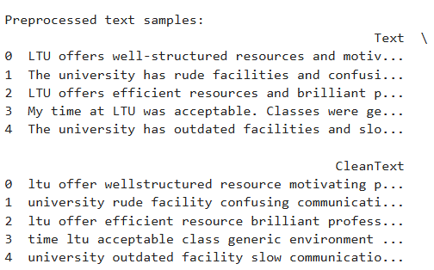
DATA PREPROCESSING
Steps: Lowercasing, stopword removal, lemmatization.
Purpose: Clean text for accurate sentiment analysis.
Tools: NLTK for preprocessing, Pandas for data handling.
04

Slide 6

METHODOLOGY
Analysis: TextBlob for polarity scoring (-1 to +1), n-gram frequency, trend detection.
Visualization: Matplotlib, Seaborn for graphs and charts.
Scope: Static analysis, excluding real-time API and neural networks.
Preprocessing → Scoring → Visualization
05

Slide 7
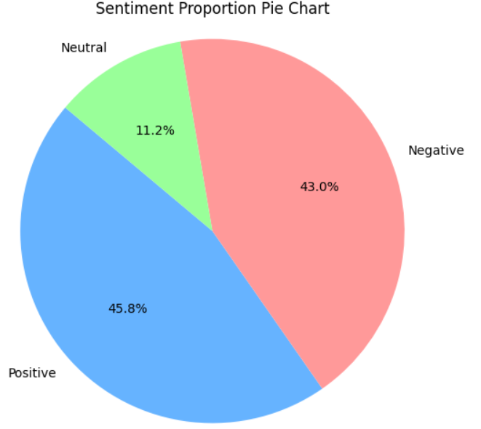
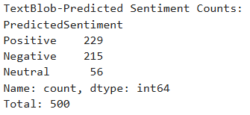
OVERALL SENTIMENT DISTRIBUTION
Positive: 45.8% (229 posts)
Negative: 43.0% (215 posts)
Neutral: 11.2% (56 posts)
Insight: Slight positive lean despite intended balance.
06

Slide 8
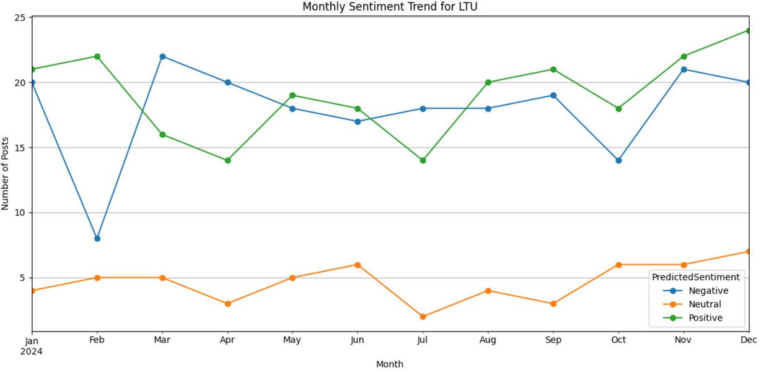
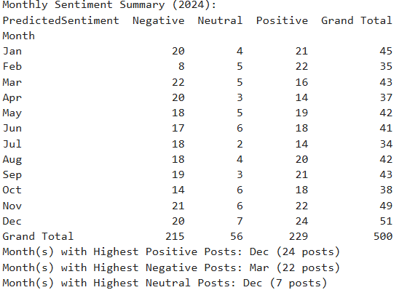
MONTHLY SENTIMENT TRENDS
Highest Positive: December (24 posts)
Highest Negative: March (22 posts)
Highest Neutral: December (7 posts)
Trends: Positive growth in late 2024, negative spike in March.
07

Slide 9
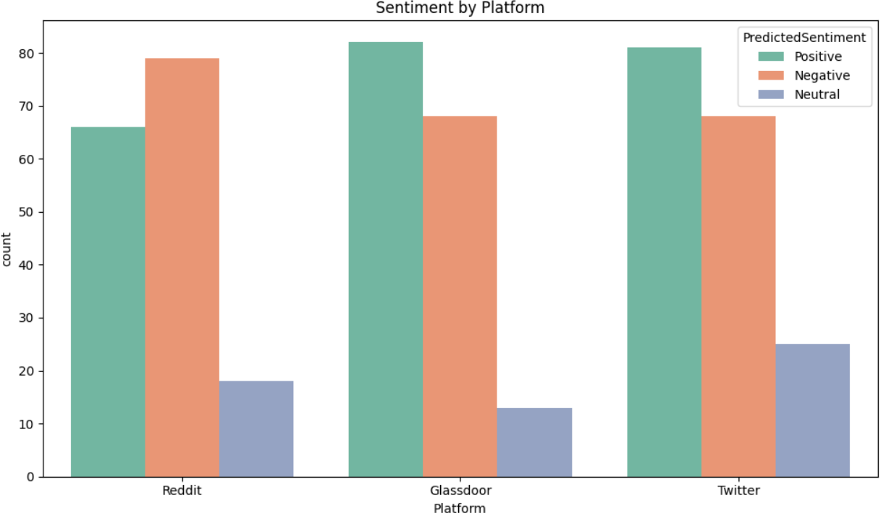
SENTIMENT BY PLATFORM
Reddit: ~70 Positive, ~80 Negative, ~20 Neutral
Glassdoor: ~80 Positive, ~70 Negative, ~15 Neutral
Twitter: ~60 Positive, ~70 Negative, ~30 Neutral
08

Slide 10
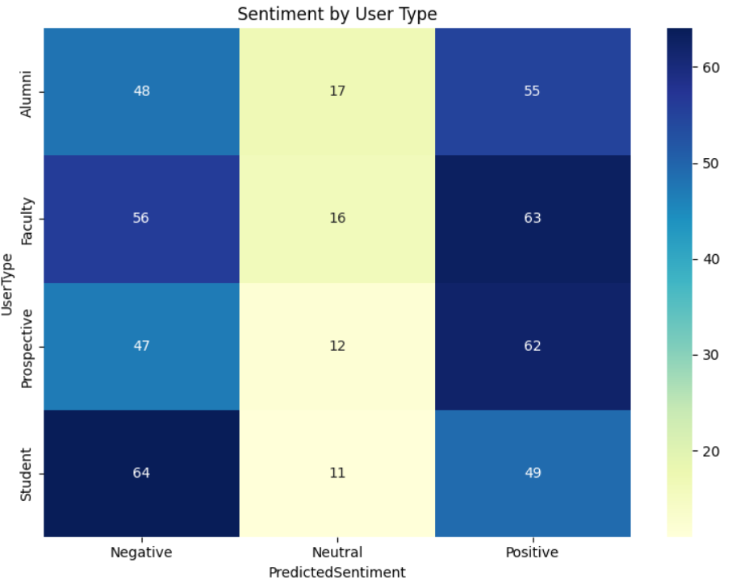
SENTIMENT BY USER TYPE
Students:
49 Positive, 64 Negative, 11 Neutral
Prospective Students:
62 Positive, 47 Negative, 12 Neutral
Faculty:
63 Positive, 56 Negative, 16 Neutral
Alumni:
55 Positive, 48 Negative, 17 Neutral
09

Slide 11
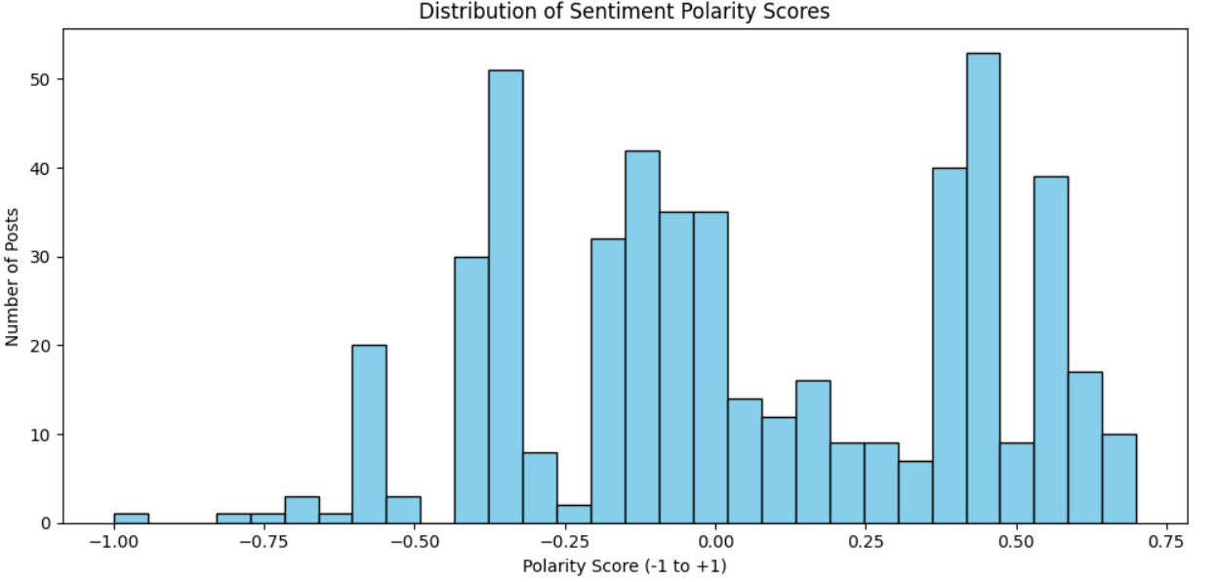
POLARITY SCORE DISTRIBUTION
Range: -1 (negative) to +1 (positive)
Peaks: -0.25 to 0.0 (moderate negative), 0.5 to 0.75 (strong positive)
Few extreme scores (-1.0 or 0.0)
10

Slide 12
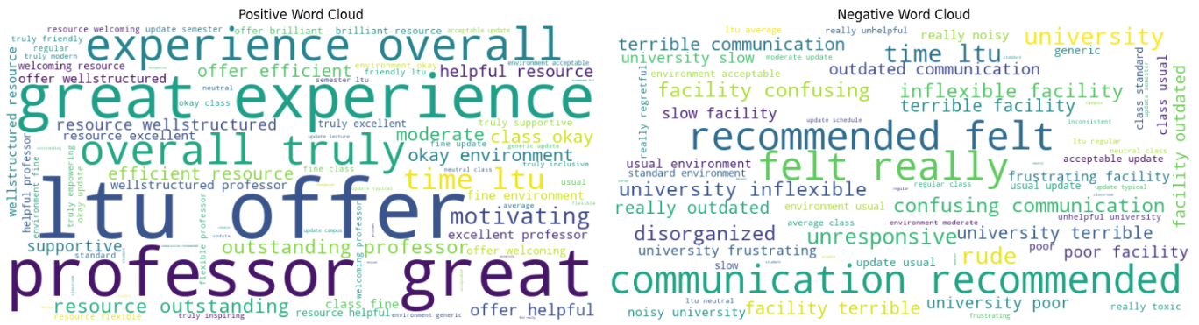
TOP WORDS AND PHRASES
Positive Words: "offers," "great," "experience," "excellent," "supportive"
Negative Words: "outdated," "unresponsive," "frustrating," "poor," "communication"
Positive 2-grams: "great experience," "excellent professors"
Negative 2-grams: “Confusing Communication," "outdated communication"
11

Slide 13
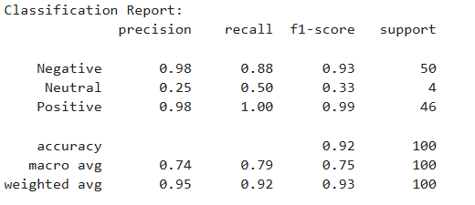
CLASSIFICATION REPORT
Accuracy: 0.92
Negative: Precision 0.98, Recall 0.88, F1-Score 0.93, Support 50
Neutral: Precision 0.25, Recall 0.50, F1-Score 0.33, Support 4
Positive: Precision 0.98, Recall 1.00, F1-Score 0.99, Support 46
Macro Avg: Precision 0.74, Recall 0.79, F1-Score 0.75, Support 100
Weighted Avg: Precision 0.95, Recall 0.92, F1-Score 0.93, Support 100
Insight: High performance for Positive and Negative, but Neutral classification is weak due to low support (4 posts).
12

Slide 14
CONCLUSIONS AND RECOMMENDATIONS
Strengths: Positive feedback on professors and resources.
Challenges: Student concerns about facilities and communication.
Recommendations: Improve infrastructure, enhance communication, and leverage positive aspects in marketing.
13

Slide 15
FUTURE WORK
For contextual analysis, use BERT or RoBERTa instead of TextBlob.
Create a live dashboard for continued institutional usage;
Analyze sentiment by user type (faculty, alumni, and students); and
Expand the dataset to incorporate real-time API data and news items.
14

Slide 16
REFERENCES
Python Libraries & Tools Used:
Pandas (Data Handling)
Website: https://pandas.pydata.org/
Citation: McKinney, W. (2010). Data Structures for Statistical Computing in Python. Proceedings of the 9th Python in Science Conference.
Matplotlib (Visualization)
Website: https://matplotlib.org/
Citation: Hunter, J. D. (2007). Matplotlib: A 2D Graphics Environment. Computing in Science & Engineering, 9(3), 90-95.
Seaborn (Advanced Visualization)
Website: https://seaborn.pydata.org/
Citation: Waskom, M. (2021). Seaborn: Statistical Data Visualization. Journal of Open Source Software, 6(60), 3021.
NLTK – Natural Language Toolkit
Website: https://www.nltk.org/
Citation: Bird, S., Klein, E., & Loper, E. (2009). Natural Language Processing with Python. O'Reilly Media Inc.
5. WordCloud
GitHub: https://github.com/amueller/word_cloud
Documentation: https://amueller.github.io/word_cloud/
6. TextBlob (Sentiment Scoring)
Website: https://textblob.readthedocs.io/en/dev/
Citation: Loria, S. (2018). TextBlob: Simplified Text Processing.
7. Scikit-learn (Machine Learning, TF-IDF, Logistic Regression)
Website: https://scikit-learn.org/stable/
Citation: Pedregosa, F., Varoquaux, G., Gramfort, A., et al. (2011). Scikit-learn: Machine Learning in Python. Journal of Machine Learning Research, 12, 2825-2830.
8. Collections (Counter)
Python Docs: https://docs.python.org/3/library/collections.html#collections.Counter
15

Slide 17
THANK YOU
16

