Slide 1
Executive Summary | FORESIGHT
Inventory decisions from demand, forecast, and risk signals
A practical view of where inventory capital is exposed and what to review next.
VALUE AT STAKE
₹1,555,838,458.90
Cost-basis exposure from D4
REORDER NOW
MARKDOWN / CLEAR
HEALTHY
118
1516
69
Protect availability: 118 SKUs flagged reorder-now.
Reduce excess: 1516 SKUs at markdown/clear.
Figures are computed from official D1-D4 outputs; recommendations and thresholds are assumptions for review.
FORESIGHT official-data readout (D1-D4) | Decision thresholds are assumptions for review

Slide 2
What Is At Risk?
D4 separates availability pressure from excess inventory
TOTAL EXPOSURE
INVENTORY EXPOSURE
STOCKOUT SHORTFALL
₹1,555,838,458.90
₹1,555,597,499.87
₹240,959.03
Decision mix
143 SKUs show a computed lead-time shortfall.
3961 SKUs exceed the healthy-cover inventory target.
Rupee values use official unit_cost on a cost basis; lost revenue is not estimated.
Reorder Now
118
Markdown Clear
1516
Watch Volatile
2792
Healthy
69
FORESIGHT official-data readout (D1-D4) | Decision thresholds are assumptions for review

Slide 3
Recommended Actions
Prioritised directly from D4 output, highest value at stake first
Immediate review queue
SKU | ACTION | VALUE AT STAKE | COVERAGE
SKU03043 | Watch Volatile | ₹24,189,235.60 | 4275.0 weeks
SKU03150 | Watch Volatile | ₹21,779,145.42 | 3974.5 weeks
SKU04062 | Watch Volatile | ₹21,531,336.60 | 7894.0 weeks
SKU03491 | Watch Volatile | ₹18,007,395.54 | 6223.3 weeks
SKU01423 | Watch Volatile | ₹17,724,477.88 | 2175.5 weeks
SKU04409 | Watch Volatile | ₹15,340,654.68 | 3886.0 weeks
SKU01428 | Watch Volatile | ₹15,288,321.22 | 7485.0 weeks
SKU01542 | Watch Volatile | ₹14,797,210.56 | 9288.0 weeks
FORESIGHT official-data readout (D1-D4) | Decision thresholds are assumptions for review

Slide 4
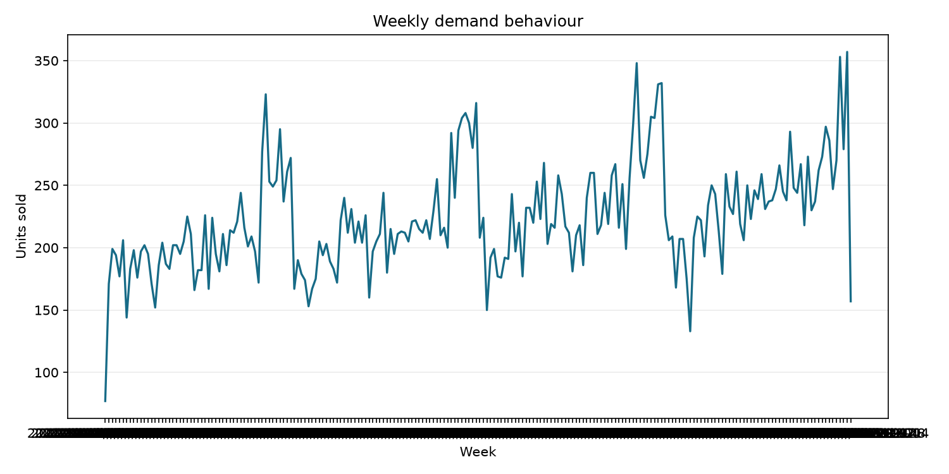
Demand & Inventory Patterns
D2 observations connect demand concentration and seasonality to inventory review
Computed observations
1. SKU04321 is the highest-volume SKU.
It represents 6.5% of 46,940 total units sold.
2. Month 12 has the highest observed demand.
The period total is 5,343 units in the computed month aggregation.
3. 1240 SKU(s) meet the computed dead/slow-stock rule.
The rule flags zero sales or bottom-quartile movement with no observed stock depletion.
4. Aggregate daily demand is increasing over the observed window.
The fitted daily slope is 0.007 units per day.
Charts are descriptive D2 summaries of the official demand data.
FORESIGHT official-data readout (D1-D4) | Decision thresholds are assumptions for review

Slide 5
Forecast Performance
D3 uses chronological rolling-origin validation
MODEL WAPE
BASELINE WAPE
WAPE IMPROVEMENT
MODEL BIAS
50.73%
63.89%
20.60%
0.09 units
Selected model: Hist Gradient Boosting.
Seasonal-naive baseline: 52-week lag.
3 rolling-origin folds with an 8-week horizon.
Negative bias means the forecasts under-predicted actual demand on average.
WAPE is primary; bias is secondary. No random split was used.
FORESIGHT official-data readout (D1-D4) | Decision thresholds are assumptions for review

Slide 6
What This Means Operationally
Translate signals into review conversations, not automated actions
Operations
Finance
Merchandising
Review REORDER_NOW SKUs first.
Check supplier lead times and on-order quantities.
Use coverage and shortfall together.
Monitor cost-basis inventory exposure.
Prioritise high-value markdown candidates.
Separate cash tied up from service risk.
Review seasonal and top-mover patterns.
Investigate low-movement inventory.
Treat volatility as a reason to review, not a forecast guarantee.
FORESIGHT official-data readout (D1-D4) | Decision thresholds are assumptions for review

Slide 7
Assumptions & Limitations
What a decision-maker should know before interpreting the numbers
All forecasts and risk scores are computed from the official D1-D4 outputs; nothing is fabricated or sourced from legacy demo files.
D4 thresholds (coverage target, volatility cut-offs, decision matrix) are implementation assumptions and must be reviewed with the mentor/client.
Rupee exposure uses official unit_cost on a cost basis; lost revenue and margin impact are not inferred.
Forecast performance is measured with chronological rolling-origin folds on the official 25,000-transaction history and should be revisited as data grows.
Promotion and seasonal relationships are descriptive, not causal claims.
The system recommends review priorities; it does not place orders or take actions automatically.
FORESIGHT official-data readout (D1-D4) | Decision thresholds are assumptions for review

Slide 8
Decision Summary & Next Steps
Prioritised actions with honest forecast accuracy and clear assumptions
Today
Before relying on outputs
Use the prioritised queue to review decisions.
Review the D3 accuracy and D4 valuation assumptions.
Keep observed metrics distinct from recommendations and thresholds.
Revisit D3 WAPE/bias and D4 valuation as the official data grows.
Compare updated data sufficiency and risk exposure across refreshes.
Validate recommendations with Operations, Finance, and the mentor before use.
The pipeline is complete on the official data and ready for ongoing review and refresh.
FORESIGHT official-data readout (D1-D4) | Decision thresholds are assumptions for review

