Slide 1
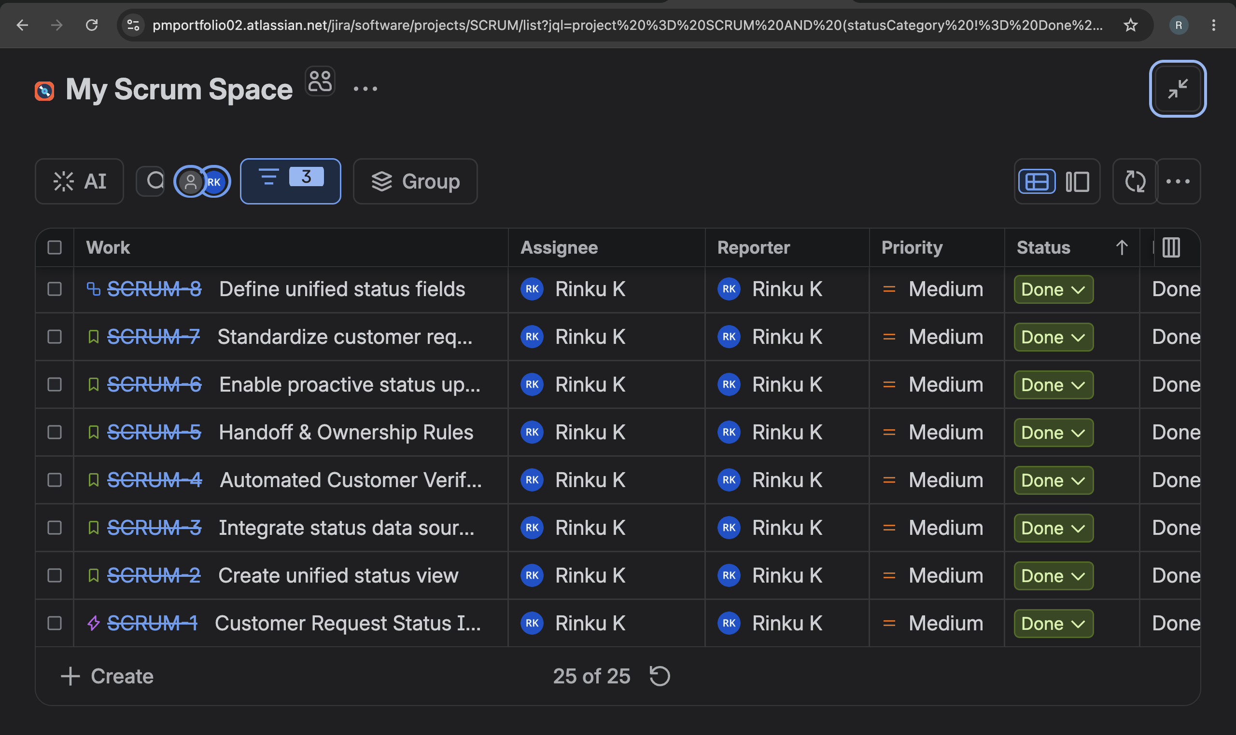
Jira Scrum Backlog – Work Item Execution

Slide 2
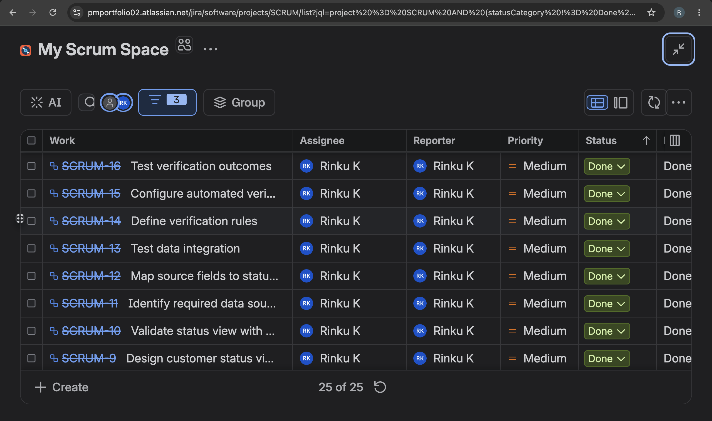
Jira Execution – Supporting Work Items

