Slide 1
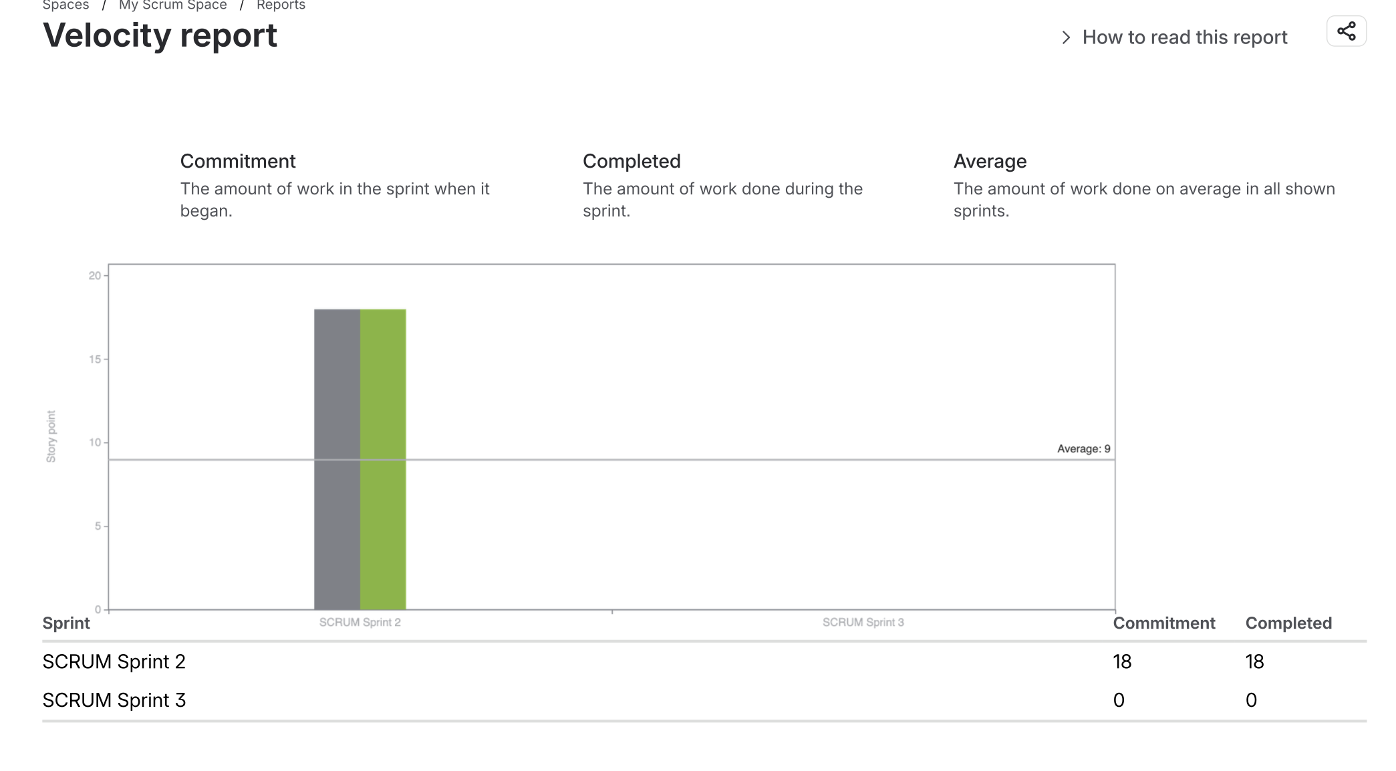
Jira Sprint Execution – Sprint 2
Sprint 2 Outcome: 18 story points committed and 18 completed, demonstrating full completion of the planned sprint scope.

