Slide 1
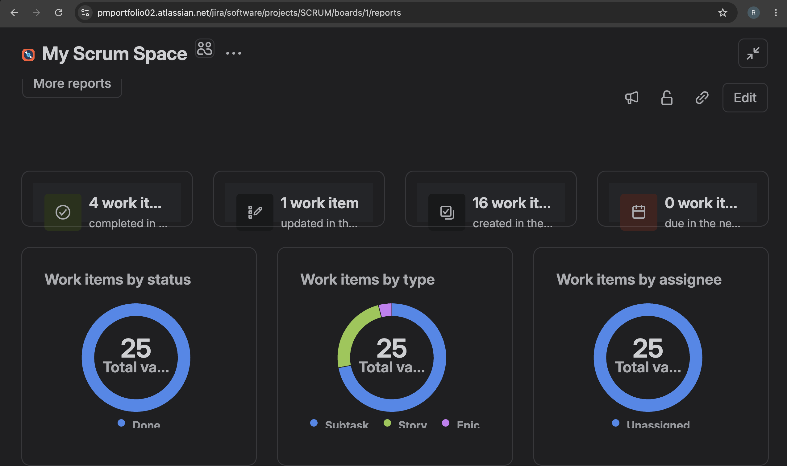
Jira Scrum Status – Overall Delivery Status
Overall Status: 25 Jira work items are shown as completed, indicating closure of the planned improvement work. The report also provides a consolidated view of work-item status, type, and ownership.

