Slide 1
PowerDash AI
Red Bull Basement - ICK

Slide 2
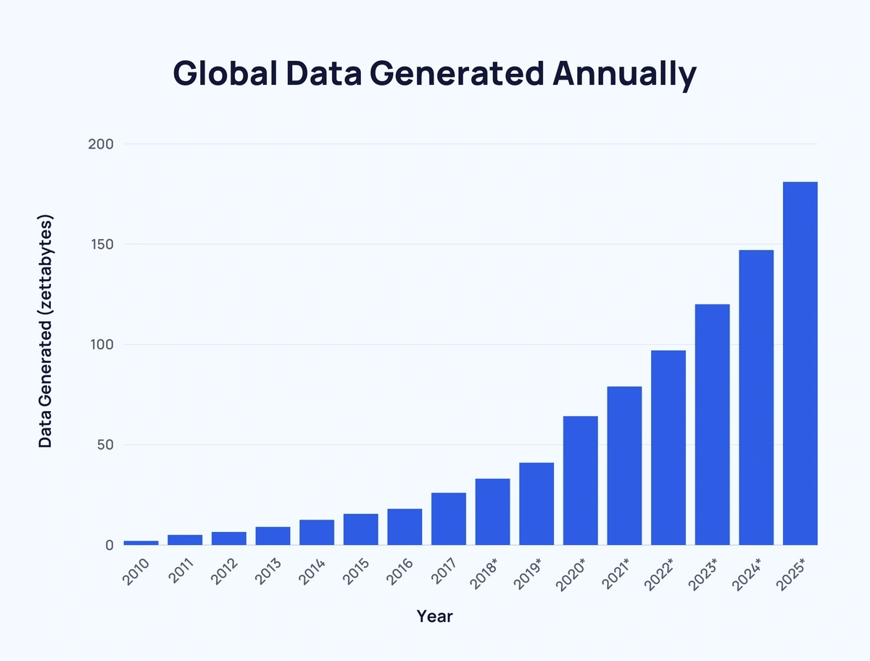
The Data Overload Problem
90% of the world’s data has been created in the last two years alone. (Source: IBM).
Only 0.5% of available data is ever analyzed and used. (Source: Forbes)

Slide 3
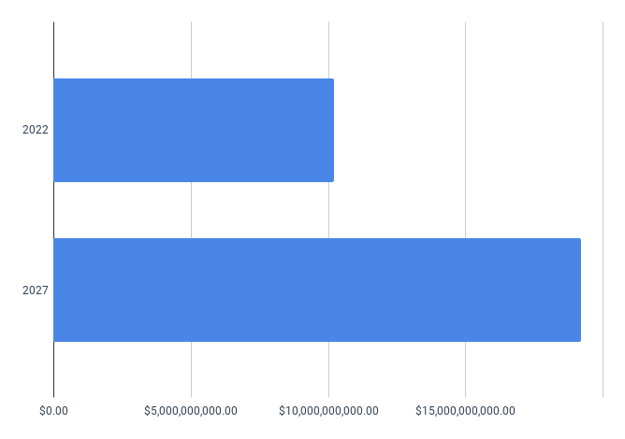
Market Demand for Accessible Data Tools
The global data visualization market is projected to grow from $10.2 billion in 2022 to $19.2 billion by 2027. (Source: MarketsandMarkets)

Slide 4
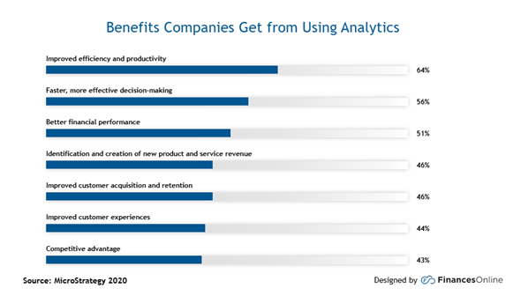
Vision and Social Impact
Data-driven businesses are 23 times more likely to acquire customers, six times more likely to retain them, and 19 times more profitable. (Source: McKinsey)

Slide 5
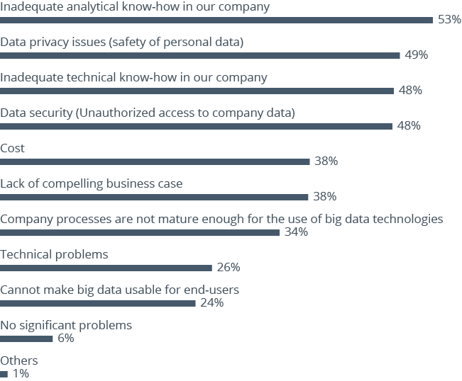
Effort & Time Required for Data Analysis
Nearly 60% of businesses find it difficult to interpret and understand data. (Source: Accenture)

Slide 6
Thank you!

