Slide 1
XAMARIN
Lunchboxapp

Slide 2
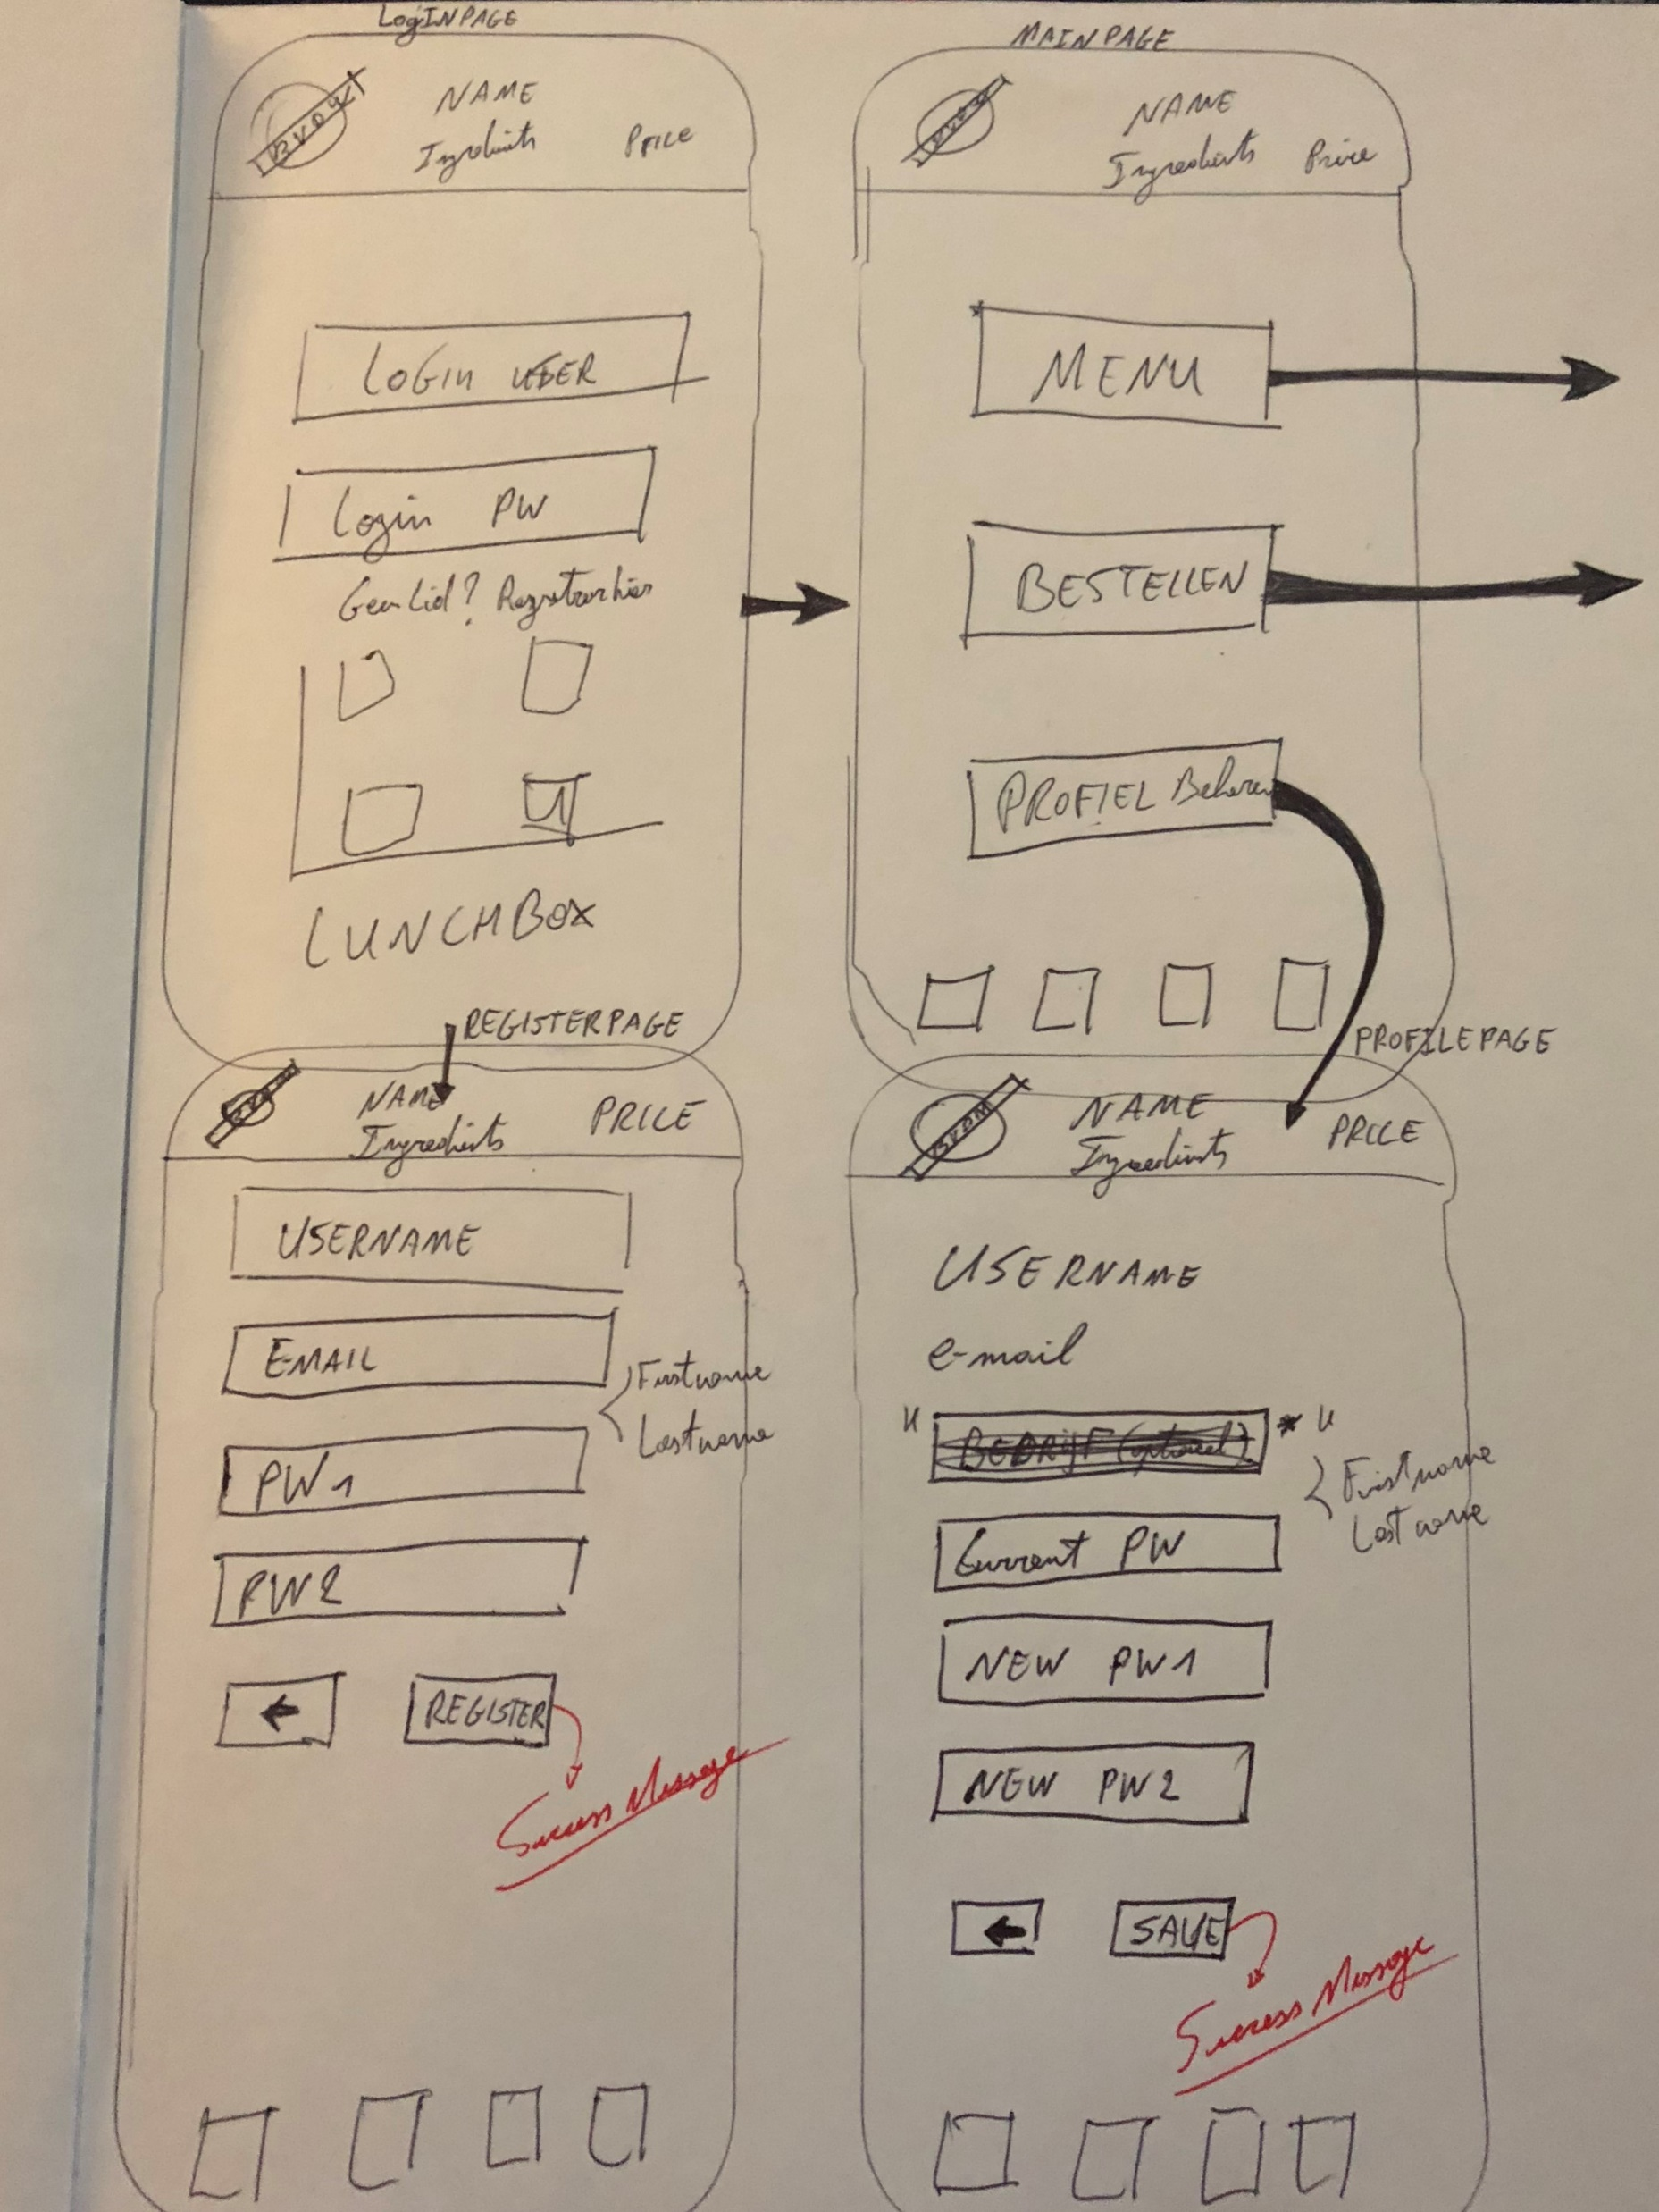
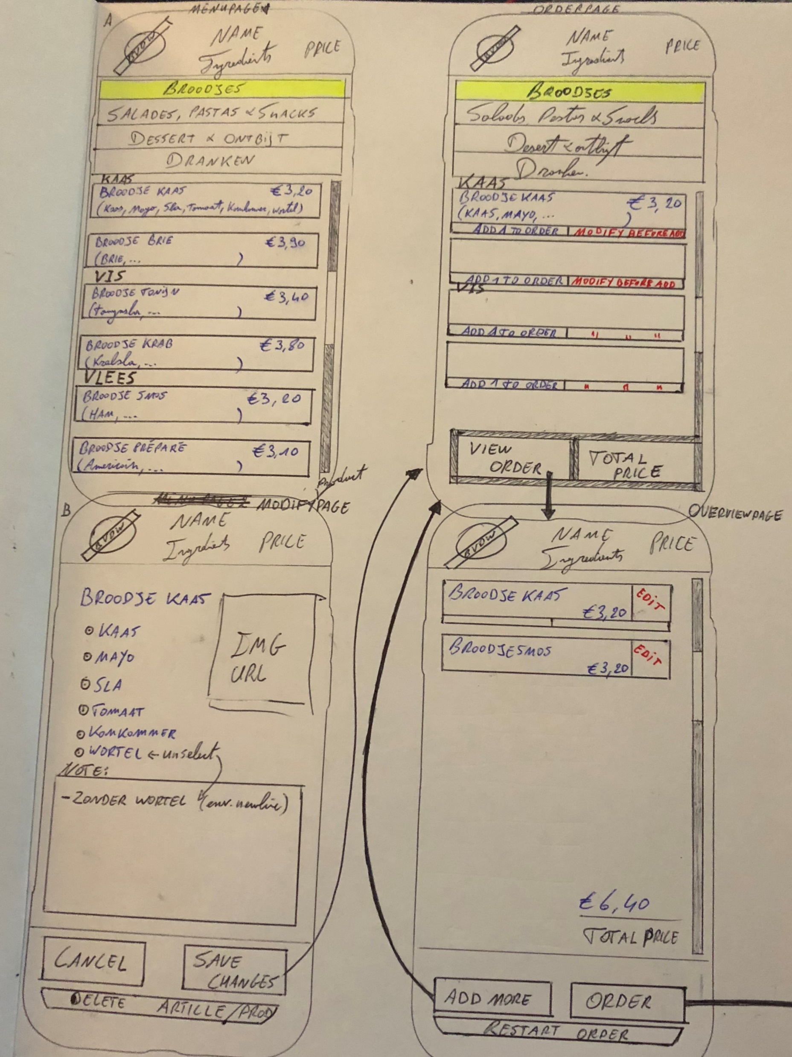
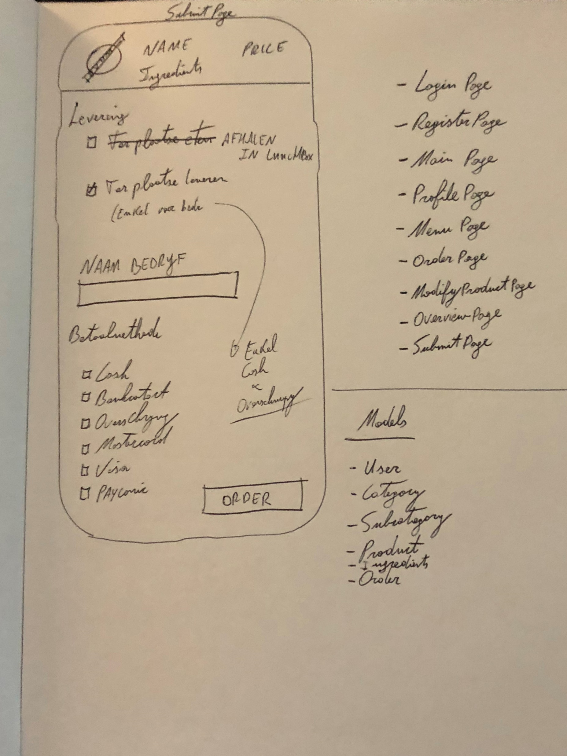
sketch

Slide 3
Models
FreshIoc
Interface
User
Category
Subcategory
Product
Ingredient
Order
Payment
UserService
CategoryService
SubcategoryService
ProductService
IngredientService
OrderService
PaymentService
IUserService
ICategoryService
ISubcategoryService
IProductService
IIngredientService
IOrderService
IPaymentService

Slide 4
Page
models
LoginPage
RegisterPage
ProfilePage
MainPage
MenuPage
ProductPage
OrderPage
Model
Model
Model
Model
Model
Model
Model

Slide 5
Services
AccountValidator
EmailService

Slide 6

Demonstration & code

