Slide 1
Business Model Canvas
Thank you: www.strategyzer.com
Key Partners Software Developers Analytics Training Professionals Business Process Platforms (SAP, Oracle, etc.) | Key Activities Development of custom fit software solutions Training in the use of analytics | Value Proposition Analytics and control over business processes, enabling process control and improvement Software and training in the use of process mining software as well as initial implementation. Uniquely positioned within South African market and environment. |  | Customer Relationships Initial implementation, training and continuous support in the use of process mining and process improvement Integral to business model. Relationships must be maintained and most possible support must be given. | Customer Segments Appealing to larger companies with integrated, and often automated, business processes. Discrete manufacturing processes can also be applied to technology at a later stage.
 | Key Resources Customer relationships are integral. IT infrastructure Training resources |  |  | Channels The IT-space is integral to the use of software for process mining. Integration with other platforms is critical. Furthermore, both remote and direct communication in training and support will be delivered.
Cost Structure Office costs IT systems procurement and maintenance Customer support, training and sales personnel |  |  | Revenue Streams Sale of software solutions (roughly 35% of revenue) Training in use of software and analysis (roughly 30% of revenue) Customer support and initial implementation (roughly 25%)
Social and Environmental Cost |  |  | Social and Environmental Benefit Saving businesses money, potentially saving jobs.
Business Name: Abstineatis Process Mining
I 4.0 Tech Used: Data mining, IT monitoring of business processes
Industry of Business: Business Process Management
Ideal Customer: Large companies with integrated business processes

Slide 2
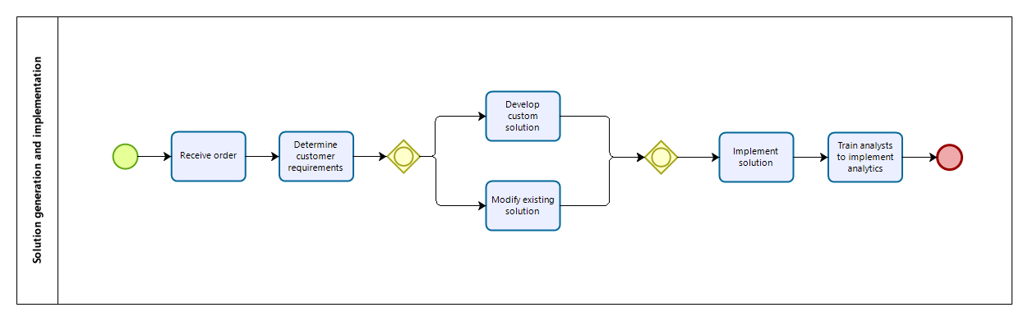
Vital Business Process Map 1

Slide 3
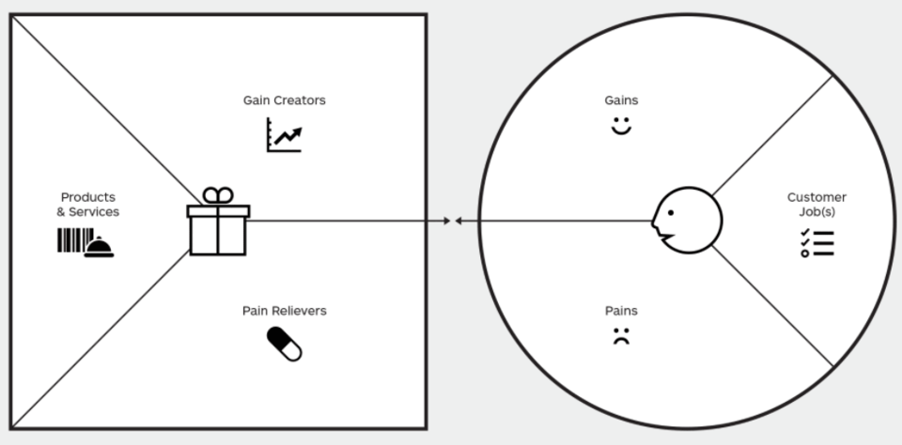
Value & Costing
www.strategyzer.com
Improve processes using analytics
Profit
Customer base expansion
Implementation of IT support
Training
Customer service process analysis
Effective marketing
Sales of products
Customer relations
Satisfying customers
Sub-optimal business process performance
Control over business processes
Analytics software
Delivery of services
Late orders
Customers not served quickly
Training in analytics

