Slide 1
SCTP:
Association, Flow Control, Error Control & Congetion Control
Rinshaj A
B.Sc CS S6
35

Slide 2
Stream Control Transmission Protocol (SCTP) is a transport-layer protocol that ensures reliable, in-sequence transport of data. SCTP provides multihoming support where one or both endpoints of a connection can consist of more than one IP address. This enables transparent failover between redundant network paths.

Slide 3
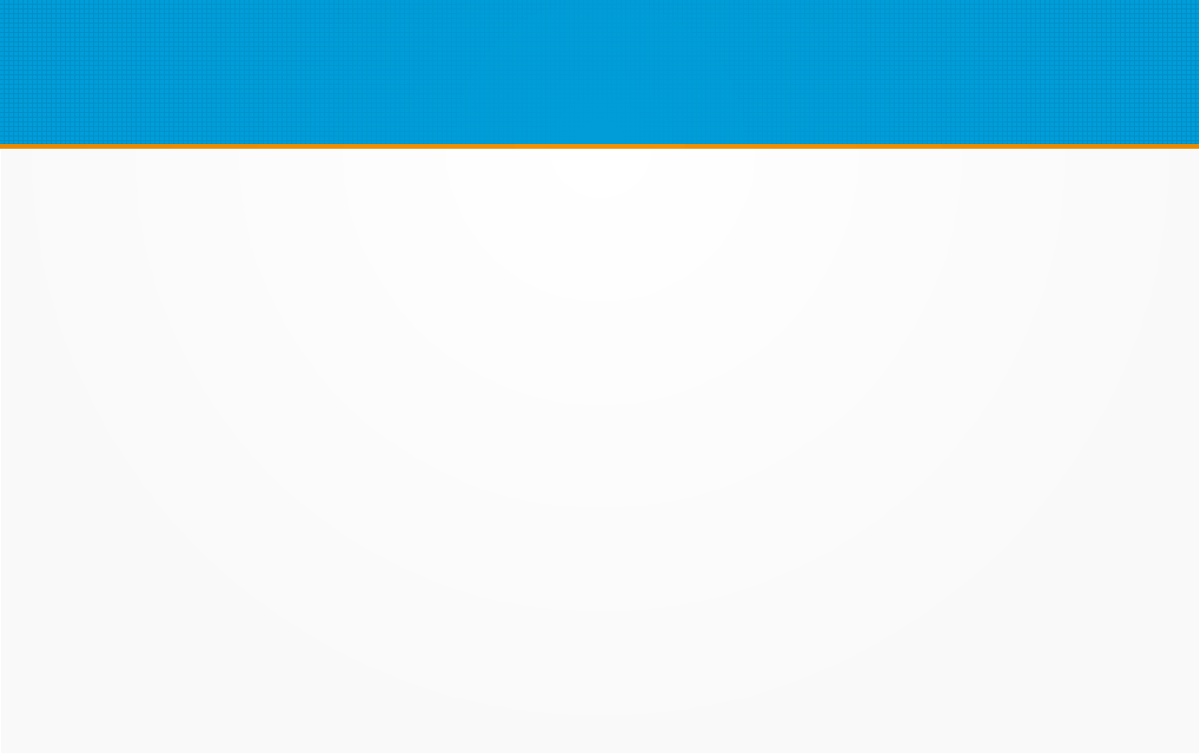
SCTP Association
A connection in SCTP is called an association
An SCTP association is a generalisation of a TCP connection. Usually a TCP connection is one-to-one between two network interfaces, one on a server and the other on a client. In contrast, an SCTP association is many-to-many in two ways:
Multiple network interfaces on a server can be associated with multiple interfaces on a client. For example, suppose the server and client both have an Ethernet card and a Wi-Fi card connected to the Internet. Then, data can flow over a single association in up to four possible ways: Ethernet to Ethernet, Ethernet to Wi-Fi, Wi-Fi to Ethernet or Wi-Fi to Wi-Fi.
An association also can carry multiple logical streams. These are numbered from zero upward. So, for example, stream zero could carry control instructions, while stream one could carry small pieces of data (such as small files), and stream two could carry larger pieces of data (such as an MPEG movie). The three streams are logically independent, so that delays on one stream do not cause delays on any other stream.

Slide 4
A single socket can have multiple associations—that is, one socket can be used to talk to multiple other hosts. In general, these different associations are distinguished by having an association ID. The socket API for SCTP distinguishes between situations where exactly one association can exist (a one-to-one socket) or where a socket can manage many associations (a one-to-many socket)

Slide 5
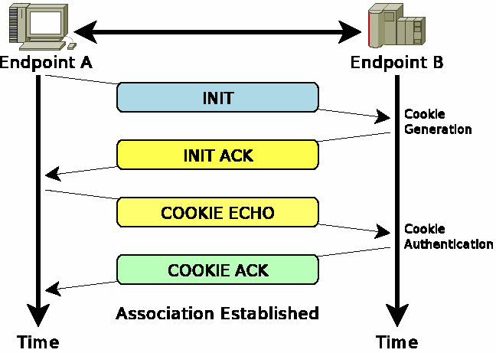
4-Way Handshake

Slide 6
Flow Control
Flow control in SCTP is similar to that in TCP. In SCTP, we need to handle two units of data, the byte and the chunk. The values of rwnd and cwnd are expressed in bytes; the values of TSN and acknowledgments are expressed in chunks. Current SCTP implementations still use a byte-oriented window for flow control.

Slide 7
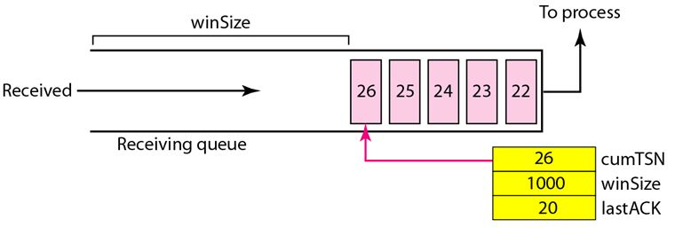
Reciever Site

Slide 8
1. When the site receives a data chunk, it stores it at the end of the buffer (queue) and subtracts the size of the chunk from winSize. The TSN number of the chunk is stored in the cumTSN variable.
2. When the process reads a chunk, it removes it from the queue and adds the size of the removed chunk to winSize (recycling).
3. When the receiver decides to send a SACK, it checks the value of lastAck; if it is less than cumTSN, it sends a SACK with a cumulative TSN number equal to the cumTSN. It also includes the value of winSize as the advertised window size.

Slide 9
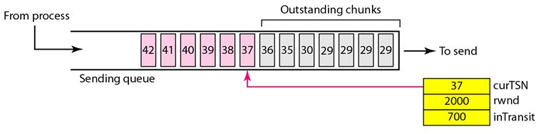
Sender Site

Slide 10
1. A chunk pointed to by curTSN can be sent if the size of the data is less than or equal to the quantity rwnd - inTransit. After sending the chunk, the value of curTSN is incremented by 1 and now points to the next chunk to be sent. The value of inTransit is incremented by the size of the data in the transmitted chunk.
2. When a SACK is received, the chunks with a TSN less than or equal to the cumulative TSN in the SACK are removed from the queue and discarded. The sender does not have to worry about them anymore. The value of inTransit is reduced by the total size of the discarded chunks. The value of rwnd is updated with the value of the advertised window in the SACK.

Slide 11
Error Control
SCTP, like TCP, is a reliable transport-layer protocol. It uses a SACK chunk to report the state of the receiver buffer to the sender. Each implementation uses a different set of entities and timers for the receiver and sender sites.

Slide 12
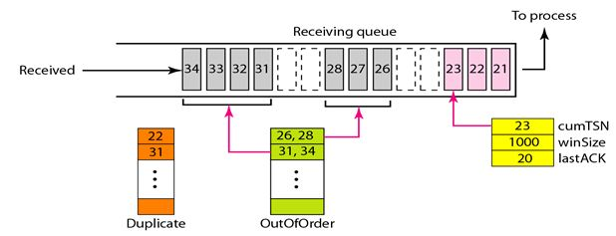
Reciever Site

Slide 13
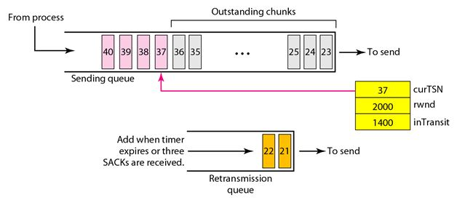
Sender Site

Slide 14
Congetion Control
SCTP, like TCP, is a transport layer protocol with packets subject to congestion in the network. The SCTP designers have used the same strategies for congestion control for TCP. SCTP has slow start, congestion avoidance, and congestion detection phases. Like TCP, SCTP also uses fast retransmission and fast recovery.

Slide 15
•SCTP congestion control is based on RFC2581 with some minor modifications.
•Congestion control is applied to the entire association, not individual streams.
•SCTP maintains a separate cwnd parameter for each peer destination address in multihomed scenarios.
•As defined in RFC2581, the transmission rate starts slowly at the beginning (slow start phase), based on feedback provided by received SACK chunks. After the slow start phase, SCTP enters the congestion avoidance phase. In case of congestion in the network, SCTP immediately reverts back to the slow start phase.

