Slide 1

CSIT 3RD YEAR PROJECT · 2026
BaoBao AI
A Deep Learning Approach to
South African Language Classification
EDA, Feature Engineering & Model Architecture · Steps 1–3
TEAM
Makhura NS
Maake KE
Mahaini RB
Mokone M
Madisha KPT

Slide 2

CONTENTS
Today's Agenda
01
Problem Recap & Project Goals
02
Phase 1 — Sourcing the Data
Why language inclusion matters
Choosing the NCHLT corpus
03
Phase 2 — Profiling the Data
04
Phase 3 — Cleaning & Split
Structure, scale, class balance
From raw text to a training set
05
Feature Engineering
06
Model Architecture
Turning words into math
Why an LSTM
07
Training Setup & Results
08
Judging Criteria & Q&A
Hyperparameters and test performance
How the work maps to the rubric
BaoBao AI — SA Language Classifier
2

Slide 3
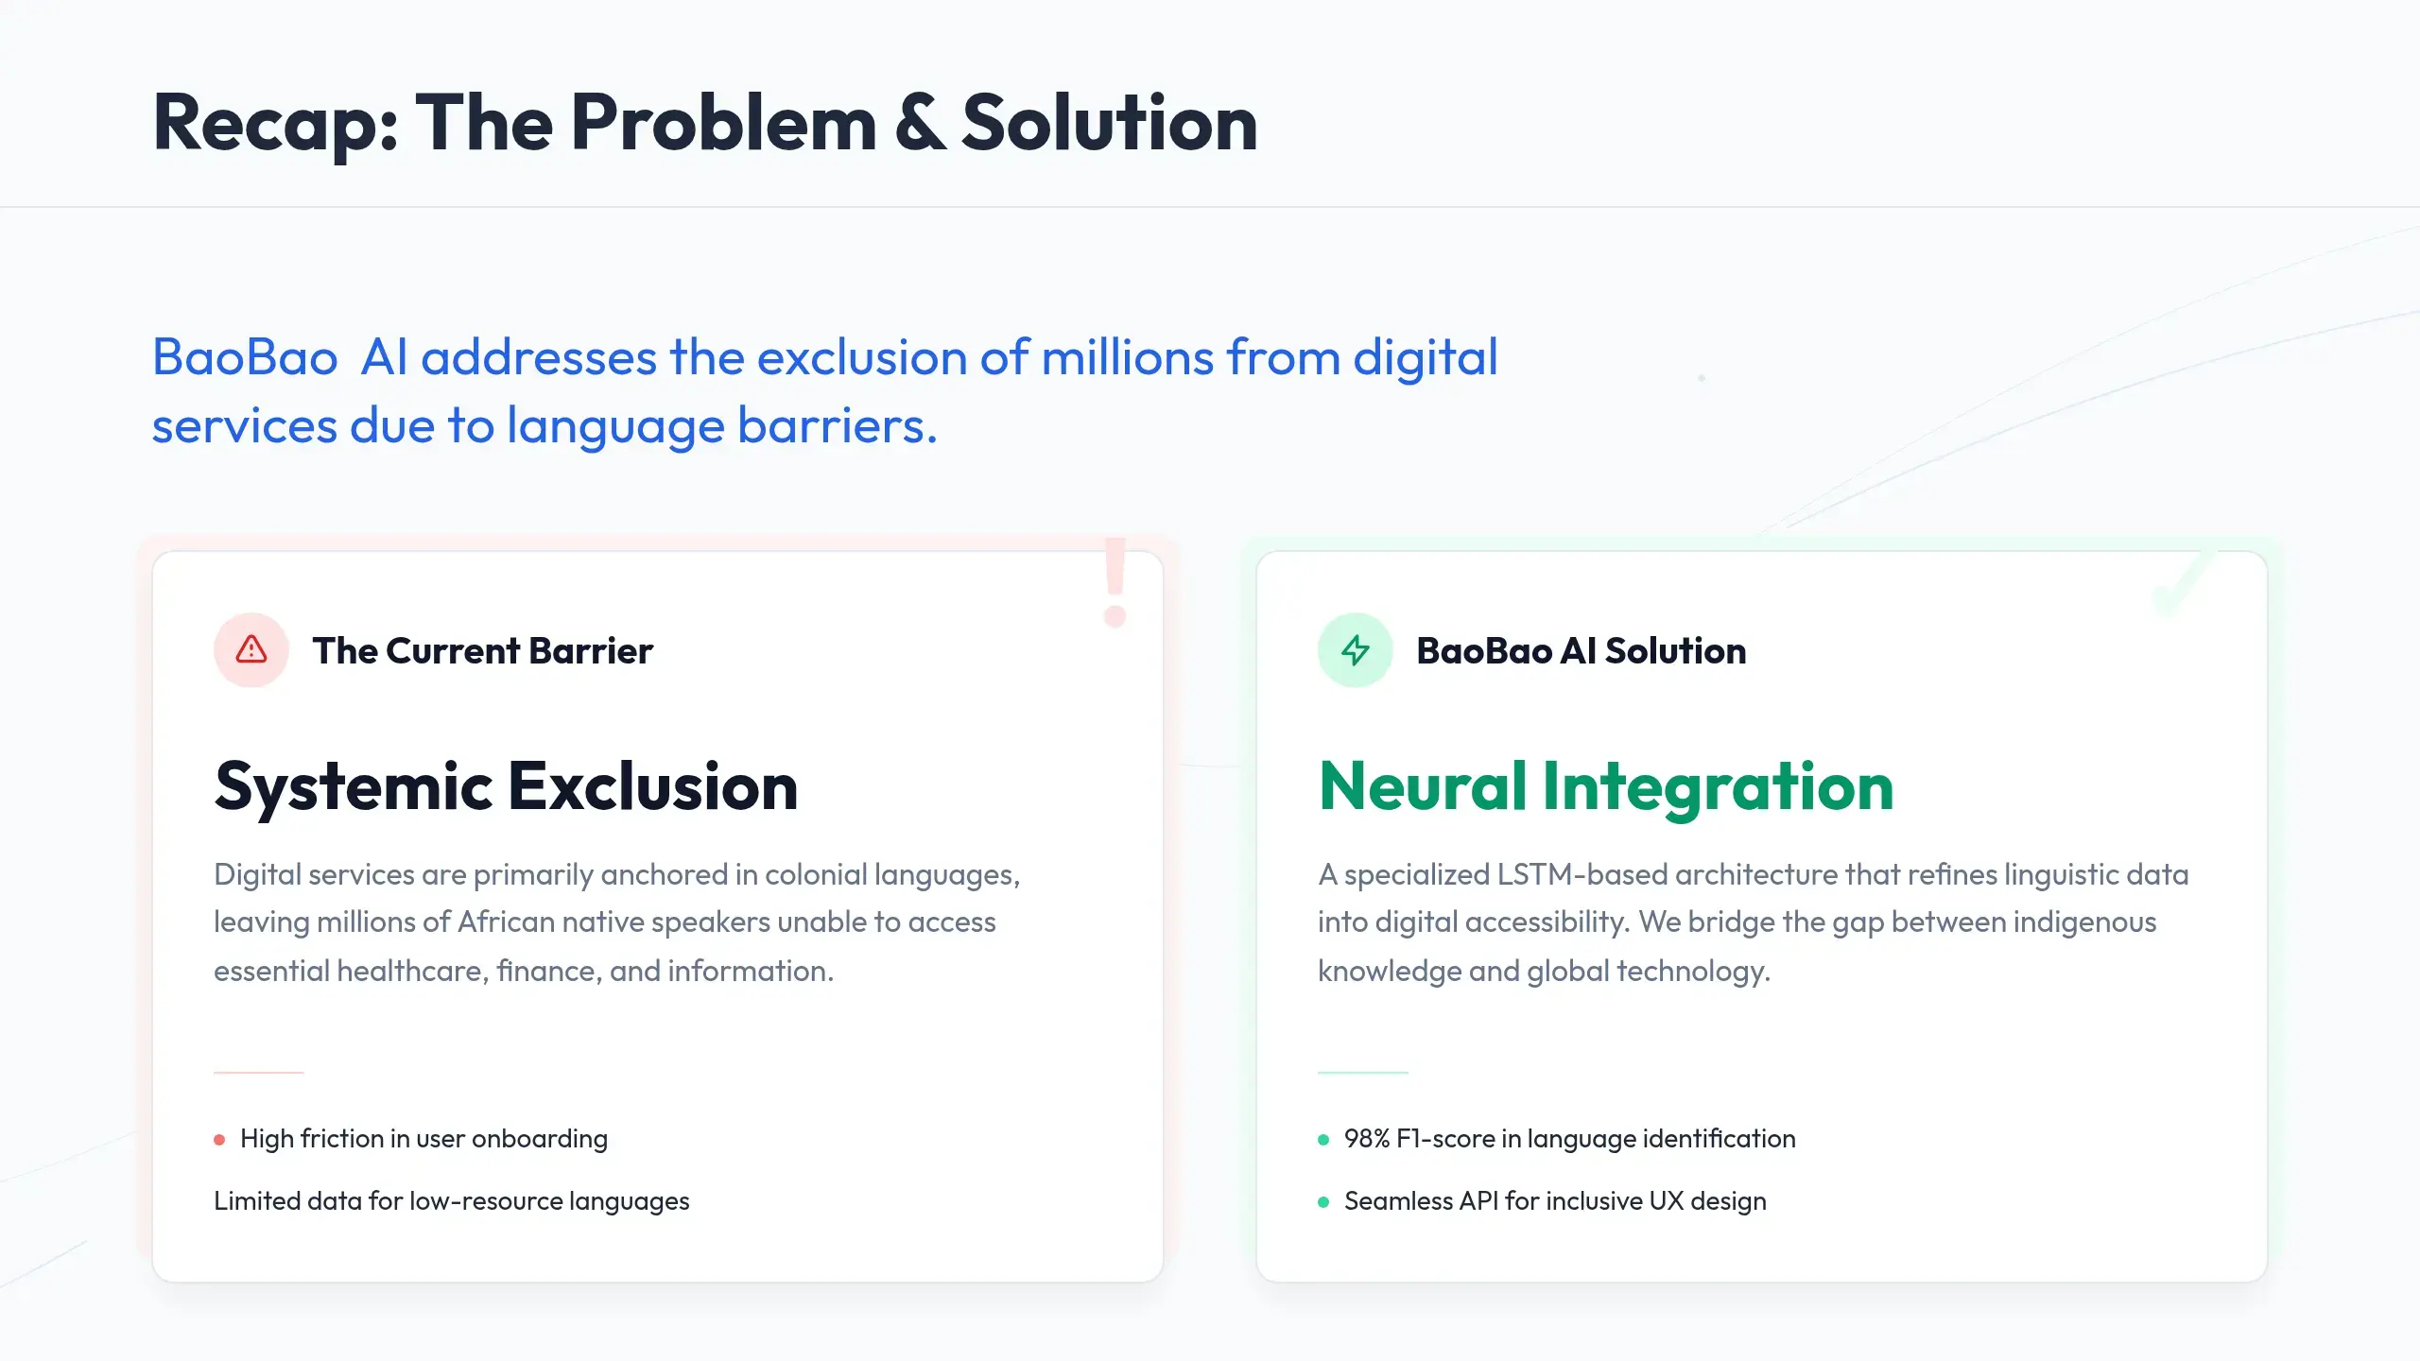

Slide 4
DATA ACQUISITION & ETHICS
Phase 1: Sourcing the Data
D
Dataset Provenance
A Comprehensive and Ethical Foundation
Developed by the National Centre for Human Language Technology (NCHLT) — a publicly available South African research corpus.
✓ 636,123 real sentences across all 11 official South African languages
We utilized the NCHLT Text Corpora as the primary source for our linguistic training — a publicly available research corpus covering all 11 official South African languages, requiring no additional ethics clearance.
✓ Publicly available research corpus — no additional ethics clearance required
N
Why NCHLT?
ETHICAL SOURCING
LOW-RESOURCE FOCUS
Publicly available corpus — no ethics clearance required.
Addressing the data gap in under-represented SA languages.
BaoBao AI — SA Language Classifier
4

Slide 5
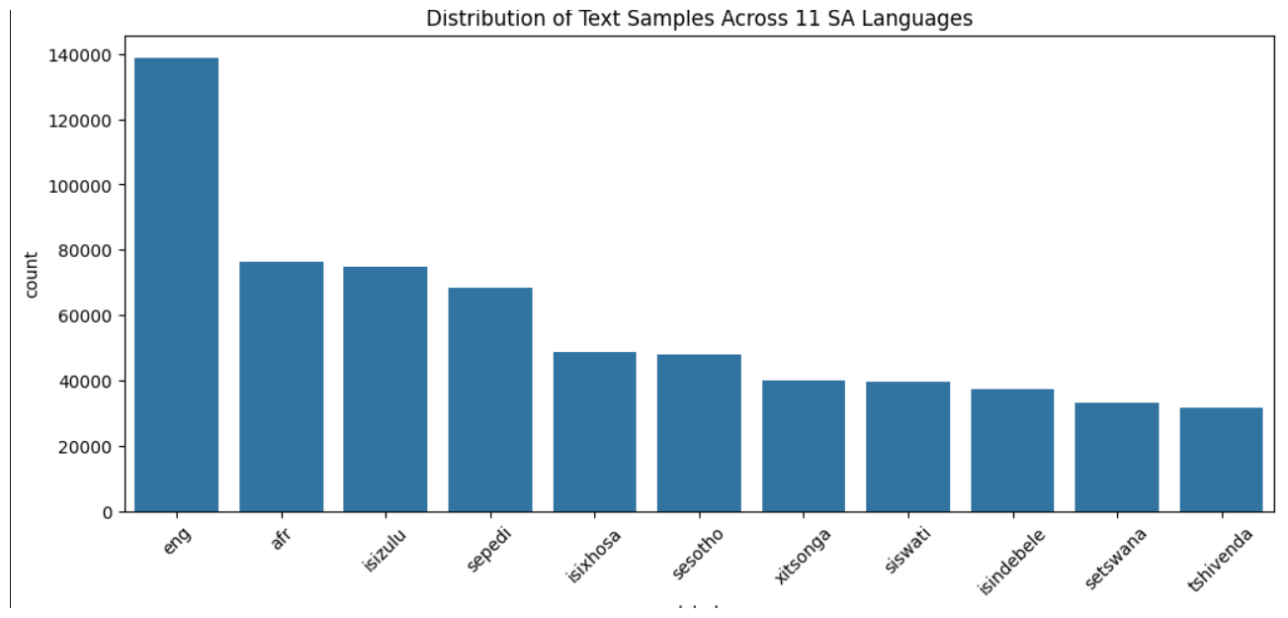
DATA ENGINEERING LIFECYCLE
Phase 2: Profiling the Data
S
Dataset at a Glance
Objectives, Structure & Class Distribution
636,123 total sentences spanning all 11 official South African languages.
RAW STRUCTURE
Our objective: classify each sentence into 1 of South Africa's 11 official languages. Profiling the raw corpus revealed necessary cleaning steps and a significant class imbalance across languages.
XML tags (<fn>) and license headers throughout the raw files, requiring removal before training.
!
Key Finding — Class Imbalance
English (largest): ~139,000 sentences
Tshivenda (smallest): ~32,000 sentences
~4.3x gap between the largest and smallest of the 11 classes — plain accuracy would be misleading, so Macro F1-Score was chosen as the evaluation metric.
BaoBao AI — SA Language Classifier
5

Slide 6
METHODOLOGY / PHASE 3
Phase 3: Cleaning, Preprocessing & Split
A rigorous cleaning, randomization, and splitting pipeline prepared the data for neural network training.
From raw XML to a clean, randomized, and split training-ready dataset.
Raw XML
Noise Filtering
Shuffling
Train / Val / Test Split
Master Set
Initial data ingestion from heterogenous XML source files.
Removal of <fn> tags, license headers, and empty lines.
Full dataset randomized before splitting to prevent order bias.
80% / 10% / 10% split across all 11 languages.
636,123 clean sentences ready for feature engineering.
Train / Validate / Test Split
TRAIN — 80%
VALIDATION — 10%
TEST — 10%
508,898 sentences
63,612 sentences
63,613 sentences
BaoBao AI — SA Language Classifier
6

Slide 7
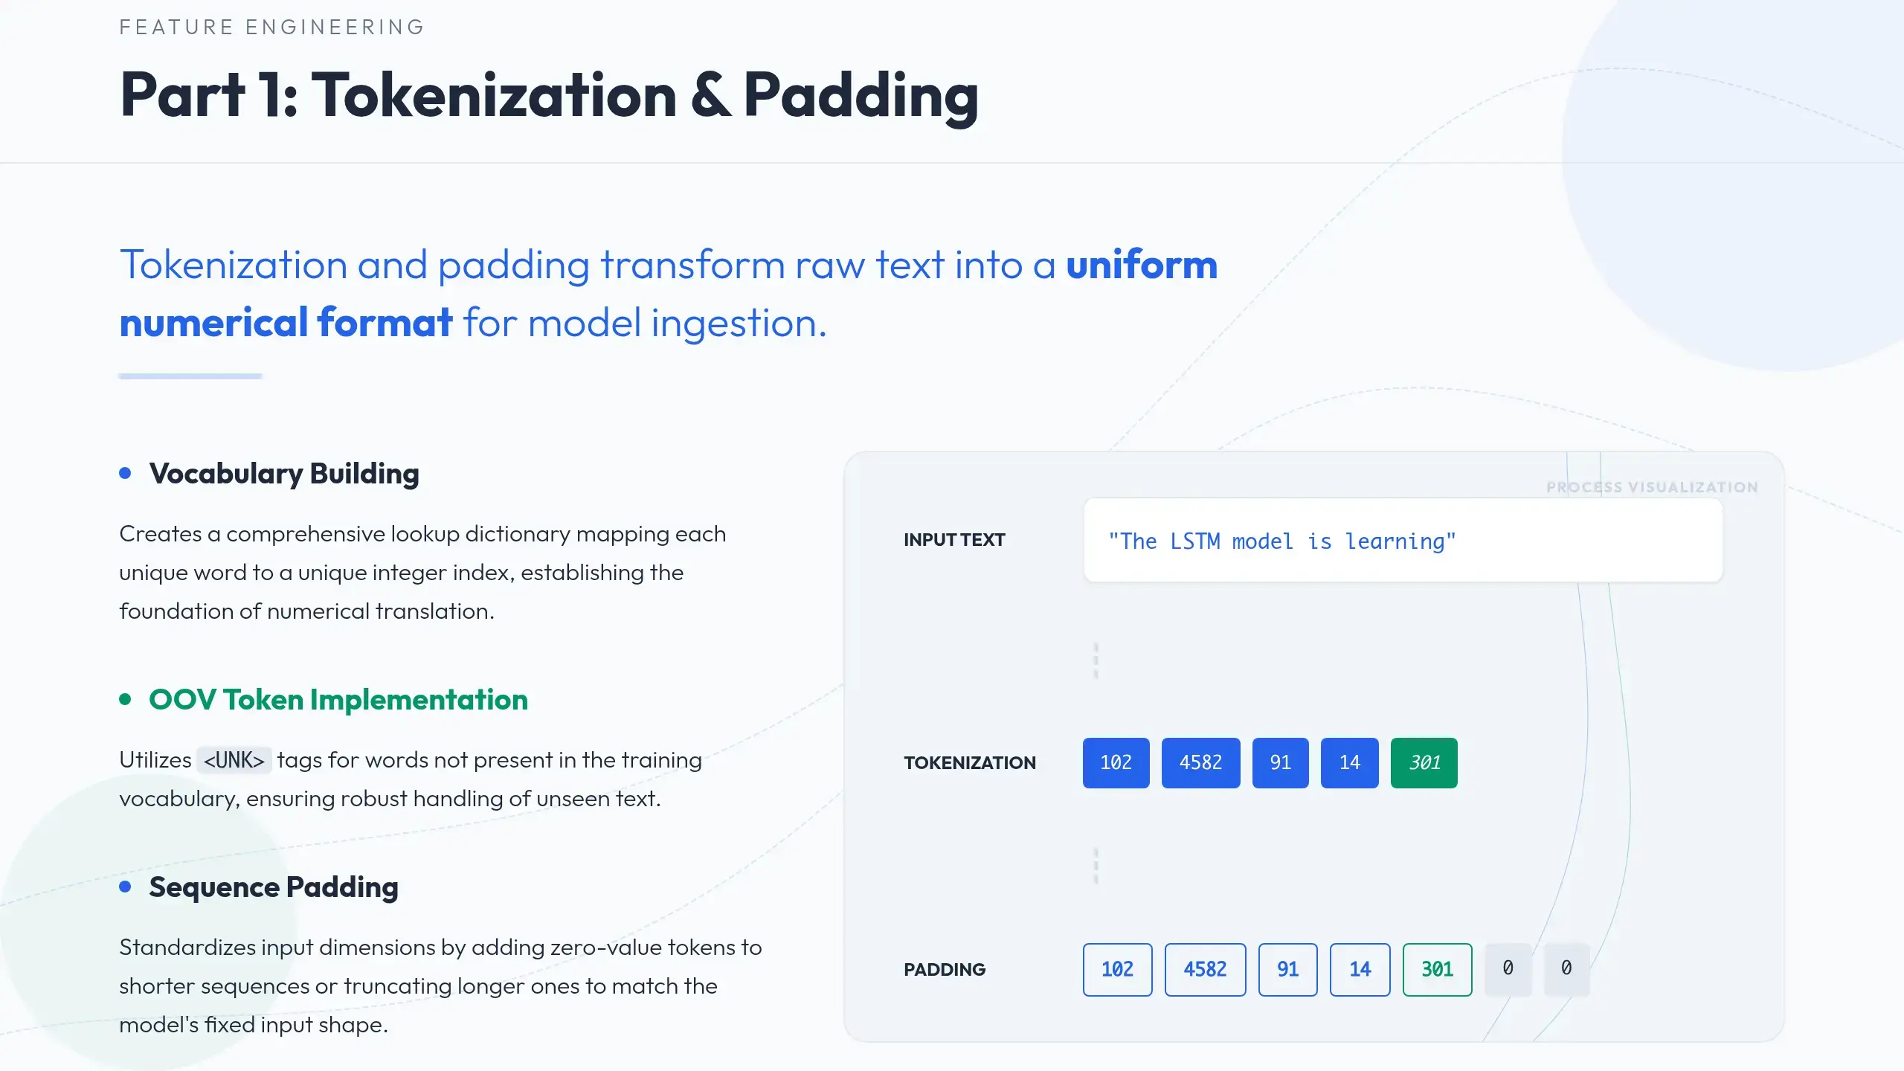

Slide 8
FEATURE ENGINEERING — PART 2
One-Hot Encoding
Ensuring Categorical Equality
NUMERICAL MATRIX
Binary Vectors
One-hot encoding ensures the model treats each language as a distinct, equal category, preventing the algorithm from assuming a numerical order between labels.
Afrikaans
isiZulu
isiXhosa
Vector 1
1
0
0
1
LABEL INPUT
Afrikaans
Vector 2
0
1
0
2
LABEL INPUT
isiZulu
Vector 3
0
0
1
3
LABEL INPUT
isiXhosa
Key result: each of the 11 languages maps to an orthogonal vector, so the distance between any two labels is mathematically identical.
BaoBao AI — SA Language Classifier
8

Slide 9
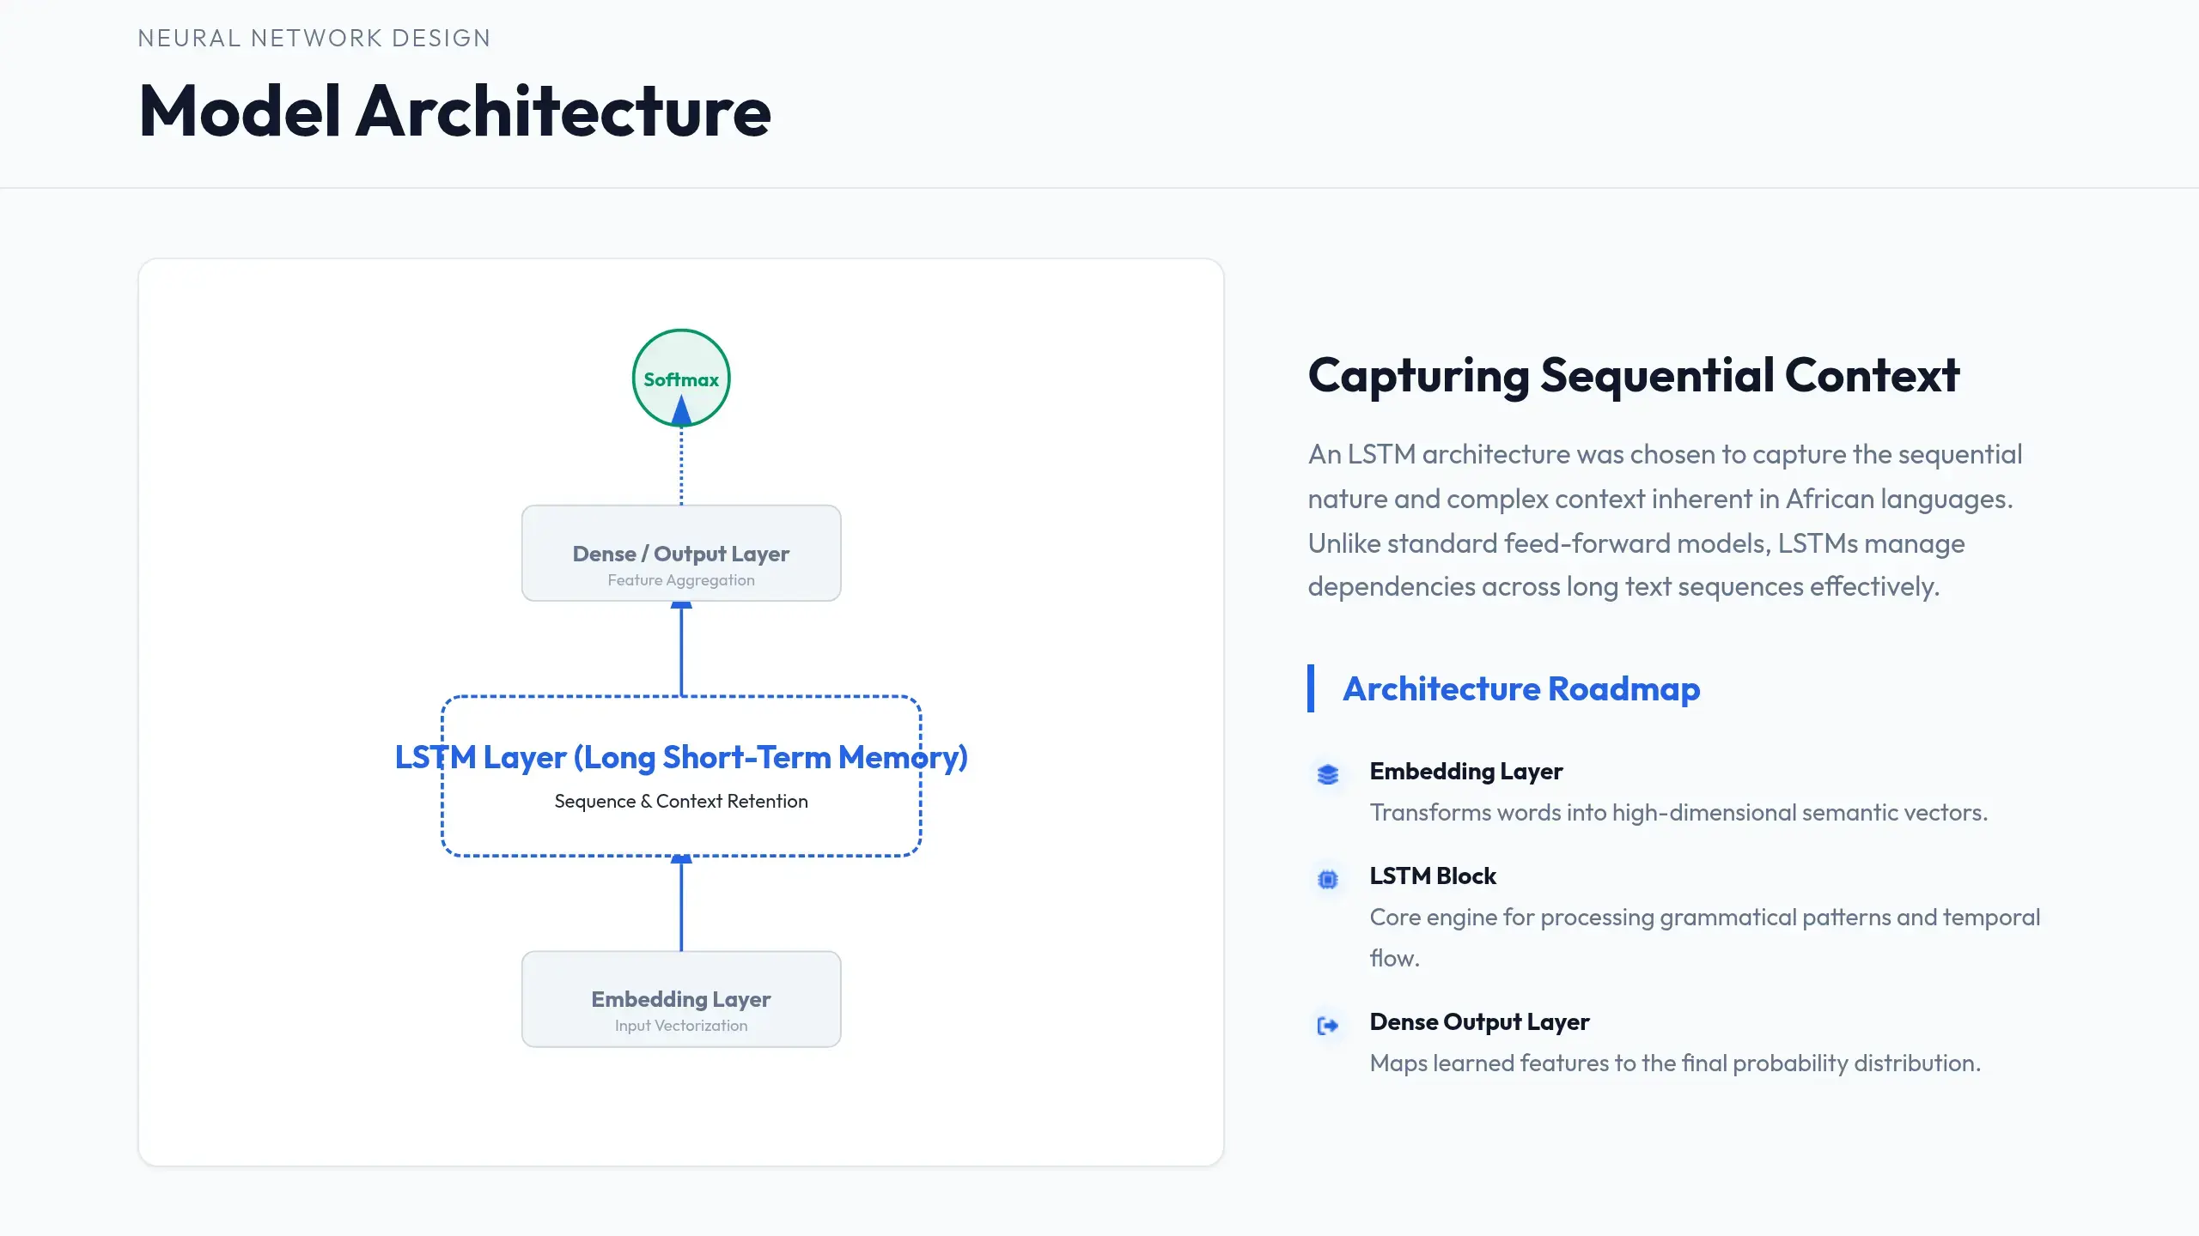

Slide 10
METHODOLOGY / STEP 5
Training Setup & Hyperparameters
The configuration used to fit the model, and what the training run told us.
Model & Training Configuration
1
Rapid Convergence
Vocabulary size
25,000 words + <OOV> token
Validation accuracy reached 97.1% after a single epoch and 97.6% by epoch 3 — the task is well-matched to the architecture, and most of the learning happens early.
Sequence length
35 tokens (post-padding)
Embedding dimension
128
SpatialDropout1D
0.2
LSTM units
100
Output layer
Dense(11), softmax
2
Early Stopping on Validation Loss
Trainable parameters
3,292,711
Validation loss bottomed at epoch 5 (0.0858) then rose for two consecutive epochs while training loss kept falling. Training halted at epoch 7 rather than 10, and the best-performing weights were retained.
Batch size
256
Epochs run
7 of 10 planned
BaoBao AI — SA Language Classifier
10

Slide 11
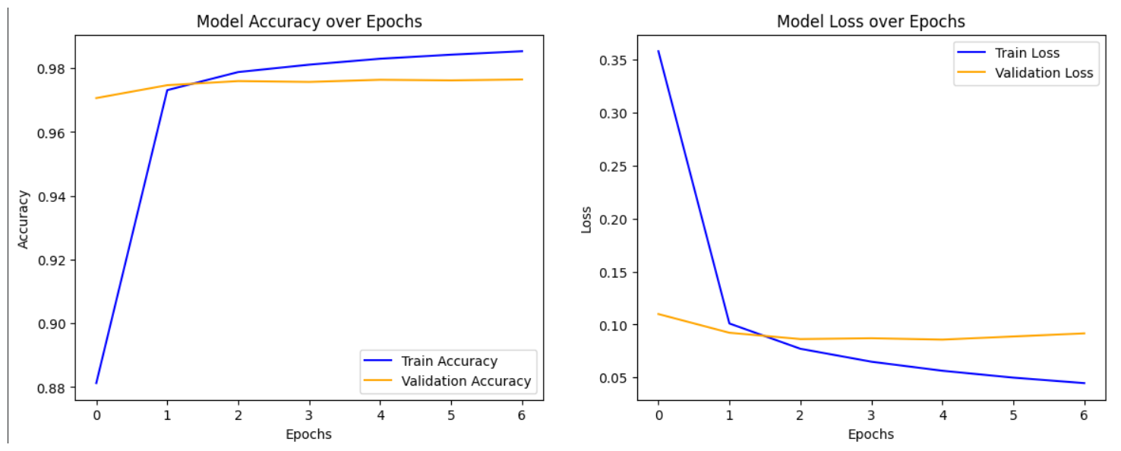
PERFORMANCE ANALYSIS
Results
98%
✓
Strong, Balanced Performance
Macro F1-Score
Macro and weighted F1 both landed at 0.98, meaning performance holds up even for the smallest classes rather than being carried by English and Afrikaans.
on 63,613 unseen test sentences
⚡
Where the Model Struggles
Per-class F1 ranged from 0.95 to 1.00. The lowest scores — isiNdebele (0.95) and siSwati (0.95) — are both Nguni languages closely related to isiZulu (0.96), exactly the confusion an LSTM was chosen to minimise. Xitsonga scored highest at 1.00.
Train vs. validation accuracy and loss over 7 epochs — validation loss flattens while training loss keeps falling, the mild overfitting that triggered early stopping.
BaoBao AI — SA Language Classifier
11

Slide 12
PROJECT VALIDATION
Alignment with Judging Criteria
Every criterion is backed by a concrete artefact from the pipeline.
D
Data Understanding
M
Methodology
R
Modelling & Results
✓ Data loading & cleaning
✓ Preprocessing
✓ Model selection
Custom parser stripped <fn> tags and license headers from raw NCHLT XML.
Shuffled before splitting to remove order bias.
LSTM justified on sequence and word-order sensitivity.
✓ EDA
✓ Data splitting
✓ Sufficient complexity
Class distribution plotted across all 11 languages; ~4.3x imbalance identified.
80/10/10 train / validation / test — test set held out entirely.
3,292,711 trainable parameters across 4 layers.
✓ Feature engineering
✓ Reproducibility
✓ Evaluation
25k-word vocabulary with <OOV>, 35-token padding, one-hot labels.
End-to-end pipeline documented and re-runnable in Colab.
Macro F1 chosen specifically to account for class imbalance.
636,123 clean sentences
508,898 / 63,612 / 63,613
0.98 Macro F1-Score
BaoBao AI — SA Language Classifier
12

Slide 13
CONCLUSION
Thank You
“BaoBao provides a foundation for inclusive digital services across South Africa.”
636,123
11
0.98
sentences
languages
Macro F1
Any Questions?
BaoBao AI — SA Language Classifier
13

