Slide 1



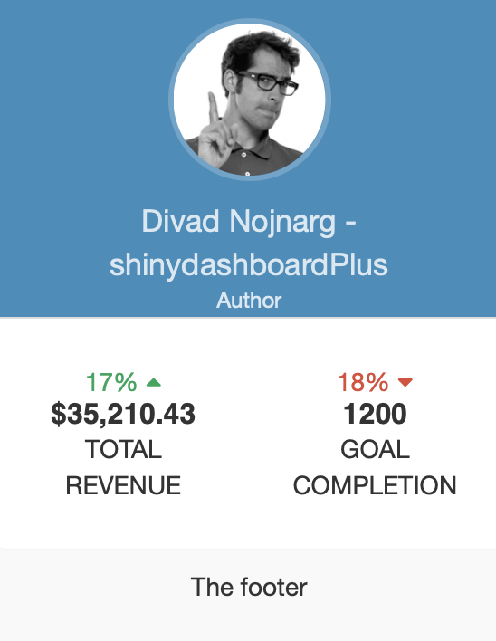
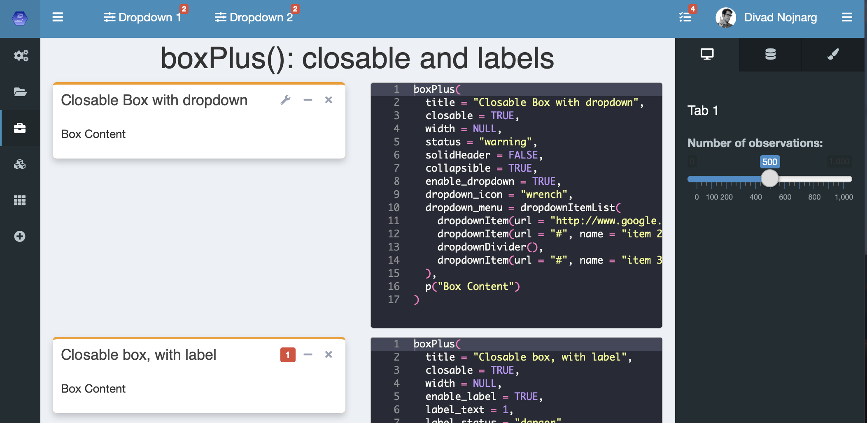
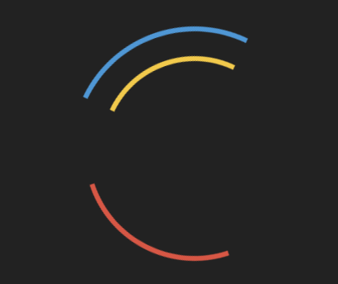
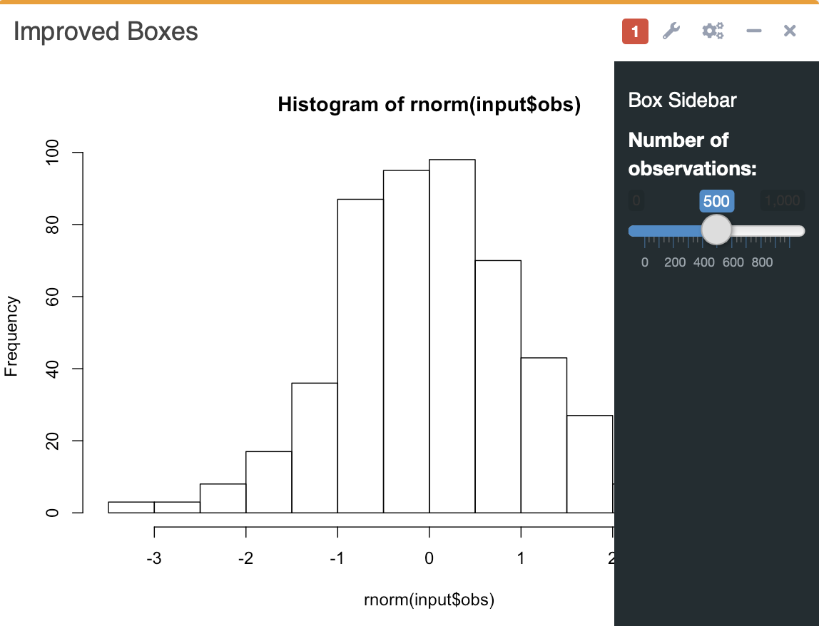
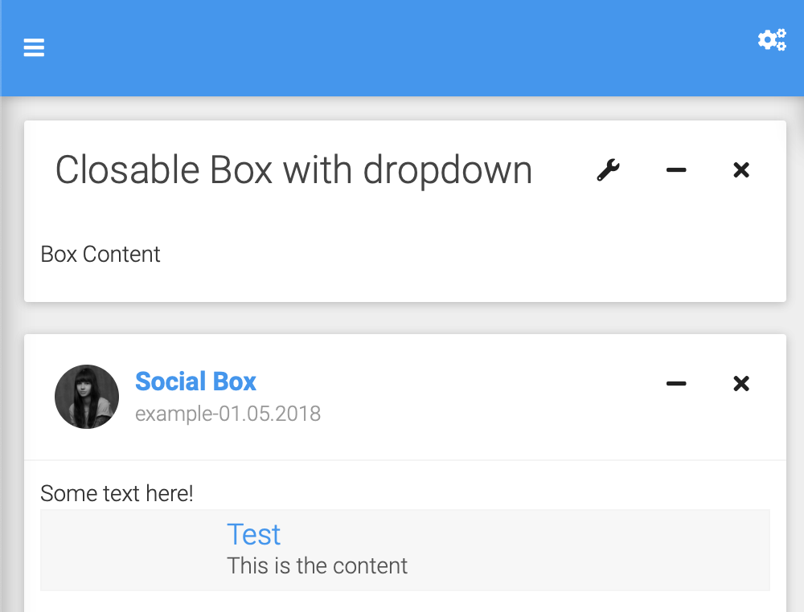

shinydashboardPlus: : CHEAT SHEET
Basics
Layout Overview
User dropdown
shinydashboardPlus is an extension for shinydashboard.
First load it right after the shinydashboard package
dashboardHeaderPlus(
enable_rightsidebar = TRUE,
rightSidebarIcon = "gears",
left_menu = tagList()
)
dashboardUser(
...,
name = NULL,
src = NULL,
title = NULL,
subtitle = NULL,
footer = NULL
)
renderUser({…})
userOutput(…)
dashboardHeaderPlus()
library(shinydashboard)
library(shinydashboardPlus)
Below is the main page structure
rightSidebar(
background = "dark",
rightSidebarTabContent(
id = 1,
icon = "desktop",
title = "Tab 1",
active = TRUE,
sliderInput(…)
),
…
)
shinyApp(
ui = dashboardPagePlus(
header = dashboardHeaderPlus( enable_rightsidebar = TRUE, rightSidebarIcon = "gears"
),
sidebar = dashboardSidebar(),
body = dashboardBody(),
rightsidebar = rightSidebar(),
title = "DashboardPage"
),
server = function(input, output) { }
)
Pre-loader
dashboardPagePlus(
enable_preloader = TRUE
…
)
rightSidebar()
Use visualizations to explain concepts quickly and concisely.
dashboardSidebar(): semi-collapsible
dashboardPagePlus() is the page wrapper. Compared to shinydashboard, you can include a footer, a right sidebar, a pre-loader and even select the dashboard theme (bootstrap or material).
Enhanced boxes
Themes (material, BS)
label()
close
dashboardPagePlus(
md = TRUE
…
)
Alternatively, you can embed shinydashboardPlus elements in vanilla shiny.
boxPlus(
closable = TRUE,
enable_label = TRUE,
enable_dropdown = TRUE,
enable_sidebar = TRUE
)
library(shinyWidgets)
shinyApp(
ui = fluidPage(
useShinydashboardPlus(),
…
)
)
sidebar
RStudio® is a trademark of RStudio, Inc. • David Granjon • dgranjon@ymail.com • https://divadnojnarg.github.io • Learn more at https://rinterface.github.io/shinydashboardPlus/ • package version 0.7.5 • Updated: 2019-06

Slide 2
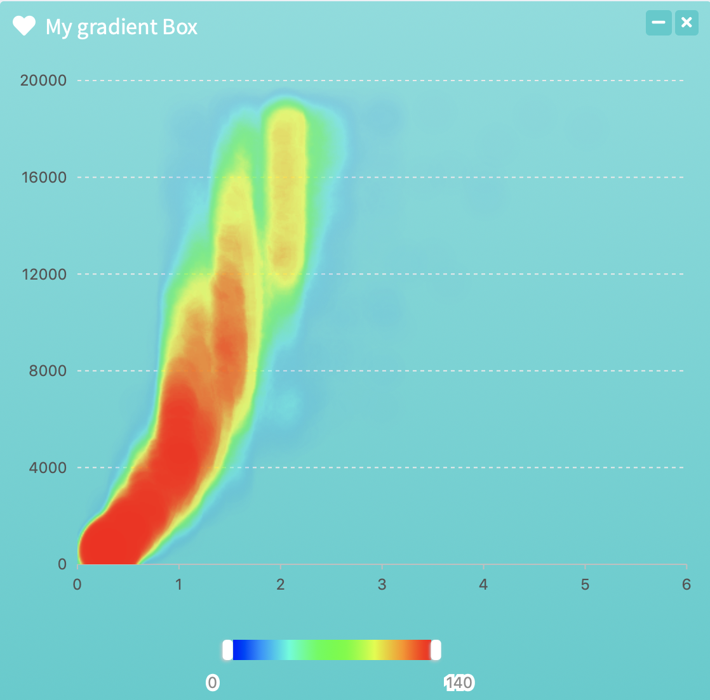
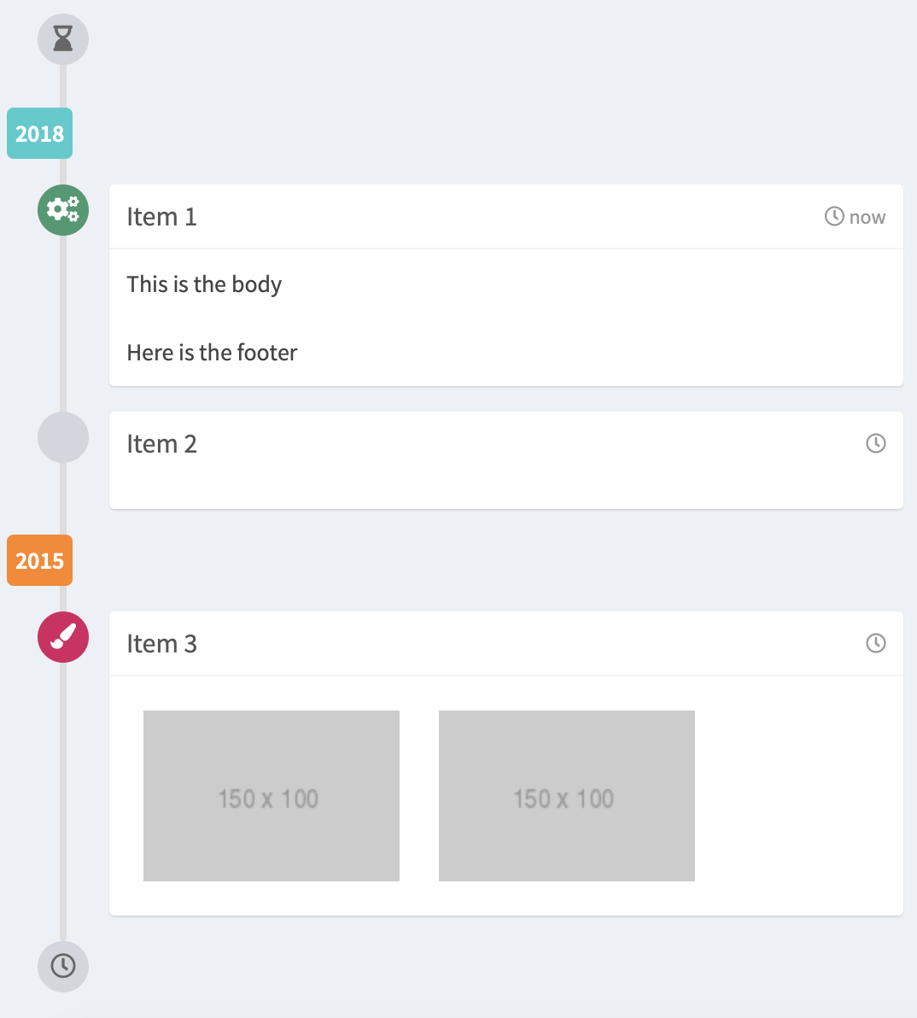
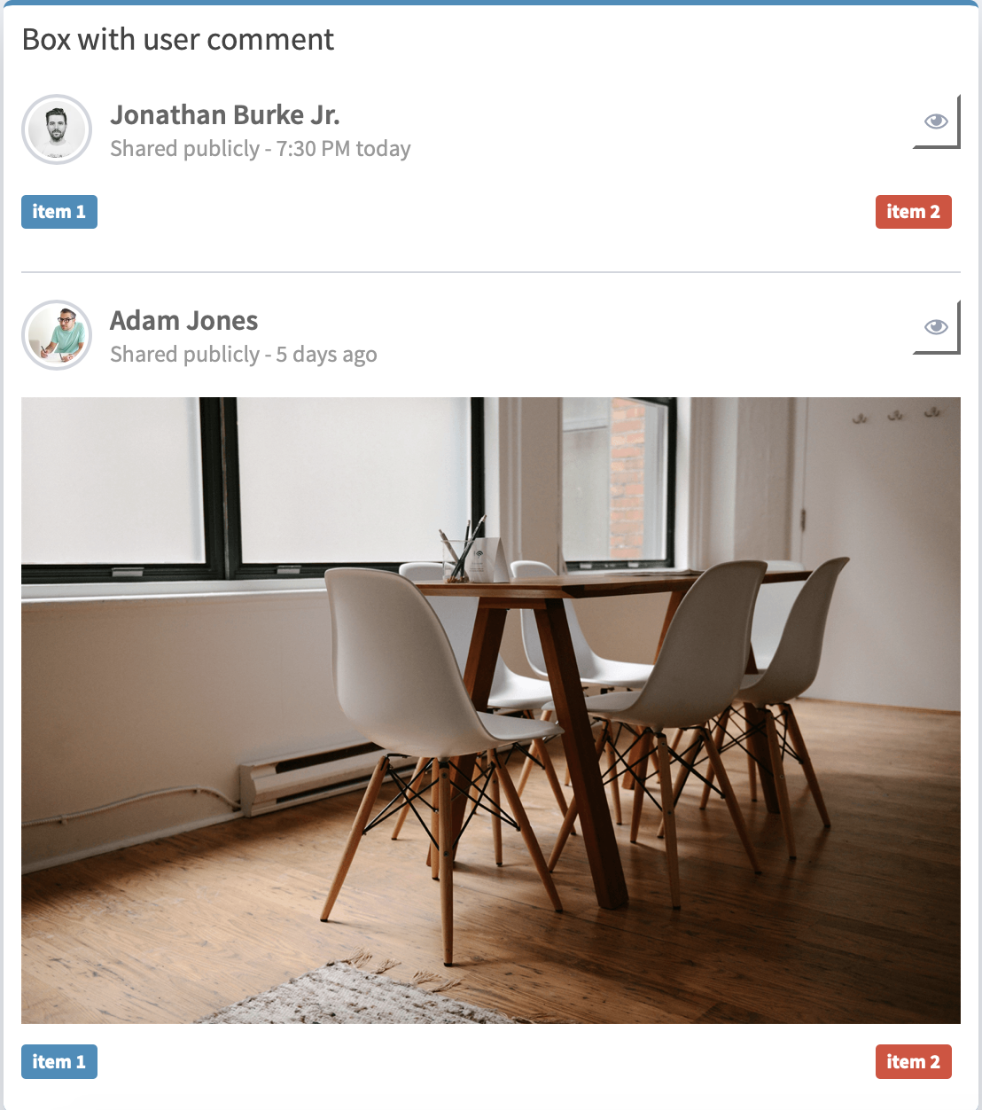
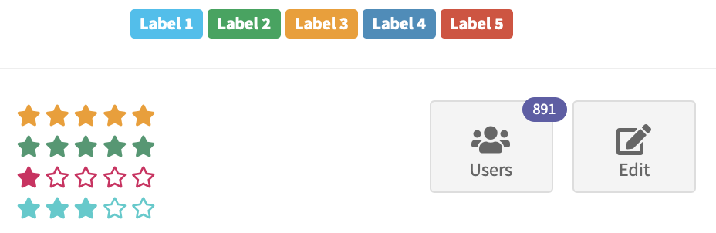
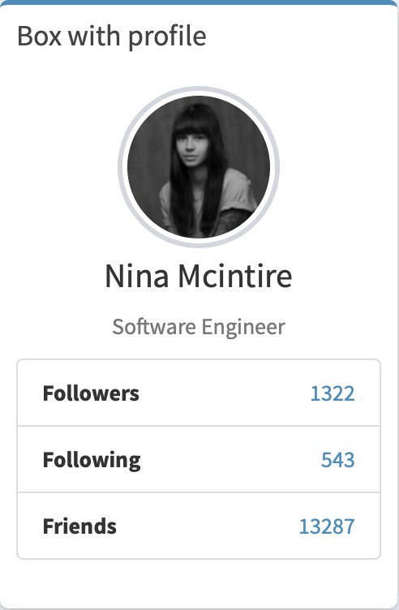
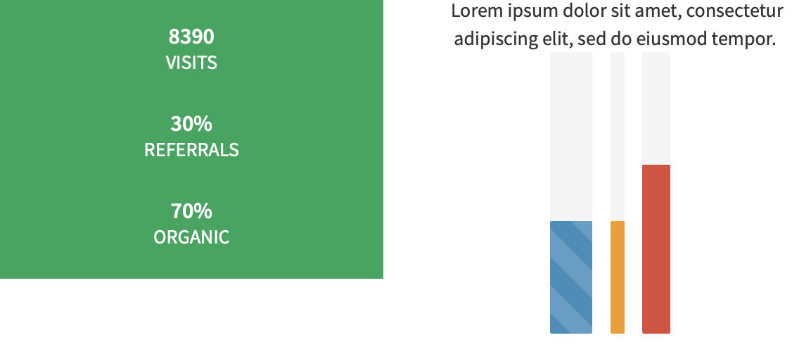
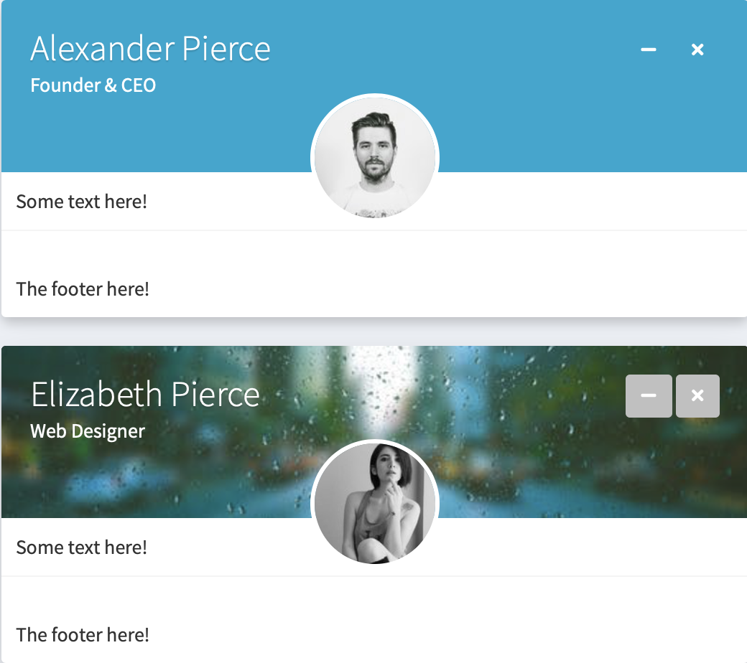
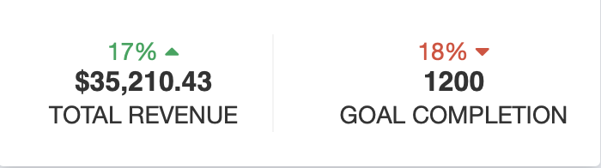
Gradient boxes
Extra Box Elements
gradientBox()
userPost()
userPostToolItemList()
userPostToolItem()
userPostMedia()
timeLineBlock()
timelineStart()
timelineItem()
userPostToolItem()
timelineLabel()
timelineItemMedia()
This feature renders well only for advanced ploting libraries supporting plot with transparent background such as plotly, echart4r, rbokeh, g2r, highcharter!
timelineStop()
userPostMedia()
dashboardLabel()
boxProfile()
boxProfileItemList()
boxProfileItem()
starBlock()
Social boxes
widgetUserBox()
boxProfile()
boxProfileItemList()
boxPad()
verticalProgress()
descriptionBlock()

