Slide 1

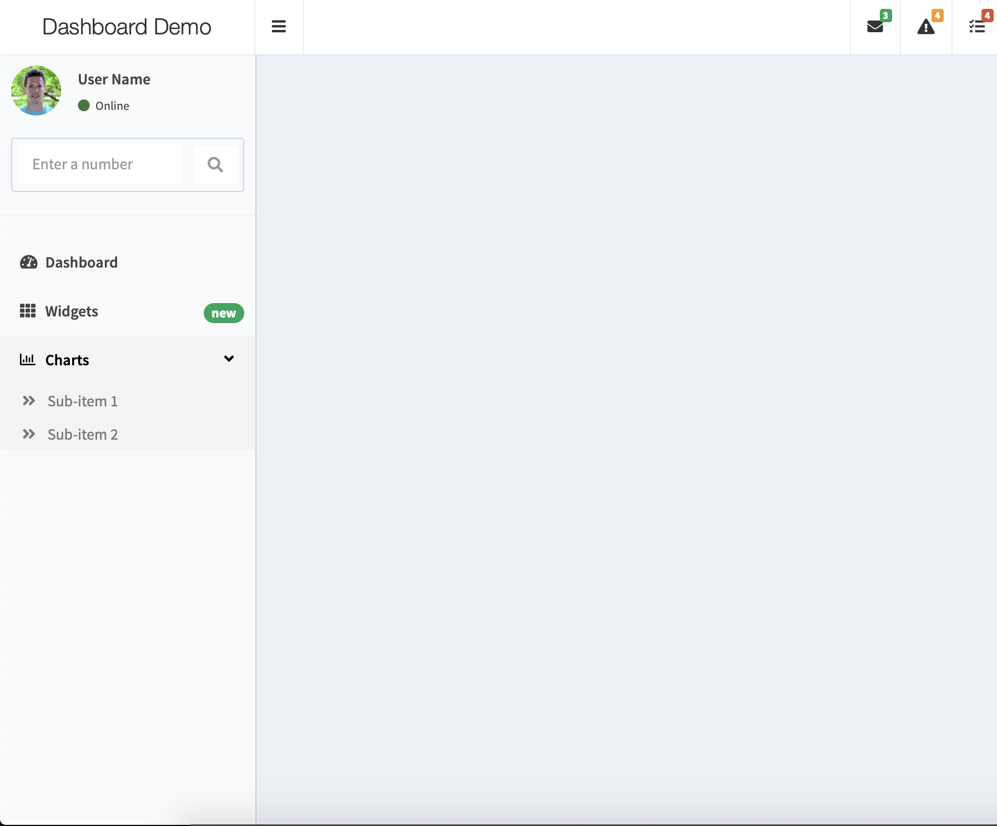
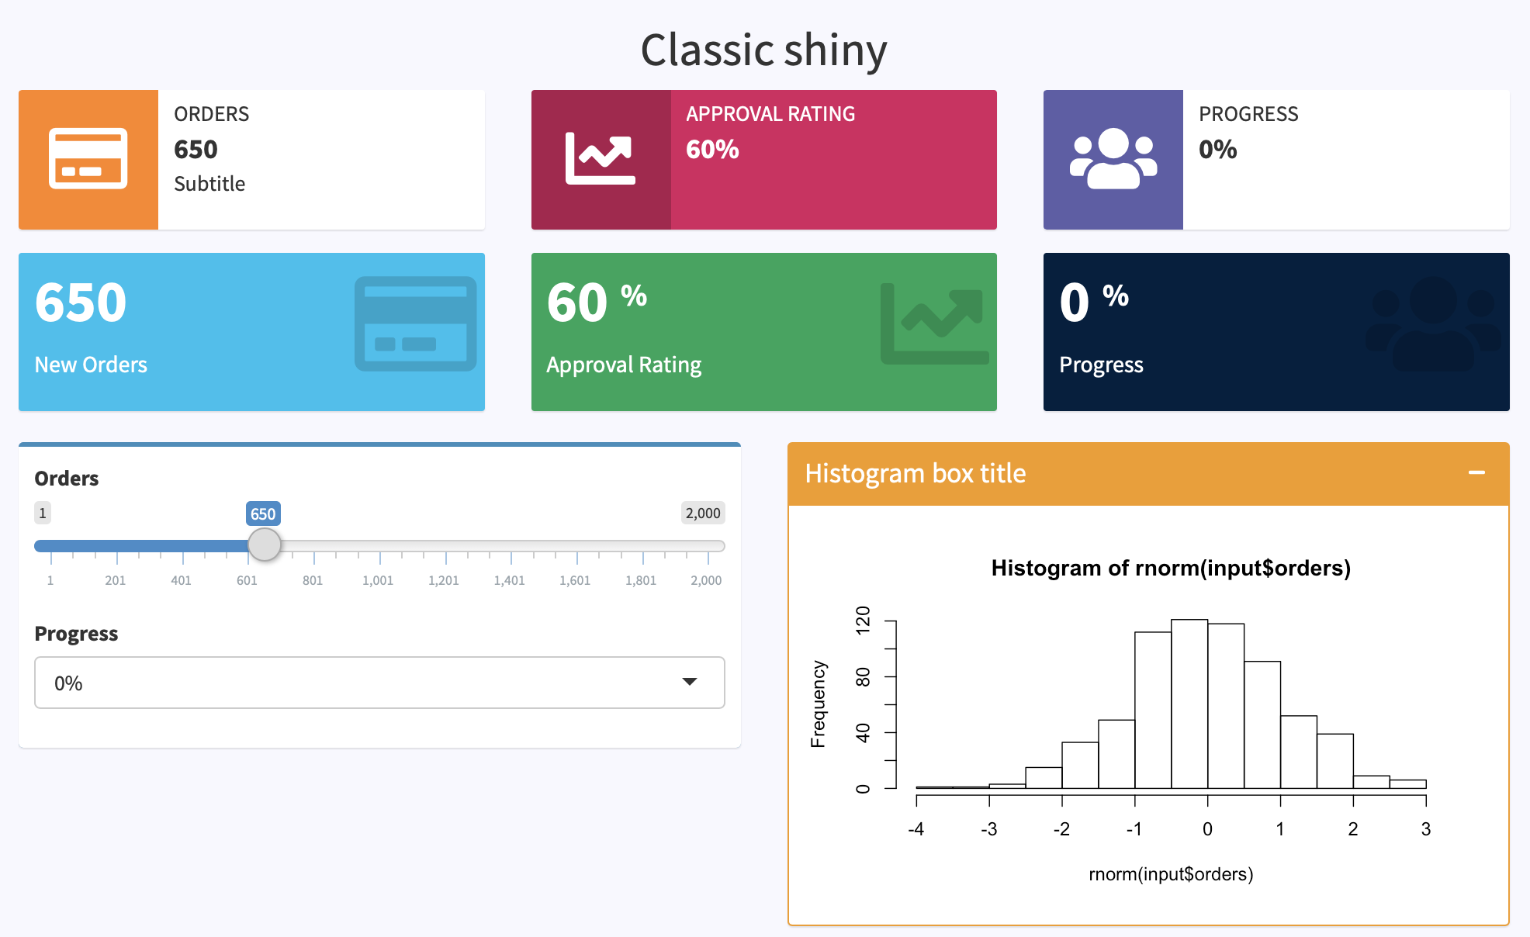

shinydashboard: : CHEAT SHEET
Basics
Layout Overview
Shinydashboard is a dashboard template for shiny, built on top of the AdminLTE2 HTML template
Header
Below is the main page structure
library(shiny)
library(shinydashboard)
shinyApp(
ui = dashboardPage(
dashboardHeader(),
dashboardSidebar(),
dashboardBody(),
title = "Dashboard example"
),
server = function(input, output) { }
)
dashboardPage(...)
taskItems(...)
Header
notificationItems(...)
Sidebar
Body
dashboardSidebar(...,)
dashboardBody(...)
dashboardHeader(...)
Export elements
sidebarMenu(...,id = NULL)
tabItems(...)
dropdownMenu(...)
Alternatively, you can embed shinydashboard elements in vanilla shiny.
sidebarUserPanel(...)
library(shinyWidgets)
shinyApp(
ui = fluidPage(
useShinydashboard(),
…
)
)
menuItem(
...,
tabName = NULL,
href = NULL
)
tabItem(
tabName = NULL,
...
)
messageItems(...)
notificationItems(...)
taskItems(...)
sidebarSearchForm(...)
One can provide the tabName argument for each menuItem /menuSubItem, or alternatively, the href argument. While the first solution must be used in combinaison with the dashboard body’s tabItems, the second opens a new page.
For each tabItem, the tabName argument must correspond to the related menuItem or menuSubItem in the sidebarMenu, if provided.
menuSubItem(
...,
tabName = NULL,
href = NULL
)
RStudio® is a trademark of RStudio, Inc. • rstudio • dgranjon@ymail.com • https://divadnojnarg.github.io • Learn more at https://rinterface.github.io/shinydashboardPlus/ • package version 0.7.5 • Updated: 2019-06

Slide 2
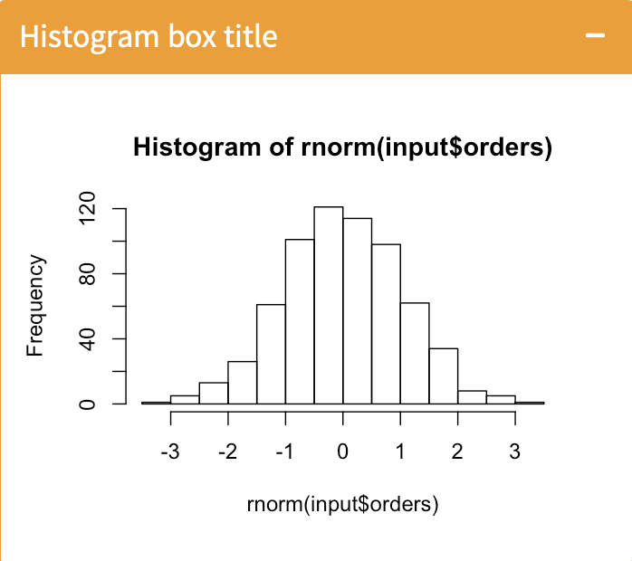
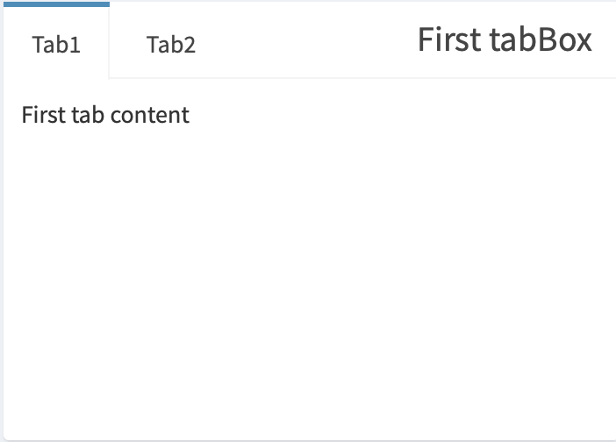

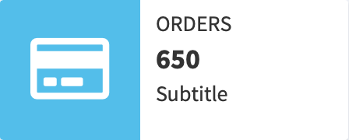
Boxes
Render/Output functions
box(...)
Server Side
UI Side
renderInfobox(...)
infoBoxOutput(...)
output$ibox <- renderInfoBox({
infoBox(...)
})
Alternatively, you can still use renderUI , even though the name is less explicit
renderValuebox(...)
valueBoxOutput(...)
tabBox(..., id = NULL)
sidebarMenuOutput(...)
renderMenu(...)
dropdownMenuOutput(...)
menuOutput(...)
menuItemOutput(...)
valueBox(...)
Update tabs
Useful Links
updateTabItems(session, id)
https://rstudio.github.io/shinydashboard/
https://github.com/rstudio/shinydashboard
https://shiny.rstudio.com/articles/dashboards.html
Useful to update tab related elements. Id corresponds to the element to update.
infoBox(...)
This function can be applied to all shinydashboard elements having an id argument like sidebarMenu() and tabBox()
Examples from the 2019 shiny contest
https://kevinrue.shinyapps.io/isee-shiny-contest/
https://gadenbuie.shinyapps.io/tweet-conf-dash/
About AdminLTE
https://adminlte.io/preview

