Slide 1



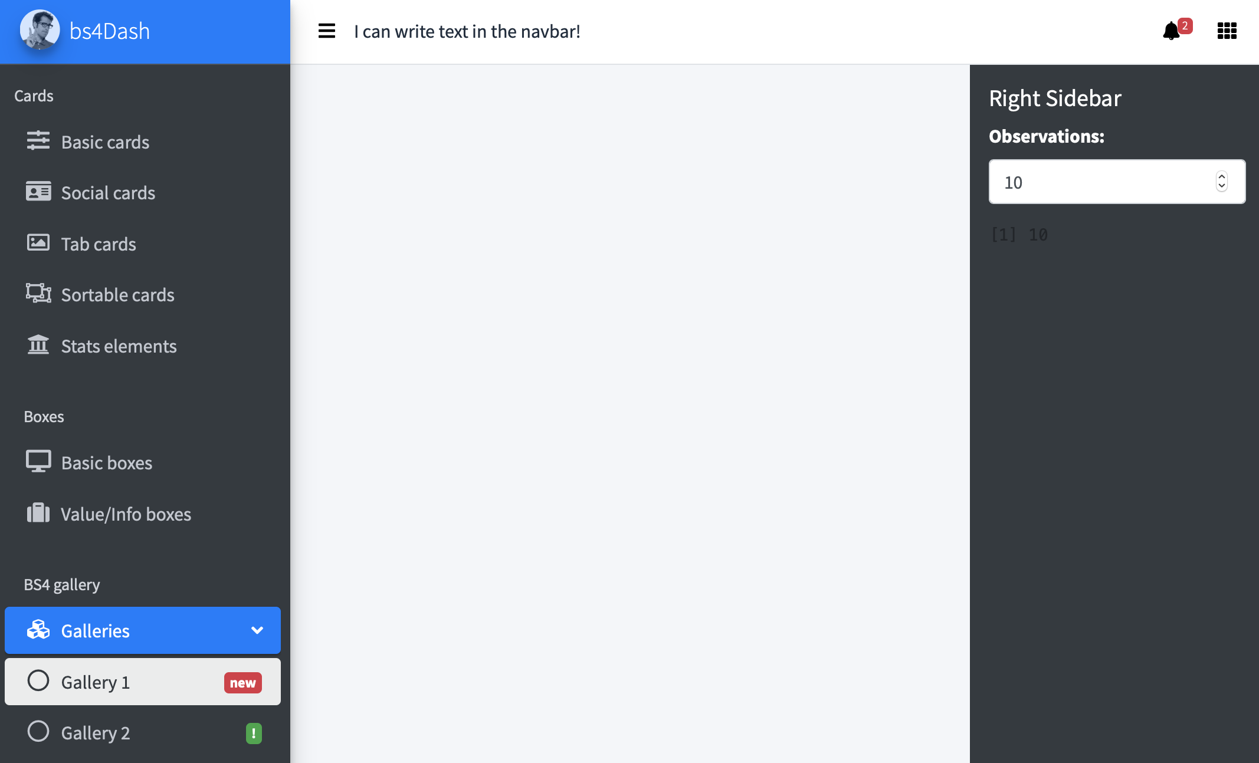
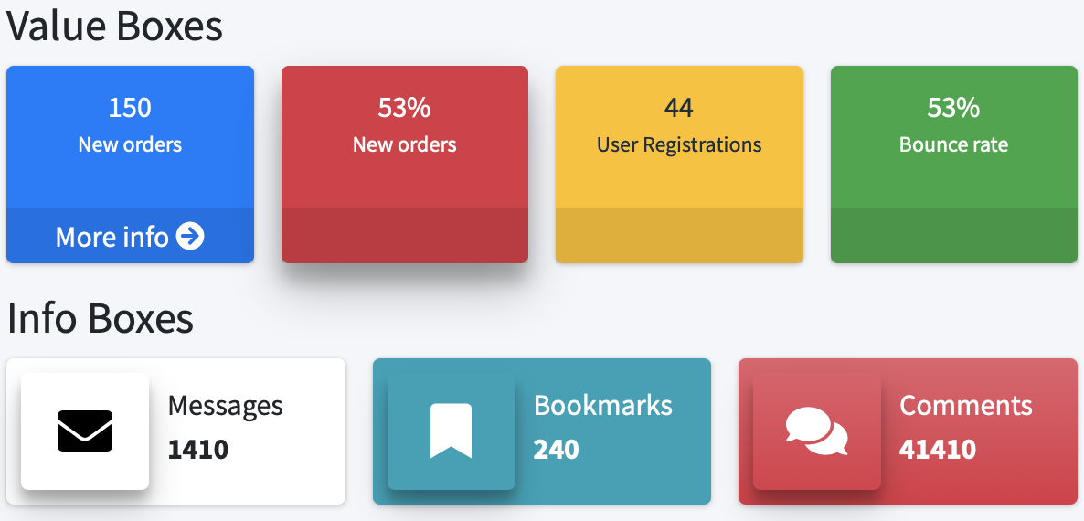
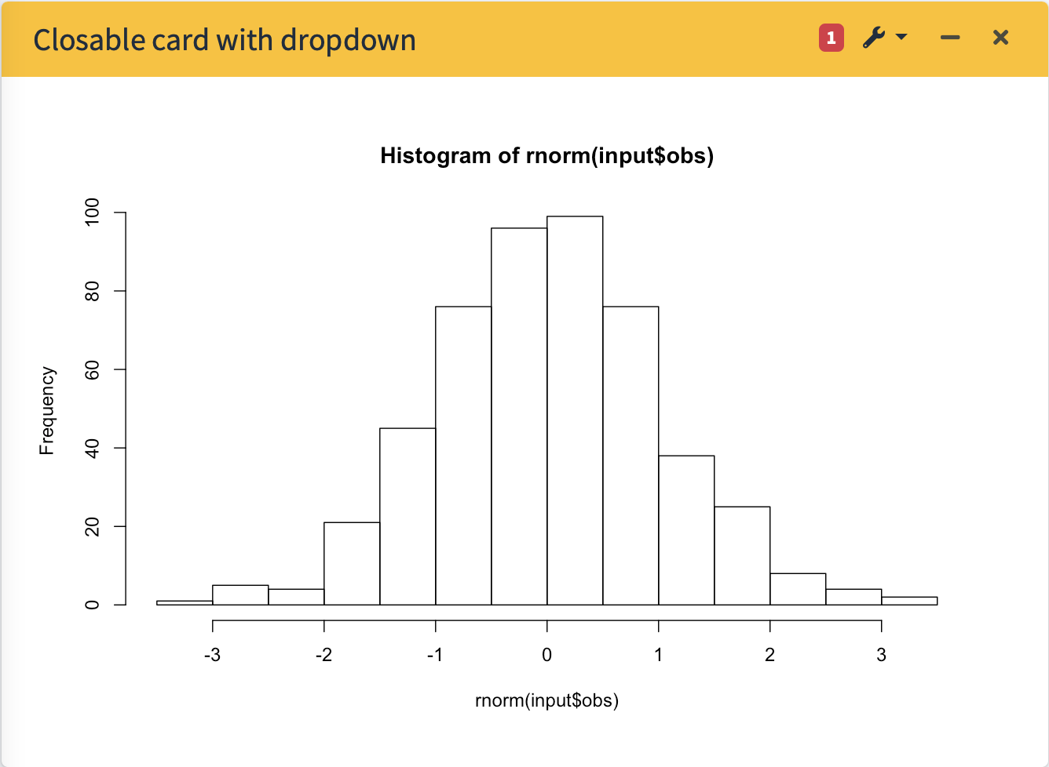
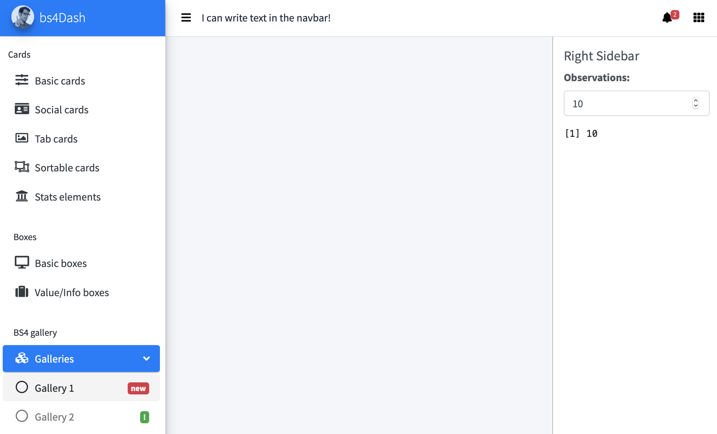
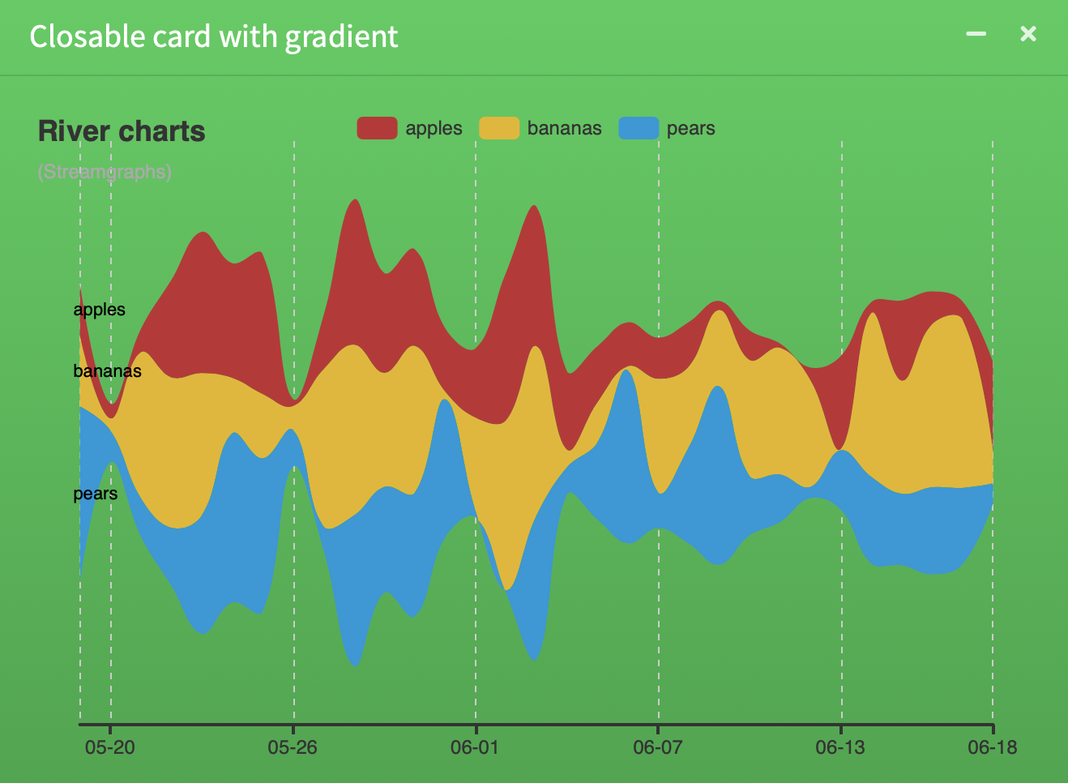

bs4Dash: : CHEAT SHEET
Basics
Layout Overview
bs4DashNavbar()
Info/Value Boxes
bs4Dash is a Bootstrap 4 version of shinydashboard.
bs4DashNavbar(..., skin = "light", status = "white", border = TRUE, sidebarIcon = "bars", controlbarIcon = "th", leftUi = NULL, rightUi = NULL, fixed = FALSE)
bs4InfoBox(…)
bs4ValueBox(…)
library(shiny)
library(bs4Dash)
Below is the main page structure
shiny::shinyApp(
ui = bs4DashPage(
old_school = FALSE,
sidebar_collapsed = FALSE,
controlbar_collapsed = FALSE,
enable_preloader = FALSE,
loading_duration = 2,
loading_background = "#1E90FF",
title = "Basic Dashboard",
navbar = bs4DashNavbar(),
sidebar = bs4DashSidebar(),
controlbar = bs4DashControlbar(),
footer = bs4DashFooter(),
body = bs4DashBody()
),
server = function(input, output) {}
)
bs4DashSidebar(
...,
title = NULL,
skin = "dark",
status = "primary",
brandColor = NULL,
url = NULL,
src = NULL,
elevation = 4,
opacity = 0.8
)
Cards
bs4Card(…)
bs4DashControlbar()
bs4DashSidebar()
bs4DashControlbar(..., skin = "dark", title = NULL, width = 250)
Use visualizations to explain concepts quickly and concisely.
Light Theme
bs4DashPage() is the page wrapper. Compared to shinydashboard, you can include an extra right sidebar, a pre-loader and even select the dashboard theme (classic or old school)…
Alternatively, you can embed bs4Dash elements in vanilla shiny.
bs4GradientCard(…)
bs4DashSidebar(..., skin = "light")
bs4DashControlbar(..., skin = "light")
library(shinyWidgets)
shinyApp(
ui = fluidPage(
useBs4Dash(),
…
)
)
RStudio® is a trademark of RStudio, Inc. • David Granjon • dgranjon@ymail.com • https://divadnojnarg.github.io • Learn more at https://rinterface.github.io/bs4Dash/ • package version 0.4.0 • Updated: 2019-06

Slide 2
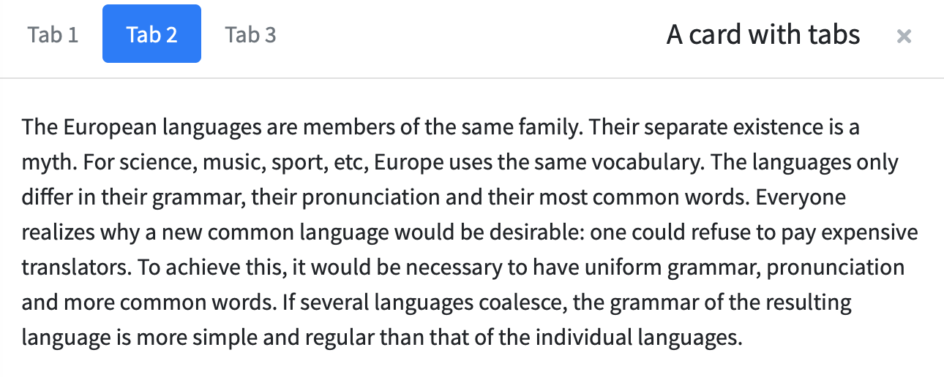
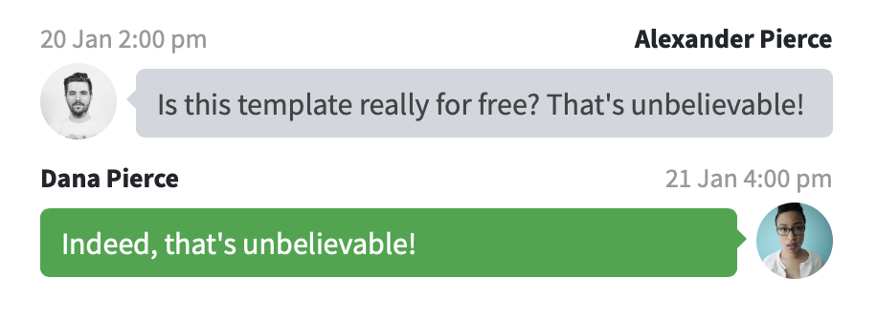
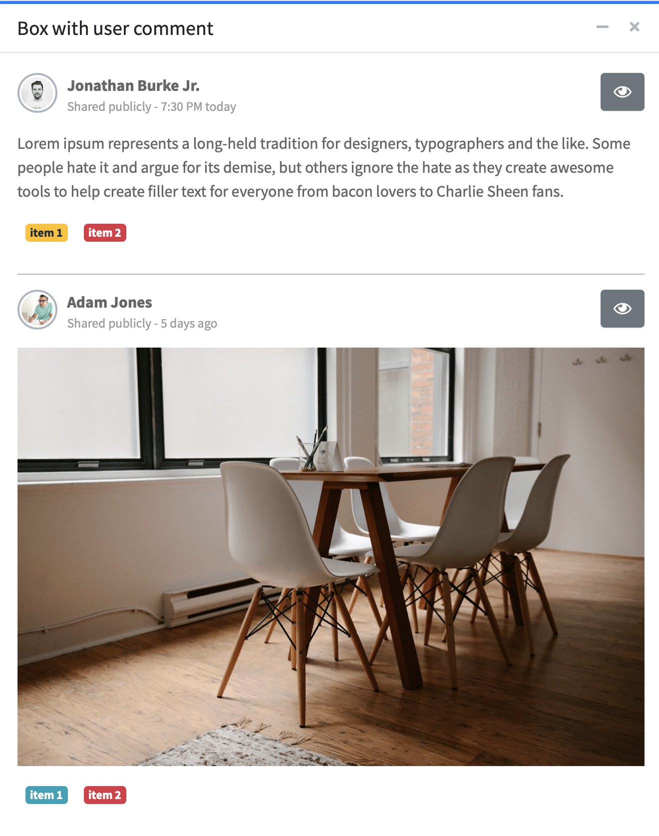
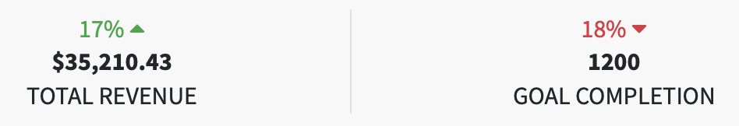
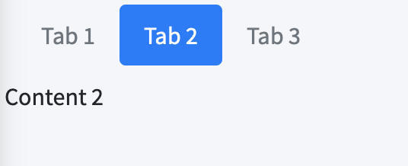
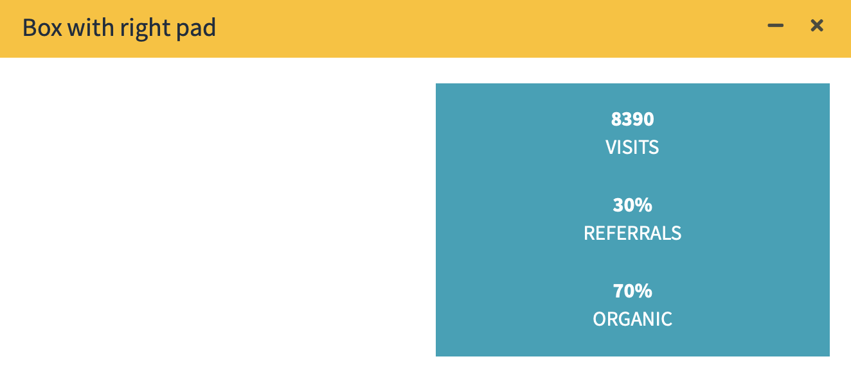

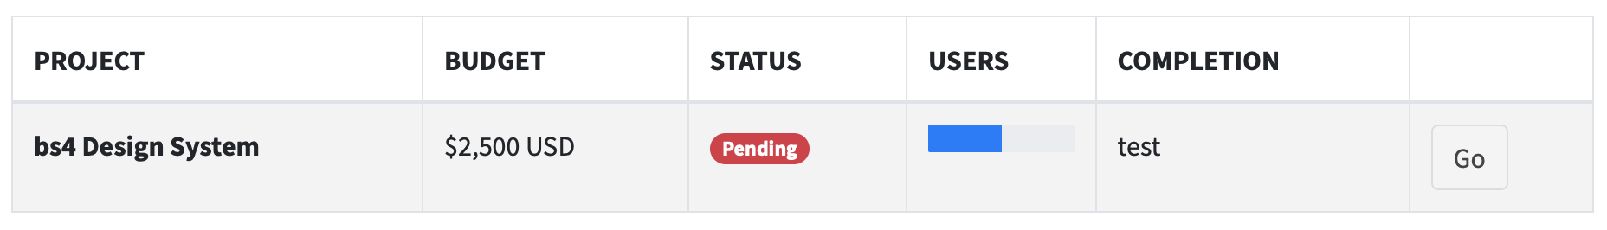
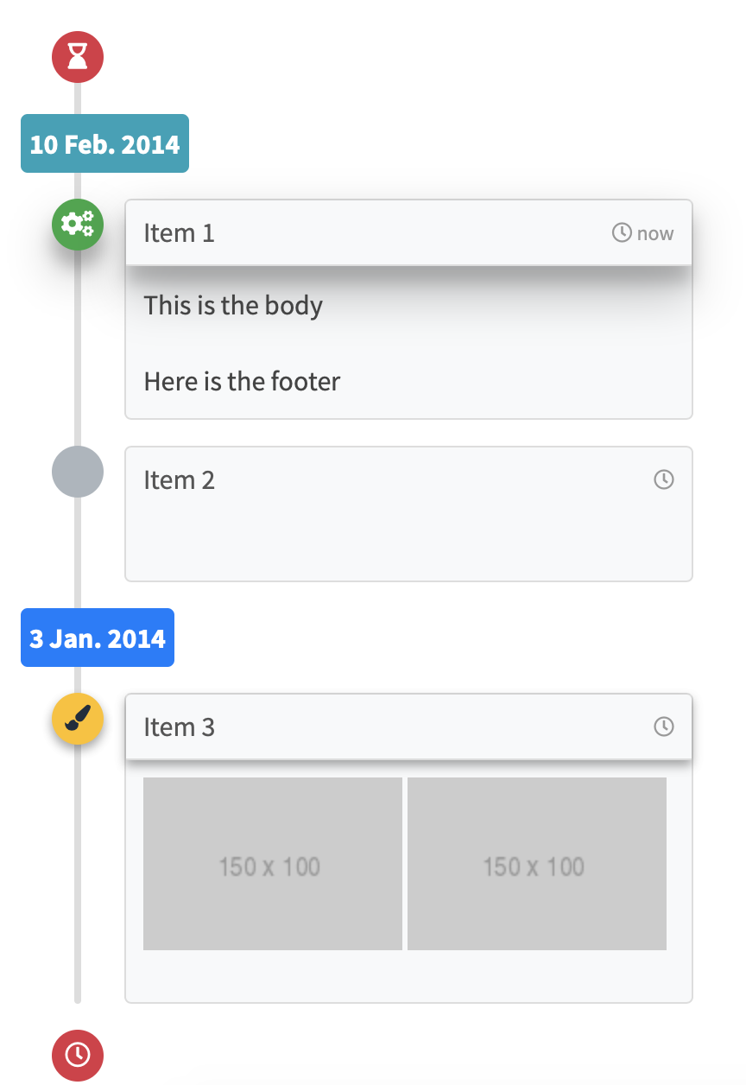
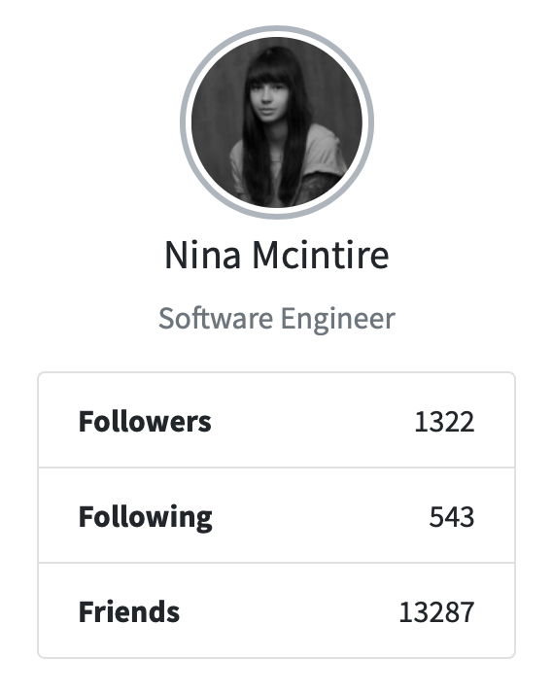


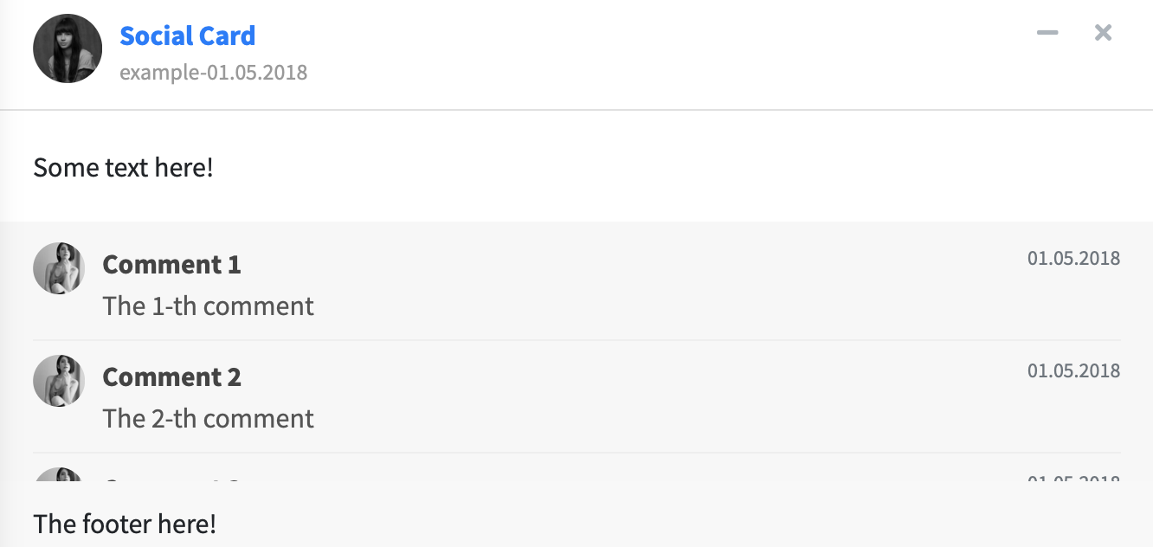
Tab Cards
Extra Box Elements
bs4TabCard()
userPost()
userPostToolItemList()
userPostToolItem()
userPostMedia()
userMessages()
userMessage()
Alternatively, you can use tabSetPanels outside cards.
userPostToolItem()
descriptionBlock()
bs4TabSetPanel()
cardPad()
Tables
starBlock()
userPostMedia()
timeLineBlock()
cardProfile()
cardProfileItemList()
cardProfileItem()
timelineStart()
dashboardLabel()
Social cards
timelineItem()
bs4UserCard()
boxProfile()
verticalProgress()
boxProfileItemList()
bs4SocialCard()
timelineLabel()
timelineItemMedia()
timelineStop()

