Slide 1

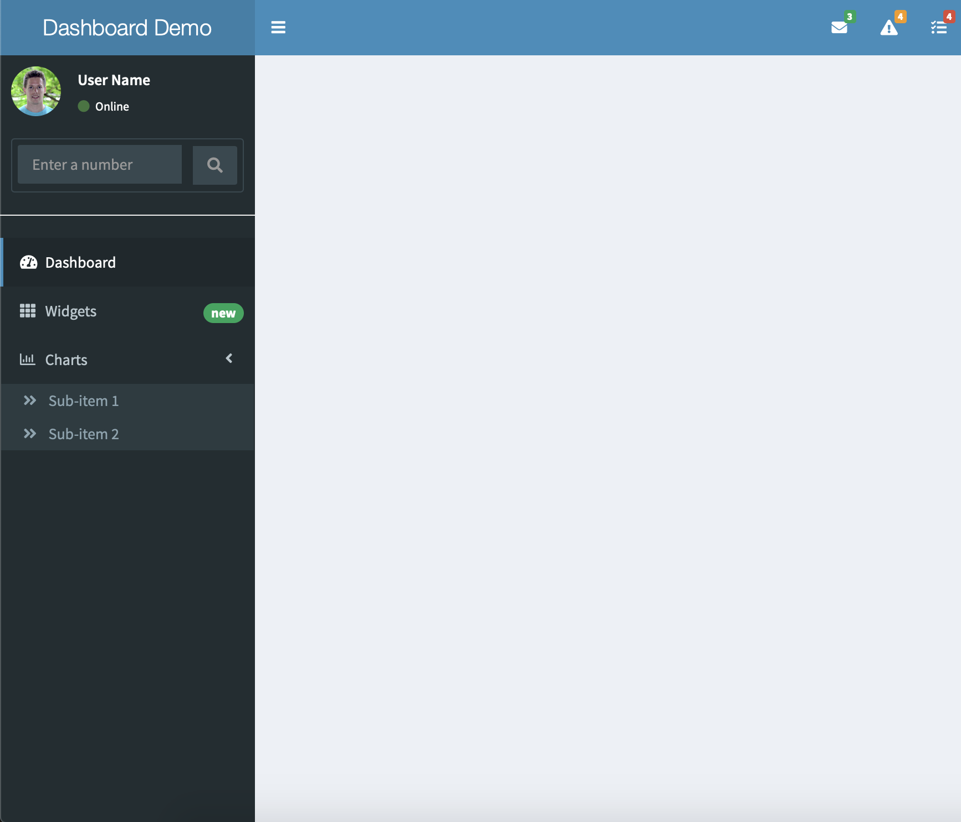

shinydashboard: : CHEAT SHEET
Basics
Layout Overview
Shinydashboard is a dashboard template for shiny.
Below is the main page structure
Header
library(shiny)
library(shinydashboard)
shinyApp(
ui = dashboardPage(
dashboardHeader(),
dashboardSidebar(),
dashboardBody(),
title = "Dashboard example"
),
server = function(input, output) { }
)
sidebarUserPanel(...)
sidebarSearchForm(...)
dashboardHeader(..., title = NULL, titleWidth = NULL, disable = FALSE, .list = NULL)
messageItems(...)
notificationItems(...)
taskItems(...)
dropdownMenu(..., type = c("messages", "notifications", "tasks"), badgeStatus = "primary", .list = NULL)
Sidebar
One can provide the tabName argument for each menuItem /menuSubItem, or alternatively, the href argument. While the first solution must be used in combinaison with the dashboard body tabItems, the second opens a new page.
Body
dashboardBody(...)
sidebarMenu(..., id = NULL, .list = NULL)
dashboardSidebar(
...,
disable = FALSE,
width = "50px",
collapsed = TRUE
)
For each tabItem, the tabName argument must correspond to the related menuItem of menuSubItem in the sidebarMenu, if provided
menuItem(..., tabName, href = NULL)
tabItems(...)
menuSubItem(..., tabName, href = NULL)
tabItem(tabName = NULL, ...)
RStudio® is a trademark of RStudio, Inc. • David Granjon • dgranjon@ymail.com • https://divadnojnarg.github.io • Learn more at https://rinterface.github.io/shinydashboardPlus/ • package version 0.7.5 • Updated: 2019-06

Slide 2
Boxes
Extra Box Elements
Alternatively, you can embed shinydashboard elements in vanilla shiny.
library(shinyWidgets)
shinyApp(
ui = fluidPage(
useShinydashboard(),
…
)
)
Social boxes

