Slide 1



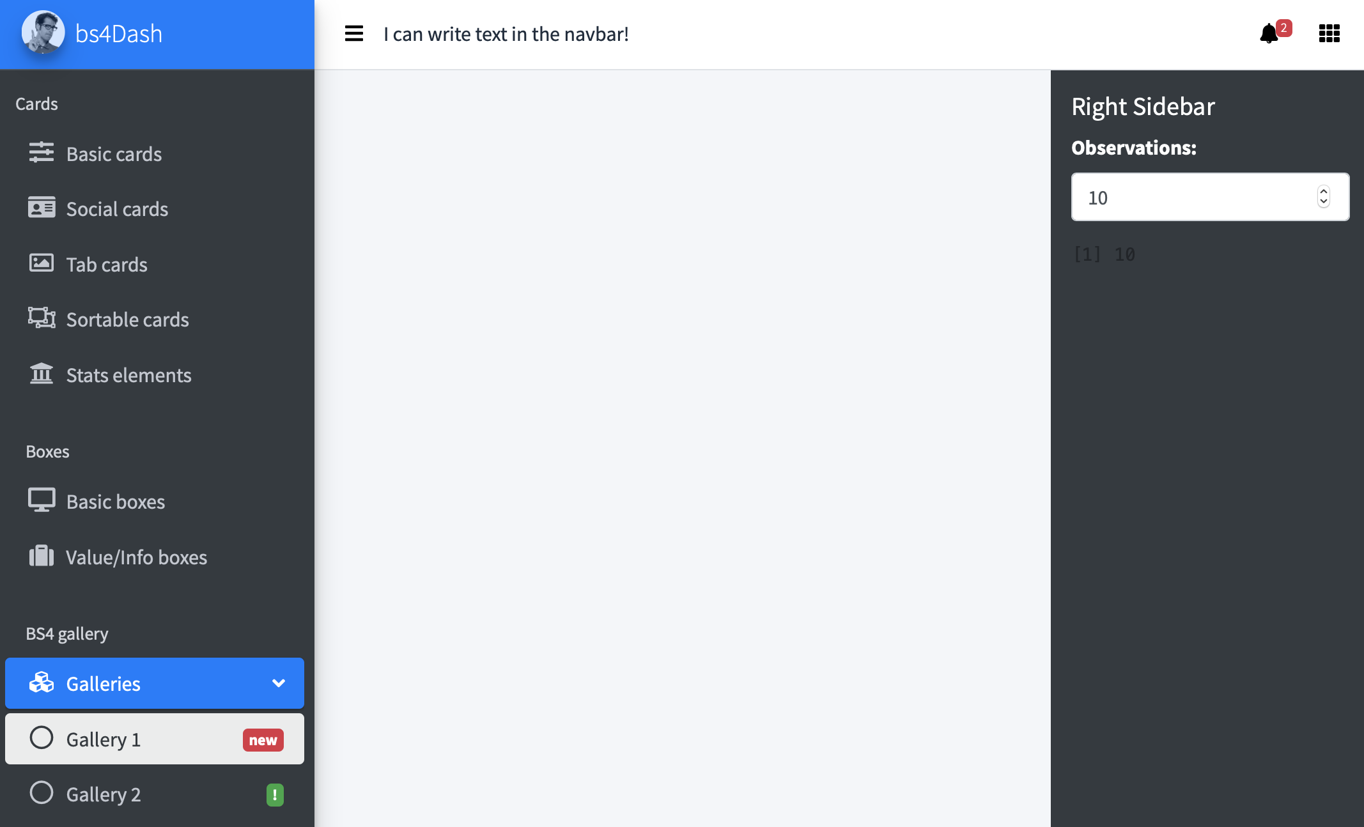
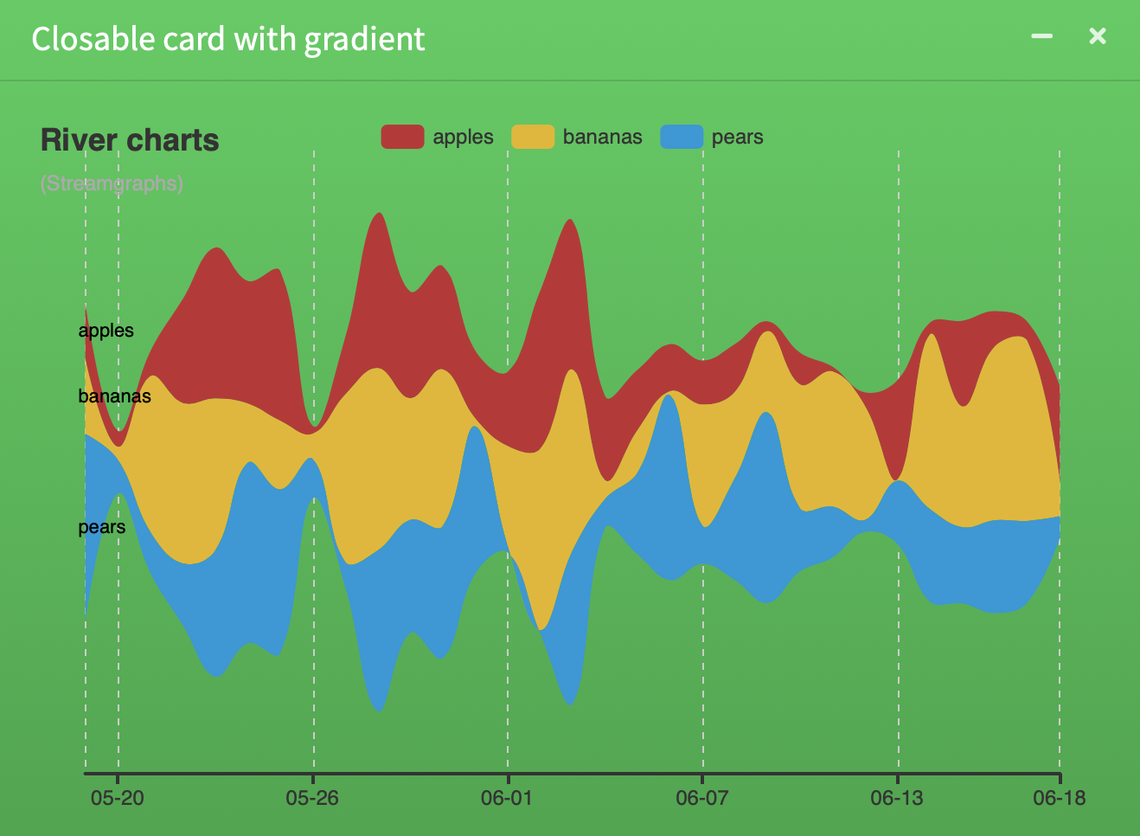
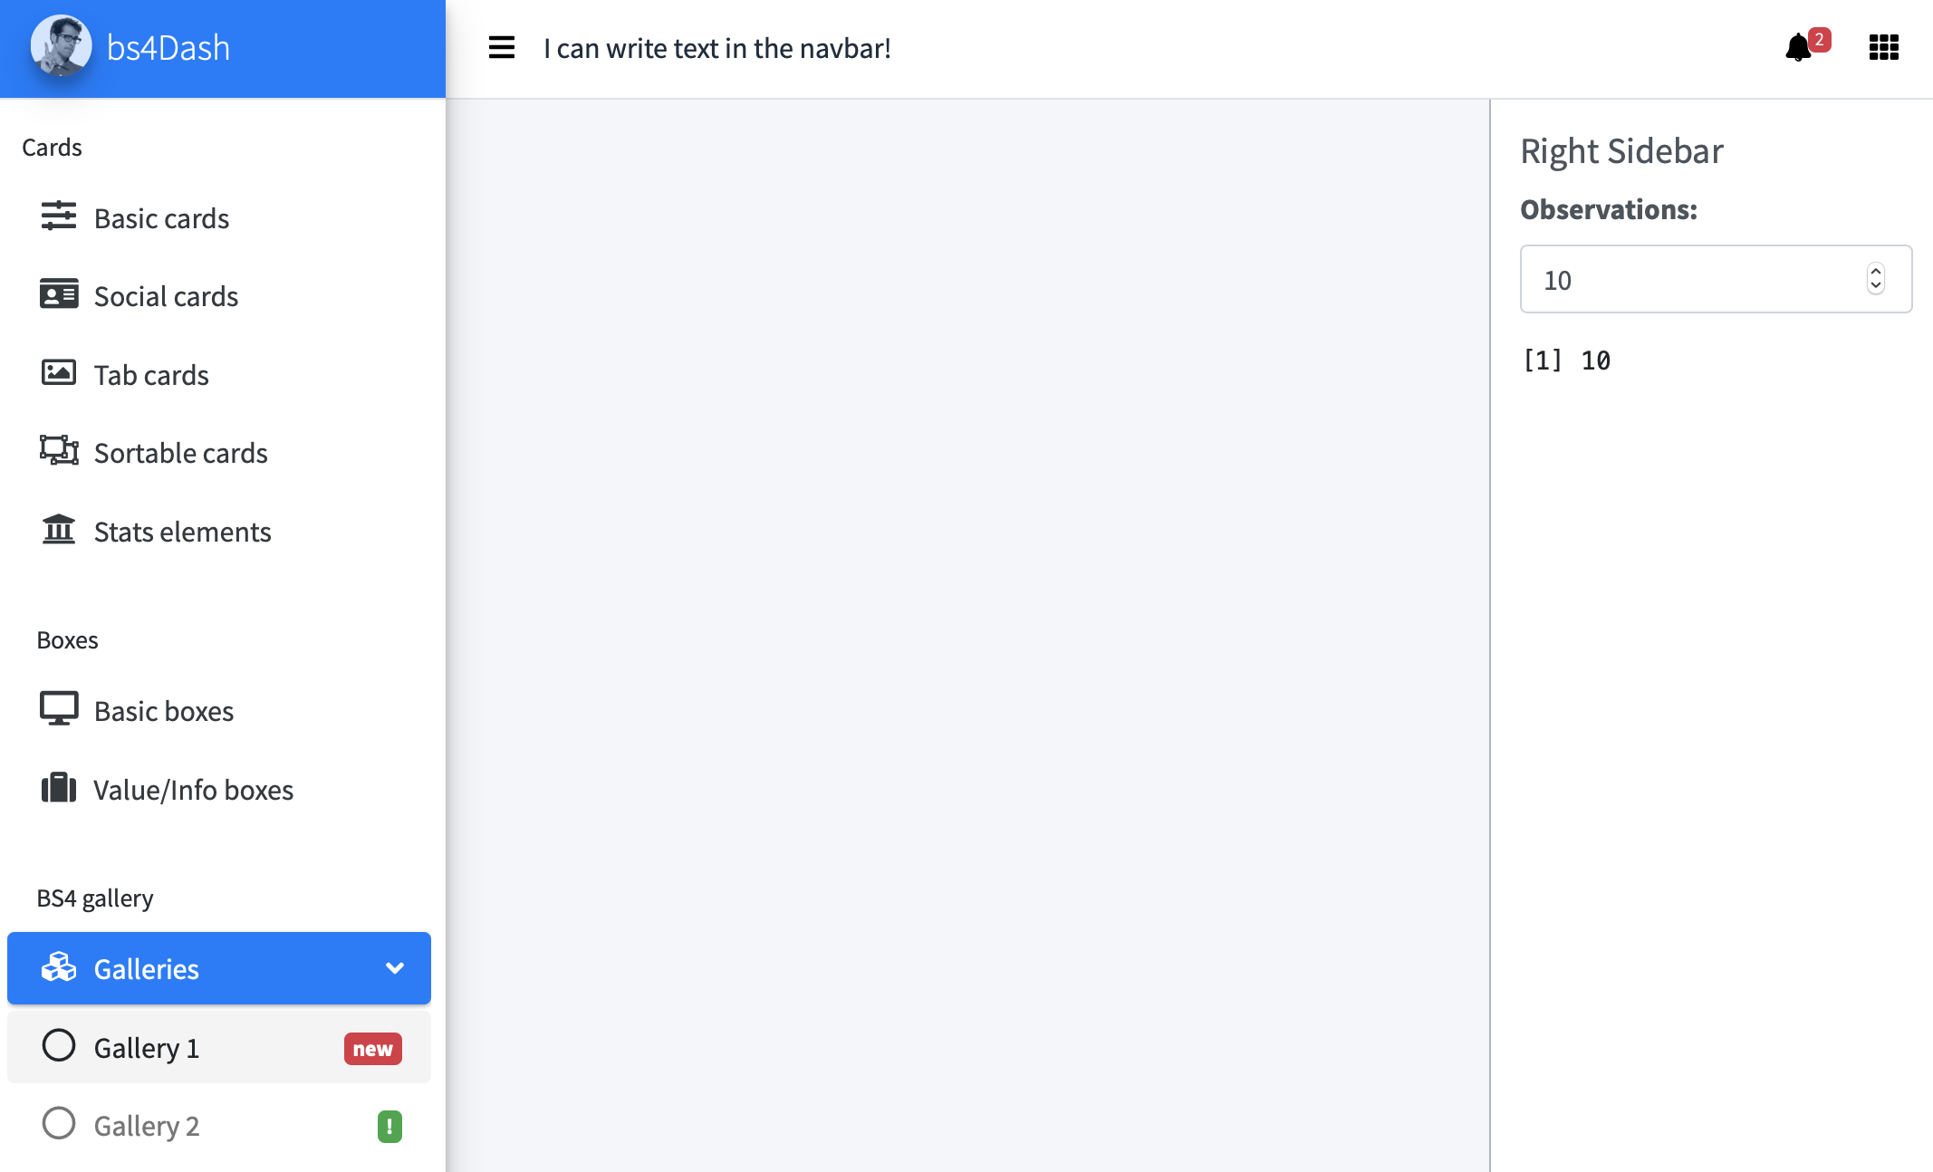
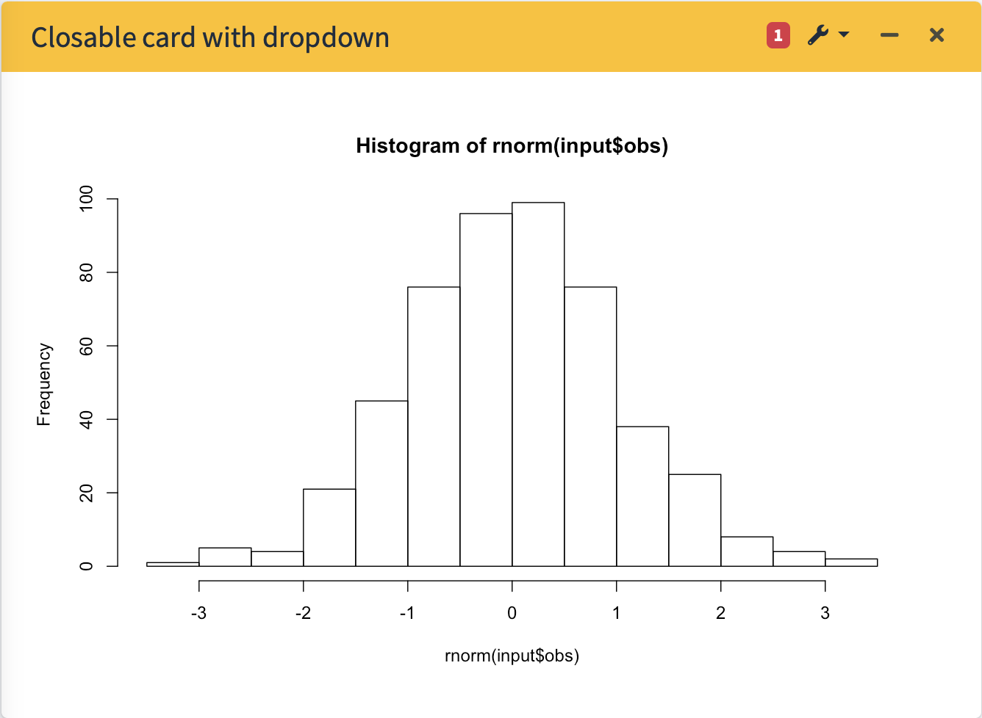

bs4Dash: : CHEAT SHEET
Basics
Layout Overview
(1)
bs4Dash has the same structure as shinydashboard
bs4DashNavbar(..., skin = "light", status = "white", border = TRUE, sidebarIcon = "bars", controlbarIcon = "th", leftUi = NULL, rightUi = NULL, fixed = FALSE)
bs4Dash is a Bootstrap 4 version of shinydashboard.
(2)
LeftUi
rightUi
library(shiny)
library(bs4Dash)
bs4DashSidebar(...)
bs4DashSidebar()
bs4DashNavbar()
Below is the main page structure
shiny::shinyApp(
ui = bs4DashPage(
old_school = FALSE,
sidebar_collapsed = FALSE,
controlbar_collapsed = FALSE,
enable_preloader = FALSE,
loading_duration = 2,
loading_background = "#1E90FF",
title = "Basic Dashboard",
navbar = bs4DashNavbar(),
sidebar = bs4DashSidebar(),
controlbar = bs4DashControlbar(),
footer = bs4DashFooter(),
body = bs4DashBody()
),
server = function(input, output) {}
)
bs4SidebarMenu(...)
bs4DashBody(...)
Put the menu in the bs4DashSidebar … arg
bs4TabItems(...)
(3)
bs4SidebarMenuItem("Item 1", tabName = "item1", ...)
bs4TabItem(tabName = NULL, ...)
Put this item in the bs4SidebarMenu … arg
The tabName must correspond to the related item in the sidebar
bs4GradientCard(…)
bs4DashControlbar()
Use visualizations to explain concepts quickly and concisely.
(4)
bs4DashControlbar(..., skin = "dark", title = NULL, width = 250)
bs4SidebarMenuSubItem(text = "Item ", tabName = "item")
bs4SidebarMenuItem can contain bs4SidebarMenuSubItem. Pass them in …
Pass your content in the … argument
bs4DashPage() is the page wrapper. Compared to shinydashboard, you can include an extra right sidebar, a pre-loader and even select the dashboard theme (classic or old school)…
Alternatively, you can embed bs4Dash elements in vanilla shiny.
Light Theme
Cards
bs4Card(…)
library(shinyWidgets)
shinyApp(
ui = fluidPage(
useBs4Dash(),
…
)
)
Both sidebars can have a light skin.
bs4DashSidebar(..., skin = "light")
bs4DashControlbar(..., skin = "light")
RStudio® is a trademark of RStudio, Inc. • David Granjon • dgranjon@ymail.com • https://divadnojnarg.github.io • Learn more at https://rinterface.github.io/bs4Dash/ • package version 0.4.0 • Updated: 2019-06

Slide 2
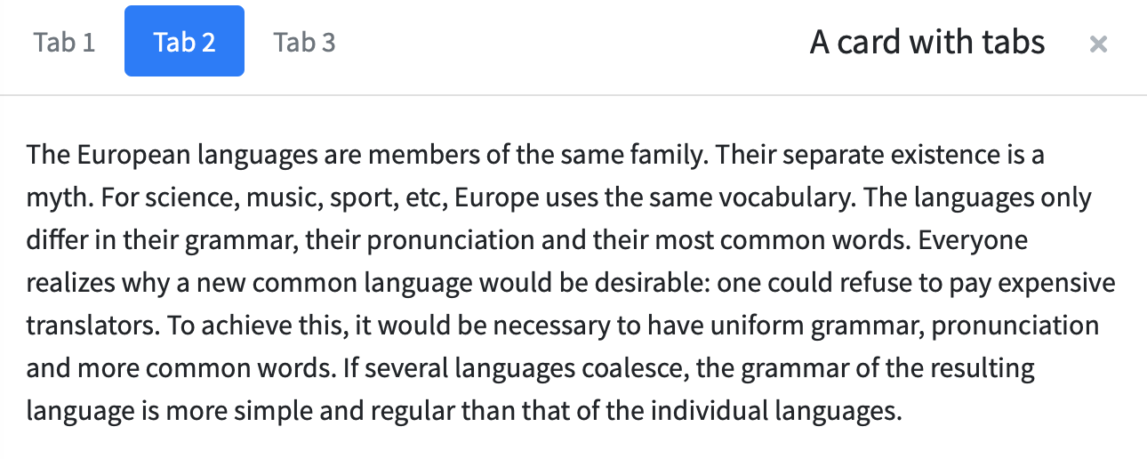
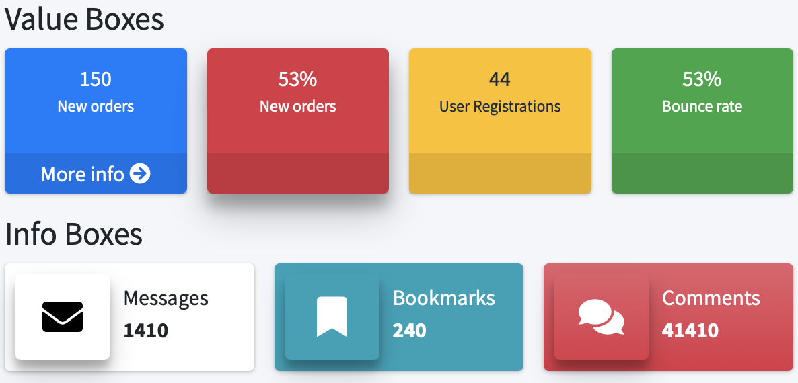
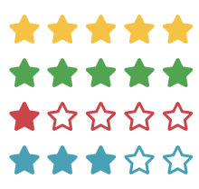

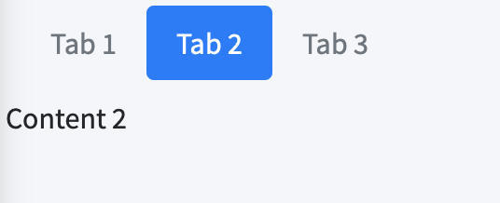
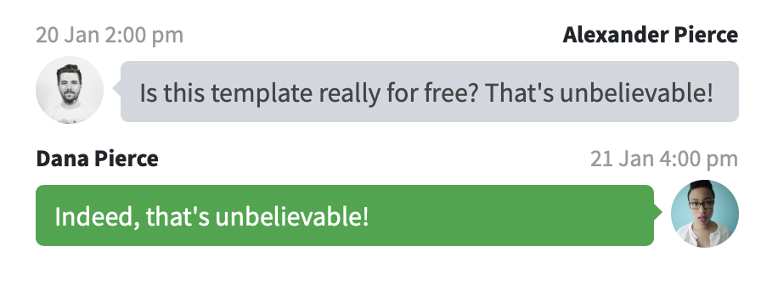
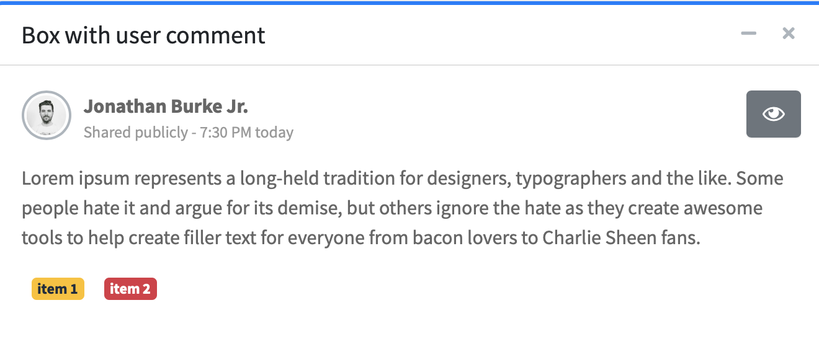
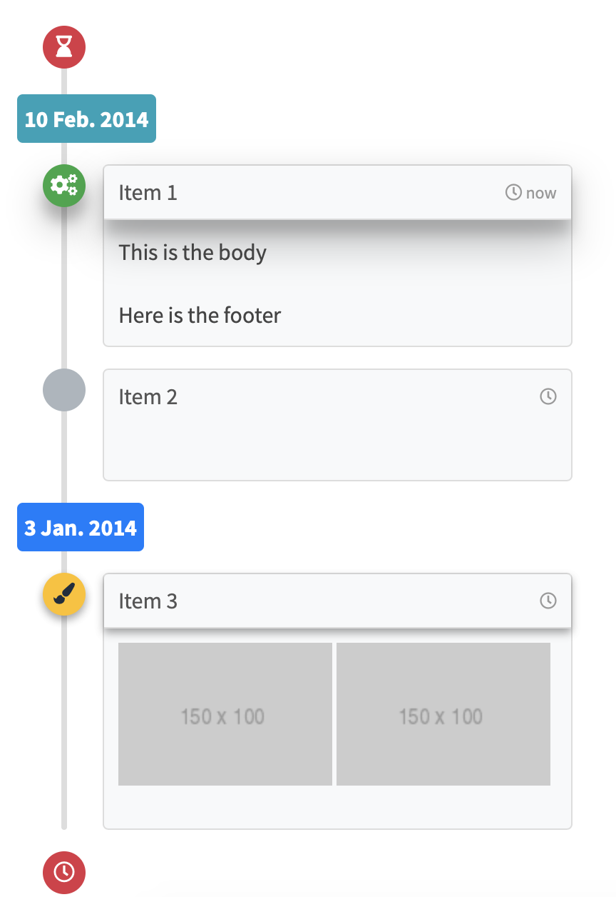
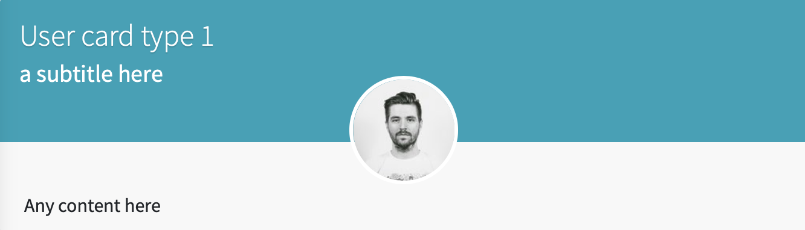
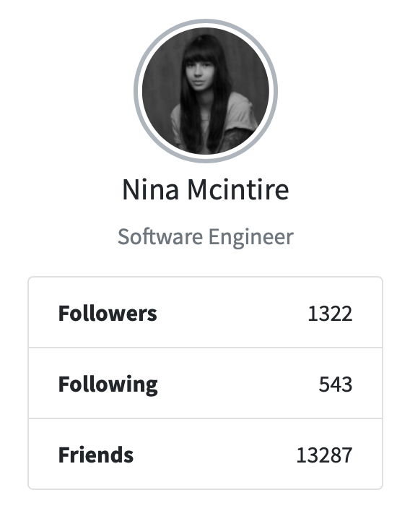
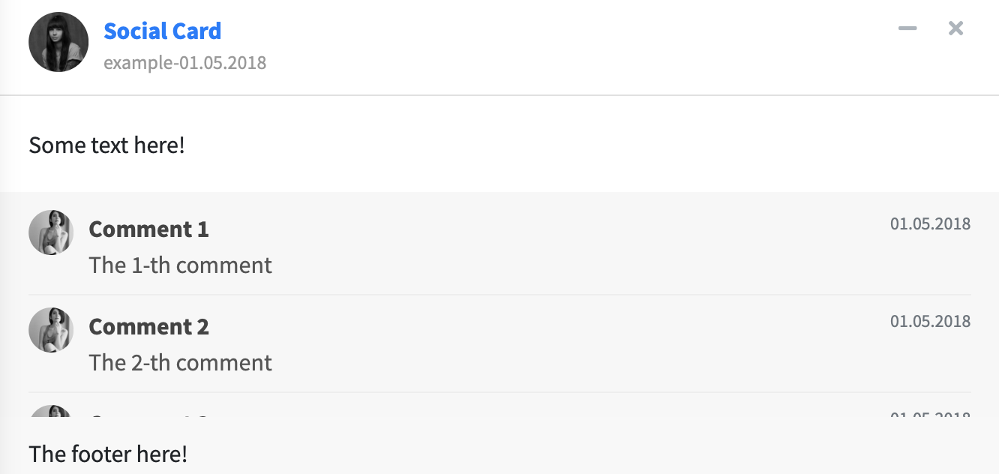
Tab Cards
Info/Value Boxes
bs4TabCard()
bs4InfoBox(…)
bs4ValueBox(…)
starBlock()
dashboardLabel()
Alternatively, you can use tabSetPanels outside cards.
Extra Box Elements (not all)
userMessages()
userMessage()
bs4TabSetPanel()
userPost()
userPostToolItemList()
userPostToolItem()
userPostMedia()
Social cards
timeLineBlock()
These items are well stuited when you build social shiny apps
userPostToolItem()
timelineStart()
cardProfile()
cardProfileItemList()
cardProfileItem()
timelineItem()
bs4UserCard()
boxProfile()
bs4SocialCard()
boxProfileItemList()
timelineLabel()
timelineItemMedia()
timelineStop()

