Slide 1
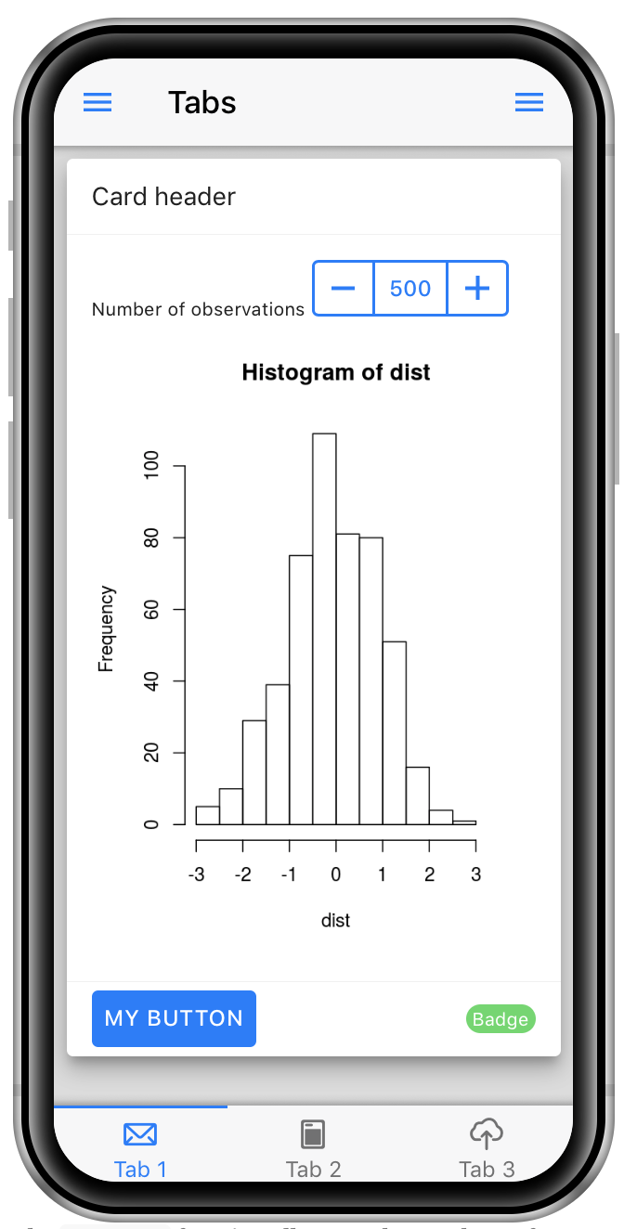
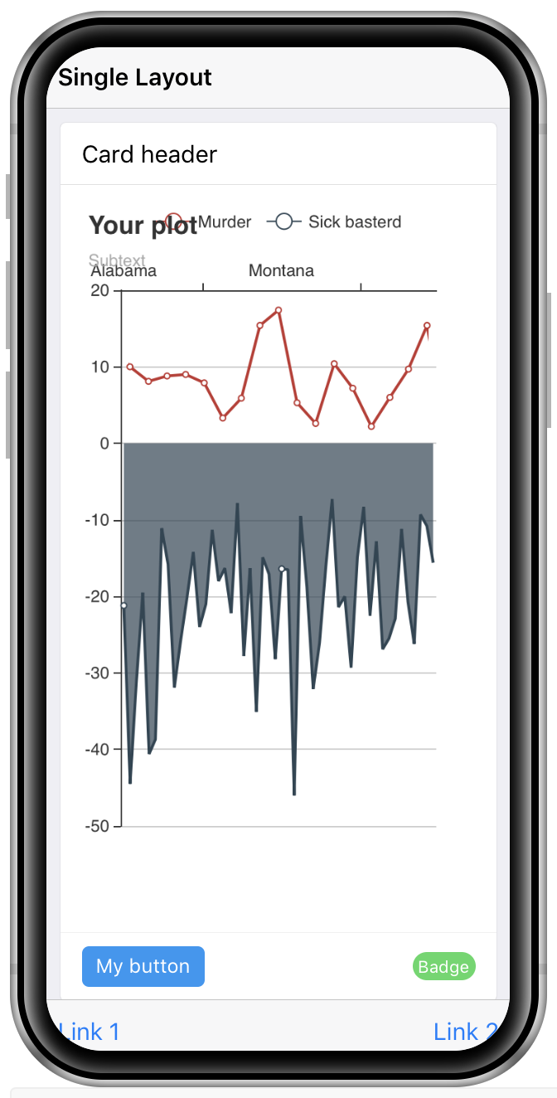
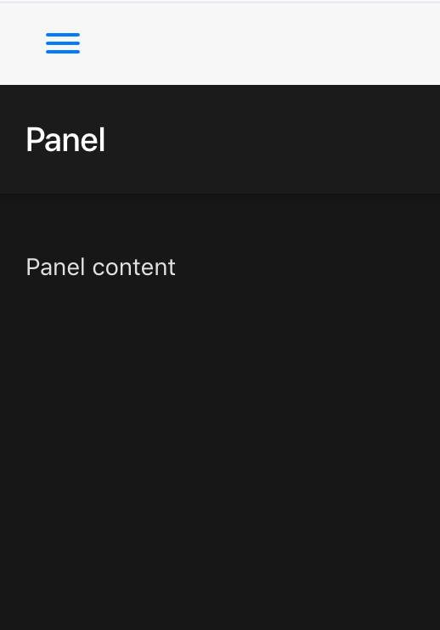
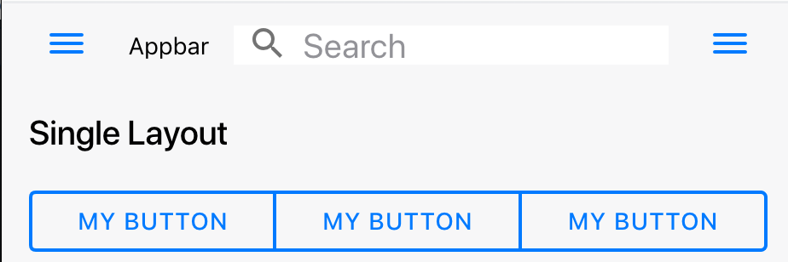
shinyMobile: : CHEAT SHEET
Basics
Layout Examples: Simple and Tabs (1)
shinyMobile is a template to design mobile ready and desktop Shiny Apps. shinyMobile is leveraging the progressive web app capability, thereby providing a standalone/fullscreen support.
TAB LAYOUT
library(shiny)
library(shinyMobile)
shiny::shinyApp(
ui = f7Page(
title = "Tab Layout",
f7TabLayout(
# panels are not mandatory. These are similar to sidebars
panels = tagList(
f7Panel(side = "left", theme = "light", effect = "cover", ...),
f7Panel(side = "right", theme = "dark", effect = "reveal", ...)
),
navbar = f7Navbar(
title = "Tabs",
# enable both panels
left_panel = TRUE,
right_panel = TRUE
),
# f7Tabs is a special toolbar with included navigation
f7Tabs(
animated = TRUE,
id = “tabs”,
f7Tab(
tabName = "Tab 1",
icon = f7Icon("email"),
active = TRUE,
# Tab 1 content
…
),
# Other tabs
...
)
)
),
server = function(input, output) {}
)
SINGLE LAYOUT
library(shiny)
Library(shinyMobile)
ui <- f7Page(
title = "My app",
f7SingleLayout(
# navbar is mandatory
navbar = f7Navbar(
title = "Single Layout",
hairline = FALSE,
shadow = TRUE
),
# main content
...,
# toolbar
toolbar = f7Toolbar(
position = "bottom",
# toolbar content
…
)
)
)
server <- function(input, output){}
shinyApp(ui = ui, server = server)
install.package(”shinyMobile”)
Remotes::install_github(“RinteRface/shinyMobile”)
You can setup custom desktop icons and splashscreen to produce a native app feeling
3 TEMPLATES
shinyMobile has 3 predefined templates:
f7SingleLayout(..., navbar, toolbar = NULL, panels = NULL, appbar = NULL, statusbar = f7Statusbar()): one page layout
f7TabLayout(..., navbar, panels = NULL, appbar = NULL, statusbar = f7Statusbar()): tab layout
f7SplitLayout(..., navbar, sidebar, toolbar = NULL, panels = NULL, appbar = NULL, statusbar = f7Statusbar()): ipad specific layout with sidebar panel and main panel
f7Page is the main wrapper function
f7TabLayout is probably the most versatile template since it adapts to many situations. By specifying an id to f7Tabs, you may recover the currently selected tab in input$id
f7SingleLayout is well suited for simple prototype apps, with only one view.
library(shiny)
Library(shinyMobile)
ui <- f7Page()
server <- function(input, output){}
shinyApp(ui = ui, server = server)
f7Panel(
...,
inputId = NULL,
title = NULL,
side = c("left", "right"),
theme = c("dark", "light"),
effect = c("reveal", "cover"),
resizable = FALSE
)
BOOKMARK YOUR APP:
Host it on shinyapps.io, RStudio Connect (www.rstudio.com/products/connect/)
or Build your own Shiny Server (www.rstudio.com/products/shiny-server/)
Visit your app using your favorite web browser (Chrome, Firefox, …)
Depending on the web browser, select the add to home screen feature
Change the name
Click on ok
Enjoy!
COMMON LAYOUT ELEMENTS
f7Appbar(..., left_panel = FALSE, right_panel = FALSE, maximizable = FALSE)
When used in a split layout context, inputId returns the currently select panel item. These items may be passed in the …
f7Navbar(...)
f7SubNavbar(...)
f7TabLayout and f7SingleLayout have an extra slot for an appbar. f7Appbar is an extra navigation bar
RStudio® is a trademark of RStudio, Inc. • CC BY SA RStudio • info@rstudio.com • 844-448-1212 • rstudio.com • Learn more at shiny.rstudio.com • shiny 0.12.0 • Updated: 2016-01

Slide 2
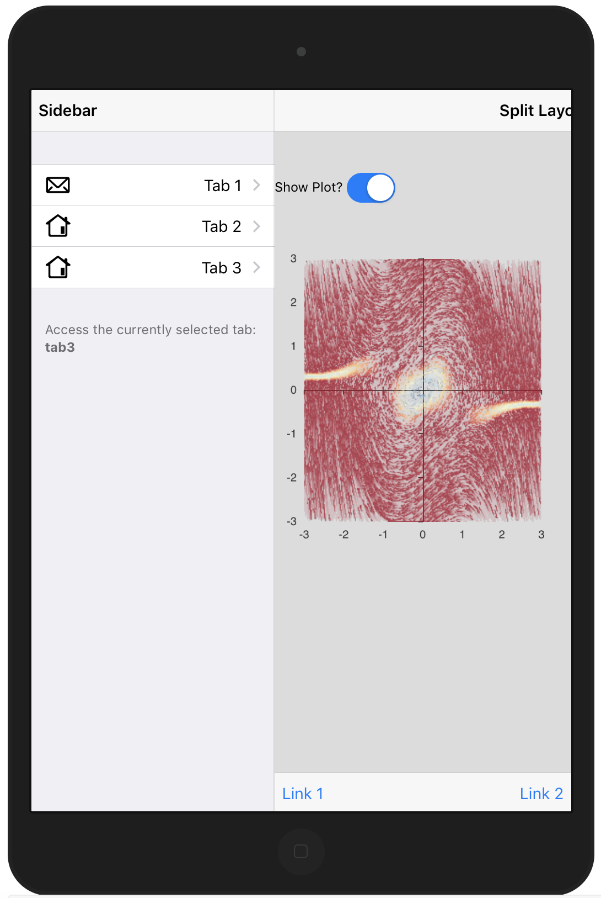
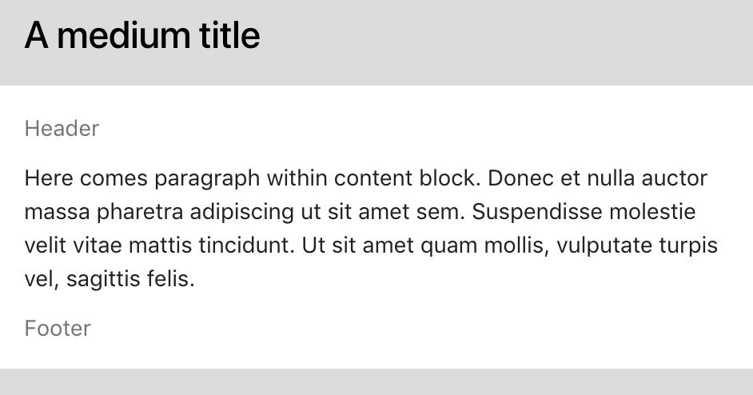
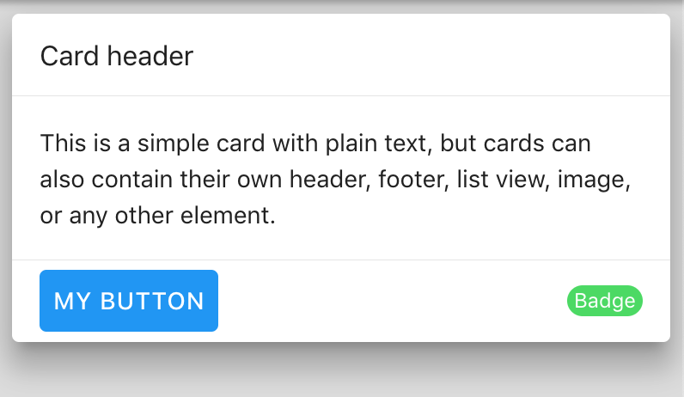
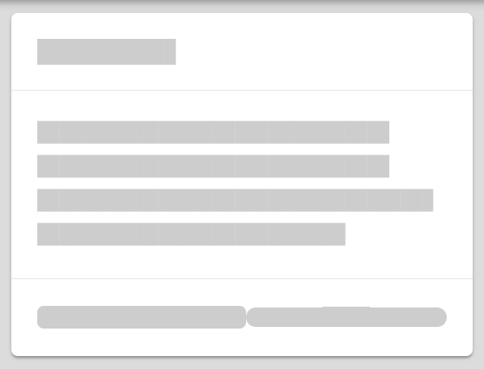
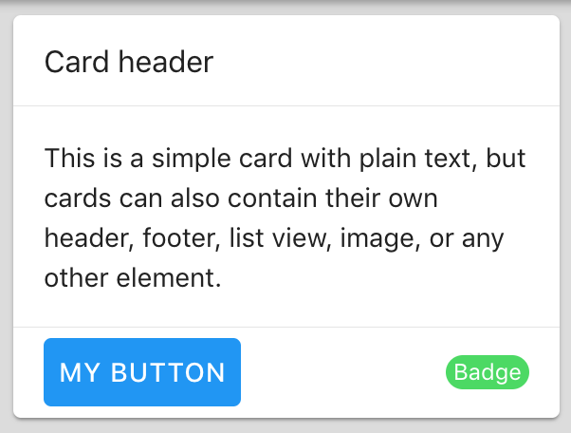
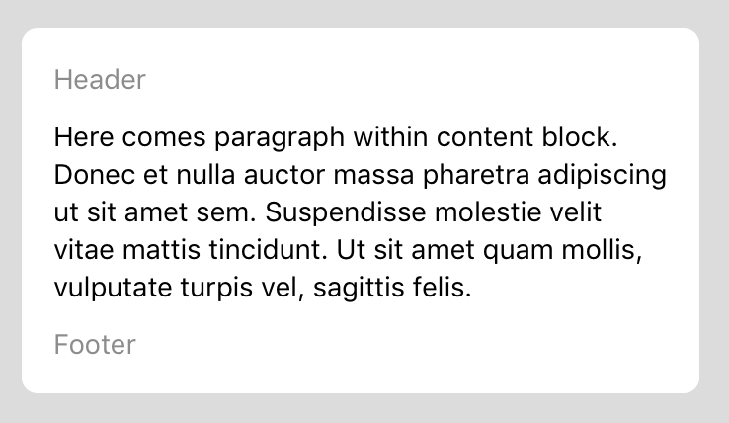
Layout Example: Split (2)
UI Configuration
SPLIT LAYOUT
library(shiny)
library(shinyMobile)
shiny::shinyApp(
ui = f7Page(
title = ”Split Layout",
f7SplitLayout(
navbar = f7Navbar( title = "Split Layout", hairline = FALSE, shadow = TRUE ),
sidebar = f7Panel(
inputId = "sidebar",
title = "Sidebar",
side = "left",
theme = "light",
# menu
f7PanelMenu(
id = "menu",
f7PanelItem(tabName = "tab1", title = "Tab 1", icon = f7Icon("email"), active = TRUE),
# other items
),
effect = "reveal"
),
# main content
f7Items(
f7Item(
tabName = "tab1",
# tab content
),
# other items
),
toolbar = f7Toolbar(
position = "bottom",
f7Link(label = "Link 1", src = "https://www.google.com"),
f7Link(label = "Link 2", src = "https://www.google.com", external = TRUE)
),
),
server = function(input, output) {}
)
shinyMobile has a dedicated configuration function allowing to fine tune the behavior of layout components, the global theme and skin.
f7Page(
init = f7Init(
skin = c("ios", "md", "auto", "aurora"),
theme = c("dark", "light"),
filled = FALSE,
color = NULL,
tapHold = TRUE,
iosTouchRipple = FALSE,
iosCenterTitle = TRUE,
iosTranslucentBars = FALSE,
hideNavOnPageScroll = TRUE,
hideTabsOnPageScroll = FALSE )
)
f7PanelMenu
f7PanelItem
The tapHold feature is unique to shinyMobile. A tapHold event corresponds to a long press on a button for instance. This allows to handle another kind of click, since on mobile, right click is not possible.
Layout: BLOCK
f7Block(..., hairlines = TRUE, strong = FALSE, inset = FALSE, tablet = FALSE)
f7BlockTitle(title = NULL, size = NULL)
f7BlockHeader(text = NULL)
f7SplitLayout is a tablet/desktop specific layout. By specifying an id to f7PanelMenu, you may recover the currently selected tab in input$id. Importantly, each f7PanelItem tabName must have a corresponding f7Item in the body content!
f7BlockFooter(text = NULL)
STRONG
Layout: effects
SKELETON (LOADING OVERLAY)
Layout: typography
f7Skeleton(tag, effect = "fade", duration = 2)
SHADOW
f7Align(tag, side = c("left", "center", "right", "justify"))
STRONG + INSET
BEFORE
AFTER
f7Float(tag, side = c("left", "right"))
f7Shadow(tag, intensity, hover = FALSE, pressed = FALSE)
fade 3s
f7Margin(tag, side = NULL)
f7Padding(tag, side = NULL)
Note: f7Align only work on text tags like p, h1, …
RStudio® is a trademark of RStudio, Inc. • CC BY SA RStudio • info@rstudio.com • 844-448-1212 • rstudio.com • Learn more at shiny.rstudio.com • shiny 0.12.0 • Updated: 2016-01

Slide 3
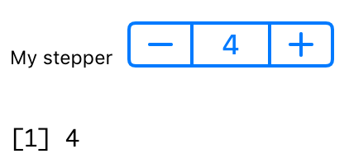
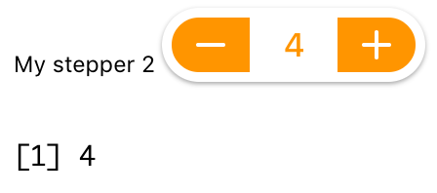
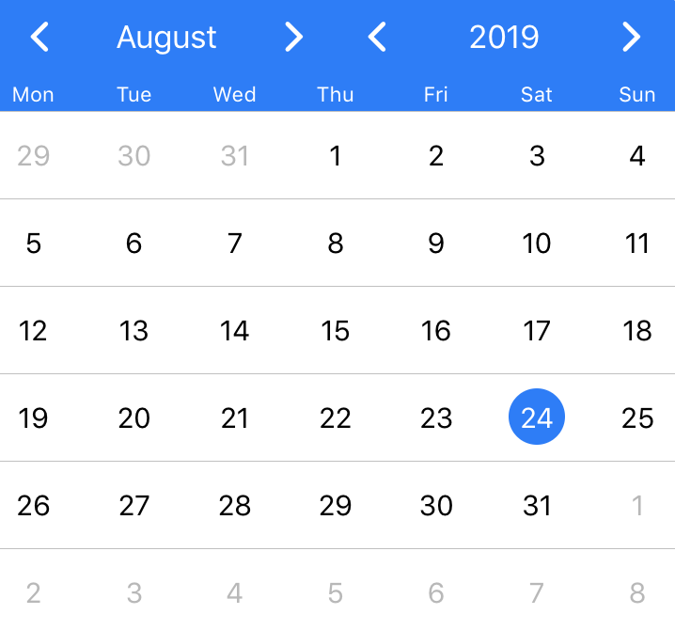

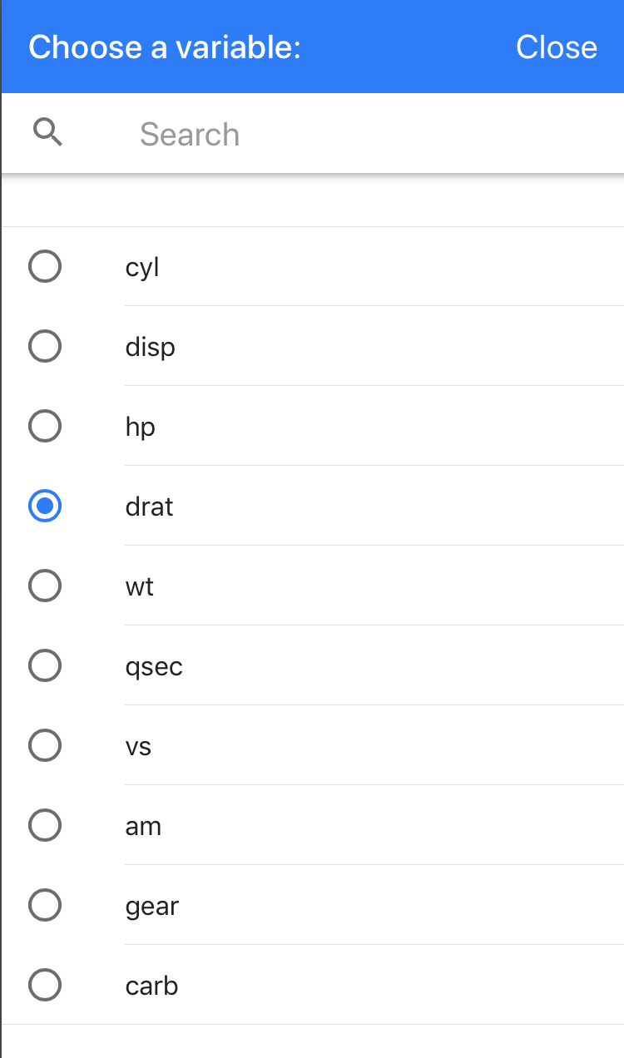
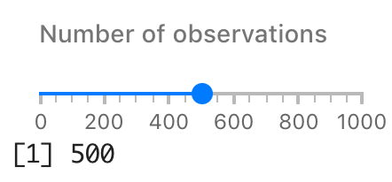
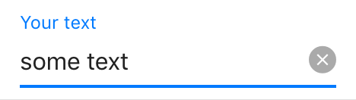
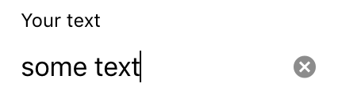
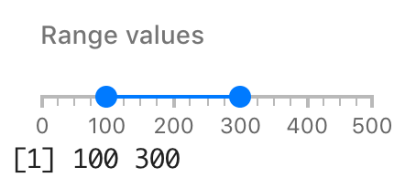
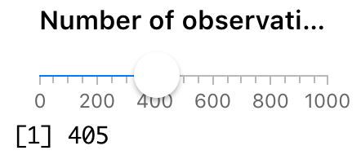
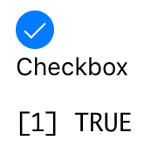
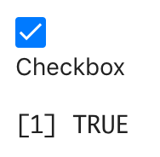
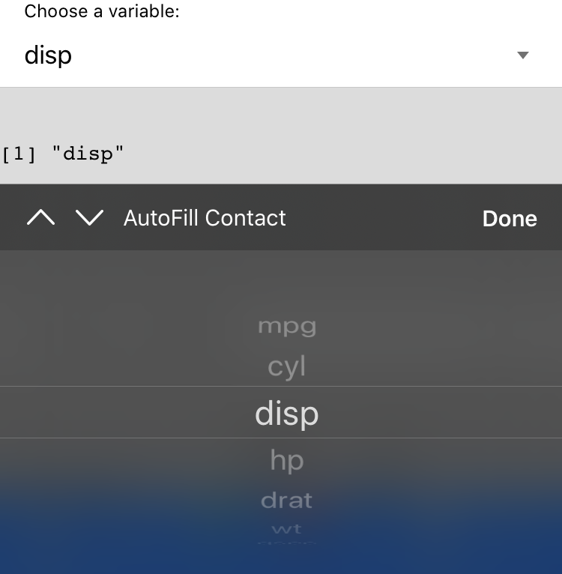
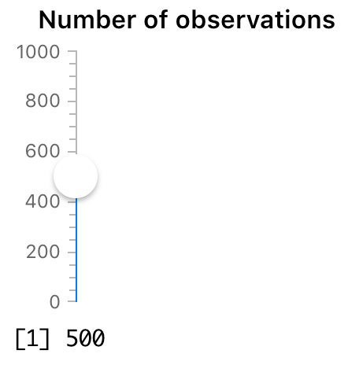
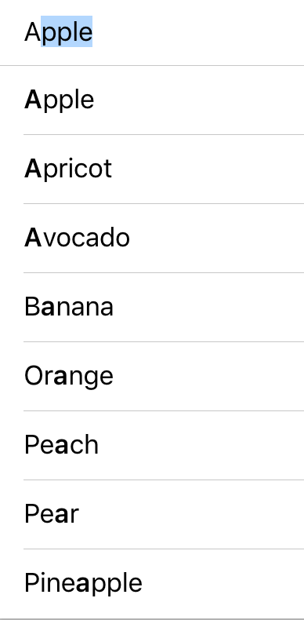
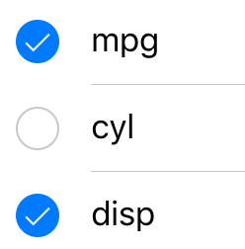
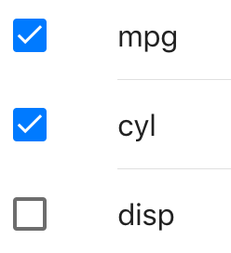
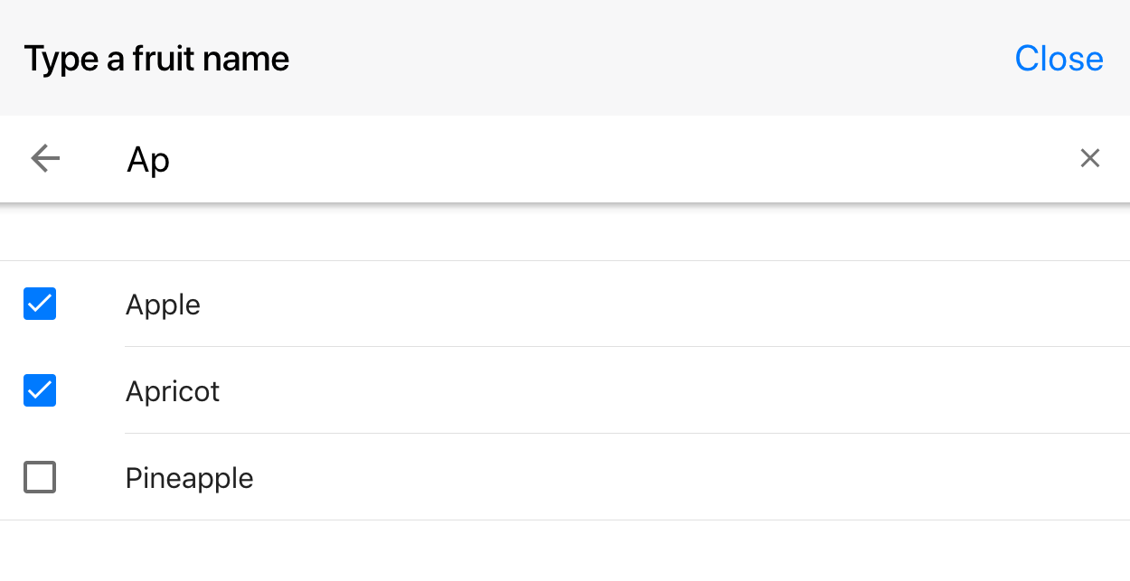
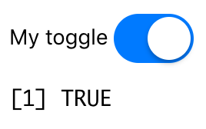
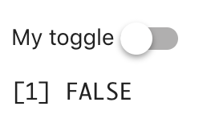
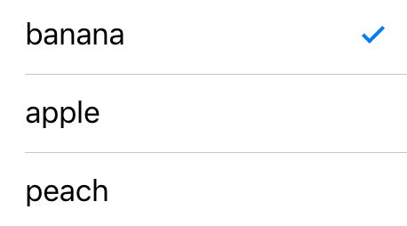
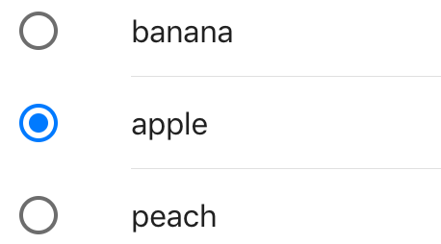
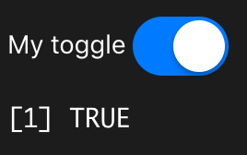
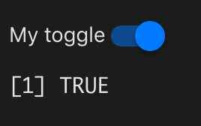
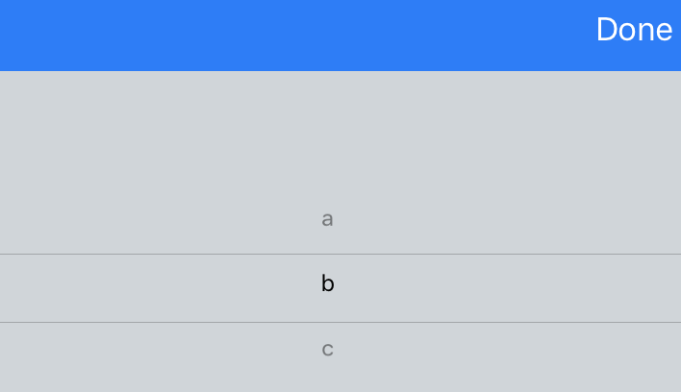
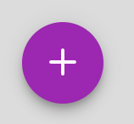
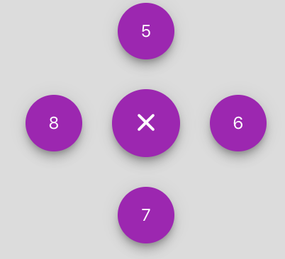
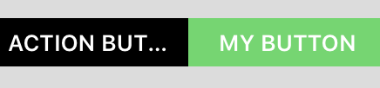
UI: inputs
simple stepper
SMART SELECT
DATE PICKER
shinyMobile has brand new inputs for Shiny! Moreover each input has its own design depending on the currently selected skin (iOS, material or desktop)
f7SmartSelect( inputId, label, choices, selected = NULL, type = c("sheet", "popup", "popover"), smart = TRUE, multiple = FALSE )
f7DatePicker( inputId, label, value = NULL, min = NULL, max = NULL, format = "yyyy-mm-dd" )
Stepper with raised, fill and rounded set to TRUE
(1)
SLIDERS
MD
f7Slider( inputId, label, min,
max, value, step = NULL,
scale = FALSE, vertical = FALSE )
TEXT
f7Text(inputId, label, value = "", placeholder = NULL)
f7Password(inputId, label, value = "", placeholder = NULL)
simple slider with material design
iOS
MD
(2)
range slider with material design
CHECKBOXES/GROUPS
f7checkBox(inputId, label, value = FALSE)
SELECT
simple slider with iOS design
iOS
MD
f7Select(inputId, label, choices)
vertical iOS slider
AUTOCOMPLETE
f7checkBoxGroup(inputId, label, choices = NULL,
selected = NULL)
f7AutoComplete( inputId, label, placeholder = NULL, value = choices[1], choices, typeahead = TRUE, expandInput = TRUE, type = c("popup", "page", "dropdown"), dropdownPlaceholderText = NULL, multiple = FALSE )
iOS
MD
TOGGLE
f7Toggle(inputId, label, checked = FALSE, color = NULL)
RADIO
iOS
MD
f7Radio(inputId, label, choices = NULL, selected = NULL)
Autocomplete input in a popup with multiple enable
ACTION BUTTON (FABS)
LIGHT
iOS
MD
f7Fabs( ..., position = c("right-top", "right-center", "right-bottom", "left-top", "left-center", "left-bottom", "center-center", "center-top", "center-bottom"), color = NULL, extended = FALSE, label = NULL, sideOpen = c("left", "right", "top", "bottom", "center"), morph = FALSE, morphTarget = NULL )
DARK
PICKER
f7Picker(inputId, label, placeholder = NULL, value = choices[1], choices)
f7Fab(inputId, label, width = NULL, ..., flag = NULL)
iOS
STEPPER
ACTION BUTTON
f7Stepper( inputId, label, min, max, value, step = 1,
fill = FALSE, rounded = FALSE, raised = FALSE, size = NULL,
color = NULL, wraps = FALSE, autorepeat = TRUE,
manual = TRUE )
f7Button(inputId = NULL, label = NULL, src = NULL, color = NULL, fill = TRUE, outline = FALSE, shadow = FALSE, rounded = FALSE, size = NULL)
click
shinyMobile tip: f7Button may be grouped in an f7Segment (see above)
shinyMobile tip: f7Fabs contain f7Fab, an improved action button.
RStudio® is a trademark of RStudio, Inc. • CC BY SA RStudio • info@rstudio.com • 844-448-1212 • rstudio.com • Learn more at shiny.rstudio.com • shiny 0.12.0 • Updated: 2016-01

Slide 4
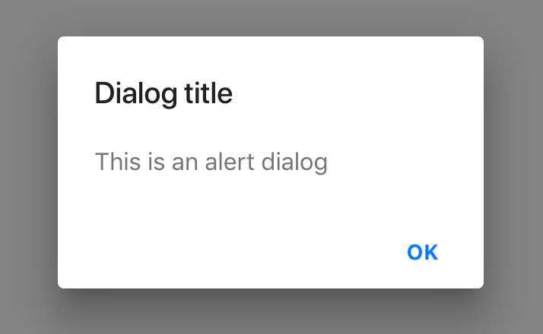
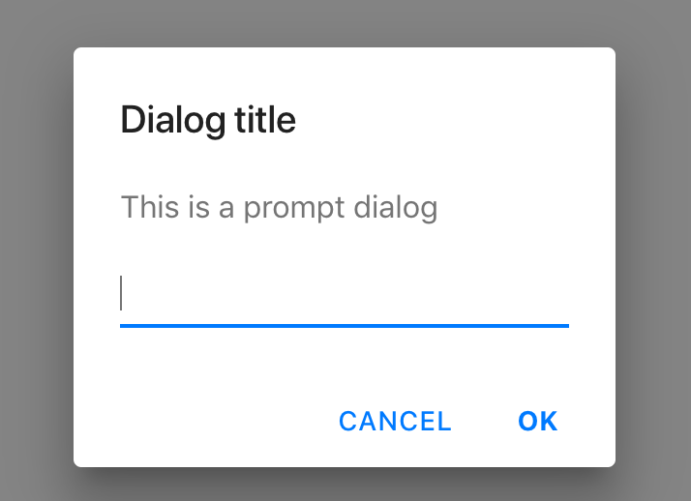
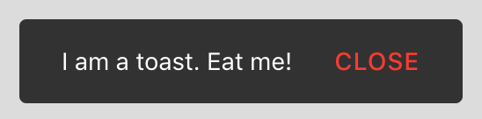
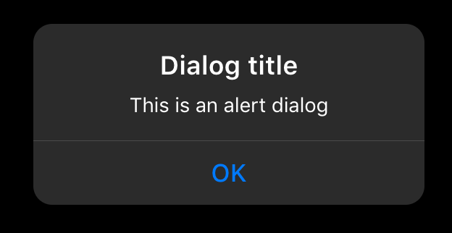
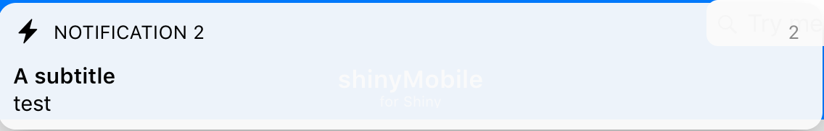
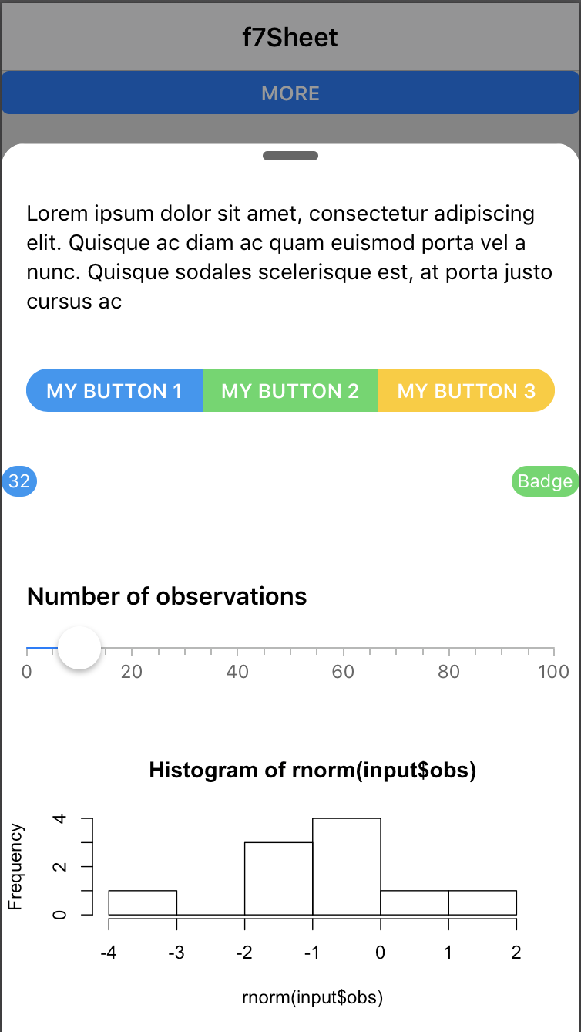
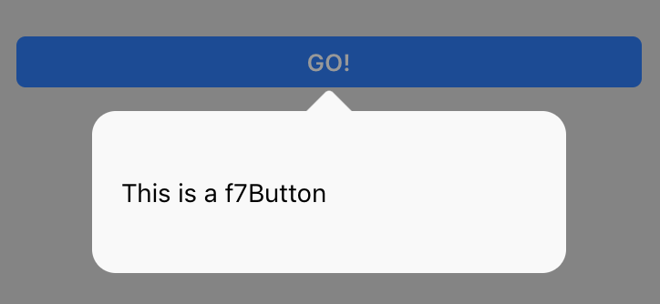
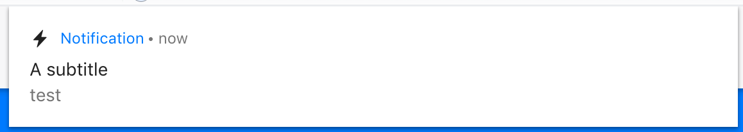
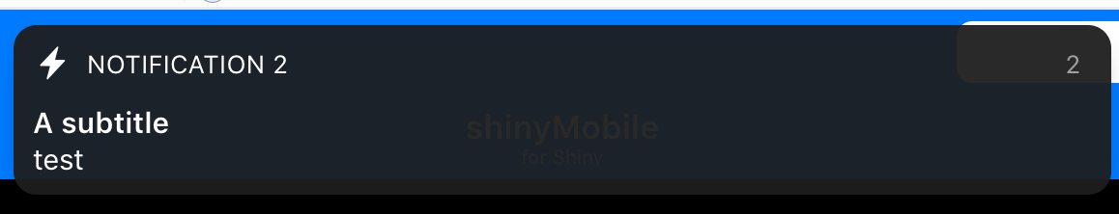
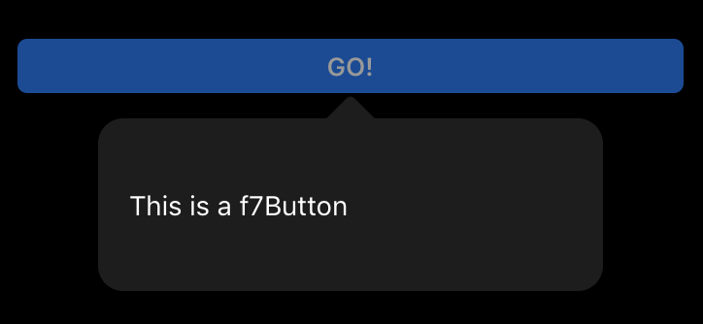
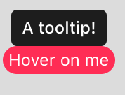
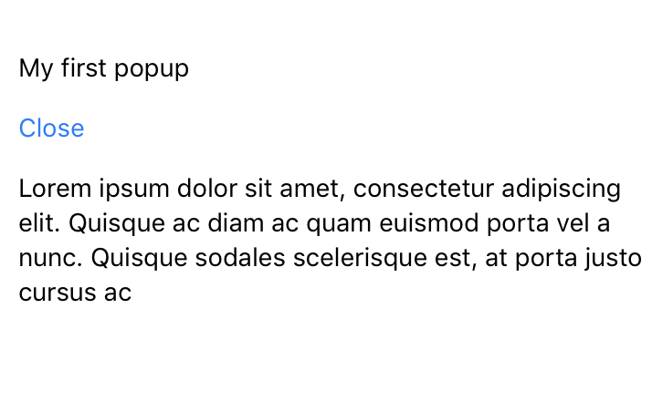
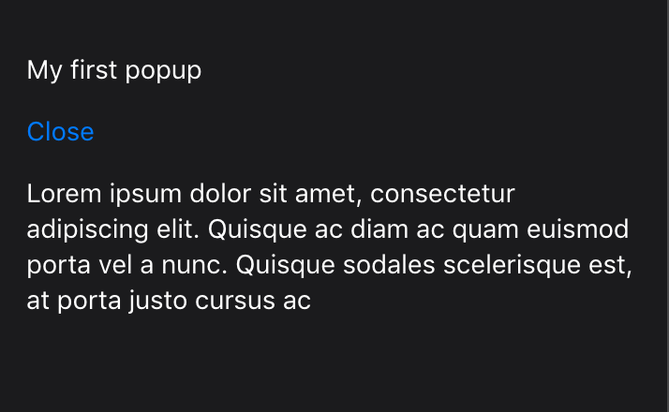



ALERTS
MD
TOAST
Server: update
shinyMobile has brand new notifications, popups, … Except for the f7Popup and f7Tooltip, all items are generated on the server side
f7Toast( session, text, position = c("bottom", "top", "center"), closeButton = TRUE, closeButtonText = "close", closeButtonColor = "red", closeTimeout = 3000, icon = NULL )
INPUTS
updateF7AutoComplete(session, inputId, value = NULL)
NOTIFICATIONS
Simple dialog
Dialog with prompt input
updateF7Checkbox(session, inputId, label = NULL, value = NULL)
f7Notif( text, icon = NULL, title = NULL, titleRightText = NULL, subtitle = NULL, closeTimeout = 5000, closeButton = FALSE, closeOnClick = TRUE, swipeToClose = TRUE, session )
updateF7Fab(session, inputId, label = NULL)
updateF7Picker(session, inputId, value = NULL, choices = NULL)
iOS/DARK
POPOVER
updateF7Slider( session, inputId, min = NULL, max = NULL, value = NULL, scale = FALSE )
iOS
f7Popover(targetId, content, session)
updateF7Stepper( session, inputId, min = NULL, max = NULL, value = NULL, step = NULL, fill = NULL, rounded = NULL, raised = NULL, size = NULL, color = NULL, wraps = NULL, autorepeat = NULL, manual = NULL )
f7PopoverTarget(tag, targetId)
MODAL SHEET
iOS/LIGHT
updateF7Text(session, inputId, label = NULL, value = NULL, placeholder = NULL)
MD
f7Sheet( ..., hiddenItems, id, label = "Open", orientation = c("top", "bottom"), swipeToClose = FALSE, swipeToStep = FALSE, backdrop = FALSE, closeByOutsideClick = TRUE, swipeHandler = TRUE )
updateF7Toggle(session, inputId, checked = NULL, color = NULL)
iOS/DARK
OTHER ELEMENTS
shinyMobile tip: f7Sheet
may also open from the top. swipeToStep allows to keep the sheet slightly open instead of completely closing it.
iOS/DARK
shinyMobile tip: shinyMobile elements like tabs, panels, sheet, accordion, cards, gauges, progress have an associated input to trigger events on the server side. There are function to update these inputs!
TOOLTIP
f7Tooltip(tag, text)
updateF7Accordion(inputId, selected = NULL, session)
SWIPEOUT
updateF7Card(id, session)
POPUP
f7Swipeout( tag, ..., left = NULL, right = NULL, side = c("left", "right", "both") )
updateF7Gauge(session, id, value)
f7Popup(..., id, label = "Open", title)
ACTION SHEET
updateF7Panel(inputId, session)
LIGHT
DARK
f7ActionSheet( id, session = shiny::getDefaultReactiveDomain(), grid = FALSE, buttons, icons = NULL )
f7SwipeoutItem(id, label, color = NULL)
updateF7Progress(session, id, value)
updateF7Sheet(inputId, session)
updateF7Tabs(session, id, selected = NULL)
iOS
Server: tapHold
shinyMobile tip: f7Swipeout
must to be used in combination with f7ListItem. Pass any f7SwipeoutItem in the … argument. The id attributes allows to perform actions on the server side with input$id.
shinyMobile tip: to trigger a taphold event (long press) on a tag, use the f7TapHold function
DIALOG
MD
f7Dialog( inputId = NULL, title = NULL, text, type = c("alert", "confirm", "prompt", "login"), session )
f7TapHold(target, callback, session)
shinyMobile tip: in f7ActionSheet buttons must be provided in a dataframe, icons in a list.
RStudio® is a trademark of RStudio, Inc. • CC BY SA RStudio • info@rstudio.com • 844-448-1212 • rstudio.com • Learn more at shiny.rstudio.com • shiny 0.12.0 • Updated: 2016-01

Slide 5















UI: Widgets
MESSAGES
TIMELINES (Examples with iOS design)
UI: Cards
shinyMobile has brand new widgets for Shiny! Some of them have their own design depending on the currently selected skin (iOS, material or desktop)
f7Messages(..., id)
f7Timeline( ..., sides = FALSE, horizontal = FALSE, calendar = FALSE, year = NULL, month = NULL )
f7Message( content, src = NULL, author = NULL, date = NULL, state = c("sent", "received"), type = c("text", "img") )
f7TimelineItem( ..., date = NULL, card = FALSE, time = NULL, title = NULL, subtitle = NULL, side = NULL )
ACCORDIONS
iOS
MD
f7Accordion(..., inputId = NULL, multiCollapse = FALSE)
f7AccordionItem(..., title = NULL, open = FALSE)
If inputId is passed, one may retrieve the currently selected item as follows
input$<inputId>$state is TRUE if open, else FALSE
input$<inputId>$value is NULL if closed else contain the f7AccordionItem value
SELECT
PHOTO BROWSER
f7PhotoBrowser( id, label, photos, theme = c("light", "dark"), type = c("popup", "standalone", "page") )
GAUGES
BADGES
f7Gauge( id, type = NULL, value = NULL, size = NULL, bgColor = NULL, borderBgColor = NULL, borderColor = NULL, borderWidth = NULL, valueText = NULL, valueTextColor = NULL, valueFontSize = NULL, valueFontWeight = NULL, labelText = NULL, labelTextColor = NULL, labelFontSize = NULL, labelFontWeight = NULL )
f7Badge(..., color = NULL)
LIGHT
DARK
SWIPER SLIDER
ACTION BUTTON (FABS)
CHIPS
f7Swiper( ..., id, spaceBetween = 50, slidePerView = "auto", centered = TRUE, speed = 400 )
PROGRESS BARS
f7Chip( label = NULL, img = NULL, icon = NULL, outline = FALSE, status = NULL, icon_status = NULL, closable = FALSE )
f7Progress(id, value, color)
f7Slide(...)
f7ProgressInf(color = NULL)
LIGHT
DARK
RStudio® is a trademark of RStudio, Inc. • CC BY SA RStudio • info@rstudio.com • 844-448-1212 • rstudio.com • Learn more at shiny.rstudio.com • shiny 0.12.0 • Updated: 2016-01

