Slide 1
CSC322 Lecture 2 – Basic C# Syntax
Dr. Victor Odumuyiwa

Slide 2
Learning outcomes
At the end of this lecture, you should be able to:
Demonstrate a good understanding of C# syntax
Write simple programs in C#

Slide 3
Main class (Program.cs)
using System.Text;
using System.Threading.Tasks;
namespace Lesson1
{
class Program
{
static void Main(string[] args)
{
}
}
}

Slide 4
Statically vs. dynamically typed languages
C# is a statically typed language, which is to say that any element of code that represents or produces information, such as a variable or an expression, has its data type determined at compile time.
Different from dynamically typed languages, such as JavaScript, in which types are determined at runtime.

Slide 5
Variable declaration (1/2)
Each variable must be preceded by its type
String name = “victor”;
int age = 22;
After declaration, no need to specify type while using the variable
name = “Jules”;
age = 14;

Slide 6
Variable declaration (2/2)
Multiple declarations in a line
int a=4, b=5, c=6;
Keyword “var” could be used to automatically determine the type
var name = “victor”;
var num = 5;
name = 6;
num = “Mike”;

Slide 7
Scope(1/4)
A variable’s scope is the range of code in which you can refer to that variable by its name.
Local variables are not the only things with scope. Methods, properties, types, and, in fact, anything with a name all have scope.
Scope is the region in which you can refer to the entity by its name

Slide 8
Scope(2/4)
A local variable’s scope starts at its declaration, and finishes at the end of its containing block.
A block is a region of code delimited by a pair of braces { }.
A method body is a block, so a variable defined in one method is not visible in another method, because it is out of scope.

Slide 9
Scope(3/4)
public int setCount()
{
int count =5;
return count;
}
public int getCount()
{
count = count+5;
return count;
}

Slide 10
Scope(4/4)
In a nested block, everything that is in scope in the outer block continues to be in scope inside that nested block.
If you declare a variable in a nested block, its scope does not extend outside of that block.

Slide 11
Scope Example
int n = 5;
if (n > 3)
{
int ans = 3;
n--;
if (n <= 2)
{
ans = 2;
}
Console.WriteLine(ans);
Console.WriteLine(n);
}

Slide 12
Declaration Space
A declaration space is a region of code in which a single name must not refer to two different entities.
Each method defines a declaration space for variables.
Nested blocks also introduce declaration spaces, and it is illegal for a nested declaration space to declare a variable with the same name as one in its parent’s declaration space.
Declaration space rules intent is that it shouldn’t matter where you put the declaration. If you were to move all of the variable declarations in a block to the start, this shouldn’t change what the code means.

Slide 13
Scope vs. Declaration Space
int n = 5;
if (n > 3)
{
int ans = 3;
n--;
if (n <= 2)
{
ans = 2;
}
Console.WriteLine(ans);
Console.WriteLine(n);
}
int n = 5;
if (n > 3)
{
int ans = 3;
n--;
if (n <= 2)
{
ans = 2;
}
int n = 7;
Console.WriteLine(ans);
Console.WriteLine(n);
}

Slide 14
Statement and Expressions
C# specification distinguishes between 14 different categories of statement
Focus here will be on:
Declaration statement
Expression statement
Iteration statement
Selection statement
What is the difference between expression and expression statement ?

Slide 15
Expression statements
An expression is a sequence of operators and operands.
You can use the following kind of expressions as statements:
Method invocation
Assignment
Increment
Decrement
New object declaration
2+3 is a valid expression but not an expression statement so the compiler will complain when you write 2+3; as a line of code.

Slide 16
Camel and Pascal Notation
Camel notation
Each word in the identifier is put together without spaces, but with the first letter of each word capitalized looking like the humps of a camel
myCamelNotationIdentifier
Pascal Notation
Pascal notation is like camel notation except that the initial letter is uppercase
MyPascalNotationIdentifier
For variables and parameters/arguments we normally use “Camel notation”.
For classes, methods and properties, we normally use “Pascal notation”.

Slide 17
Preprocessing Directives (1/2)
Before your code is compiled, another program called the preprocessor runs and prepares your program for the compiler.
The preprocessor examines your code for special preprocessor directives, all of which begin with the pound sign (#).
These directives allow you to define identifiers and then test for their existence.
Examples
#define, #if , #endif, #error, #warning, #line, #pragma
#region and #endregion

Slide 18
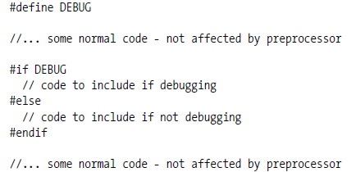
Preprocessing Directives (2/2)

Slide 19
Constants
A constant is an object whose values can not be changed.
Literals e.g. 10, 23, 45
Symbolic
Const type identifier = value; //architecture(syntax)
Const int BoilingPoint = 100;
Enumerations
[attributes] [modifiers] enum identifier
[:base-type] {enumerator-list}

Slide 20
Intrinsic types
Numeric types
Integer types
Floating-point types
Boolean
Strings and Characters
Object

Slide 21
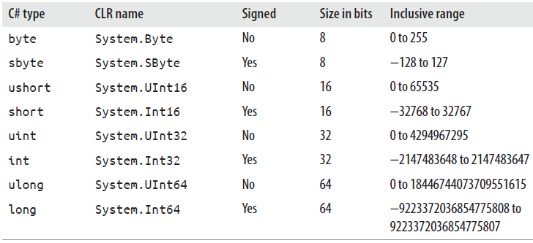
Integer types

Slide 22
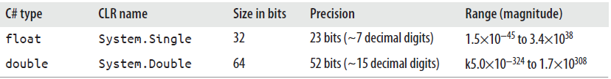
Floating-point type
C# also recognizes a third floating-point type called Decimal (System.Decimal in the CLR) which is 128 bit value.

Slide 23
In-class activity
Numeric conversion
int i = 42;
double di = i;
Console.WriteLine(i / 5);
Console.WriteLine(di / 5);
Console.WriteLine(i / 5.0);

Slide 24
Checked context (1/2)
Checked
C# defines the checked keyword which you can put in front of either a statement or an expression, making it a checked contest.
This means that certain arithmetic operations, including casts, are checked for range overflow at runtime.
If you cast a value to an integer type in a checked context, and the value is too high or low to fit, an error will occur—the code will throw a System.OverflowException.
Checked contexts will also detect range overflows in ordinary arithmetic

Slide 25
Checked context (2/2)
Unchecked
C# also defines the unchecked keyword which can be used inside a checked block to indicate that a particular expression or nested block should not be a checked context
You can configure the C# compiler to put everything into a checked context by default, so that only explicitly unchecked expressions and statements will be able to overflow silently.

Slide 26
Checked context - example
int result = checked( a + b ) + c;
Checked
{
int r1 = a + b;
int r2 = r1 – (int) c;
}

Slide 27
Arithmetic Operators
Operator | Description | Example
+ | Addition | i+5
- | Subtraction | J-10
* | Multiplication | i*8
/ | Division | a/3
% | Modulus (division remainder) | i%6
++ | increment | ++i
-- | Decrement | --i

Slide 28
Assignment Operators
Operator | Example | Equivalent to
= | i=5 | i = 5
+= | j+=4 | j = j+4
+= | a += ‘string’ | a = a + ‘string’
-= | j-=4 | j = j -4
*= | b*=2 | b = b*2
/= | c/=5 | c = c/5
%= | d%=6 | d = d % 6

Slide 29
Comparison Operators
Operator | Description | Example
== | Is equal to | I == 5
!= | Is not equal to | J !=10
> | Is greater than | i>0
< | Is less than | i<6
>= | Is greater than or equal to | J>=15
<= | Is less than or equal to | J <=20

Slide 30
Logical Operators
Operator | Description | Example
&& | And | a==4 && b==5
|| | Or | a<5||a>0
! | Not | !(a==b)

Slide 31
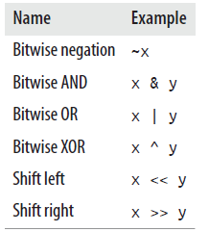
Binary integer operators

Slide 32
Ternary operator (Conditional operator)
Conditional-expression ? expression1 : expression2
int value1 = 5;
int value2 = 10;
int maxValue = value2 > value1 ? Value2 : value1

Slide 33
Control structure
Sequential
Flows from beginning to the end
Selection
Single selection
Double selection
Multiple selection
Repetition
Fixed repetition
Pretest repetition
Posttest repetition

Slide 34
In-class activities
1. Implement factorial using iteration
2. Implement factorial using recursion
3. Implement a score grader
4. Implement a GPA calculator

