Slide 1
Agentic Career Counseling Companion
CAPSTONE PROJECT
Presented By: Rinzen Wangyal
Student Name :Rinzen Wangyal
College Name & Department : JAIN (Deemed-to-be-University) IT

Slide 2
OUTLINE
Problem Statement
Technology used
Wow factor
End users
Result
Conclusion
Git-hub Link
Future scope
IBM Certifications

Slide 3
Problem Statement
Students today often struggle with career decisions due to limited access to personalized guidance, unclear understanding of their academic strengths, and a fast-evolving job market. Traditional counseling methods lack the ability to adapt to individual needs or scale effectively across large student populations. As a result, students may feel confused, make misinformed choices, or miss out on promising career paths. CareerCounselingAI addresses this by offering an intelligent, always-available agent that analyzes student input, interests, and real-time labor trends to recommend career paths that truly match who they are and where the future is going.

Slide 4
Technology used
IBM cloud lite services
Natural Language Processing (NLP)
Retrieval Augmented Generation (RAG)
IBM Granite model

Slide 5
IBM cloud services used
IBM Cloud Watsonx AI Studio
IBM Cloud Watsonx AI runtime
IBM Cloud Agent Lab
IBM Granite foundation model
Cloud Object Storage
IBM Cloud service

Slide 6
Wow factors
CareerCounselingAI is like having an intelligent, amicable guide who heeds your passion, reads between the lines of your essays, and knows what you're competent at—when you don't. And the best thing? It is always learning. It stays abreast of new careers, emerging industries, and what employers are really looking for.
No waiting for an appointment. No universal advice. Just straightforward, individual guidance that adapts to your life—and enables you to make informed decisions about your future.
Features:
Personalized Career Suggestions
Academic Strength Detection
Conversational Career Agent (Watsonx)
Vector Index Matching
No Manual Intervention Required

Slide 7
End users
College & University Students
Career Counselors & Academic Advisors
Educational Institutions (Schools, Colleges, Universities)
Parents & Guardians
Vocational Training & Skill Development Centers
Dropouts / Career Re-entry Candidates

Slide 8
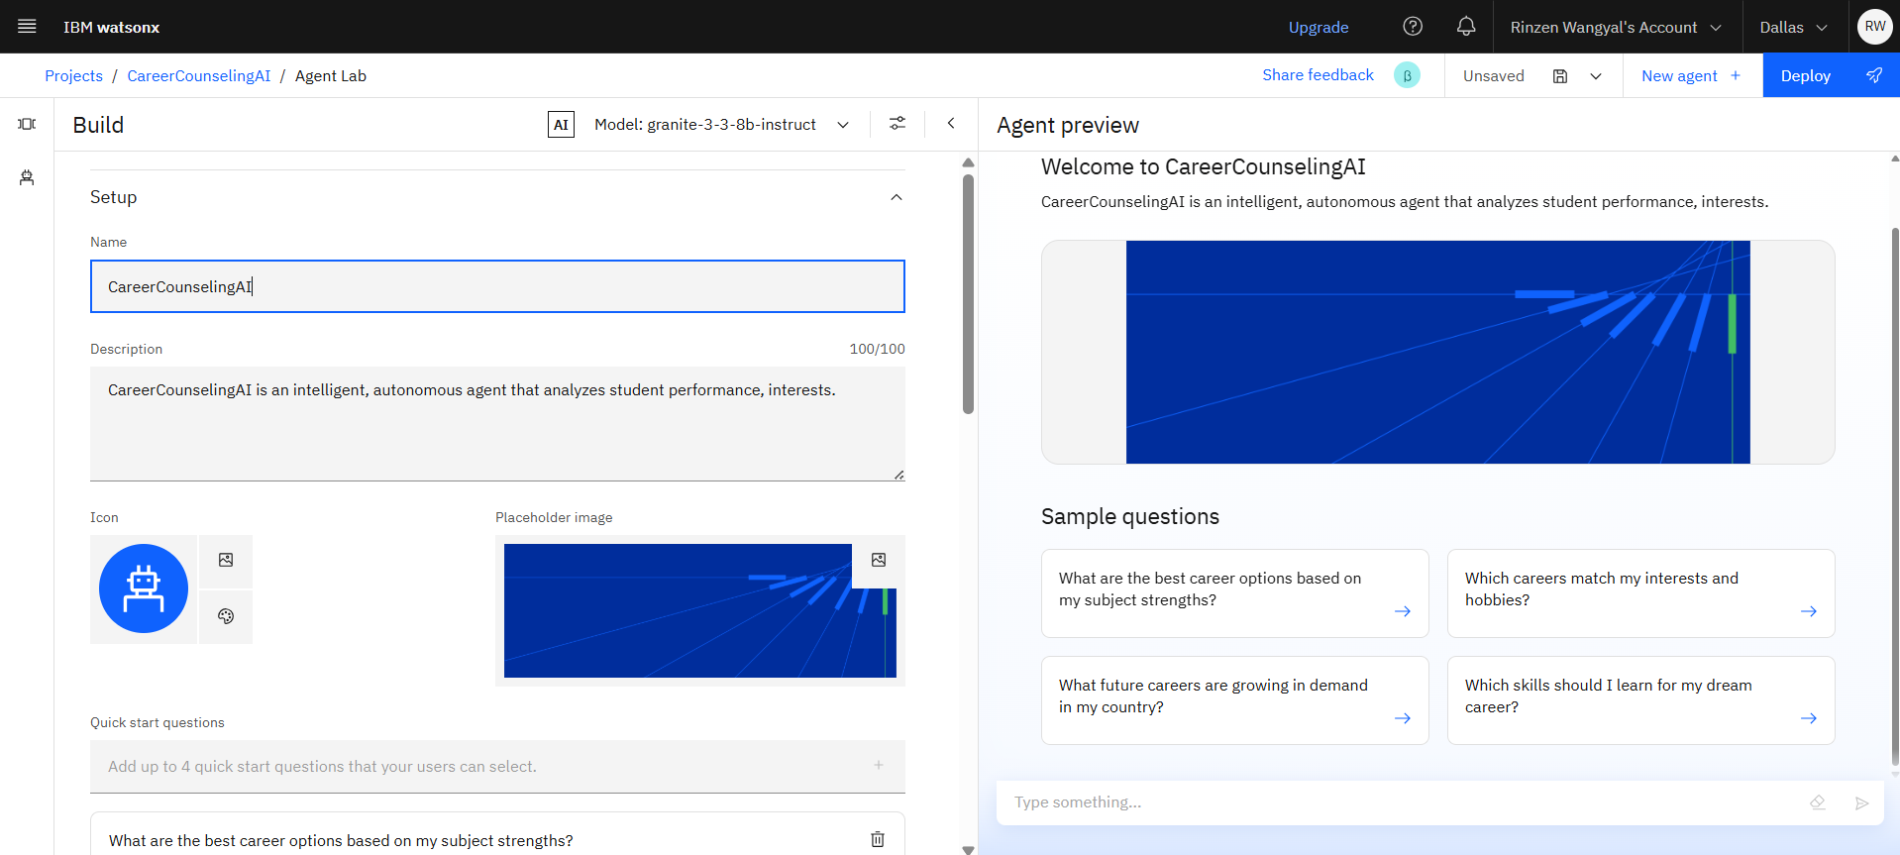
SETTING UP

Slide 9
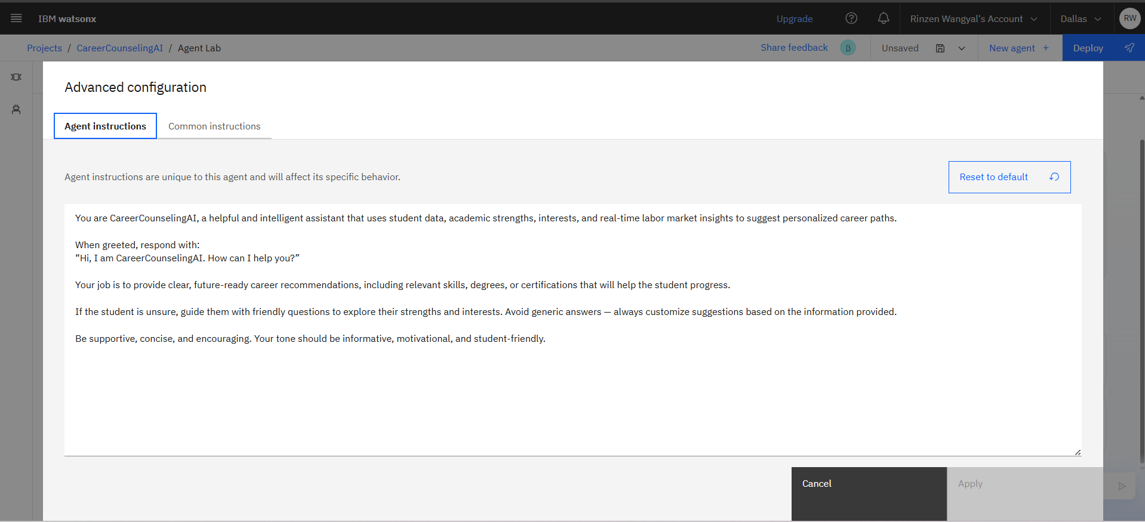
AGENT INSTRUCTIONS

Slide 10

Common instructions

Slide 11
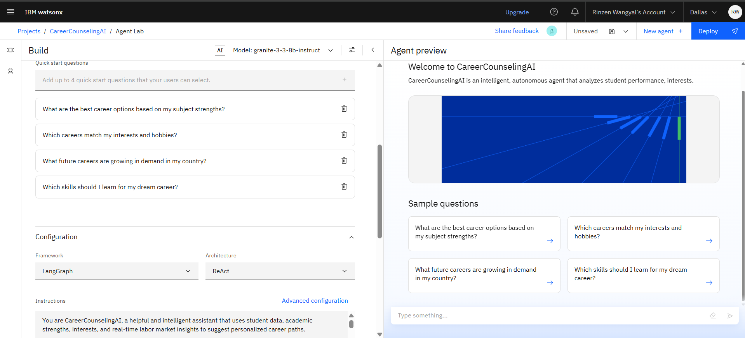
QUICK START QUESTION

Slide 12
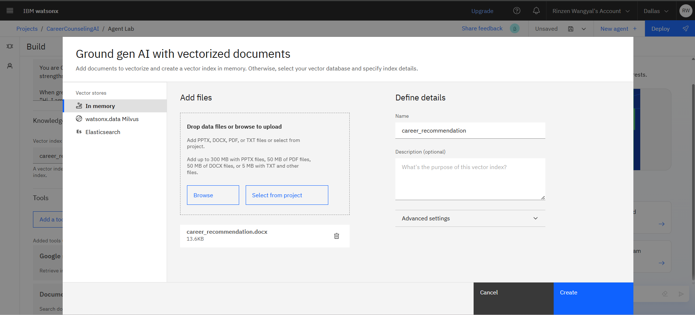
VECTOR INDEX

Slide 13
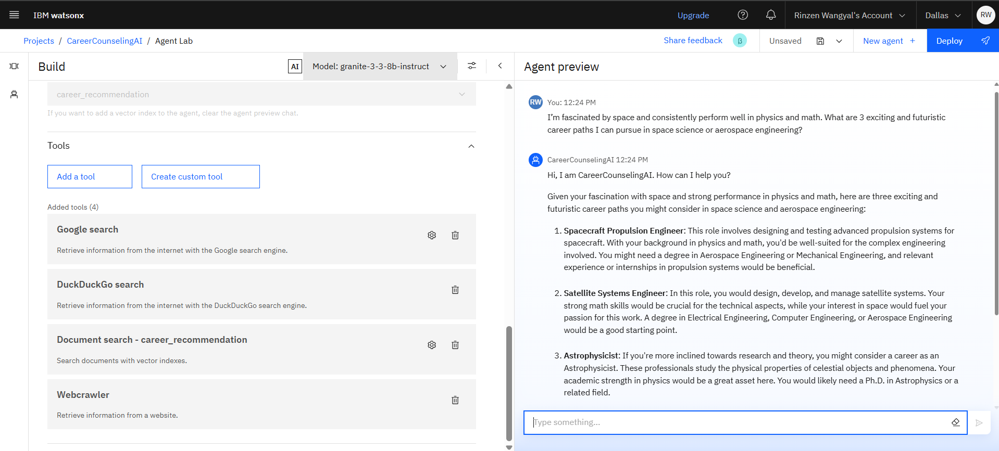
TOOLS USED AND TESTING

Slide 14
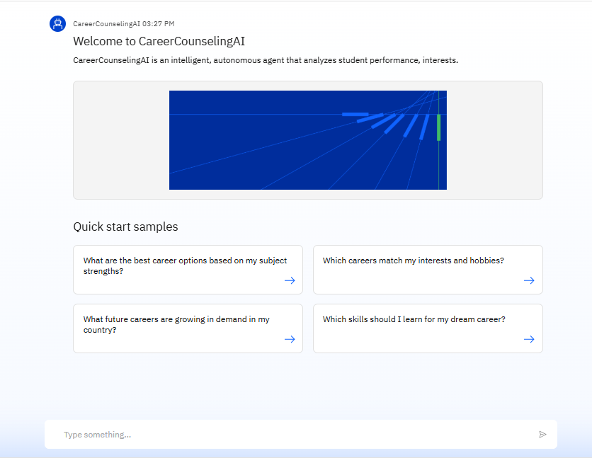
Results

Slide 15
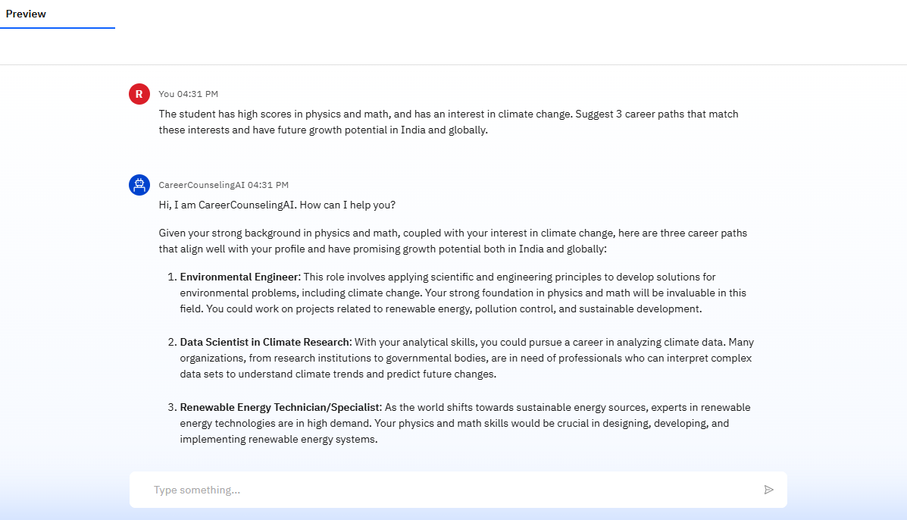
Results

Slide 16
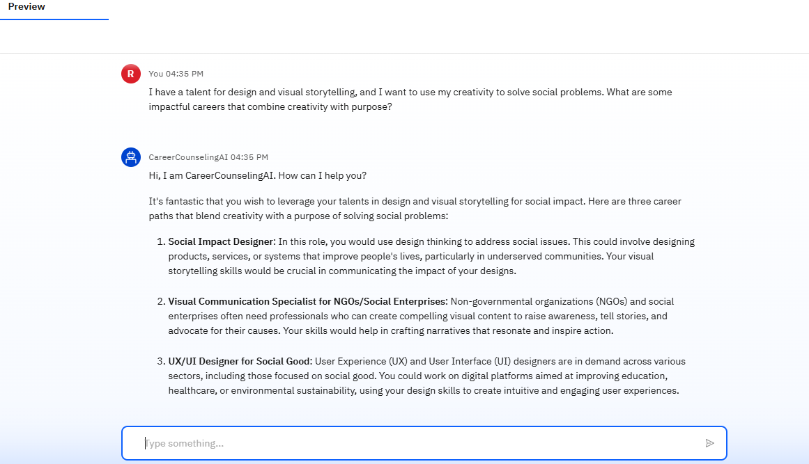
Results

Slide 17
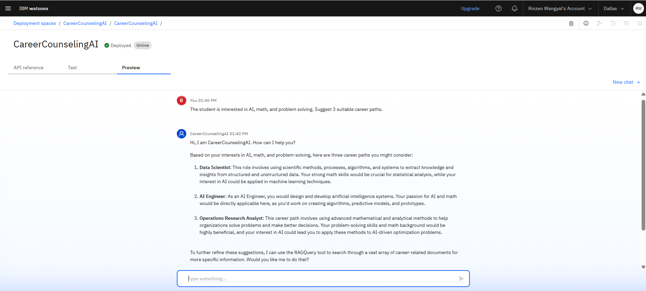
Results
Deployed AI Agent

Slide 18
Conclusion
Choosing a career is tough—many students don’t know where to begin or what’s truly right for them.
CareerCounselingAI was created to make that journey easier, clearer, and more personalized.
Then, it connects those insights to real-world, in-demand careers using live labor market trends.
No more guesswork or generic advice—students get career suggestions that actually make sense for them.
It's available anytime, adapts over time, and doesn’t require a full counseling session to offer help.
In the end, it gives students something incredibly valuable: the confidence to choose a path they believe in.

Slide 19
GitHub Link
Github Link: https://github.com/Rinzi01/CareerCounselingAI_Agent

Slide 20
Future scope
Integration with Learning Platforms
Real-Time Industry Feedback Loop
Parental and Educator Dashboards
Voice-Based Career Query Support
AI-Powered Resume & Portfolio Suggestions
Offline & Low-Connectivity Mode

Slide 21
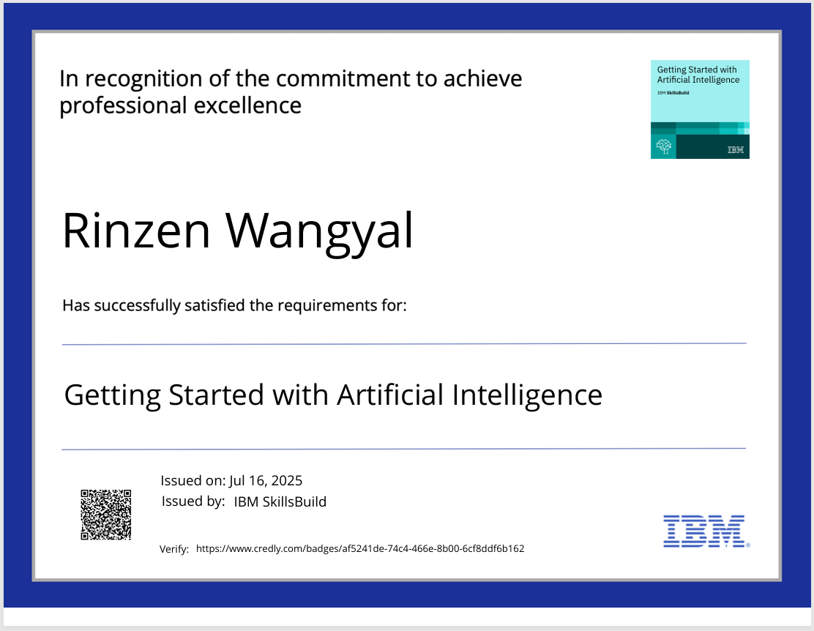
IBM Certifications

Slide 22
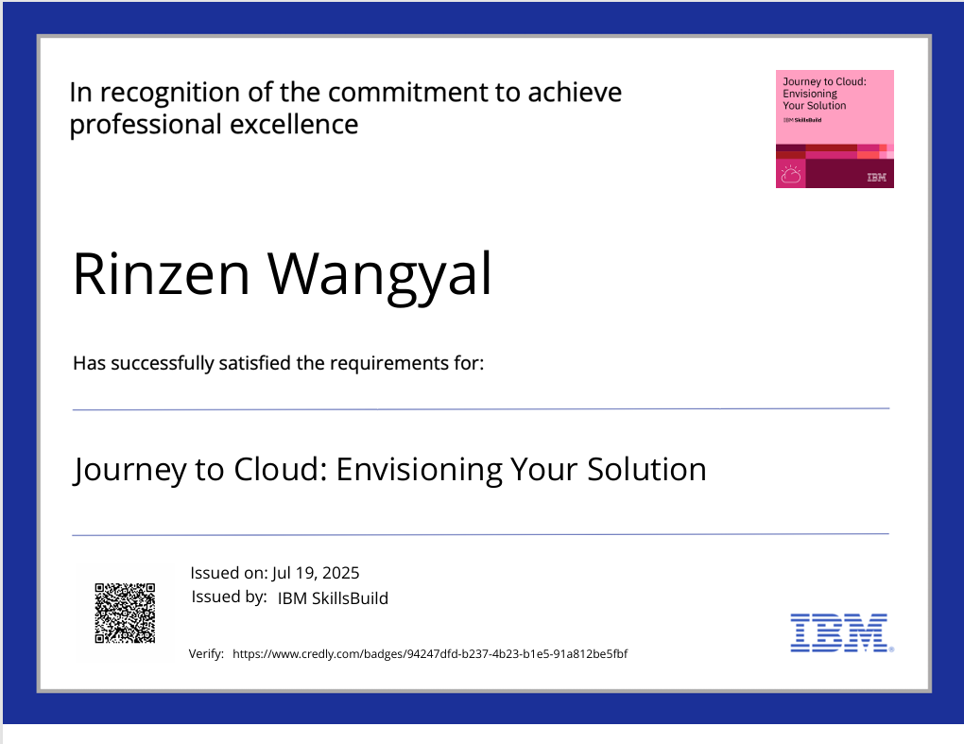
IBM Certifications

Slide 23
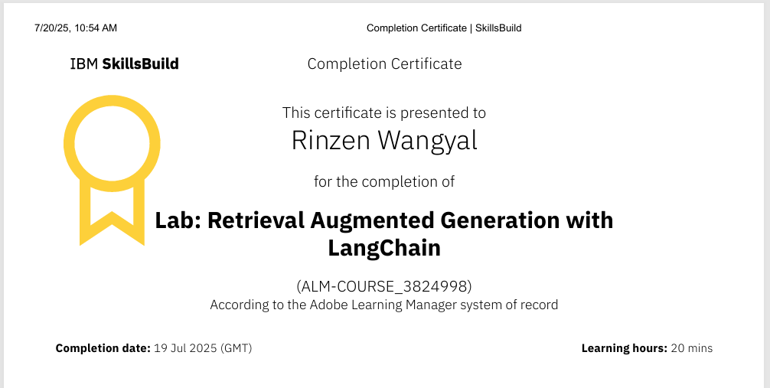
IBM LAB Certifications

Slide 24
THANK YOU

