Slide 1
Chapter 6: CPU Scheduling

Slide 2
Chapter 6: CPU Scheduling
Basic Concepts
Scheduling Criteria
Scheduling Algorithms
Thread Scheduling
Multiple-Processor Scheduling
Real-Time CPU Scheduling
Operating Systems Examples
Algorithm Evaluation

Slide 3
Objectives
To introduce CPU scheduling, which is the basis for multiprogrammed operating systems
To describe various CPU-scheduling algorithms
To discuss evaluation criteria for selecting a CPU-scheduling algorithm for a particular system
To examine the scheduling algorithms of several operating systems

Slide 4

Basic of Process and Thread
Process – a program in execution; process execution must progress in sequential fashion
Thread – the smallest sequence of programmed instructions

Slide 5

The State Machine of Processes
Status of a process

Slide 6
CPU Scheduler
Short-term scheduler selects from among the processes in ready queue, and allocates the CPU to one of them
  Queue may be ordered in various ways
CPU scheduling decisions may take place when a process:
  1. Switches from running to waiting state
  2. Switches from running to ready state
  3. Switches from waiting to ready
  Terminates
Scheduling under 1 and 4 is nonpreemptive
All other scheduling is preemptive
  Consider access to shared data
  Consider preemption while in kernel mode
  Consider interrupts occurring during crucial OS activities

Slide 7
Dispatcher
Dispatcher module gives control of the CPU to the process selected by the short-term scheduler; this involves:
  switching context
  switching to user mode
  jumping to the proper location in the user program to restart that program
Dispatch latency – time it takes for the dispatcher to stop one process and start another running

Slide 8
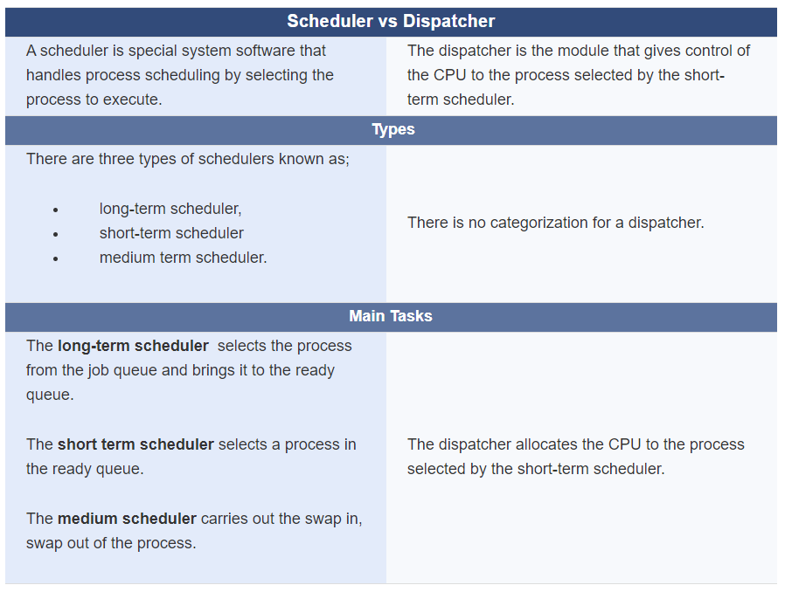


Slide 9
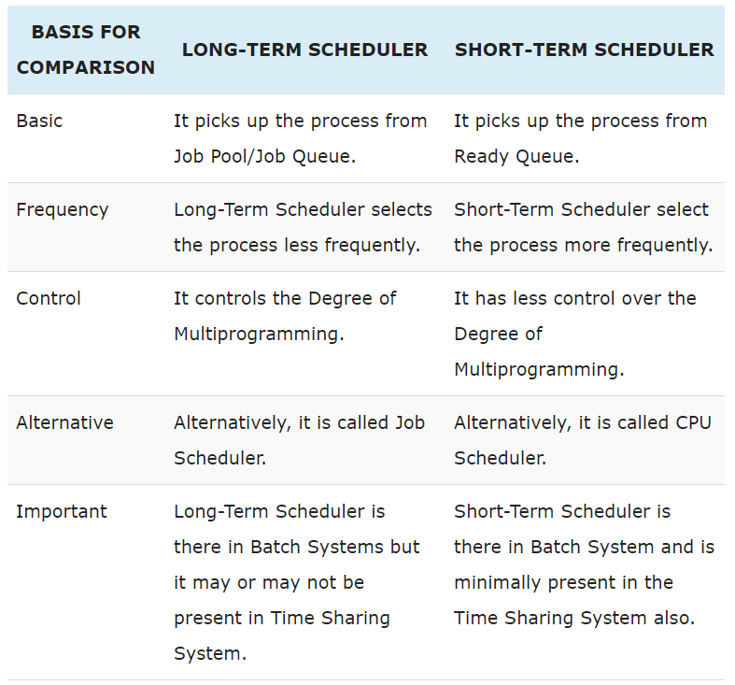

Slide 10

Basic Concepts
Maximum CPU utilization obtained with multiprogramming
CPU–I/O Burst Cycle – Process execution consists of a cycle of CPU execution and I/O wait
CPU burst followed by I/O burst
CPU burst distribution is of main concern

Slide 11

Histogram of CPU-burst Times

Slide 12
Scheduling Criteria
CPU utilization – keep the CPU as busy as possible
Throughput – # of processes that complete their execution per time unit
Turnaround time – amount of time to execute a particular process
Waiting time – amount of time a process has been waiting in the ready queue
Response time – amount of time it takes from when a request was submitted until the first response is produced, not output (for time-sharing environment)

Slide 13
Scheduling Algorithm Optimization Criteria
Max CPU utilization
Max throughput
Min turnaround time
Min waiting time
Min response time

Slide 14

First- Come, First-Served (FCFS) Scheduling
Process Burst Time
P₁ 24
P₂ 3
P₃ 3
Suppose that the processes arrive in the order: P₁ , P₂ , P₃
The Gantt Chart for the schedule is:
Waiting time for P₁ = 0; P₂ = 24; P₃ = 27
Average waiting time: (0 + 24 + 27)/3 = 17
Response time: P1=0, P2=24, P3=27
Average response time: 17

Slide 15

FCFS Scheduling (Cont.)
Suppose that the processes arrive in the order:
P₂ , P₃ , P₁
The Gantt chart for the schedule is:
Waiting time for P₁ = 6; P₂ = 0; P₃ = 3
Average waiting time: (6 + 0 + 3)/3 = 3
Much better than previous case
Convoy effect - short process behind long process
  Consider one CPU-bound and many I/O-bound processes

Slide 16
Shortest-Job-First (SJF) Scheduling
Associate with each process the length of its next CPU burst
  Use these lengths to schedule the process with the shortest time
SJF is optimal – gives minimum average waiting time for a given set of processes
  The difficulty is knowing the length of the next CPU request
  Could ask the user

Slide 17

Example of SJF
ProcessArriva l Time Burst Time
P₁ 0.0 6
P₂ 2.0 8
P₃ 4.0 7
P₄ 5.0 3
SJF scheduling chart
Average waiting time = (3 + 16 + 9 + 0) / 4 = 7

Slide 18

Example of Shortest-remaining-time-first
Now we add the concepts of varying arrival times and preemption to the analysis
ProcessA arri Arrival TimeT Burst Time
P₁ 0 8
P₂ 1 4
P₃ 2 9
P₄ 3 5
Preemptive SJF Gantt Chart
Average waiting time = [(10-1)+(1-1)+(17-2)+5-3)]/4 = 26/4 = 6.5 msec
Notes:
Average Response time = (17-2+5-3)/4=17/4 Average Turnaround time = 52/4=13

Slide 19
Priority Scheduling
A priority number (integer) is associated with each process
The CPU is allocated to the process with the highest priority (smallest integer ≡ highest priority)
  Preemptive
  Nonpreemptive
SJF is priority scheduling where priority is the inverse of predicted next CPU burst time
Problem ≡ Starvation – low priority processes may never execute
Solution ≡ Aging – as time progresses increase the priority of the process

Slide 20

Example of Priority Scheduling
ProcessA arri Burst TimeT Priority
P₁ 10 3
P₂ 1 1
P₃ 2 4
P₄ 1 5
P₅ 5 2
Priority scheduling Gantt Chart
Average waiting time = 8.2 msec

Slide 21
Round Robin (RR)
Each process gets a small unit of CPU time (time quantum q), usually 10-100 milliseconds. After this time has elapsed, the process is preempted and added to the end of the ready queue.
If there are n processes in the ready queue and the time quantum is q, then each process gets 1/n of the CPU time in chunks of at most q time units at once. No process waits more than (n-1)q time units.
Timer interrupts every quantum to schedule next process
Performance
  q large ⇒ FIFO
  q small ⇒ q must be large with respect to context switch, otherwise overhead is too high

Slide 22

Example of RR with Time Quantum = 4
Process Burst Time
P₁ 24
P₂ 3
P₃ 3
The Gantt chart is:
Typically, higher average turnaround than SJF, but better response
q should be large compared to context switch time
q usually 10ms to 100ms, context switch < 10 usec

Slide 23

Time Quantum and Context Switch Time

Slide 24

Turnaround Time Varies With The Time Quantum
80% of CPU bursts should be shorter than q

Slide 25
Multilevel Queue
Ready queue is partitioned into separate queues, eg:
  foreground (interactive)
  background (batch)
Process permanently in a given queue
Each queue has its own scheduling algorithm:
  foreground – RR
  background – FCFS
Scheduling must be done between the queues:
  Fixed priority scheduling; (i.e., serve all from foreground then from background). Possibility of starvation.
  Time slice – each queue gets a certain amount of CPU time which it can schedule amongst its processes; i.e., 80% to foreground in RR
  20% to background in FCFS

Slide 26

Multilevel Queue Scheduling

Slide 27
Multilevel Feedback Queue
A process can move between the various queues; aging can be implemented this way
Multilevel-feedback-queue scheduler defined by the following parameters:
  number of queues
  scheduling algorithms for each queue
  method used to determine when to upgrade a process
  method used to determine when to demote a process
  method used to determine which queue a process will enter when that process needs service

Slide 28

Example of Multilevel Feedback Queue
Three queues:
  Q₀ – RR with time quantum 8 milliseconds
  Q₁ – RR time quantum 16 milliseconds
  Q₂ – FCFS
Scheduling
  A new job enters queue Q₀ which is served FCFS
    When it gains CPU, job receives 8 milliseconds
    If it does not finish in 8 milliseconds, job is moved to queue Q₁
  At Q₁ job is again served FCFS and receives 16 additional milliseconds
    If it still does not complete, it is preempted and moved to queue Q₂

Slide 29
End of Chapter 6

