Slide 1
Chapter 5: Synchronization

Slide 2
Chapter 5: Synchronization
Background
The Critical-Section Problem
Peterson’s Solution
Synchronization Hardware
Mutex Locks
Semaphores
Classic Problems of Synchronization
Monitors
Synchronization Examples
Alternative Approaches

Slide 3
Objectives
To present the concept of process synchronization.
To introduce the critical-section problem, whose solutions can be used to ensure the consistency of shared data
To present both software and hardware solutions of the critical-section problem
To examine several classical process-synchronization problems
To explore several tools that are used to solve process synchronization problems

Slide 4
Background
Processes can execute concurrently
May be interrupted at any time, partially completing execution
Concurrent access to shared data may result in data inconsistency
Maintaining data consistency requires mechanisms to ensure the orderly execution of cooperating processes
Illustration of the problem: Suppose that we wanted to provide a solution to the consumer-producer problem that fills all the buffers. We can do so by having an integer counter that keeps track of the number of full buffers. Initially, counter is set to 0. It is incremented by the producer after it produces a new buffer and is decremented by the consumer after it consumes a buffer.

Slide 5
Producer
while (true) { /* produce an item in next produced */
while (counter == BUFFER_SIZE) ;
/* do nothing */
buffer[in] = next_produced;
in = (in + 1) % BUFFER_SIZE;
counter++;
}

Slide 6
Consumer
while (true) {
while (counter == 0)
; /* do nothing */
next_consumed = buffer[out];
out = (out + 1) % BUFFER_SIZE;
counter--;
/* consume the item in next consumed */
}

Slide 7
Race Condition
counter++ could be implemented as register1 = counter register1 = register1 + 1 counter = register1
counter-- could be implemented as register2 = counter register2 = register2 - 1 counter = register2
Consider this execution interleaving with “count = 5” initially:
S0: producer execute register1 = counter {register1 = 5} S1: producer execute register1 = register1 + 1 {register1 = 6} S2: consumer execute register2 = counter {register2 = 5} S3: consumer execute register2 = register2 – 1 {register2 = 4} S4: producer execute counter = register1 {counter = 6 } S5: consumer execute counter = register2 {counter = 4}

Slide 8
Race Condition
The value of counter becomes messed up and the program becomes disorder. This type of disorder is caused by the race condition between multiple processes.
A race condition or race hazard is the condition of an electronics, software, or other system where the system's substantive behavior is dependent on the sequence or timing of other uncontrollable events. It becomes a bug when one or more of the possible behaviors is undesirable.
The synchronization for shared variables is the key to avoid the race condition.

Slide 9
Critical Section & Critical Section Problem
The critical section is a particular segment of code where each process has the chance to change common variables, update the common table, or write to the same file etc. that is the race condition may happen.
Consider system of n processes {p₀, p₁, … p_{n-1}}
Each process has critical section segment of code
Process may be changing common variables, updating table, writing file, etc
When one process in critical section, no other may be in its critical section
Critical section problem is a problem of having critical section. Synchronization is the key to solve critical section problem.
Each process must ask permission to enter critical section in entry section, may follow critical section with exit section, then remainder section

Slide 10
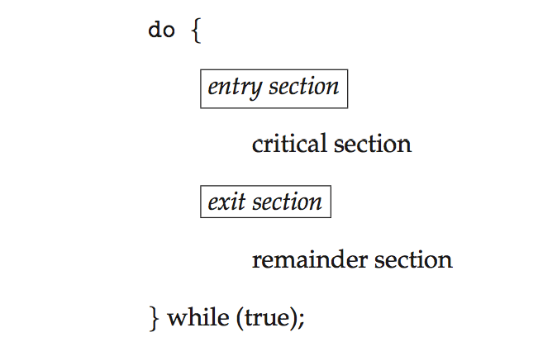
Critical Section
General structure of process P_{i}

Slide 11
Algorithm for Process P_{i}
do {
while (turn == j);
critical section
turn = j;
remainder section
} while (true);

Slide 12
Solution to Critical-Section Problem
1. Mutual Exclusion - If process P_{i} is executing in its critical section, then no other processes can be executing in their critical sections
2. Progress - If no process is executing in its critical section and there exist some processes that wish to enter their critical section, then the selection of the processes that will enter the critical section next cannot be postponed indefinitely
3. Bounded Waiting - A bound must exist on the number of times that other processes are allowed to enter their critical sections after a process has made a request to enter its critical section and before that request is granted
Assume that each process executes at a nonzero speed
No assumption concerning relative speed of the n processes
Notes:
Progress is to make these waiting capable to come in.
Bounded waiting is to make the one accessing the critical area capable to come out.

Slide 13
Critical-Section Handling in OS
Two approaches depending on if kernel is preemptive or non- preemptive
Preemptive – allows preemption of process when running in kernel mode
Non-preemptive – runs until exits kernel mode, blocks, or voluntarily yields CPU
Essentially free of race conditions in kernel mode

Slide 14
Peterson’s Solution
Good algorithmic description of solving the problem
Two process solution
Assume that the load and store machine-language instructions are atomic; that is, cannot be interrupted
The two processes share two variables:
int turn;
Boolean flag[2]
The variable turn indicates whose turn it is to enter the critical section
The flag array is used to indicate if a process is ready to enter the critical section. flag[i] = true implies that process P_{i} is ready!

Slide 15
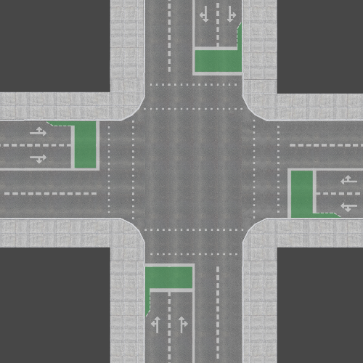
Algorithm for Process P_{i}
do {
flag[i] = true; //I am ready
turn = j; //it’s your turn
while (flag[j] && turn = = j); //see if u’r ready && your turn
critical section
flag[i] = false; //I’m done
remainder section
} while (true);
//I am ready
//it’s your turn
//if u’r ready && your turn
//I’ll wait in loop
//I am ready
//it’s your turn
//if u’r ready && your turn
//I’ll wait in loop

Slide 16
Peterson’s Solution (Cont.)
Provable that the three CS requirement are met:
1. Mutual exclusion is preserved
P_{i} enters CS only if:
either flag[j] = false or turn = i
2. Progress requirement is satisfied
3. Bounded-waiting requirement is met

Slide 17
Synchronization Hardware
Many systems provide hardware support for implementing the critical section code.
All solutions below based on idea of locking
Protecting critical regions via locks
Uniprocessors – could disable interrupts
Currently running code would execute without preemption
Generally too inefficient on multiprocessor systems
Operating systems using this not broadly scalable
Modern machines provide special atomic hardware instructions
Atomic = non-interruptible
Either test memory word and set value
Or swap contents of two memory words

Slide 18
Solution to Critical-section Problem Using Locks
do {
acquire lock
critical section
release lock
remainder section
} while (TRUE);

Slide 19
test_and_set Instruction
Definition:
boolean test_and_set (boolean *target)
{
boolean rv = *target;
*target = TRUE;
return rv:
}
Executed atomically
Returns the original value of passed parameter
Set the new value of passed parameter to “TRUE”.

Slide 20
Solution using test_and_set()
Shared Boolean variable lock, initialized to FALSE
Solution:
do { while (test_and_set(&lock))
; /* do nothing */
/* critical section */
lock = false;
/* remainder section */
} while (true);

Slide 21
compare_and_swap Instruction
Definition:
int compare _and_swap(int *value, int expected, int new_value) {
int temp = *value;
if (*value == expected)
*value = new_value;
return temp;
}
Executed atomically
Returns the original value of passed parameter “value”
Set the variable “value” the value of the passed parameter “new_value” but only if “value” ==“expected”. That is, the swap takes place only under this condition.

Slide 22
Solution using compare_and_swap
Shared integer “lock” initialized to 0;
Solution:
do { while (compare_and_swap(&lock, 0, 1) != 0)
; /* do nothing */
/* critical section */
lock = 0;
/* remainder section */
} while (true);

Slide 23
Bounded-waiting Mutual Exclusion with test_and_set
do { waiting[i] = true; key = true; while (waiting[i] && key)
key = test_and_set(&lock);
waiting[i] = false;
/* critical section */
j = (i + 1) % n;
while ((j != i) && !waiting[j])
j = (j + 1) % n;
if (j == i)
lock = false;
else
waiting[j] = false;
/* remainder section */
} while (true);

Slide 24
Mutex Locks
Previous solutions are complicated and generally inaccessible to application programmers
OS designers build software tools to solve critical section problem
Simplest is mutex lock
Protect a critical section by first acquire() a lock then release() the lock
Boolean variable indicating if lock is available or not
Calls to acquire() and release() must be atomic
Usually implemented via hardware atomic instructions
But this solution requires busy waiting
This lock therefore called a spinlock

Slide 25
acquire() and release()
acquire() { while (!available)
; /* busy wait */
available = false;
}
release() {
available = true;
}
do {
acquire lock
critical section
release lock
remainder section
} while (true);

Slide 26
Semaphore
Synchronization tool that provides more sophisticated ways (than Mutex locks) for process to synchronize their activities.
Semaphore S – integer variable
Can only be accessed via two indivisible (atomic) operations
wait() and signal()
Originally called P() and V()
Definition of the wait() operation
wait(S) {
while (S <= 0)
; // busy wait
S--;
}
Definition of the signal() operation
signal(S) {
S++;
}

Slide 27
Semaphore Usage
Counting semaphore – integer value can range over an unrestricted domain
Binary semaphore – integer value can range only between 0 and 1
Same as a mutex lock
Can solve various synchronization problems
Consider P₁ and P₂ that require S₁ to happen before S₂
Create a semaphore “synch” initialized to 0
P1:
S₁;
signal(synch);
P2:
wait(synch);
S₂;
Can implement a counting semaphore S as a binary semaphore

Slide 28
Semaphore Implementation
Must guarantee that no two processes can execute the wait() and signal() on the same semaphore at the same time
Thus, the implementation becomes the critical section problem where the wait and signal code are placed in the critical section
Could now have busy waiting in critical section implementation
But implementation code is short
Little busy waiting if critical section rarely occupied
Note that applications may spend lots of time in critical sections and therefore this is not a good solution

Slide 29
Semaphore Implementation with no Busy waiting
With each semaphore there is an associated waiting queue
Each entry in a waiting queue has two data items:
value (of type integer)
pointer to next record in the list
Two operations:
block – place the process invoking the operation on the appropriate waiting queue
wakeup – remove one of processes in the waiting queue and place it in the ready queue
typedef struct{
int value;
struct process *list;
} semaphore;

Slide 30
Implementation with no Busy waiting (Cont.)
wait(semaphore *S) {
S->value--;
if (S->value < 0) { add this process to S->list;
block();
}
}
signal(semaphore *S) {
S->value++;
if (S->value <= 0) { remove a process P from S->list;
wakeup(P);
}
}

Slide 31
Deadlock and Starvation
Deadlock – two or more processes are waiting indefinitely for an event that can be caused by only one of the waiting processes
Let S and Q be two semaphores initialized to 1
P₀ P₁
wait(S); wait(Q);
wait(Q); wait(S);
... ...
signal(S); signal(Q);
signal(Q); signal(S);
Starvation – indefinite blocking
A process may never be removed from the semaphore queue in which it is suspended
Priority Inversion – Scheduling problem when lower-priority process holds a lock needed by higher-priority process
Solved via priority-inheritance protocol

Slide 32
Functional Programming Languages
Functional programming languages offer a different paradigm than procedural languages in that they do not maintain state.
Variables are treated as immutable and cannot change state once they have been assigned a value.
There is increasing interest in functional languages such as Erlang and Scala for their approach in handling data races.

Slide 33
Classical Problems of Synchronization
Classical problems used to test newly-proposed synchronization schemes
Bounded-Buffer Problem
Readers and Writers Problem
Dining-Philosophers Problem

Slide 34
Bounded-Buffer Problem
n buffers, each can hold one item
Semaphore mutex initialized to the value 1
Semaphore full initialized to the value 0
Semaphore empty initialized to the value n
Using mutex to enter the critical section.
Producer using empty to count if there is a empty slot.
Consumer using full to count if there is a slot to consume.

Slide 35
Bounded Buffer Problem (Cont.)
The structure of the producer process
do {
... /* produce an item in next_produced */
...
wait(empty);
wait(mutex);
... /* add next produced to the buffer */
...
signal(mutex);
signal(full);
} while (true);

Slide 36
Bounded Buffer Problem (Cont.)
The structure of the consumer process
Do {
wait(full);
wait(mutex);
... /* remove an item from buffer to next_consumed */
...
signal(mutex);
signal(empty);
... /* consume the item in next consumed */
... } while (true);

Slide 37
Readers-Writers Problem
A data set is shared among a number of concurrent processes
Readers – only read the data set; they do not perform any updates
Writers – can both read and write
Problem – allow multiple readers to read at the same time
Only one single writer can access the shared data at the same time
Several variations of how readers and writers are considered – all involve some form of priorities
Shared Data
Data set
Semaphore rw_mutex initialized to 1
Semaphore mutex initialized to 1
Integer read_count initialized to 0

Slide 38
Readers-Writers Problem (Cont.)
The structure of a writer process
do { wait(rw_mutex);
... /* writing is performed */
...
signal(rw_mutex);
} while (true);

Slide 39
Readers-Writers Problem (Cont.)
The structure of a reader process
do { wait(mutex); read_count++; if (read_count == 1)
wait(rw_mutex);
signal(mutex);
... /* reading is performed */
...
wait(mutex); read_count--; if (read_count == 0)
signal(rw_mutex);
signal(mutex);
} while (true);

Slide 40
Readers-Writers Problem Variations
First variation – no reader kept waiting unless writer has permission to use shared object
Second variation – once writer is ready, it performs the write ASAP
Both may have starvation leading to even more variations
Problem is solved on some systems by kernel providing reader-writer locks

Slide 41
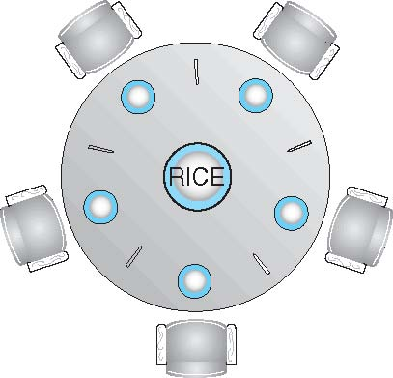
Dining-Philosophers Problem
Philosophers spend their lives alternating thinking and eating
Don’t interact with their neighbors, occasionally try to pick up 2 chopsticks (one at a time) to eat from bowl
Need both to eat, then release both when done
In the case of 5 philosophers
Shared data
Bowl of rice (data set)
Semaphore chopstick [5] initialized to 1

Slide 42
Dining-Philosophers Problem Algorithm
The structure of Philosopher i:
do {
wait (chopstick[i] );
wait (chopStick[ (i + 1) % 5] );
// eat
signal (chopstick[i] );
signal (chopstick[ (i + 1) % 5] );
// think
} while (TRUE);
What is the problem with this algorithm?

Slide 43
Dining-Philosophers Problem Algorithm (Cont.)
Deadlock handling
Allow at most 4 philosophers to be sitting simultaneously at the table.
Allow a philosopher to pick up the forks only if both are available (picking must be done in a critical section.
Use an asymmetric solution -- an odd-numbered philosopher picks up first the left chopstick and then the right chopstick. Even-numbered philosopher picks up first the right chopstick and then the left chopstick.

Slide 44
Problems with Semaphores
Incorrect use of semaphore operations:
signal (mutex) …. wait (mutex)
wait (mutex) … wait (mutex)
Omitting of wait (mutex) or signal (mutex) (or both)
Deadlock and starvation are possible.

Slide 45
End of Chapter 5

