Slide 1
Chapter 8: Virtual Memory

Slide 2
Chapter 8: Virtual Memory
Background
Demand Paging
Copy-on-Write
Page Replacement
Allocation of Frames
Thrashing
Working-Set Model

Slide 3
Objectives
To describe the benefits of a virtual memory system
To explain the concepts of demand paging, page-replacement algorithms, and allocation of page frames
To discuss the principle of the working-set model
To examine the relationship between shared memory and memory-mapped files
To explore how kernel memory is managed

Slide 4
Background
Code needs to be in memory to execute, but entire program rarely used
  Error code, unusual routines, large data structures
Entire program code not needed at same time
Consider ability to execute partially-loaded program
  Program no longer constrained by limits of physical memory
  Each program takes less memory while running -> more programs run at the same time
    Increased CPU utilization and throughput with no increase in response time or turnaround time
  Less I/O needed to load or swap programs into memory -> each user program runs faster

Slide 5
Background (Cont.)
Virtual memory – separation of user logical memory from physical memory
  Only part of the program needs to be in memory for execution
  Logical address space can therefore be much larger than physical address space
  Allows address spaces to be shared by several processes
  Allows for more efficient process creation
  More programs running concurrently
  Less I/O needed to load or swap processes

Slide 6
Background (Cont.)
Virtual address space – logical view of how process is stored in memory
  Usually start at address 0, contiguous addresses until end of space
  Meanwhile, physical memory organized in page frames
  MMU must map logical to physical
Virtual memory can be implemented via:
  Demand paging
  Demand segmentation

Slide 7
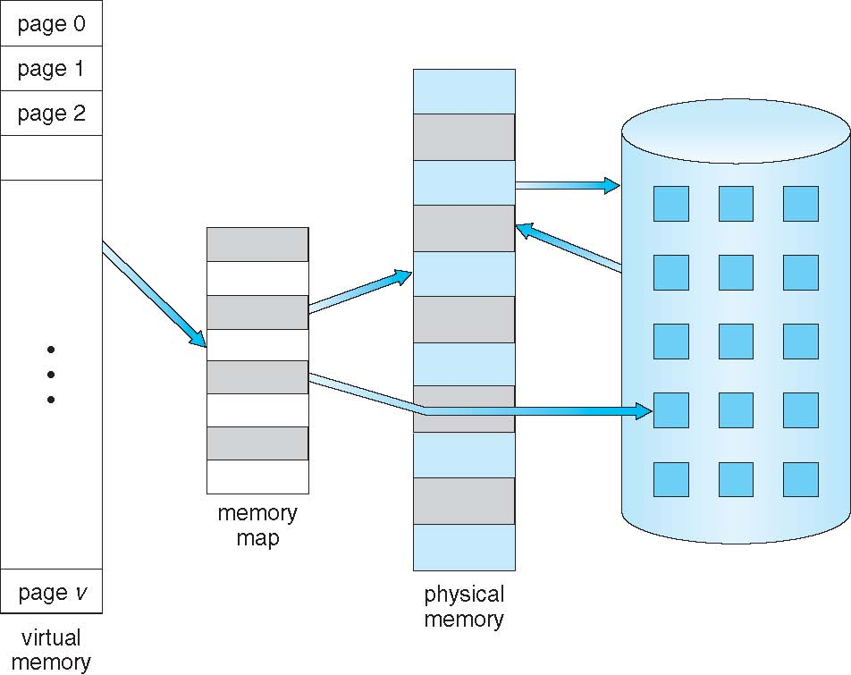
Virtual Memory That is Larger Than Physical Memory

Slide 8
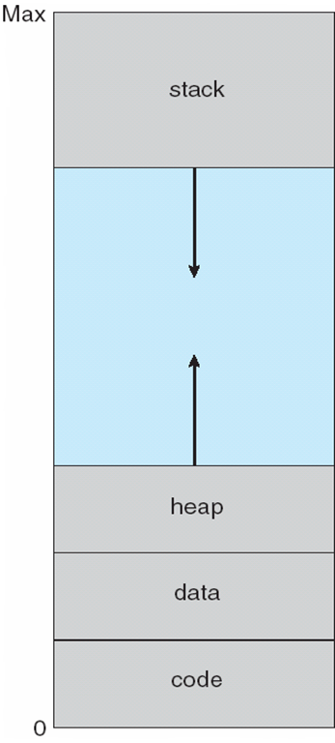
Virtual-address Space
Usually design logical address space for stack to start at Max logical address and grow “down” while heap grows “up”
  Maximizes address space use
  Unused address space between the two is hole
    No physical memory needed until heap or stack grows to a given new page
Enables sparse address spaces with holes left for growth, dynamically linked libraries, etc
System libraries shared via mapping into virtual address space
Shared memory by mapping pages read-write into virtual address space
Pages can be shared during fork(), speeding process creation

Slide 9
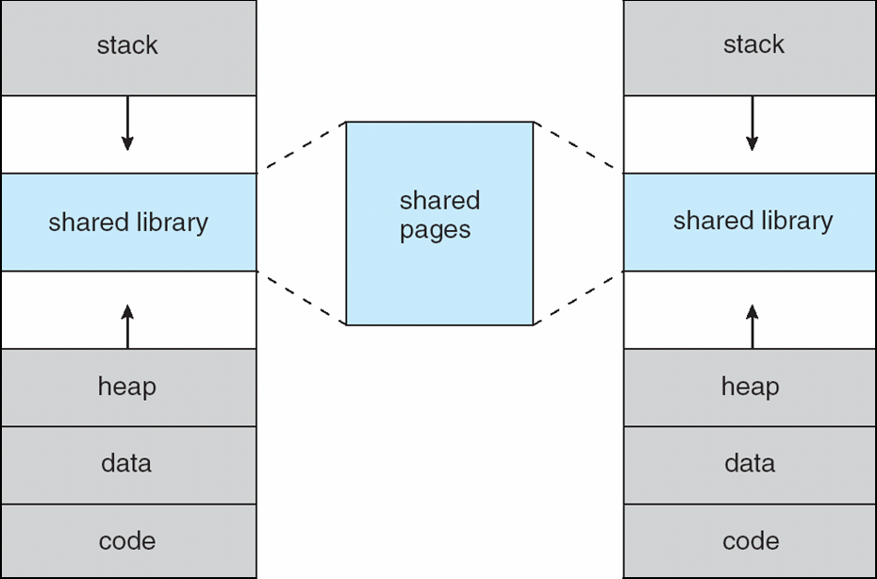
Shared Library Using Virtual Memory

Slide 10
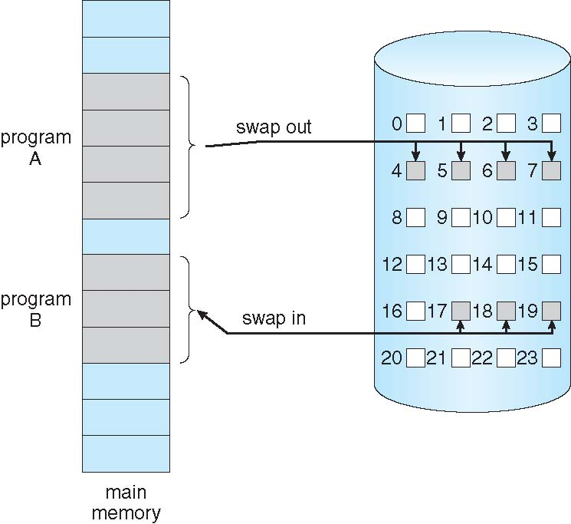
Demand Paging
Could bring entire process into memory at load time
Or bring a page into memory only when it is needed
  Less I/O needed, no unnecessary I/O
  Less memory needed
  Faster response
  More users
Similar to paging system with swapping (diagram on right)
Page is needed ⇒ reference to it
  invalid reference ⇒ abort
  not-in-memory ⇒ bring to memory
Lazy swapper – never swaps a page into memory unless page will be needed
  Swapper that deals with pages is a pager

Slide 11
Basic Concepts
With swapping, pager guesses which pages will be used before swapping out again
Instead, pager brings in only those pages into memory
How to determine that set of pages?
  Need new MMU functionality to implement demand paging
If pages needed are already memory resident
  No difference from non demand-paging
If page needed and not memory resident
  Need to detect and load the page into memory from storage
    Without changing program behavior
    Without programmer needing to change code

Slide 12
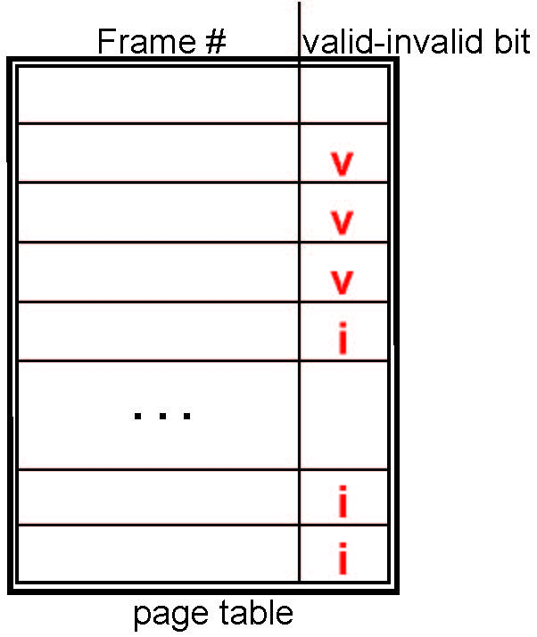
Valid-Invalid Bit
With each page table entry a valid–invalid bit is associated
(v ⇒ in-memory – memory resident, i ⇒ not-in-memory)
Initially valid–invalid bit is set to i on all entries
Example of a page table snapshot:
During MMU address translation, if valid–invalid bit in page table entry is i ⇒ page fault

Slide 13
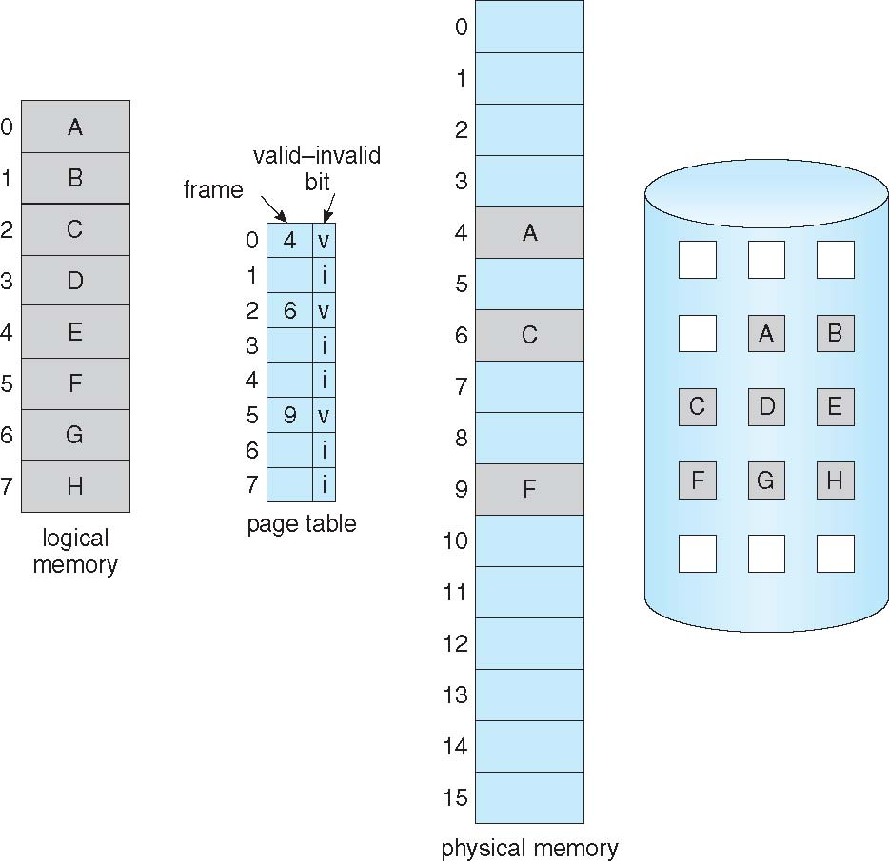
Page Table When Some Pages Are Not in Main Memory

Slide 14
Page Fault
If there is a reference to a page, first reference to that page will trap to operating system:
page fault
Operating system looks at another table to decide:
  Invalid reference ⇒ abort
  Just not in memory
Find free frame
Swap page into frame via scheduled disk operation
Reset tables to indicate page now in memory
Set validation bit = v
Restart the instruction that caused the page fault

Slide 15
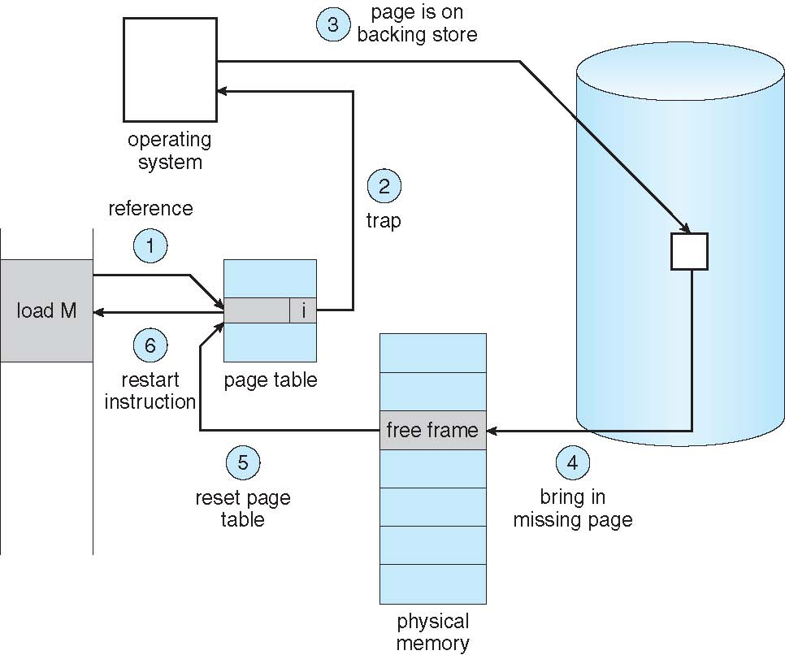
Steps in Handling a Page Fault

Slide 16
Aspects of Demand Paging
Extreme case – start process with no pages in memory
  OS sets instruction pointer to first instruction of process, non-memory-resident -> page fault
  And for every other process pages on first access
  Pure demand paging
Actually, a given instruction could access multiple pages -> multiple page faults
  Consider fetch and decode of instruction which adds 2 numbers from memory and stores result back to memory
  Pain decreased because of locality of reference
Hardware support needed for demand paging
  Page table with valid / invalid bit
  Secondary memory (swap device with swap space)
  Instruction restart

Slide 17
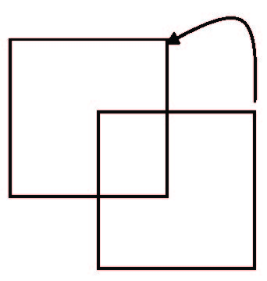
Instruction Restart
Consider an instruction that could access several different locations
  block move
  auto increment/decrement location
  Restart the whole operation?
    What if source and destination overlap?

Slide 18
Performance of Demand Paging
Stages in Demand Paging (worse case)
Trap to the operating system
Save the user registers and process state
Determine that the interrupt was a page fault
Check that the page reference was legal and determine the location of the page on the disk
Issue a read from the disk to a free frame:
  Wait in a queue for this device until the read request is serviced
  Wait for the device seek and/or latency time
  Begin the transfer of the page to a free frame
While waiting, allocate the CPU to some other user
Receive an interrupt from the disk I/O subsystem (I/O completed)
Save the registers and process state for the other user
Determine that the interrupt was from the disk
Correct the page table and other tables to show page is now in memory
Wait for the CPU to be allocated to this process again
Restore the user registers, process state, and new page table, and then resume the interrupted instruction

Slide 19
Performance of Demand Paging (Cont.)
Three major activities
  Service the interrupt – careful coding means just several hundred instructions needed
  Read the page – lots of time
  Restart the process – again just a small amount of time
Page Fault Rate 0 ≤ p ≤ 1
  if p = 0 no page faults
  if p = 1, every reference is a fault
Effective Access Time (EAT)
EAT = (1 – p) x memory access
+ p (page fault overhead
+ swap page out
+ swap page in )

Slide 20
Demand Paging Example
Memory access time = 200 nanoseconds
Average page-fault service time = 8 milliseconds
EAT = (1 – p) x 200 + p (8 milliseconds)
= (1 – p x 200 + p x 8,000,000
= 200 + p x 7,999,800
If one access out of 1,000 causes a page fault, then
EAT = 8.2 microseconds.
This is a slowdown by a factor of 40!!
If want performance degradation < 10 percent
  220 > 200 + 7,999,800 x p
  20 > 7,999,800 x p
  p < .0000025
  < one page fault in every 400,000 memory accesses

Slide 21
Demand Paging Optimizations
Swap space I/O faster than file system I/O even if on the same device
  Swap allocated in larger chunks, less management needed than file system
Copy entire process image to swap space at process load time
  Then page in and out of swap space
  Used in older BSD Unix
Demand page in from program binary on disk, but discard rather than paging out when freeing frame
  Used in Solaris and current BSD
  Still need to write to swap space
    Pages not associated with a file (like stack and heap) – anonymous memory
    Pages modified in memory but not yet written back to the file system
Mobile systems
  Typically don’t support swapping
  Instead, demand page from file system and reclaim read-only pages (such as code)

Slide 22
Copy-on-Write
Copy-on-Write (COW) allows both parent and child processes to initially share the same pages in memory
  If either process modifies a shared page, only then is the page copied
COW allows more efficient process creation as only modified pages are copied
In general, free pages are allocated from a pool of zero-fill-on-demand pages
  Pool should always have free frames for fast demand page execution
    Don’t want to have to free a frame as well as other processing on page fault
  Why zero-out a page before allocating it?
vfork() variation on fork() system call has parent suspend and child using copy-on-write address space of parent
  Designed to have child call exec()
  Very efficient

Slide 23
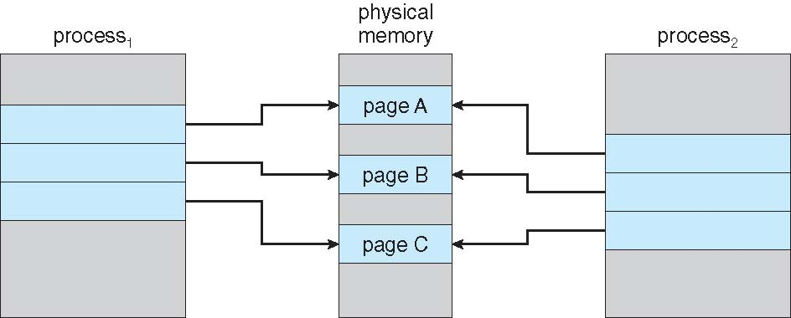
Before Process 1 Modifies Page C

Slide 24
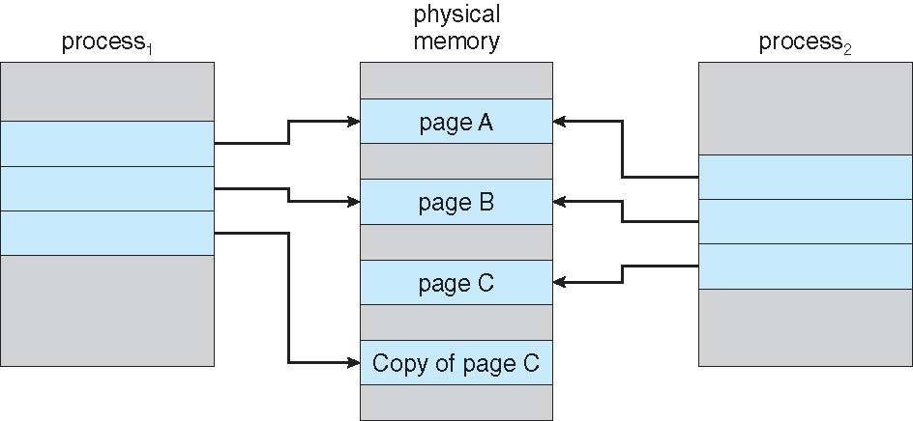
After Process 1 Modifies Page C

Slide 25
What Happens if There is no Free Frame?
Used up by process pages
Also in demand from the kernel, I/O buffers, etc
How much to allocate to each?
Page replacement – find some page in memory, but not really in use, page it out
  Algorithm – terminate? swap out? replace the page?
  Performance – want an algorithm which will result in minimum number of page faults
Same page may be brought into memory several times

Slide 26
Page Replacement
Prevent over-allocation of memory by modifying page-fault service routine to include page replacement
Use modify (dirty) bit to reduce overhead of page transfers – only modified pages are written to disk
Page replacement completes separation between logical memory and physical memory – large virtual memory can be provided on a smaller physical memory

Slide 27
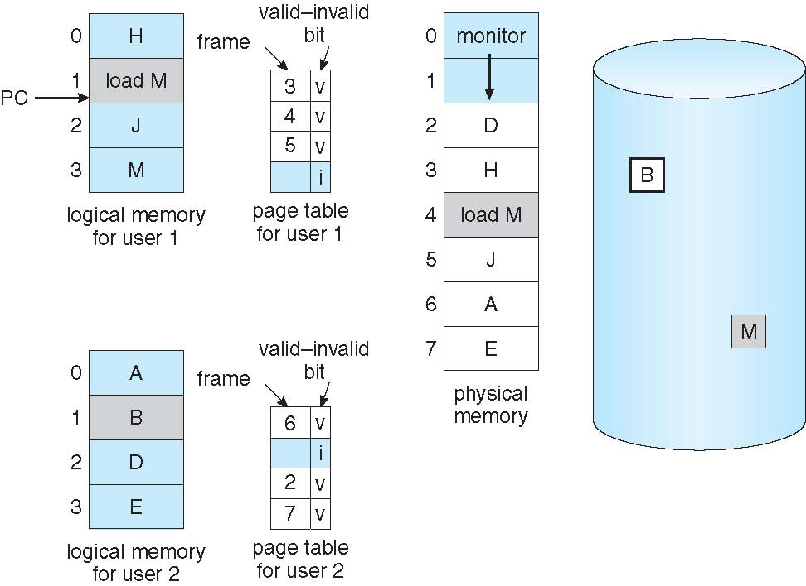
Need For Page Replacement

Slide 28
Basic Page Replacement
Find the location of the desired page on disk
Find a free frame:
- If there is a free frame, use it
- If there is no free frame, use a page replacement algorithm to select a victim frame
- Write victim frame to disk if dirty
Bring the desired page into the (newly) free frame; update the page and frame tables
Continue the process by restarting the instruction that caused the trap
Note now potentially 2 page transfers for page fault – increasing EAT

Slide 29
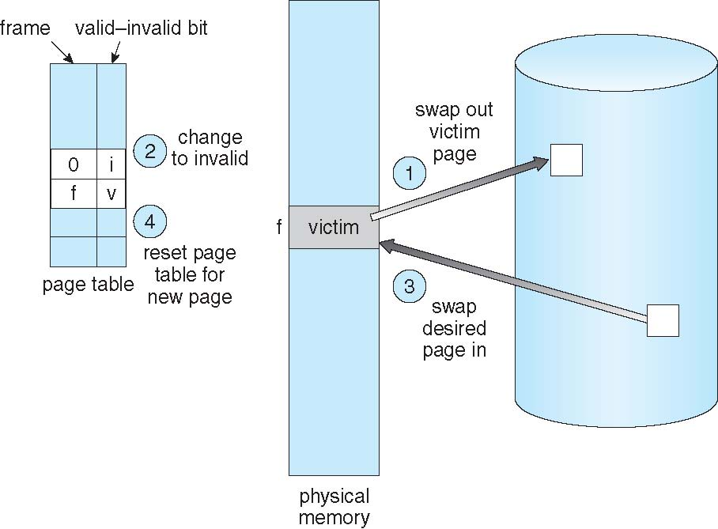
Page Replacement

Slide 30
Page and Frame Replacement Algorithms
Frame-allocation algorithm determines
  How many frames to give each process
  Which frames to replace
Page-replacement algorithm
  Want lowest page-fault rate on both first access and re-access
Evaluate algorithm by running it on a particular string of memory references (reference string) and computing the number of page faults on that string
  String is just page numbers, not full addresses
  Repeated access to the same page does not cause a page fault
  Results depend on number of frames available
In all our examples, the reference string of referenced page numbers is
7,0,1,2,0,3,0,4,2,3,0,3,0,3,2,1,2,0,1,7,0,1
Page numbers requested | →

Slide 31
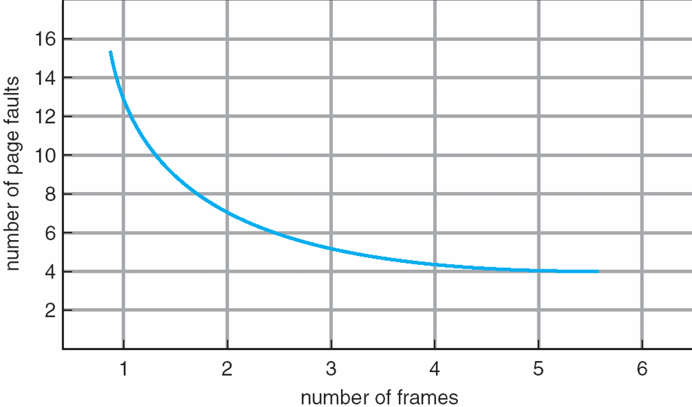
Graph of Page Faults Versus The Number of Frames

Slide 32
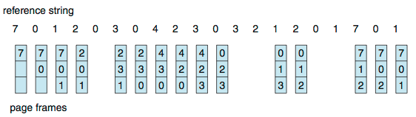
First-In-First-Out (FIFO) Algorithm
Reference string: 7,0,1,2,0,3,0,4,2,3,0,3,0,3,2,1,2,0,1,7,0,1
3 frames (3 pages can be in memory at a time per process)
Can vary by reference string: consider 1,2,3,4,1,2,5,1,2,3,4,5
  Adding more frames can cause more page faults!
    Belady’s Anomaly
    the phenomenon in which increasing the number of page frames results in an increase in the number of page faults for certain memory access patterns
How to track ages of pages?
  Just use a FIFO queue
15 page faults

Slide 33
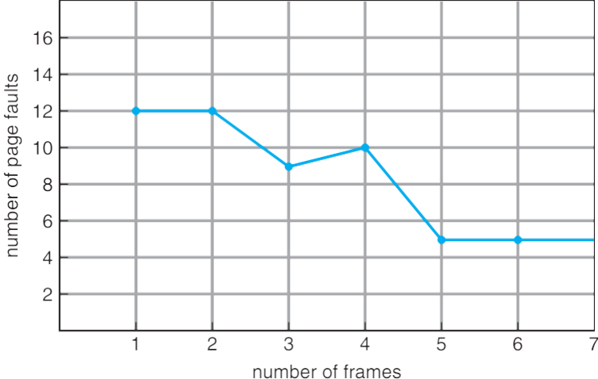
FIFO Illustrating Belady’s Anomaly
The phenomenon in which increasing the number of page frames results in an increase in the number of page faults for certain memory access patterns

Slide 34
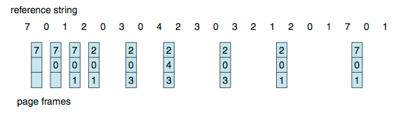
Optimal Algorithm
Replace page that will not be used for longest period of time
  9 is optimal for the example
How do you know this?
  Can’t read the future
Used for measuring how well your algorithm performs

Slide 35
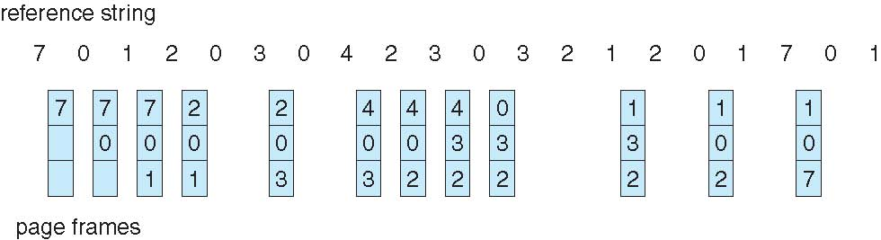
Least Recently Used (LRU) Algorithm
the algorithm implemented on most systems
Use past knowledge rather than future
Replace page that has not been used in the most amount of time
Associate time of last use with each page
12 faults – better than FIFO but worse than OPT
Generally good algorithm and frequently used
But how to implement?

Slide 36
LRU Algorithm (Cont.)
Counter implementation
  Every page entry has a counter; every time page is referenced through this entry, copy the clock into the counter
  When a page needs to be changed, look at the counters to find smallest value
    Search through table needed
Stack implementation
  Keep a stack of page numbers in a double link form:
  Page referenced:
    move it to the top
    requires 6 pointers to be changed
  But each update more expensive
  No search for replacement
LRU and OPT are cases of stack algorithms that don’t have Belady’s Anomaly

Slide 37
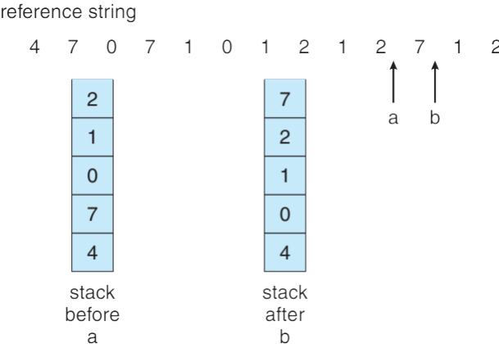
Use Of A Stack to Record Most Recent Page References

Slide 38
Counting Algorithms
Keep a counter of the number of references that have been made to each page
  Not common
Least Frequently Used (LFU) Algorithm: replaces page with smallest count
Most Frequently Used (MFU) Algorithm: based on the argument that the page with the smallest count was probably just brought in and has yet to be used

Slide 39
Frame Lock Bit
A lock bit is associated with every frame. If a frame is locked, it cannot be selected for replacement.
Frame lock bit is often associated with I/O request.
  This avoids the replacement of the pages for other processes and the possible unavailability of those pages when the I/O request advances to the head of the device queue. When the I/O is complete, the pages are unlocked.
To write a block on tape, we lock into memory the pages containing the block. The system then continues as usual with other processes if the I/O request is in a queue for that I/O device.

Slide 40
Allocation of Frames
Each process needs minimum number of frames
Example: IBM 370 – 6 pages to handle SS MOVE instruction:
  instruction is 6 bytes, might span 2 pages
  2 pages to handle from
  2 pages to handle to
Maximum of course is total frames in the system
Two major allocation schemes
  fixed allocation
  priority allocation
Many variations

Slide 41
Fixed Allocation
Equal allocation – For example, if there are 100 frames (after allocating frames for the OS) and 5 processes, give each process 20 frames
  Keep some as free frame buffer pool
Proportional allocation – Allocate according to the size of process
  Dynamic as degree of multiprogramming, process sizes change
62

Slide 42
Priority Allocation
Use a proportional allocation scheme using priorities rather than size
If process P_{i} generates a page fault,
  select for replacement one of its frames
  select for replacement a frame from a process with lower priority number

Slide 43
Global vs. Local Replacement
Global replacement – process selects a replacement frame from the set of all frames; one process can take a frame from another
  But then process execution time can vary greatly
  But greater throughput so more common
Local replacement – each process selects from only its own set of allocated frames
  More consistent per-process performance
  But possibly underutilized memory

Slide 44
TLB Reach
TLB Reach = (TLB Size) X (Page Size).
For example, TLB contains the information of 32 pages, so the TLB Reach will be page size * 32 pages.
Two strategies to increase the TLB Reach are
  (1) increasing the number of entries in the TLB,
  and (2) increasing the page size.

Slide 45
Thrashing
If a process does not have “enough” pages, the page-fault rate is very high
  Page fault to get page
  Replace existing frame
  But quickly need replaced frame back
  This leads to:
    Low CPU utilization
    Operating system thinking that it needs to increase the degree of multiprogramming
    Another process added to the system
Thrashing ≡ a process is busy swapping pages in and out
Notes:
The degree of multiprogramming describes the maximum number of processes that a single-processor system can accommodate efficiently
The primary factor affecting the degree of multiprogramming is the amount of memory available to be allocated to executing processes.

Slide 46
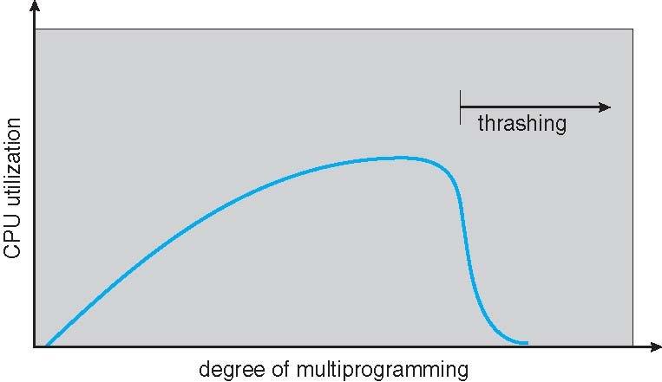
Thrashing (Cont.)

Slide 47
Demand Paging and Thrashing
Why does demand paging work?
Locality model
  Process migrates from one locality to another
  Localities may overlap
Why does thrashing occur?
Σ size of locality > total memory size
  Limit effects by using local or priority page replacement
Notes:
Locality model: the tendency of a processor to access the same set of memory locations repetitively over a short period of time.
There are two basic types of reference locality – temporal and spatial locality. Temporal locality refers to the reuse of specific data, and/or resources, within a relatively small time duration. Spatial locality (also termed data locality^{[3]}) refers to the use of data elements within relatively close storage locations.

Slide 48
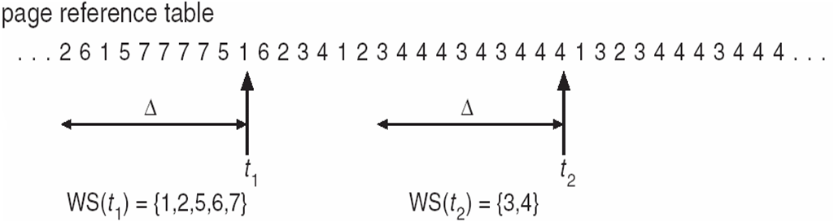
Working-Set Model
Δ ≡ working-set window ≡ a fixed number of page references
Example: 10,000 instructions
WSS_{i} (working set of Process P_{i}) =
total number of pages referenced in the most recent Δ (varies in time)
  if Δ too small will not encompass entire locality
  if Δ too large will encompass several localities
  if Δ = ∞ ⇒ will encompass entire program
D = Σ WSS_{i} ≡ total demand frames
  Approximation of locality
if D > m ⇒ Thrashing
Policy if D > m, then suspend or swap out one of the processes

Slide 49
Prepaging
many paging systems try to keep track of each process' working set and make sure that it is in memory before letting the process run. This approach is called the working set model.
Loading the pages before letting processes run is also called prepaging.

Slide 50
Keeping Track of the Working Set
Approximate with interval timer + a reference bit
Example: Δ = 10,000
  Timer interrupts after every 5000 time units
  Keep in memory 2 bits for each page
  Whenever a timer interrupts copy and sets the values of all reference bits to 0
  If one of the bits in memory = 1 ⇒ page in working set
Why is this not completely accurate?
Improvement = 10 bits and interrupt every 1000 time units

Slide 51
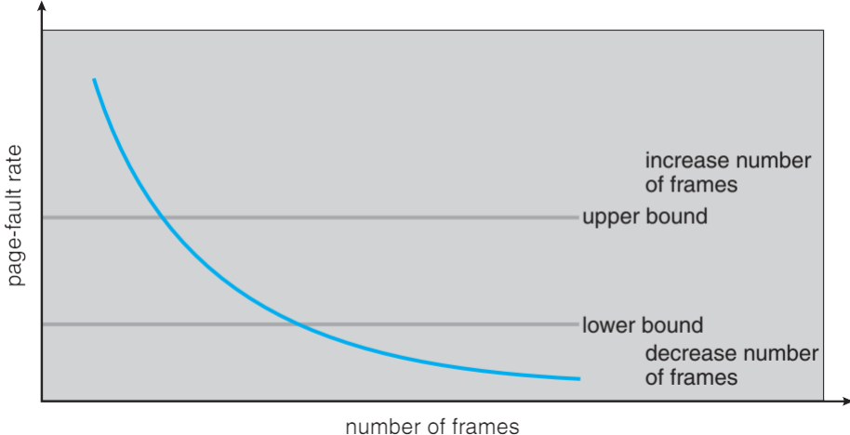
Page-Fault Frequency
More direct approach than WSS
Establish “acceptable” page-fault frequency (PFF) rate and use local replacement policy
  If actual rate too low, process loses frame
  If actual rate too high, process gains frame

Slide 52
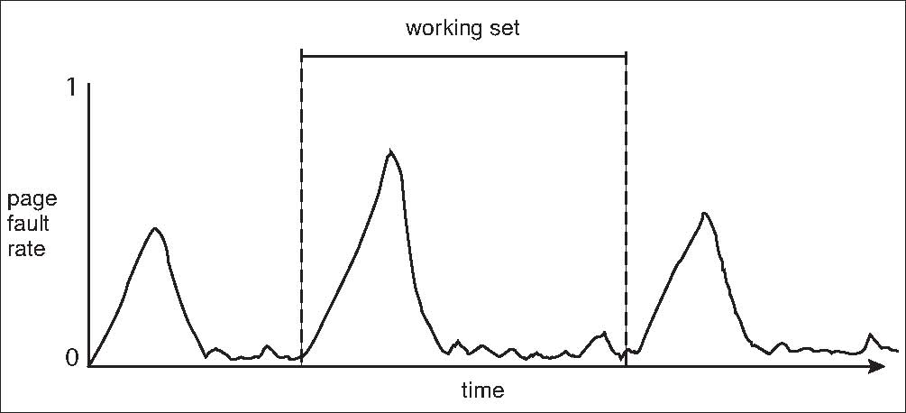
Working Sets and Page Fault Rates
Direct relationship between working set of a process and its page-fault rate
Working set changes over time
Peaks and valleys over time

Slide 53
End of Chapter 8

