Slide 1

Hate Speech Detection on Twitter
Classifying Hate Speech, Offensive Language, and Neutral Content
Prachi Pradhan • Rhea Shastri • Akash Chauhan
ECE-GY 6143 | Machine Learning

Slide 2
Problem Overview
HATE SPEECH
Targeted attacks on individuals or groups based on protected characteristics
The Challenge
Online platforms struggle to moderate harmful content due to massive volumes of user-generated text.
OFFENSIVE LANGUAGE
Contains profanity or crude language but lacks hateful targeting
The key difficulty: distinguishing hate speech from offensive language, as they share similar vocabulary and patterns.
NEITHER
Neutral content without hate speech or offensive elements

Slide 3
Dataset Description
~24,000
3
Total Tweets
Classification Classes
Class Imbalance Challenge
⚠️
Majority of tweets labeled as offensive language, creating significant class imbalance that directly impacts model performance—especially recall for hate speech class.
Data Characteristics
Tweet length variations analyzed
Noisy texts with stopwords and platform artifacts
Pre-labeled with human annotations
Vote Based Labels

Slide 4



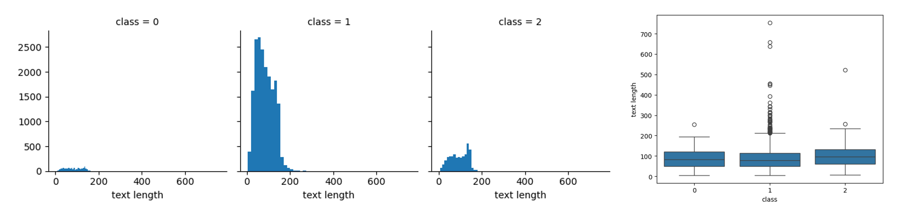
Dataset Description
1,430
19,190
4,163
Hate Speech (5.8%)
Offensive (77.4%)
Neither (16.8%)

Slide 5

Methodology
Text Preprocessing Steps
Text Cleaning
Lowercasing
Stopword Removal
Stemming
Feature Extraction
Result: cleaner token stream → better feature vectors.
Example: "Wow!! @user This is AMAZING!!!" → "wow amaz"
Feature Sets Evaluated
TF-IDF
Sentiment
Doc2Vec
Readability
Unigrams + Bigrams
VADER sentiment analysis
Document embeddings
Linguistic features, FK score
Approach: Each feature combination tested across multiple ML models to identify optimal performance.

Slide 6

Models Evaluated
Logistic Regression
Random Forest
Linear classifier with probabilistic outputs
Ensemble of decision trees
BEST
Naive Bayes
Support Vector Machine
Probabilistic classifier based on Bayes' theorem
Maximum-margin hyperplane classifier
Evaluation Metrics
Accuracy
Precision
Recall
F1-Score
Confusion Matrices

Slide 7
TF-IDF (F1)
Term Frequency-Inverse Document Frequency
Converts text into numerical vectors by weighting terms based on their importance in documents
Mathematical Formula
TF(t,d) = (Number of times term t appears in document d) / (Total terms in document d)
IDF(t) = log(Total documents / Documents containing term t)
TF-IDF(t,d) = TF(t,d) × IDF(t)
Intuition
Implementation
High TF-IDF = term appears frequently in this document but rarely across all documents (discriminative)
Used n-gram range (1,2) for unigrams and bigrams, max_df=0.75, min_df=5
Why TF-IDF? Captures term importance better than raw counts. Common words get lower weights, rare discriminative words get higher weights.

Slide 8
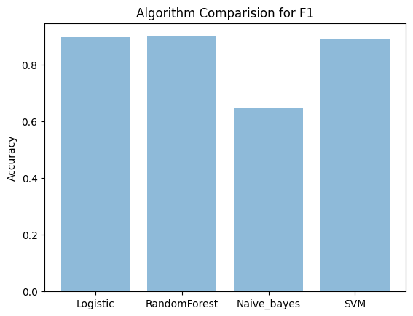
TF-IDF (F1)
Configuration: F2 = F1 + Sentiment
Concatenated TF-IDF vectors with VADER sentiment scores and Twitter metadata features
Features Added (10 additional dimensions)
Positive, negative, neutral, compound sentiment scores + hashtag count, mention count, URL count, retweet indicators
Performance Change
Marginal improvements in some models, SVM remained strongest performer
Observation
Sentiment features provided small boost but not game-changing improvement
Conclusion: Sentiment adds context but TF-IDF captures most discriminative information for this task

Slide 9
TF-IDF + Sentiment Analysis (F2)
VADER: Valence Aware Dictionary and sEntiment Reasoner
Lexicon and rule-based sentiment analysis tool specifically attuned to social media text
Sentiment Scores
Additional Features Extracted
Positive score (0 to 1)
Negative score (0 to 1)
Neutral score (0 to 1)
Compound score (-1 to +1)
Hashtag count
Mention count
URL count
Retweet indicators
Hypothesis: Hate speech might exhibit different sentiment patterns compared to offensive language. Combining sentiment scores with TF-IDF could improve classification.

Slide 10
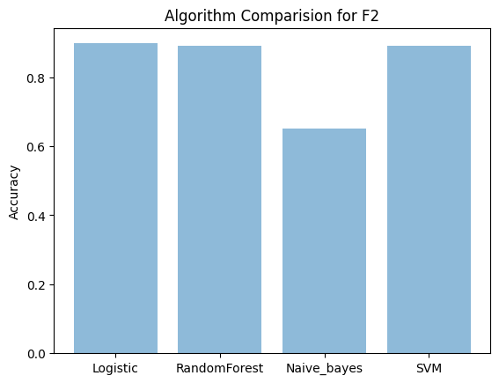
TF-IDF + Sentiment Analysis (F2)
Configuration: F2 = F1 + Sentiment
Concatenated TF-IDF vectors with VADER sentiment scores and Twitter metadata features
Features Added (10 additional dimensions)
Positive, negative, neutral, compound sentiment scores + hashtag count, mention count, URL count, retweet indicators
Performance Change
Marginal improvements in some models, SVM remained strongest performer
Observation
Sentiment features provided small boost but not game-changing improvement
Conclusion: Sentiment adds context but TF-IDF captures most discriminative information for this task

Slide 11
TF-IDF + Sentiment Analysis + Doc2Vec Embeddings (F3)
Document Embeddings via Neural Networks
Extension of Word2Vec that learns fixed-length feature representations for variable-length documents
How Doc2Vec Works
Uses shallow neural network to predict context words given a document ID and word
Training produces dense vector representation of each document that captures semantic meaning
Advantage over TF-IDF
Implementation
Captures semantic similarity and word context, not just term frequency
Trained Doc2Vec model on preprocessed tweets to generate embedding vectors
Key Insight: Doc2Vec embeddings capture latent semantic structure that might help distinguish subtle differences in hate speech vs offensive language

Slide 12
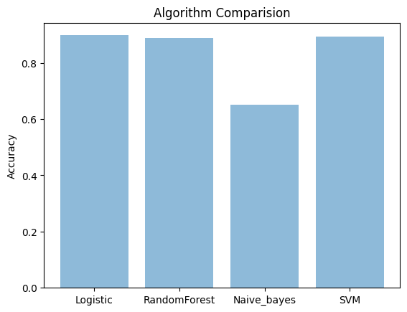
TF-IDF + Sentiment Analysis + Doc2Vec Embeddings (F3)
Configuration: F3 = F2 + Doc2Vec
Added document embeddings to capture semantic relationships between tweets
Doc2Vec Training Process
1. Tagged documents created from preprocessed tweets
2. Model trained to learn document vectors
3. Vectors concatenated with existing features
Expected Benefit
Capture semantic similarity and context that TF-IDF misses
Actual Result
Minimal improvement over F2 configuration
Analysis: For short texts like tweets, TF-IDF's bag-of-words approach already captures sufficient information. Semantic embeddings add little value.

Slide 13
TF-IDF + Sentiment Analysis + Doc2Vec Embeddings + Linguistic features (F4)
Text Complexity and Readability Metrics
Statistical features that measure linguistic complexity and readability of text
Features Extracted
Flesch-Kincaid Formula
Syllable Count
Character Count
Word Count
Average Word Length
Flesch-Kincaid Grade Level
FK Grade = 0.39 × (words/sentences) + 11.8 × (syllables/words) - 15.59
Measures text complexity on US grade-level scale
Rationale: Hate speech and offensive language might differ in linguistic complexity—hateful content could use simpler or more complex language patterns

Slide 14
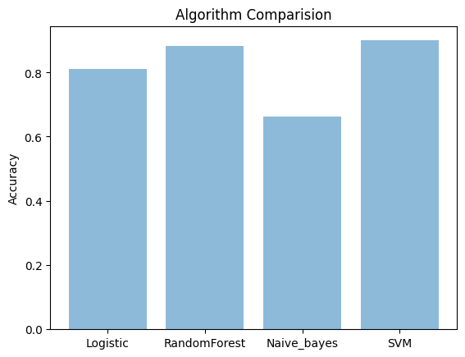
TF-IDF + Sentiment Analysis + Doc2Vec Embeddings + Linguistic features (F4)
Configuration: F4 = F3 + Readability
Complete feature set
Hypothesis
Linguistic Complexity might differ between hate speech and offensive language
Outcome
Still minimal gains over simpler configuration
Critical Insight: Complexity does not equal performance. Diminishing returns from feature engineering observed.

Slide 15
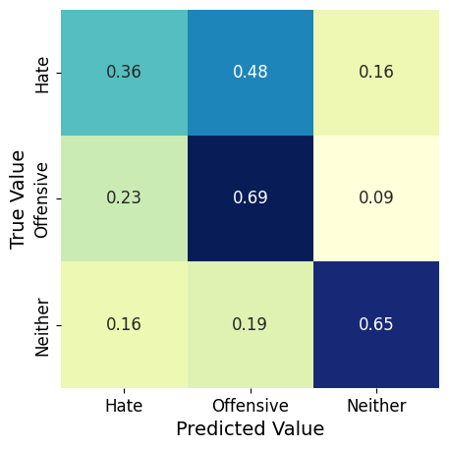
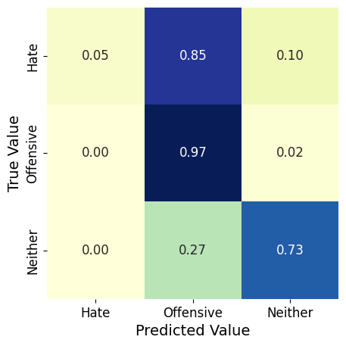
Additional Feature Combination Test
Testing Alternative Feature Combinations
Evaluated different subsets to identify minimal effective feature set
TF-IDF + Doc2Vec + Readability
TF-IDF + Sentiment + Readability
Skipped sentiment features to test if they were redundant
Skipped Doc2Vec to test embedding necessity
Results Across All Models
Logistic Regression, Random Forest, Naive Bayes, and SVM all tested on each configuration
Consistent Finding: SVM with TF-IDF baseline consistently outperformed or matched more complex configurations

Slide 16
Comprehensive Model Comparison
Winner: SVM with TF-IDF
~90%
Overall Accuracy
Why SVM Won
Other Models
Effective in high-dimensional sparse spaces (TF-IDF vectors), robust to overfitting with proper regularization
Logistic Regression close second, Random Forest and Naive Bayes competitive but slightly lower accuracy
Performance Metrics
High precision and recall for offensive and neither classes. Lower recall for hate speech due to class imbalance.
Bar charts in notebook visualize accuracy comparison across all four models and feature configurations

Slide 17
Conclusion & Takeaways
Key Findings
1
TF-IDF remains a strong baseline for short-text classification tasks like tweet analysis
2
Increasing feature complexity yields diminishing returns—simplicity is often more effective
3
Dataset imbalance is the dominant factor limiting hate speech recall performance
Future Directions
Address class imbalance with resampling techniques
Explore deep learning models for contextual understanding
Investigate ensemble methods combining multiple models
Impact
This work demonstrates practical NLP approaches for moderating online content and protecting communities from harmful language.

Slide 18
Thank You

