Slide 1
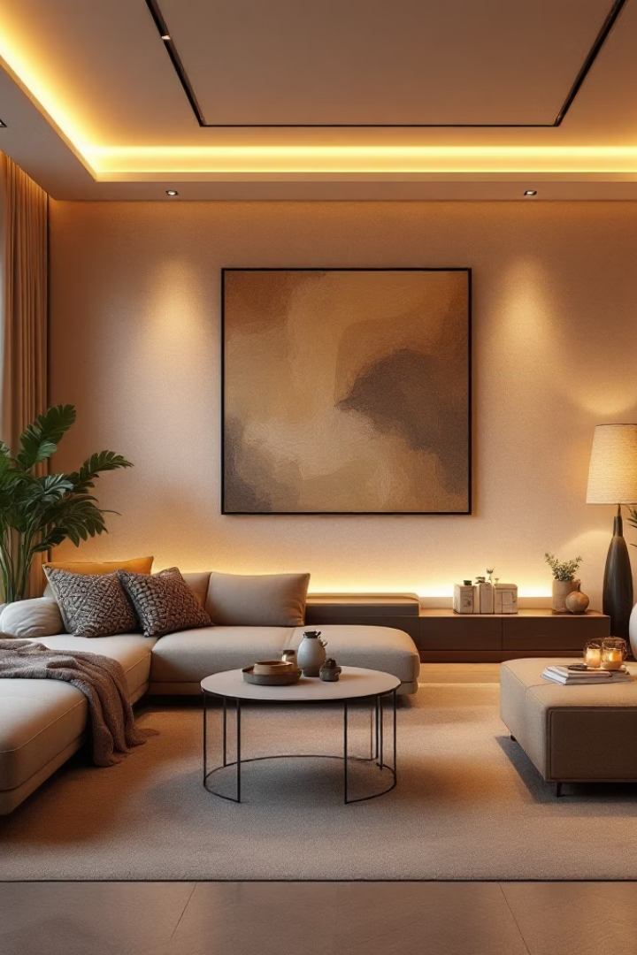
Introducing Glowo: Paint That Feels
Glowo is a mood-enhancing smart paint designed for modern homes. Infused with nano-particles, it reacts to your emotions, elevating your living space with color that reflects you.
Ra
by Rohan

Slide 2

Glowo: The Science of Emotion in Color
Our unique formula features emotion-responsive nano-particles. Walls subtly shift shades based on emotional state, creating a dynamic and personalized home environment. Glowo seamlessly combines decor with emotional well-being.
Unique Formula
Dynamic Shades
Personalized Home
Emotion-responsive nano-particles.
Walls shift based on emotional state.
Decor combined with well-being.

Slide 3
Why Glowo? Key Features & Benefits
Enhances mood.
Durable, washable, and long-lasting.
Creates a positive atmosphere.
Wide range of base colors.
Integrates into smart home ecosystems.
One liter covers 100 sq ft.
Glowo offers seamless smart home integration and a durable, washable finish. Available in a wide range of base colors for customization.

Slide 4

Target Market: Who Loves Glowo?
Young Professionals
Seeking innovative home solutions.
Home Decor Enthusiasts
Value personalization in their spaces.
Wellness Advocates
Interested in emotional well-being.
Interior Designers
Looking for unique, cutting-edge products.

Slide 5
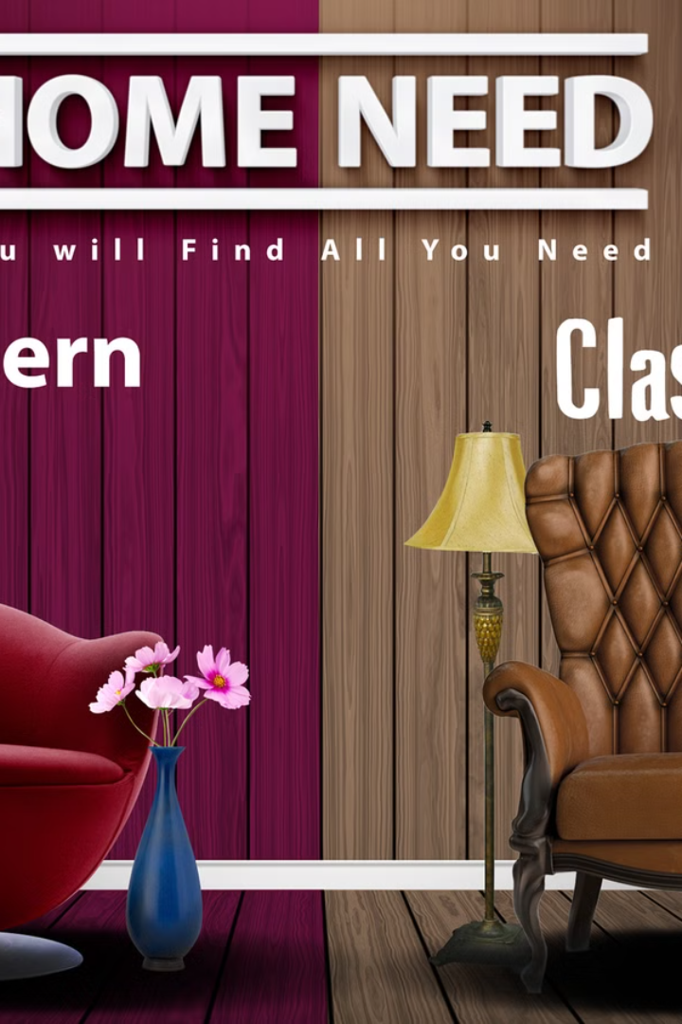
Marketing Strategy: Capturing the Emotion
1
Mood-Themed Ads
Highlighting emotional benefits.
2
Social Media Campaigns
Showcasing real-time color changes.
3
Interior Design Collaborations
Working with influencers.
4
Smart Home Partnerships
Collaborating with tech brands.
Our marketing focuses on the intersection of technology, design, and well-being.

Slide 6


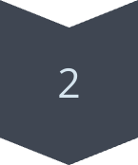

Glowo vs. Traditional Paint: A New Era
Emotional Response
Smart Home Integration
Aesthetic Appeal
Glowo is a first-of-its-kind technology merging decor with emotional well-being. Cost: $500/liter, Selling Price: $999/liter. Traditional paints offer static color; Glowo provides a dynamic and responsive environment.

Slide 7



The Future of Home Decor: Invest in Glowo
1
Expansion
2
Distribution
3
Trend
Capitalizing on smart homes and emotional wellness. Expanding the product line with new colors and functionalities. Securing distribution partnerships with major retailers.

Slide 8

Join the Glowo Revolution!
Visit Website
Learn More
Contact Us
Get in Touch
Follow Us
Stay Updated
Experience the future of home decor. Let Glowo transform your space and elevate your mood.

