Slide 1
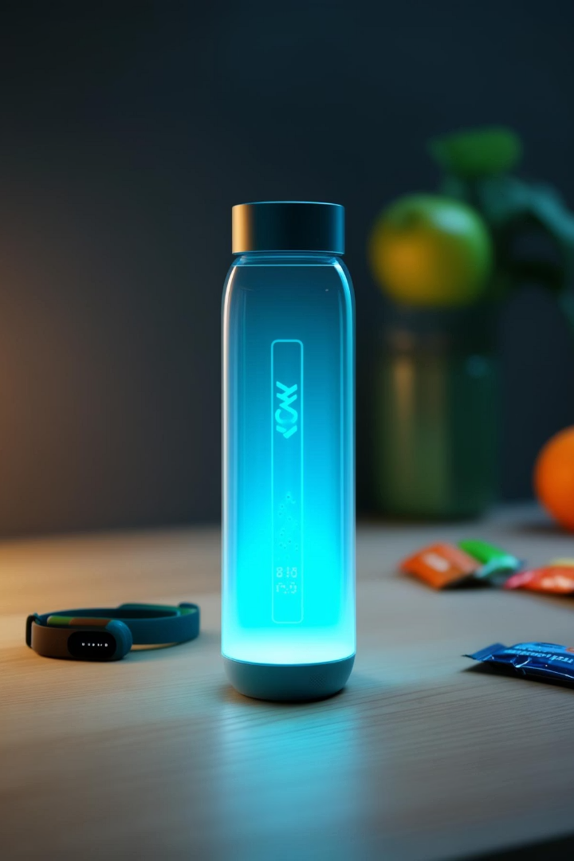
Introducing SipSync: Hydration, Personalized
Meet SipSync, the smart water bottle that syncs with your fitness apps. It glows to remind you to drink based on your real-time hydration needs. Experience personalized hydration for a healthier lifestyle.
Ra
by Rohan and Team

Slide 2

The Problem: Are You Drinking Enough?
Did you know that 75% of people are chronically dehydrated? Dehydration can lead to fatigue and headaches. It can also reduce your overall performance. Most people underestimate their daily water needs. Current water bottles don't offer intelligent tracking.
Common Issue
Negative Effects
75% of people are dehydrated.
Leads to fatigue, headaches, and reduced performance.
Lacking Today
Existing bottles offer no intelligent tracking.

Slide 3





SipSync: The Smart Solution
SipSync tracks your water intake. It suggests optimal hydration based on your activity. The bottle glows when it’s time to sip. It syncs with fitness apps like Fitbit and Apple Health.
Tracks Intake
Suggests Goals
Glows to Remind
Seamless Sync

Slide 4
Key Features & Benefits
Real-Time Tracking
Personalized Advice
Glow Reminders
99% accuracy in monitoring water intake.
Custom hydration recommendations based on your data.
Customizable colors to remind you to drink.
Durable, BPA-free construction
Long-lasting battery (up to 7 days)
Sleek design and easy to clean

Slide 5
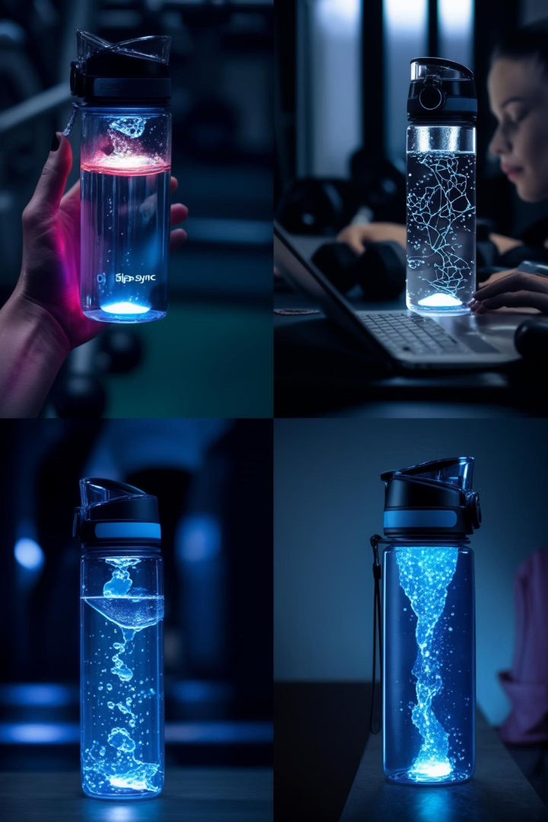
Target Market: Who Needs SipSync?
Fitness Enthusiasts
Working Professionals
Optimize performance and recovery.
Stay focused and energized.
Athletes
Maintain peak hydration.
SipSync is the perfect hydration companion. It can help you manage your well-being.

Slide 6
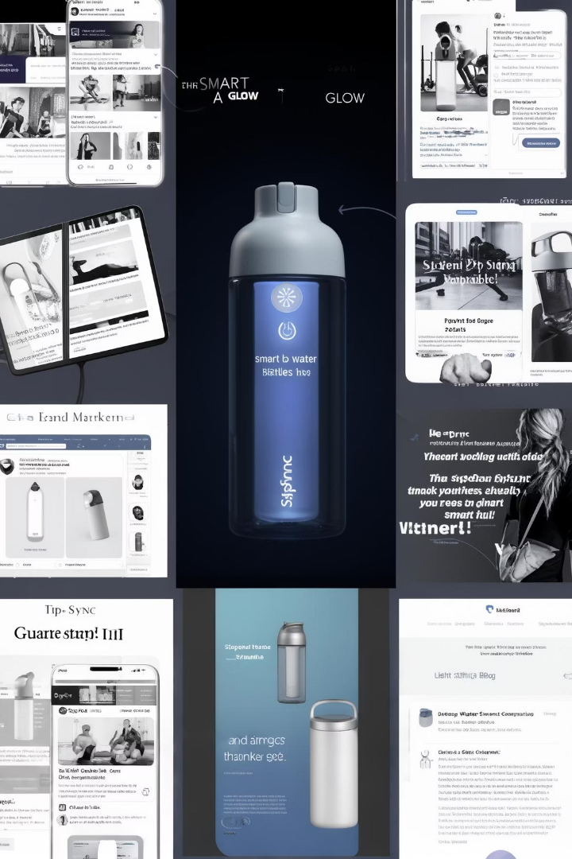



Marketing Strategy: Reaching Our Audience
Our marketing strategy includes social media campaigns. It also includes content marketing and partnerships. We also use email marketing and affiliate programs. We'll showcase SipSync during training and competition.
Social Media
Targeted ads and influencers
Content
Blog posts and articles
Partnerships
Gyms, studios, and orgs

Slide 7
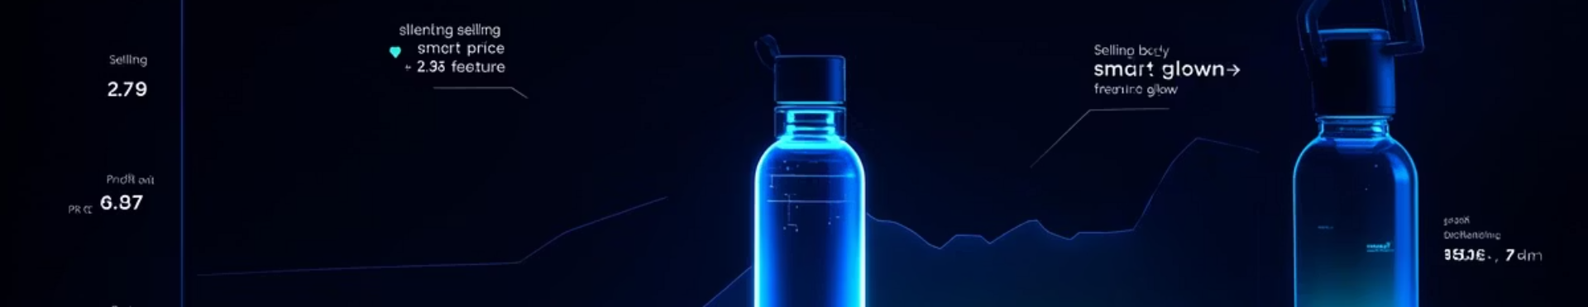
Investment and ROI
Our cost per unit is ₹700 INR. The selling price is ₹1599 INR. That's a profit margin of ~56%. We project 10,000 units sold in 12 months. That's projected revenue of ₹15,990,000 INR.
700
1599
56%
Cost/Unit (INR)
Selling Price (INR)
Profit Margin

Slide 8
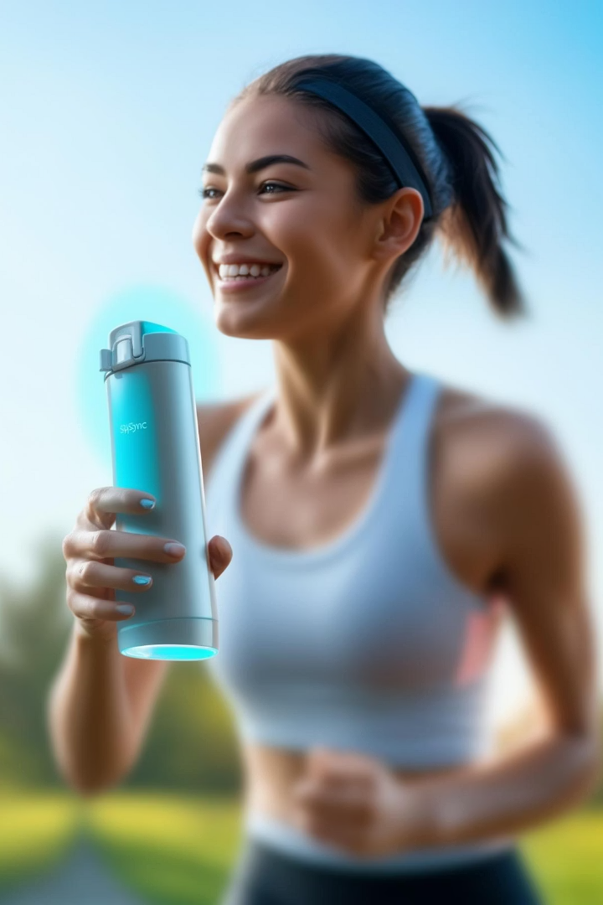
SipSync: Invest in Your Health, Invest in SipSync
SipSync offers personalized hydration. It can help you live a healthier lifestyle. Join us in revolutionizing hydration. Thank you - are there any questions?
Personalized
For a healthier life
Revolutionizing
The way people hydrate
Q&A
We're here to help!

