Slide 1
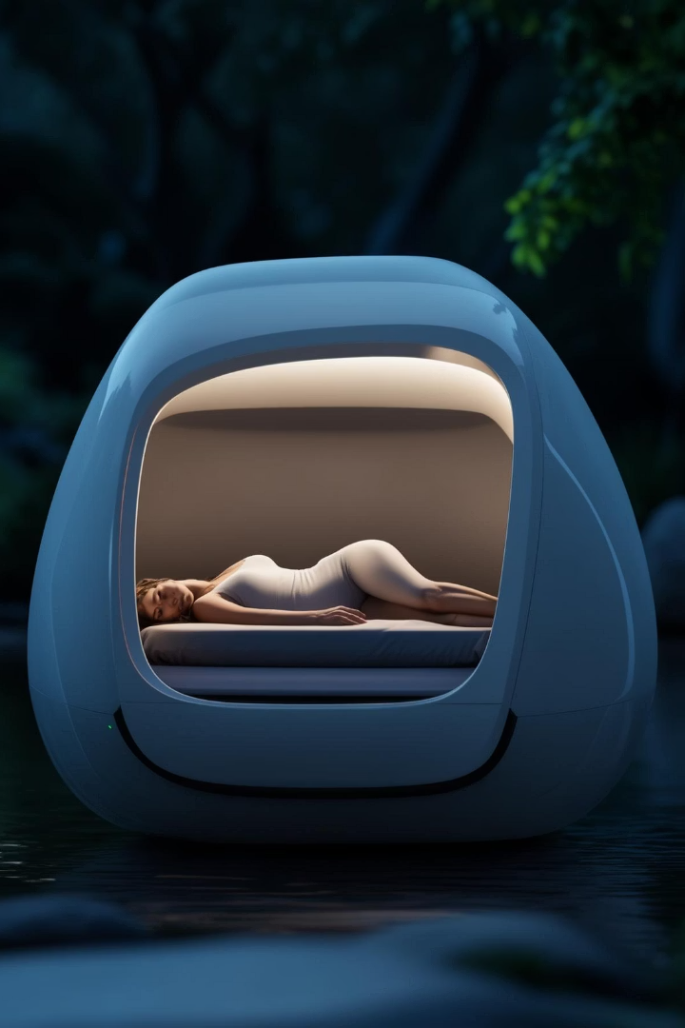
Introducing Snooze Pad: Sleep Anywhere, Anytime
Snooze Pad is a portable sleep pod. It blacks out noise and creates a cocoon of peaceful sounds. Enjoy stress-free rest whenever and wherever you need it.
Ra
by Rion alphonso

Slide 2
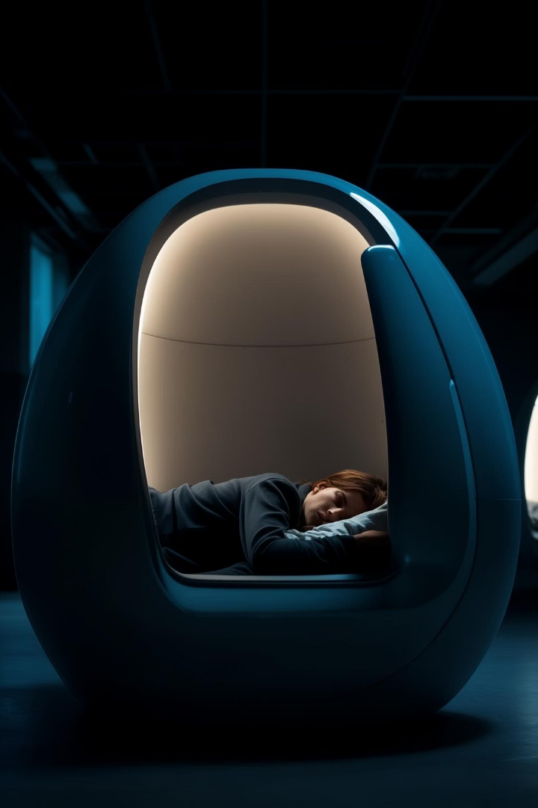
The Problem: Constant Stress and Sleep Deprivation
Adults struggle with sleep due to stress. Office workers lose sleep due to noise. Sleep deprivation causes $411 billion losses annually. Sleep is critical for cognitive and physical health.
70%
2
Adults report sleep trouble
Hours of sleep lost
$411B
Annual loss from sleep deprivation

Slide 3
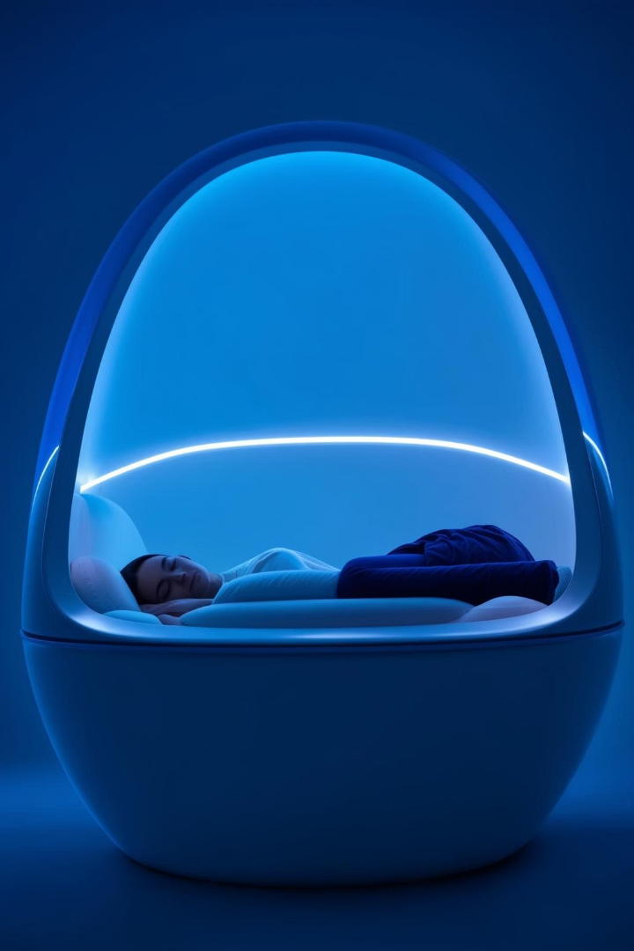



Snooze Pad: Your Personal Oasis of Calm
Snooze Pad is a foldable mini pod with built-in tech. It combines noise canceling, aromatherapy and temperature control. Creates the perfect environment for rest anytime.
Aromatherapy
Enjoy personalized aromatherapy settings
Temperature control
Set your ideal temperature for comfort
Noise Cancellation
Block external distractions and focus on sleep

Slide 4
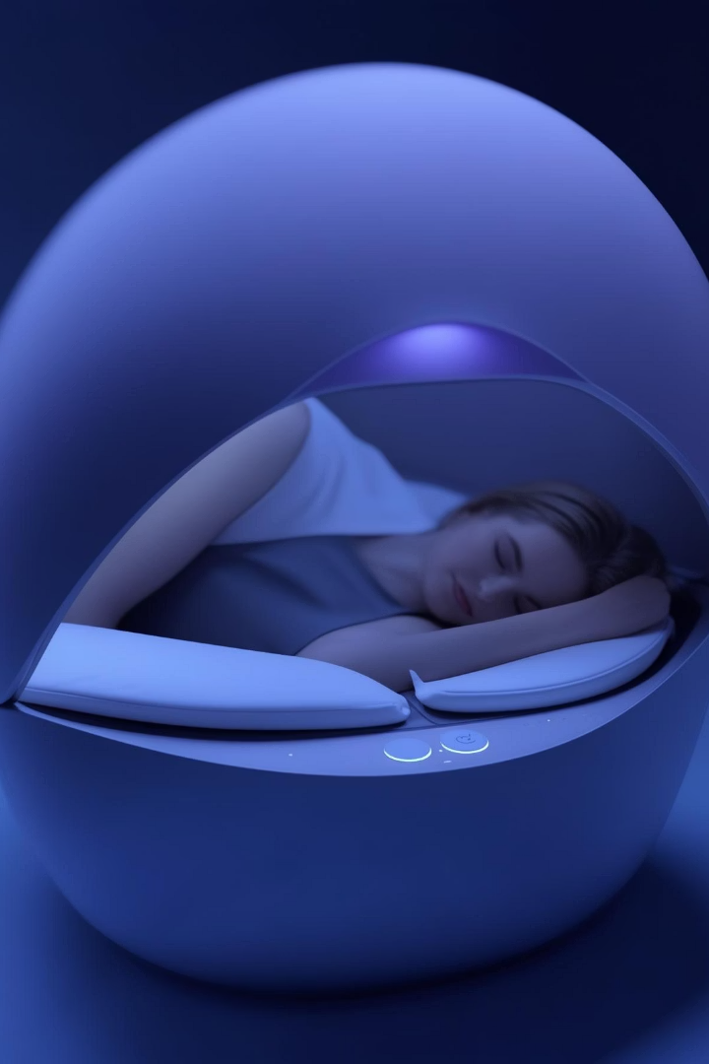




Key Features and Benefits
Noise Cancellation
White Noise
Aromatherapy
Creates a peaceful soundscape
Calming scents for relaxation
Blocks external distractions
Temperature Control
Personalized comfort

Slide 5

Target Market: Stressed, Sleep-Deprived Individuals
Office Workers
Students
Seeking midday recharge to enhance productivity and reduce stress.
Needing quiet study and rest to improve focus and manage stress.
Travelers
Wanting peaceful sleep on the go.
They value convenience and premium comfort.

Slide 6
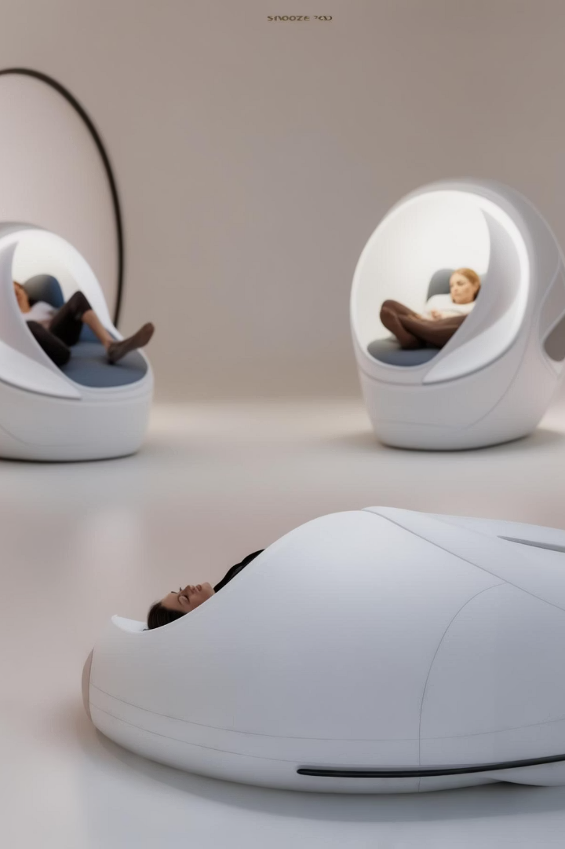
Competitive Advantage: The Ultimate Sleep Solution
All-in-one
No need for separate products for sleep.
Superior experience
Get a unique, premium sleep experience.
Unique product
No similar product like this on the market.
Snooze Pad combines comfort, tech, noise canceling, and aromatherapy.

Slide 7





Marketing Strategy: Reach Our Target Audience
Digital marketing
Target stressed demographics on social media.
Influencer marketing
Partner with wellness and productivity gurus.
Partnerships
Develop corporate wellness programs.
Content marketing
Educate the public about rest.

Slide 8

Investment Opportunity: High Growth Potential
The cost is $2000, and the selling price is $4999. There is a strong profit margin. There is a high demand for sleep solutions. Invest in Snooze Pad and capitalize on the market.
$2000
$4999
60%
Cost
Selling Price
Profit margin

