Slide 1





Slide 2

WHAT IS GIN GONIC?
A built-in web server
Automatic routing
A set of tools for handling requests and responses
Middleware for adding functionality
A built-in logger
Support for templating
Developers can use Gin in a variety of ways, such as to develop web applications, API servers, or even command-line tools.
It is an HTTP web framework written in Go(Golang).
Gin is built around a simple idea: it is possible to write web applications without much boilerplate code using reflect. This means that your code will be concise and easy to read.
Gin comes with many features that make development faster and easier. These include

Slide 3


Why use Gin?
if you’re looking for a fast and lightweight web framework, Golang Gin is a great option. It’s easy to use and has a great community behind it. Here are some reasons why you should use Golang Gin.
Gin is fast: Golang Gin is one of the fastest web frameworks available. It’s built on top of the powerful Gin gopher library, making it very quick and efficient.
Gin is lightweight: Another great thing about Golang Gin is that it’s very lightweight, making it ideal for building small and light web applications.
Gin is easy to use: Golang Gin is easy to use and has great documentation. If you’re new to web development, you’ll find it very straightforward to get started with Gin.
Golang has a great community: Golang Gin has a great community behind it. Many Gin developers are always willing to help and contribute.
Golang and Gin are open source: Golang Gin is open source and released under the MIT license, so you can use it for any purpose, including commercial projects.

Slide 4


Gin Project Examples
Gin Vue Element Admin
Gin: Refers to the Gin web framework in Go (Golang), which is known for its speed and efficiency. Gin is used to create web applications and API services in Go.
Vue: Vue.js is an open source framework for building user interfaces in web applications. It is very popular for its ease of use and performance.
Element: Element is a Vue.js UI component library that provides a wide range of ready-to-use visual components.
Admin: In the context of "Gin Vue Element Admin", "Admin" generally refers to an administration panel or control panel application. These applications are used to manage and monitor other systems, data or applications.
Docker Registry(v2)
Docker: Docker is a container platform that allows developers to package applications and their dependencies into lightweight, portable containers. Docker is used to simplify the deployment of applications in container environments.
Registry: A Docker registry is a repository where container images are stored and can be shared. Registries allow developers to upload, download, and manage container images.

Slide 5

The Pros and Cons of Gin
PROS
High performance
Crash-free
Great error management
Easy JSON validation
Room for control and experimentation
CONS
Sub-par documentation
Less-concise syntax
Not as flexible in development

Slide 6
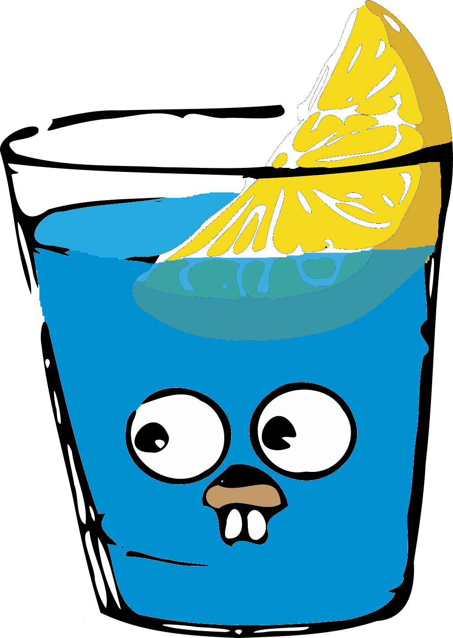
Thanks for your attention

