Slide 1

KESHAV MEMORIAL INSTITUTE OF TECHNOLOGY
(AN AUTONOMOUS INSTITUTION)
Accredited by NBA & NAAC, Approved by AICTE, Affiliated to JNTUH, Hyderabad
Department of Computer Science and Engineering
A.Y 2025-26
An Industry Oriented Mini project on Calory – AI Powered Fitness ChatBot
Under the guidance of
Komala Bukka
Team No: 13
(Name) (RollNo.)
B.Satvik 22BD1AO55N
R.Hanuth 22BD1AO55J
Mihir 22BD1AO55U
Aman 22BD1AO553

Slide 2
Introduction
Fitness industry is growing but lacks adoption of AI and automation.
Chatbots improve efficiency, provide 24/7 availability, and reduce dependency on human trainers.
Goal: Create an interactive chatbot to guide users in diet, exercise, and fitness tracking.

Slide 3
Purpose of the Project
Make fitness tracking simple using AI conversations
Replace manual calorie searching with automatic estimation
Provide real-time diet & workout guidance
Create a unified, user-friendly fitness dashboard
Allow future expansion into IoT & wearable devices

Slide 4
Disadvantages of Existing System
Computational Lag: Constant re-learning and analyzing new queries in real-time is a challenging task that can lead to slow response times.
Accuracy Decay: Performance degrades when users enter queries with phrases and jargons that differ from the training data.
Complex Query Inefficiency: Processing multi-part queries can slow down the system and reduce the precision of the results provided.

Slide 5
Scope of the Project
Functional Scope
Chatbot
Automated calorie estimation
Custom diets & workouts
Dashboard with charts

Slide 6
Architecture
Frontend (Next.js/React)
UI, chat interface, dashboard
Backend (Flask API)
Handles AI queries
AI Layer
NLP model → calorie estimate, diet & workout suggestions
Database
User logs & history
Communication: REST APIs

Slide 7
Literature Survey
Existing apps like MyFitnessPal & HealthifyMe: ✔ Good for basic logging ✘ Poor personalization ✘ No conversational AI ✘ Inconsistent food databases ✘ Paid features limit accessibility

Slide 8
Software Requirements
Functional Requirements
Register/login
Log food
Auto calorie calculation
Chatbot suggestions
Reports & analytics
Non-Functional
Fast loading (2–3s)
Secure & reliable
Easy to use
Scalable

Slide 9
Implementation Overview
Includes:
Food logging logic
Chatbot logic
API integration
Error handling
UI pages (chat, diet, workouts)
Simple Example: User: “Suggest a 10-minute chest workout.” Bot: “Try 3 sets of push-ups, knee push-ups & incline push-ups.”

Slide 10
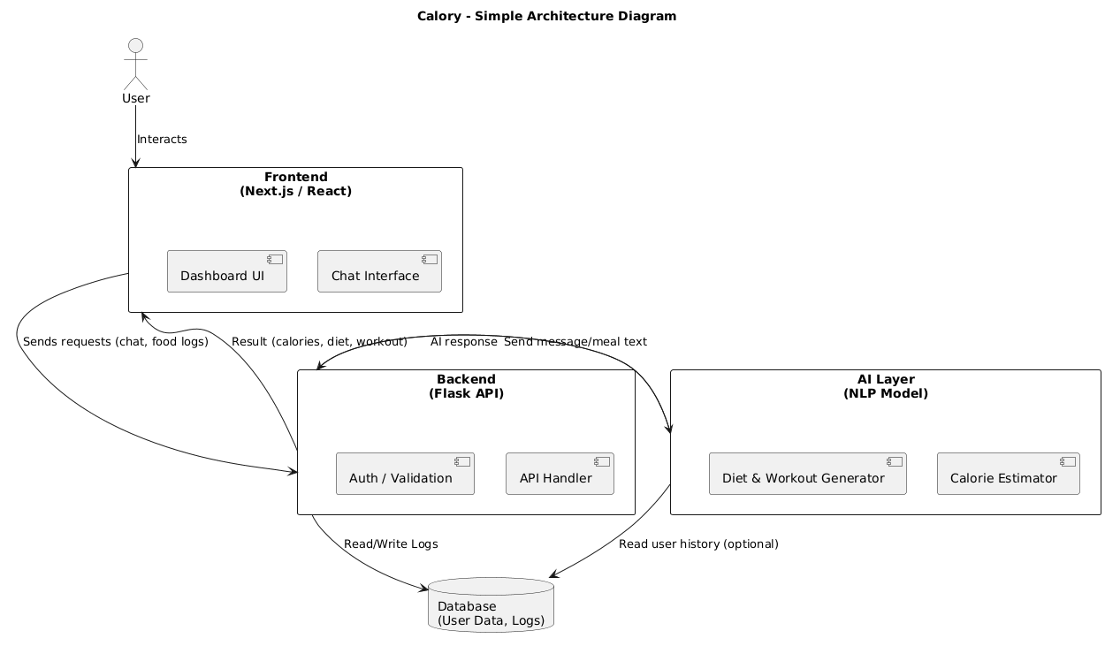
Architecture Diagram

Slide 11
Conclusion
The system successfully:
Tracks calories automatically
Provides personalized diet/workout suggestions
Uses AI for real-time guidance
Offers a modern, interactive UI
Is scalable for future enhancements

Slide 12
Future Enhancements
Wearable integration
Image-based food recognition
Voice logging
Advanced analytics
Social fitness challenges
Medical-grade diet plans

