Slide 1

Submitted By: Name: Tanjina Akter Ripa ID: 2018-3-60-024 Name: Fariha Tabassum ID: 2018-3-60-077 Name: Sharmin Islam ID: 2018-3-60-078 Submitted To: Md. Mohsin Uddin Senior Lecturer, Department of Computer Science & Engineering, East West University
Project Topic :
Online Auction System

Slide 2
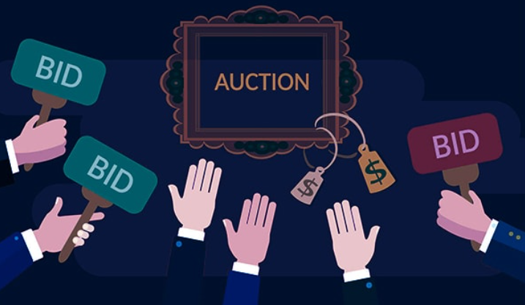
ABSTRACT:
An online auction holds of various products on a website and servers sellers and bidders accordingly.
The system is designed to allow users to set up their products for auction and bidders to register and bid for various product available for bidding.
The Project is developed by using Python, JavaScript, HTML , CSS, Bootstrap to computerize the process of auction. The project covers only the basic features required.

Slide 3
Features :
Registration
Login
Add new product/Delete product
Write blogs and articles
Like, Comment on any blog or product
Upload images
Make user Wish list
Etc…

Slide 4
Our website involves all the basic features of the online auction system. But here we failed to add any feature to countdown the ending time of any auction. The future implementation will be to add a timer to maintain the schedule and also a chat bot for the user.
Future Scope:

Slide 5
Conclusion:
Online auctions reach buyers from around the world. If you're worried about your stuff being given away, online auctions provide the reach to find the right buyer for each and every item. Convenience: Buyers can bid when and where they want and bid on multiple auctions in the same day. It has revolutionized the way people normally buy and has greatly benefited the customer and seller in different ways. Online auctions are one of the websites that have made it more convenient for customers to buy cheap products and have made it easy for sellers to be sellers.

Slide 6
Thank You !

