Slide 1
INTERNSHIP IN A COMPANY(CISCO PROJECT)
Ripenpreet kaur(1896417)
Jaswinder kaur(1896537)
Armaan singh(1895749)
Attardeep singh()

Slide 2
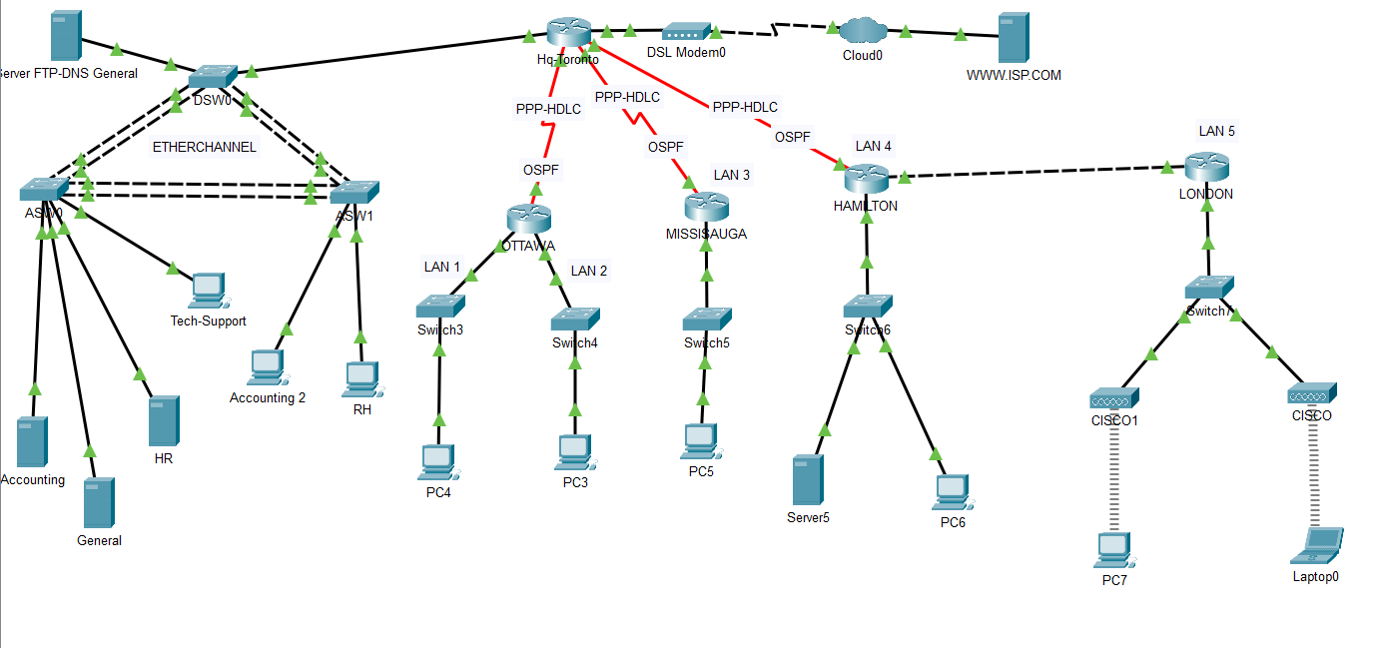

Slide 3
SWITCH CONFIGURATIONS

Slide 4

Default mode for spanning-tree is used here.
Extended system-id enables updating bridge id’s of all STP instances.
Bridge priority has been set by using “spanning-tree vlan 2-5 priority 20480”, which makes router with this value as root bridge.
Basic Switch Configuration

Slide 5
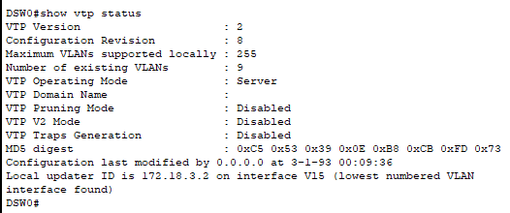
DSW0(Distribution Switch)
Vtp mode server command is used to configure switch as a VTP server
Make sure all switches are configured before issuing this command to avoid problems with configuration revision numbers
Use Show vtp status command to verify
The number of existing VLAN’ s is 9

Slide 6
Configure VTP Domain name and Password
VTP clients must have the same domain name as the VTP server before it accepts VTP advertisements
Configuring the password using the VTP Password command
Use Show VTP password to verify

Slide 7
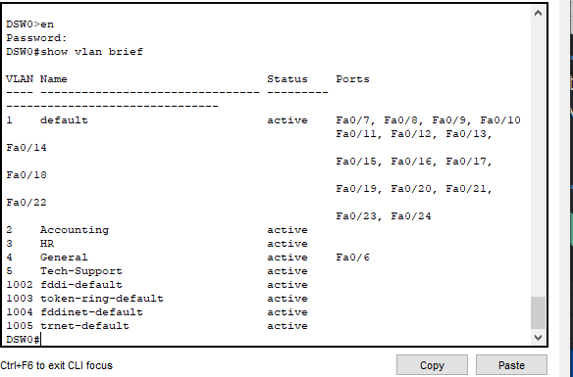
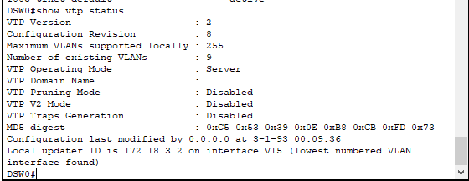
Configure VTP clients by using vtp mode client
Use vlan vlan-number command to create VLAN’ s like vlan 2 in our case.
Assigned name for vlan like for vlan 2 , we designated Accounting
Use show vlan brief to verify
Show vtp status command to verify server status

Slide 8
ROUTER
CONFIGURATIONS

Slide 9
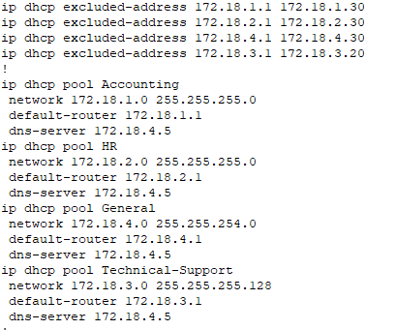
# Toronto
DHCP Pool Accounting
ip Address assigned to hosts is 172.18.1.0
gateway is 172.18..1.1
DNS server’s ip is 172.18.4.5
DHCP Pool HR
ip Address assigned to hosts is 172.18.2.0
gateway is 172.18.2.1
DNS server’s ip is 172.18.4.5
DHCP Pool General
ip Address assigned to hosts is 172.18.4.0
gateway is 172.18.4.1
DNS server’s ip is 172.18.4.5
DHCP Pool Technical-Support
ip Address assigned to hosts is 172.18.3.0
gateway is 172.18.3.1
DNS server’s ip is 172.18.4.5

Slide 10
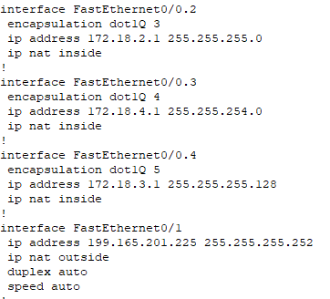
The encapsulation dotIQ command is used associate VLAN with subinterfaces
IP address command is used to configure ip setting like its address and mask
NAT
Interface fa0/0.3 and ip nat inside is to configure nat inside
Interface fa0/0.3 and ip nat outside is to configure nat outside
Interface
# Toronto
continued…..

Slide 11
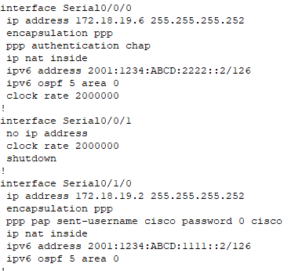
#Encapsulation ppp and #ppp authentication command shows the implication of chap
#ppp pap username password is assigning the username and password in pap
# Toronto
continued….

Slide 12
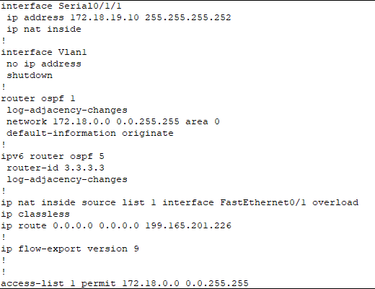
#Ip route 0.0.0.0.0.0.0.0 is the default route set to 199.165.201.226 ,which is ISP server
# Toronto

Slide 13
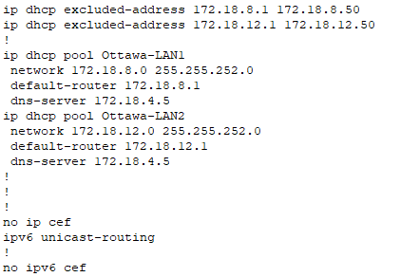
DHCP POOL CREATED FOR LAN 1
ip Address assigned to hosts is 172.18.8.0
gateway is 172.18.4.5
DNS server’s ip is 172.18.4.5 to LAN 1
DHCP POOL CREATED FOR LAN 2
ip Address assigned to hosts is 172.18.12.0
gateway is 172.18.12.1
DNS server’s ip is 172.18.4.5 to LAN 2
Ottawa

Slide 14
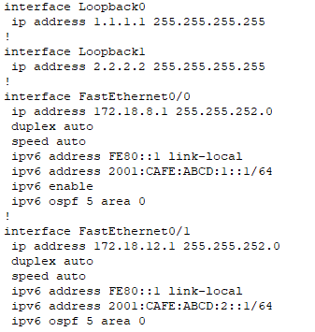
#Interface Loopback command is used to provide id to router
Ottawa
continued...

Slide 15
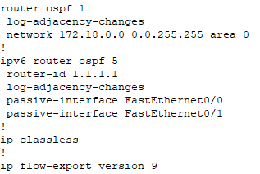
F 0/0 and F0/1 interfaces are considered passive interfaces .Thus, OSPF does not require to send packets on these interfaces.
Ottawa

Slide 16
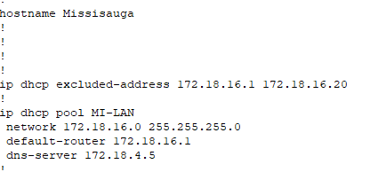
ip Address assigned to hosts is 172.18.16.0
gateway is 172.18.16.1
DNS server’s ip is 172.18.4.5
Mississauga

Slide 17
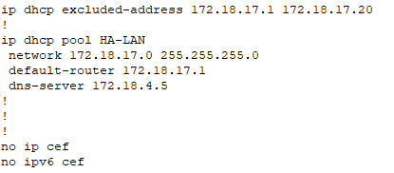
ip Address assigned to hosts is 172.18.17.0
gateway is 172.18.17.1
DNS server’s ip is 172.18.4.5
Hamilton

Slide 18
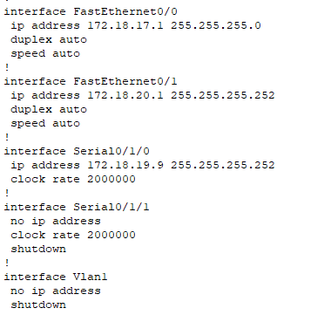
Hamilton

Slide 19

ip Address assigned to hosts is 172.18.18.0
gateway is 172.18.18.1
DNS server’s ip is 172.18.4.5
London

